Slide 1
Unit 4: Miscellaneous
Radical Ideas 2
4/27/2012

Slide 2
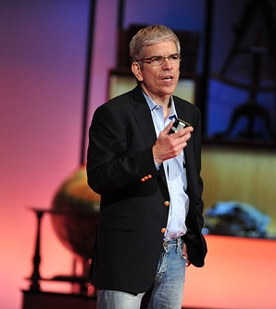
Charter Cities
Paul Romer is an economist
most known for his work in endogenous growth theory.
His current project is advocating charter cities, both intellectually in academia and by personally lobbying countries to try it.

Slide 3
Charter Cities
charter city –
a city in which the governing system is defined by the city's own charter document rather than by state, provincial,
regional or national laws

Slide 4
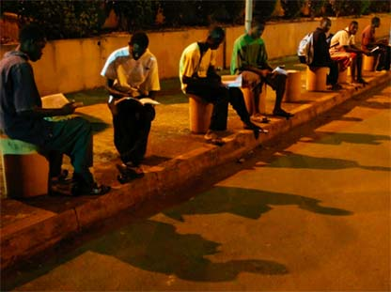
Charter Cities
These kids study under lights by the airport because there are no lights in their homes.
Why do people have access
to cellphones but not electricity in their homes?

Slide 5
Charter Cities
Electric companies operate under a rule that forces them to charge a low subsidized amount – they lose money
(no incentive to provide
electricity to more homes).
This is a bad rule, but it is
hard to change politically.

Slide 6
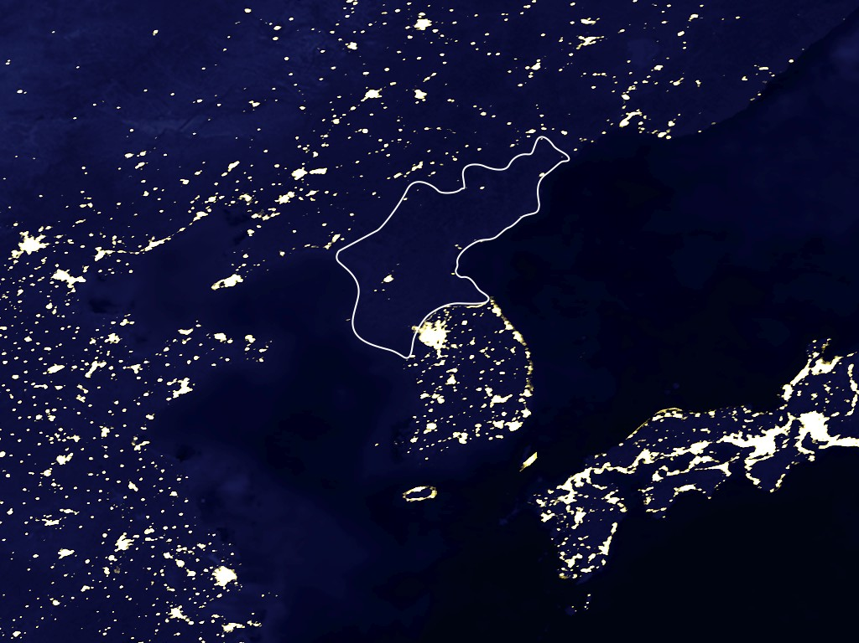
Charter Cities
North Korea is black hole at night – it has no electricity most places.
Contrast with South Korea which started out with the same rules and the same culture.

Slide 7
Charter Cities
When North Korea and South Korea split up, South Korea adopted better rules which allowed it to grow faster. Electricity is a manifestation of that difference in results.

Slide 8
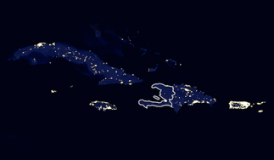
Charter Cities
See also Haiti vs. the Dominican Republic
(on the same island).
And see Puerto Rico
on the right here.

Slide 9
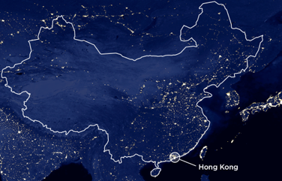
Charter Cities
This is China.
Notice it is brightest
in Hong Kong.

Slide 10
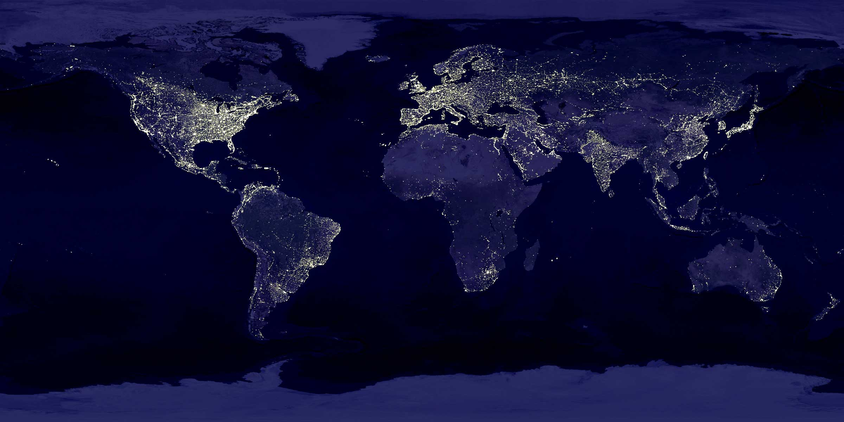
Charter Cities

Slide 11
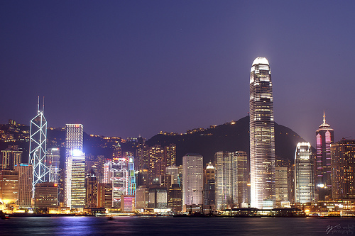
Charter Cities
Hong Kong is the best example of a sort of charter city in practice.

Slide 12
Charter Cities
It was a British colony under British law even though its culture and most of its citizens are Chinese. Hong Kong grew much faster than mainland China.

Slide 13
Charter Cities
Hong Kong’s success was a puzzle to many because it was a barren rocky island with no resources whatsoever.
But Hong Kong has unilateral free trade and practically no barriers to entrepreneurship.

Slide 14
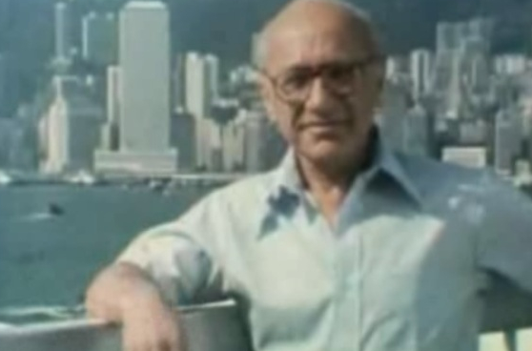
Charter Cities
Milton Friedman profiled Hong Kong
on his pioneering
PBS documentary
Free to Choose.

Slide 15
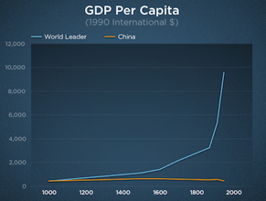
Charter Cities
China was the world's technology leader for most of world history.
For example, in the year 1000 it had printing, steel, gunpowder, etc.
Then for 1000 years
it stagnated.

Slide 16
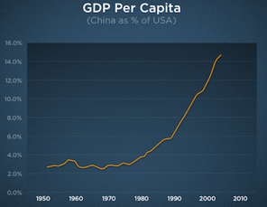
Charter Cities
Recently its growth
has resumed.
It will probably regain its place as world leader by the end of the century.

Slide 17
Charter Cities
Its recipe for success?
4 special zones with good rules (Hong Kong is 1).
Then move to the market economy everywhere.

Slide 18
Charter Cities
You need a place to innovate – to test out new rules and sort out the good from the bad.
A village is too small.
A country is too big.
Cities are just right.

Slide 19
Charter Cities
A charter specifies all
the rules for the city.
Charter attracts
investors
build infrastructure
firms
hire people
families
live and work there

Slide 20
Charter Cities
Pick a plot of uninhabited land that isn’t doing much good for people or for the existing government that owns it.
Sell land when it becomes more valuable to finance infrastructure.

Slide 21
Charter Cities
Britain by forming
Hong Kong did more to eliminate poverty than all the aid programs of the last century combined.

Slide 22
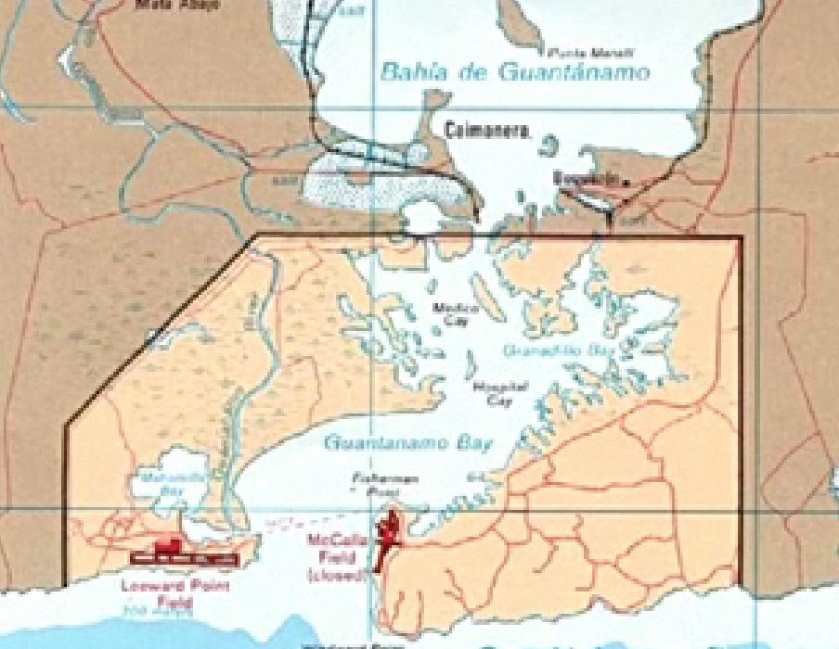
Charter Cities
One possible location suggested by Romer was Guantanamo Bay, Cuba.
The U.S. currently owns this land, but it is a public relations nightmare for the U.S. (detainees).

Slide 23
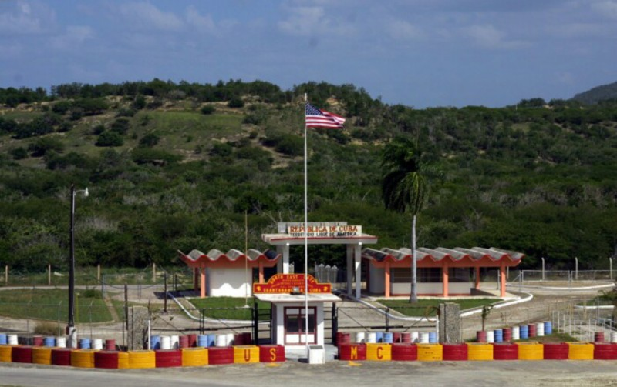
Charter Cities
Why not start a charter city there administered
by a less hated country (like Canada)?
Romer also suggested starting charter cities in Africa with a foreign nation responsible for administration.

Slide 24
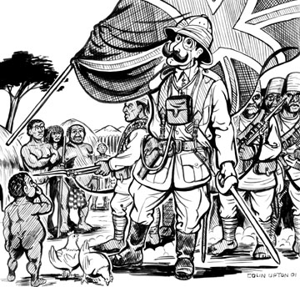
Charter Cities
Why is this not colonialism?
Colonies involve coersion
and condescension.
But charter cities involve choice, not coersion.
Natives are not subjugated. Instead everyone moves there voluntarily because they like the rules in the charter.

Slide 25
Charter Cities
Existing cities take up only 3% of the arable land on earth.
Charter cities wouldn’t eat up much land, but have the potential for great innovation.

Slide 26
Charter Cities
So far no countries have agreed to start a charter city in their territory, but Romer has gotten very close several times.
Update:
Honduras wants to implement charter cities.

Slide 27
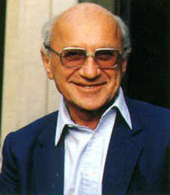
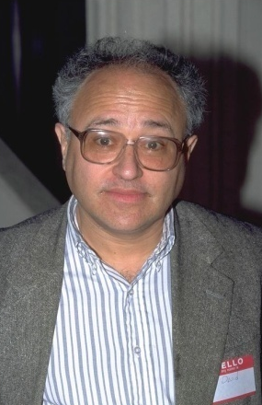
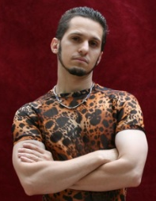
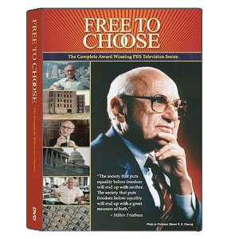
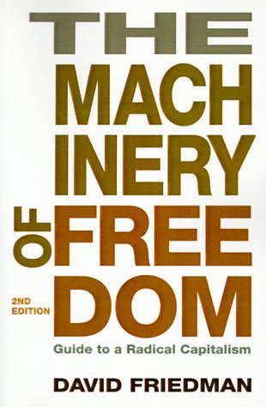
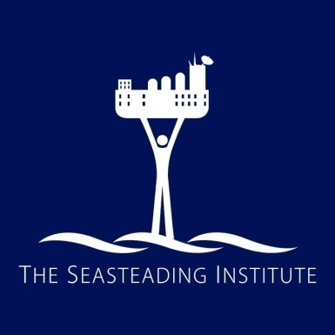
Friedman family
Milton Friedman
David Friedman
Patri Friedman

Slide 28
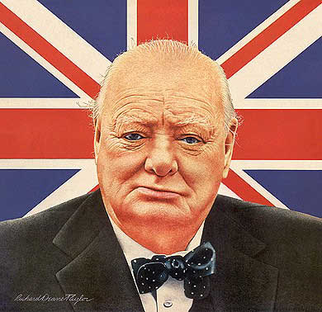
Seasteading
“Democracy is the worst form of government except for all the others.” – Winston Churchill

Slide 29
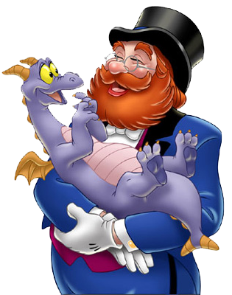
Seasteading
Patri Friedman thinks that is an argument from a lack of imagination.

Slide 30
Seasteading
Every new idea at some
point was unknown.
There may be better forms of government than democracy which we haven’t yet thought of yet.

Slide 31
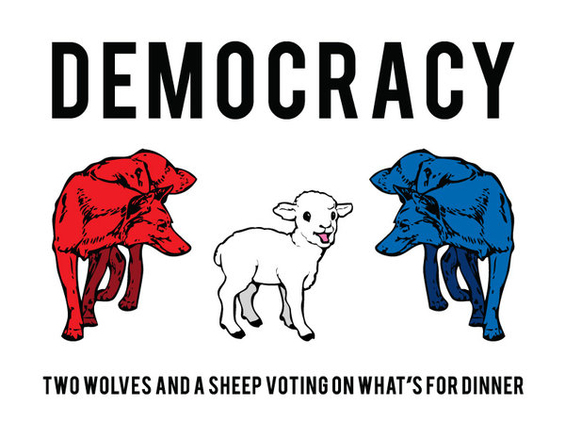
Seasteading
We've only tried a tiny number of the possible ways to organize a society.

Slide 32
Seasteading
Due to advances in psychology, economics, information technology, and every other science – we have options available today not available 20 years ago or 200 years ago (e.g., the Internet).

Slide 33
Seasteading
We throw out our computers and cellphones every few years.
Why is the government
industry different?

Slide 34
Seasteading
Knowledge progresses through trial and error – the scientific method.

Slide 35
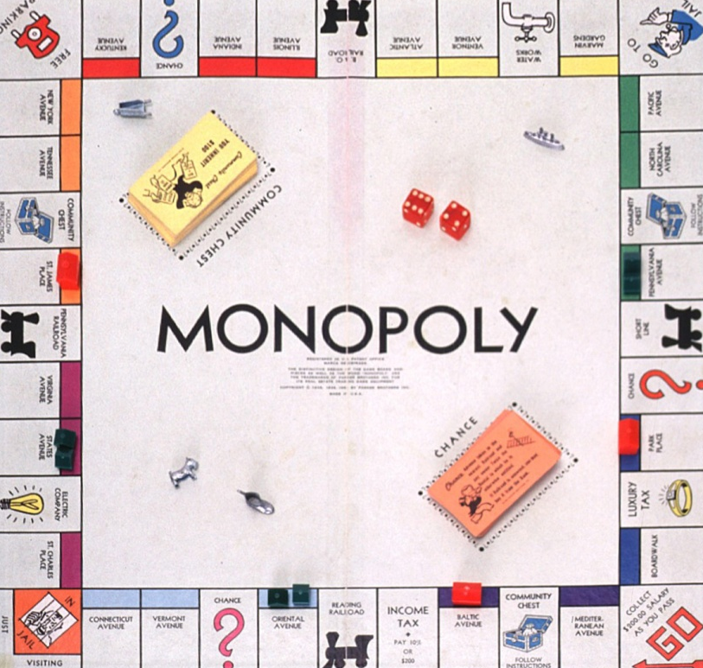
Seasteading
Unfortunately governments are monopolies. They are not open to competition – to the trial and error of the scientific method.

Slide 36
Seasteading
Barriers of entry are
high for government.
It is difficult to gain control of a government.
There are 3 ways to do so.

Slide 37
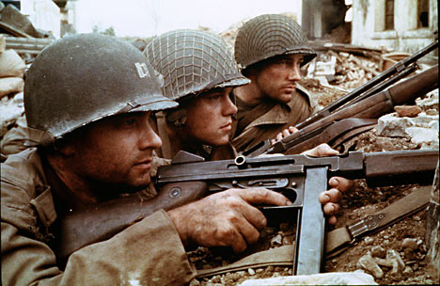
Seasteading
1. Win a war.

Slide 38
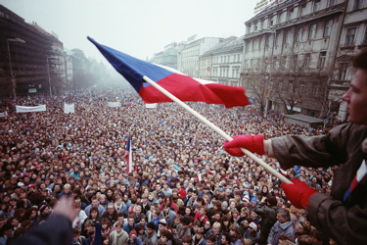
Seasteading
2. Win a revolution.

Slide 39
Seasteading
3. Win an election.

Slide 40
Seasteading
Peaceful entrepreneurs with brilliant ideas of how to organize a society aren't able to test their ideas.

Slide 41
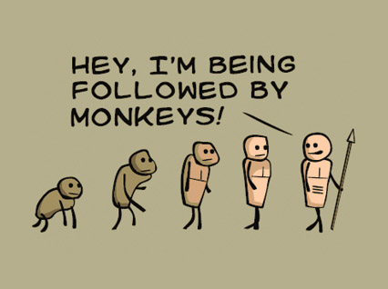
Seasteading
It's no wonder
government
doesn't evolve.

Slide 42
Seasteading
The cost of switching (immigrating) is also really high: you need to sell your house, move your stuff, and adapt to differences in culture and language.

Slide 43
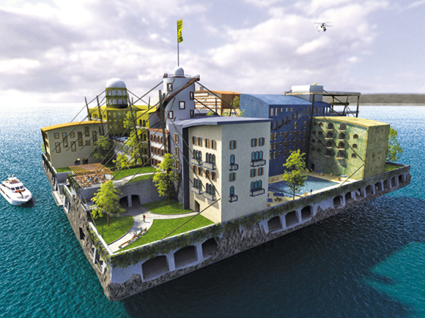
Seasteading
The solution is not to complain about politicians or laws, but rather to enable startups.
The best way to do this
is seasteading.

Slide 44
Seasteading
seasteading –
creating permanent dwellings at sea, called seasteads, outside the territories claimed by the governments of any standing nation

Slide 45
Seasteading
Seasteading significantly lowers the barrier of entry.
The ocean is a frontier:
it's open and unclaimed.
You don't have to win a war, revolution, or election.
Hundreds of people and tens of millions of dollars could create a floating city.

Slide 46
Seasteading
If a floating city passes a bad law, the residents will move (decouple and reform
around another city hall).
You don't have to move to benefit: competitive pressure will force existing countries to improve or face a drain of brains and capital.

Slide 47
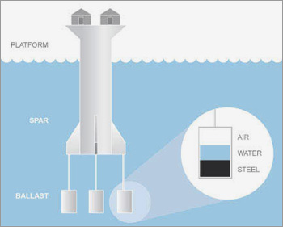
Seasteading
Oceans are 68% of the earth’s surface.
There are already semi-permanent oil platforms where people live and work. They just need to be made a bit larger & more hospitable.

Slide 48
Seasteading
The Seasteading Institute was formed by Patri Friedman with a $500,000 donation from venture capitalist (and PayPal founder) Peter Thiel.
They are researching seastead designs.

Slide 49
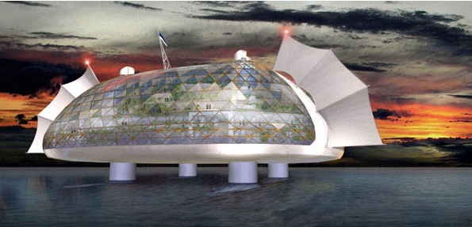
Seasteading

Slide 50
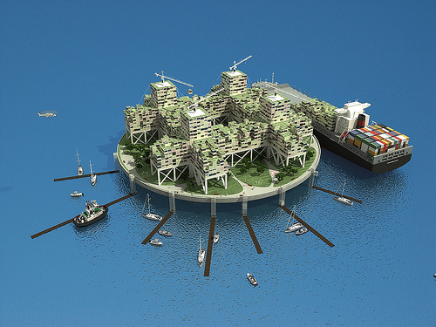
Seasteading

Slide 51
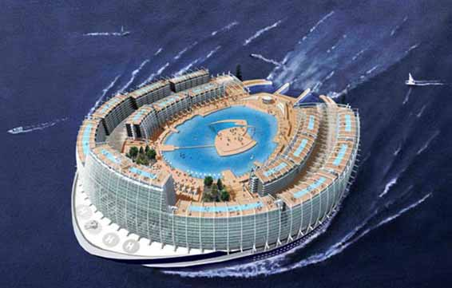
Seasteading

Slide 52
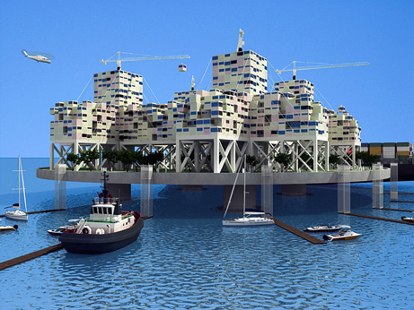
Seasteading

Slide 53
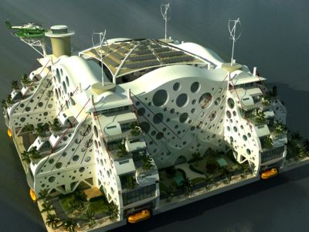
Seasteading

Slide 54
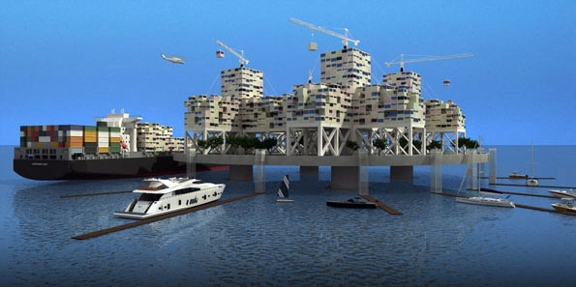
Seasteading

Slide 55
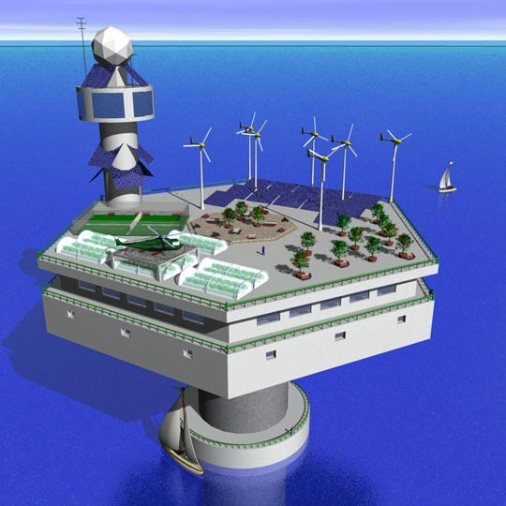
Seasteading

Slide 56
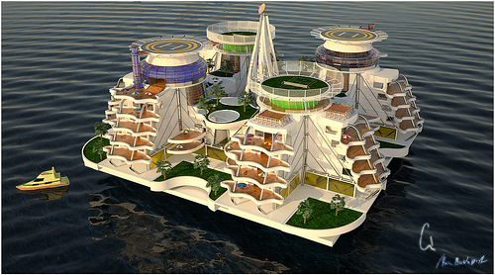
Seasteading

Slide 57
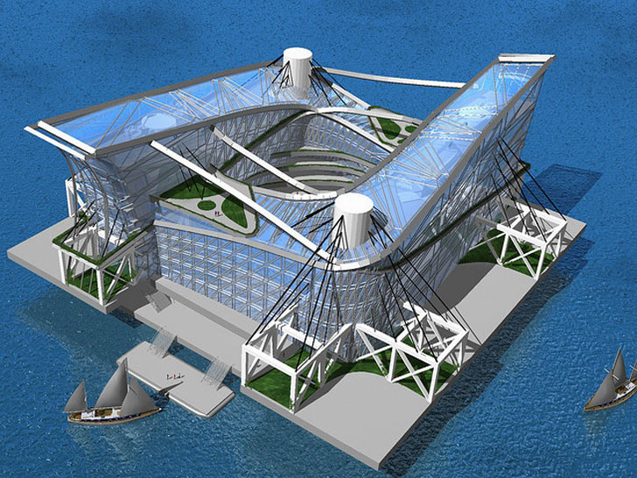
Seasteading

Slide 58
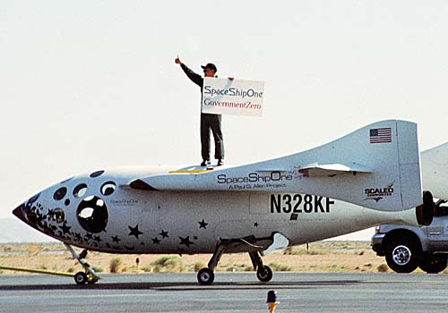
Seasteading
And the concept can be expanded into another frontier: space.
The barrier of entry for space is very high now, but will plummet very soon as technology improves.

Slide 59
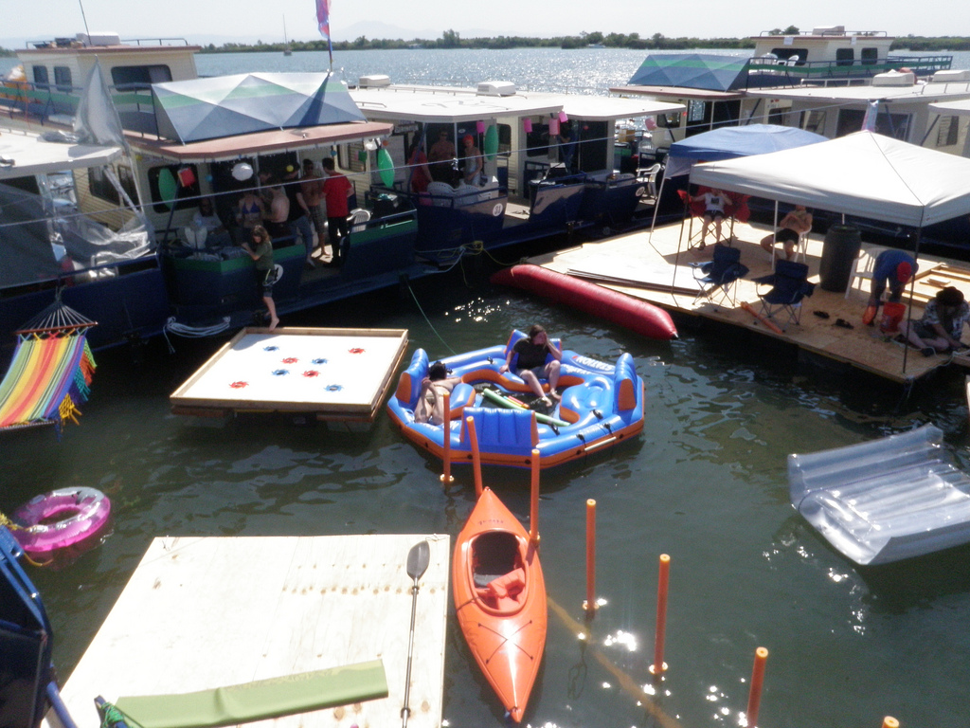
Ephemerisle
The Seasteading Institute has an annual festival where people bring rafts and boats together in the middle of a river.

Slide 60
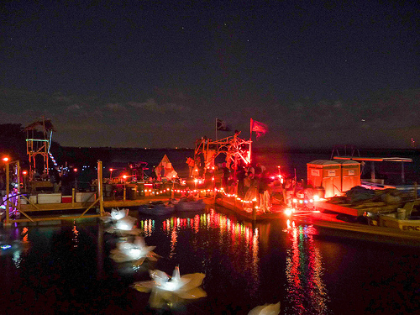
Ephemerisle
It’s called Ephemerisle – kind of a cross between Burning Man and the movie Water World.

Slide 61
Postscript
Recently Patri Friedman stepped down as CEO of the Seasteading Institute to pursue other opportunities. He remains chairman of the board.
Some of his plans include for profit seasteads and for profit permanent residences on ships.
Patri Friedman

Slide 62
Postscript
And his latest venture?
He started a company called Future Cities Development, Inc. His aim is to establish a for-profit charter city in Hondorus, which implemented special development regions to implement charter cities.
Patri Friedman

Slide 63
Postscript
Patri’s company has signed a memorandum of understanding with Hondorus to start a charter city there.
However, Paul Romer doesn’t endorse the venture because Friedman is trying to make money. Romer advocates non-profit cities.
Patri Friedman

