Slide 1
Unit 4: Miscellaneous
Historical Monetary Standards
4/18/2012

Slide 2
Historical Monetary Systems
Main periods
gold standard (1870-1914) + earlier
gold exchange standard (1918-1939)
Bretton Woods (1944-1973)
floating (1973-present)

Slide 3
Historical Monetary Systems
classical gold standard –
countries fix their national monies to a weight of gold and use gold as reserves in central banks
gold exchange standard –
countries fix their national monies to a weight of gold and use both gold and another currency (e.g., dollars) as reserves in central banks

Slide 4
Historical Monetary Systems
Bretton Woods –
countries fix their national monies to the dollar, the dollar fixes to a weight of gold, and countries use mainly dollars as reserves in central banks
floating –
Countries let their currencies float against one another (they don’t
fix against any currency)

Slide 5
Historical Monetary Systems
The classical gold standard experienced a gradual deflation of 0.5% per year on average. Countries would temporarily leave the gold standard to inflate for war, and return afterward – often at the old parity.

Slide 6
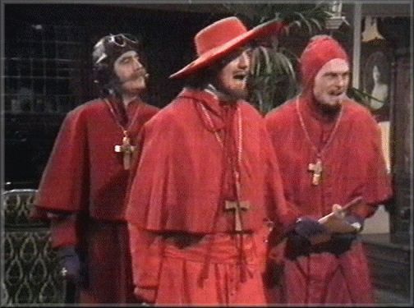
Historical Monetary Systems
During the 16th century, Spain’s price level increased 200-300% due to gold and silver imports from the new world (1% per year).
185,000 kg of gold was imported in 15 years, increasing Europe’s gold supply by 20%.

Slide 7
Historical Monetary Systems
price-specie flow mechanism –
automatic reduction of current account surpluses and deficits
through gold flows
Rules of the Game –
central bank intervention in the
asset market to mitigate gold inflows/outflows

Slide 8
Historical Monetary Systems
Gold inflows and outflows increase or decrease the money supply, which affects the domestic price level.
An inflow of gold inflates prices.
An outflow of gold deflates prices.

Slide 9
Historical Monetary Systems
A current account surplus in excess of the non-reserve financial account means gold flows into the country —raising domestic prices & lowering foreign prices. Domestic goods become more expensive and foreign goods become cheaper, reducing the current account surplus.

Slide 10
Historical Monetary Systems
A current account deficit in excess of the non-reserve financial account means gold flows out of the country — lowering domestic prices & raising foreign prices. Domestic goods become cheaper and foreign goods become more expensive, reducing the current account deficit.

Slide 11
Historical Monetary Systems
Under the rules of the game central banks sell domestic assets to acquire money when gold exited the country as payments for imports.
This decreased the money supply
and increased interest rates, attracting financial inflows to match a current account deficit, reversing or reducing gold outflows.

Slide 12
Historical Monetary Systems
Under the rules of the game central banks buy domestic assets to inject money when gold entered the country as payments for exports.
This increased the money supply
and decreased interest rates, encouraging financial outflows to match a current account surplus, reversing or reducing gold inflows.

Slide 13
Historical Monetary Systems
Banks with decreasing gold reserves had a strong incentive for the rules of the game: they couldn’t redeem currency without sufficient gold.
Banks with increasing gold reserves had a weak incentive to practice the rules of the game: gold did not earn interest, but domestic assets did.

Slide 14
Historical Monetary Systems
In practice, central banks with increasing gold reserves seldom followed the rules.
Central banks often sterilized gold flows, trying to prevent any effect on money supplies and prices.

Slide 15
Historical Monetary Systems
The gold standard made it hard for countries to have an independent monetary policy.
Also returning to the old parity after temporarily leaving the gold standard for wars often necessitated a painful recession.

Slide 16
Historical Monetary Systems
After World War I countries were not eager to induce recessions by returning at to the gold standard at the old parity.
So instead they created a new standard – the gold exchange standard – which allowed more flexibility and monetary policy within some constraints.

Slide 17
Historical Monetary Systems
Under the gold exchange standard several currencies were used as reserves by central banks in addition to gold. These primarily included the American dollar and the British pound.

Slide 18
Historical Monetary Systems
After World War II economists met together at Bretton Woods, New Hampshire to form a new monetary system. John Maynard Keynes (from Great Britain’s delegation) was instrumental in its formation.

Slide 19
Historical Monetary Systems
Bretton Woods involved the dollar fixing to a weight of gold ($35/ounce) and all other countries fixing to the dollar. Capital controls were imposed to prevent speculative attacks on the fixed exchange rates.

Slide 20
Historical Monetary Systems
Dollars could be used as reserves by central banks
(other than the United States).
The United States could have an independent monetary policy, while other countries could not.

Slide 21
Historical Monetary Systems
Other countries became frustrated with the U.S.’s high inflation levels during the late 1960’s and early 1970’s. The U.S. had high inflation both as a monetary policy to stimulate employment and to monetize the debt incurred by the U.S. government for the Vietnam War.

Slide 22
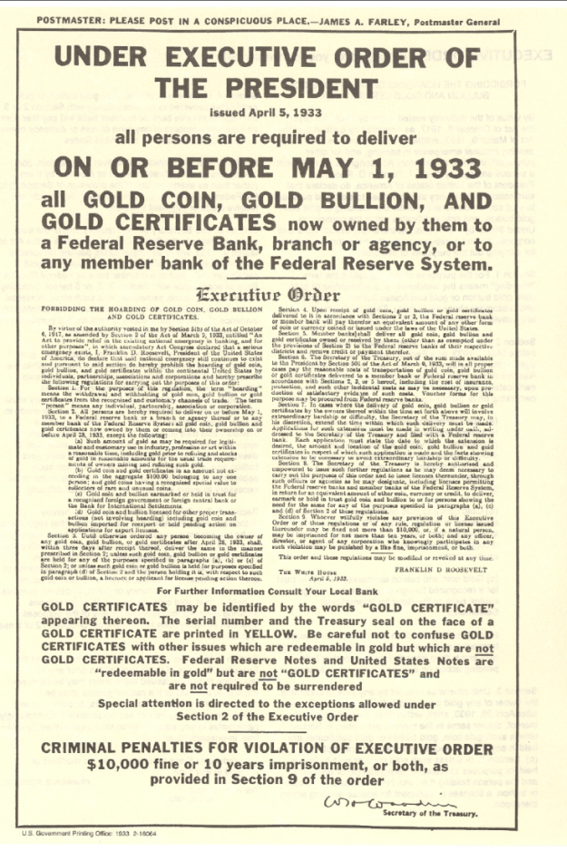
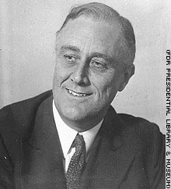
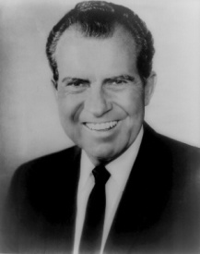
Historical Monetary Systems
The United States left the gold standard for a fiat standard domestically in 1933 when F.D.R. seized all gold by executive order.
The United States left the gold standard internationally in 1971 when Nixon ended Bretton-Woods dollar convertability.

Slide 23
Historical Monetary Systems
So from 1933 to 1971 foreign central banks could turn in dollars to the Federal Reserve for gold. Many other countries demanded gold en mass when they became frustrated with U.S. inflation. The U.S. floated internationally to prevent running out of gold reserves.

Slide 24
Historical Monetary Systems
Since 1973 most of the major industrialized countries in the world decided to float their currencies. Smaller countries frequently fix to the currency of a large trading partner such as the dollar or the euro.

Slide 25
European Monetary Systems
European Monetary System
(EMS) –
a system of fixed exchange rates implemented in 1979 through an exchange rate mechanism (ERM) for participating European countries

Slide 26
European Monetary Systems
euro zone –
a form of currency union:
a subset of the European Union countries that use the euro,
a common currency

Slide 27
European Monetary Systems
EU membership requires
low trade barriers
low financial assets barriers
common immigration policy
common regulations
workplace safety
consumer protection
liberal democracy

Slide 28
European Monetary Systems
EMS membership requires
EU membership
adhere to the ERM
narrow ER bands
restrained policies
fiscal
monetary

Slide 29
European Monetary Systems
euro zone membership requires
EMS membership
adopt the euro
replace national currency
coordinate policy
European Central Bank

Slide 30
European Monetary Systems
euro zone also requires
attain exchange rate stability
attain price stability
max inflation: 1.5% above 3 lowest inflation rates
restrictive fiscal policy
deficit < 3% of GDP
debt < 60% of GDP

Slide 31
European Monetary Systems
From 1979 to 1993, the EMS defined the exchange rate mechanism to allow most currencies to fluctuate +/– 2.25% around target exchange rates.
The exchange rate mechanism was redefined in 1993 to allow for bands of +/–15% of the target value.

Slide 32
European Monetary Systems
To prevent speculation, early in the EMS some exchange controls were enforced to limit currency trading.
But from 1987 to 1990 these controls were lifted in order to make the EU a common market for financial assets.

Slide 33
European Monetary Systems
In effect, EMS members were following the restrained monetary policies of Germany, which has traditionally had low inflation.
Under the EMS exchange rate mechanism of fixed bands, Germany was exporting its monetary policy.

Slide 34
European Monetary Systems
The Single European Act of 1986 recommended that many barriers to trade, asset flows, and immigration be removed by December 1992.
It also allowed EU policy to be approved with less than unanimous consent among members.

Slide 35
European Monetary Systems
The Maastricht Treaty, proposed in 1991 transformed the EMS into an economic and monetary union (the euro zone for those that joined).
It also required standardizing regulations and centralizing foreign policies among EU countries.

Slide 36
European Monetary Systems
The euro was adopted in 1999, and the previous exchange rate mechanism became obsolete.
But a new exchange rate mechanism—ERM 2—was established between the economic and monetary union and outside countries.

Slide 37
European Monetary Systems
It allowed countries (either within or outside of the EU) that wanted to enter the economic and monetary union in the future to maintain stable exchange rates before doing so.
It allowed EU members outside of the economic and monetary union to maintain fixed exchange rates.

Slide 38
Basel Accords
Basel accords provide standard regulations and accounting for international financial institutions.
1988 accords (Basel I) tried to make bank capital measurements standard across countries.

Slide 39
Basel Accords
They developed risk-based capital requirements, where more risky assets require a more bank capital.
Core principles of effective banking supervision was developed by the Basel Committee in 1997 for countries without adequate banking regulations and accounting standards.

Slide 40
Basel Accords
Basel I was passed in 1988.
Basel II (stricter regulations)
was passed in 2004.
Basel III (even stricter regulations)
was passed in 2010.

