Slide 1
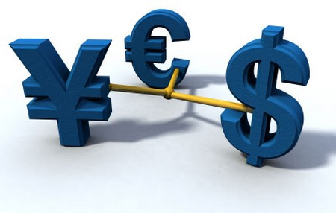
Unit 3: Exchange Rates
Crash Course in Money
3/19/2012

Slide 2
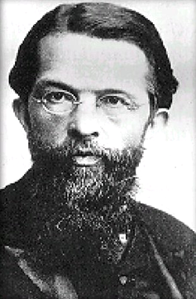
Origin of Money
Carl Menger is the father of the
Austrian school of economics.
He theorized that money came about
through evolution from barter.

Slide 3
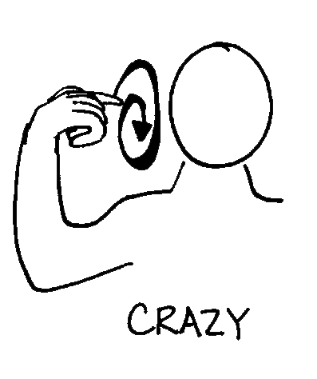
Menger’s Origin of Money
Why do people trade
useful goods and services
for silly little pieces of paper?!

Slide 4
Menger’s Origin of Money
Barter (Direct)
Medium of Exchange (Indirect)
Money (CAMOE)

Slide 5
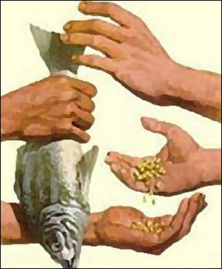
Barter
barter (direct exchange) –
trade for something that can be used directly
in consumption or production

Slide 6
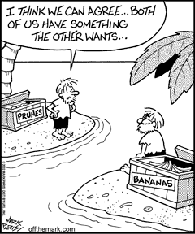
Barter
Barter can work well when you easily find a parallel trader.
In that case not using money actually saves a step.

Slide 7
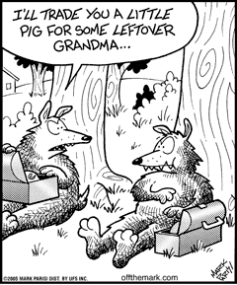
Barter
But often finding someone who has what you want and wants what you have is very difficult.
Search costs and other transaction costs can
be quite high.

Slide 8
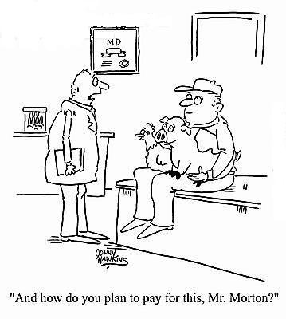
Barter
double coincidence of wants –
each person must want the good his trading partner is offering

Slide 9
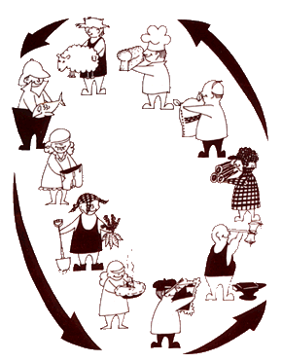
Barter
transaction costs –
opportunity costs of finding a trading partner, negotiating a deal, and monitoring the terms

Slide 10
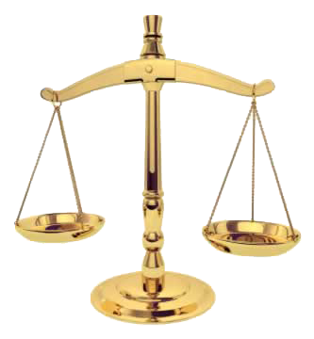
Barter
Transaction costs of barter are so huge that it is very inefficient.
Barter only exists where laws or social norms make efficient indirect trade difficult or impossible.

Slide 11
Barter
places barter survives
to evade or reduce taxes
underground economy
marriage, dating, sex
new car (trade in old)
health/dental benefits (less taxes)

Slide 12
Indirect Exchange
medium of exchange
(indirect exchange) –
something not wanted
for commodity value,
but rather for trade value

Slide 13
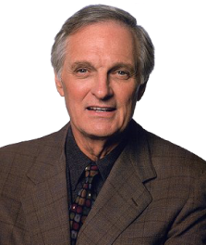
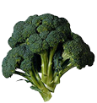
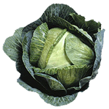
Indirect Exchange
trader
endowment
preference
trades
ends with
B > A > C B-owner refuses
to trade for A.
C > B > A C-owner refuses
to trade for B.
A > C > B A-owner refuses
to trade for C.
A
B
C

Slide 14
Indirect Exchange
trader
endowment
preference
trades
ends with
B > A > C (1) A → C
(2) C → B
C > B > A B → C
A > C > B C → A
A
B
C

Slide 15
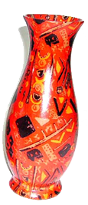
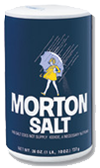
Indirect Exchange
The trades worked because a medium of exchange was used.
Here broccoli was the
medium of exchange.
But the medium of exchange could be anything.
(MOE)
(MOE)
?

Slide 16
Indirect Exchange
degree of marketability –
more highly marketable goods
are easier to sell for a “good price”
(best price with full information)
In other words, more marketable goods have lower transaction costs;
more sellers will accept them.

Slide 17
Indirect Exchange
Marketability is a
non-Walrasian concept.
In Walrasian economics
everything is always at equilibrium
(there are no transaction costs).

Slide 18
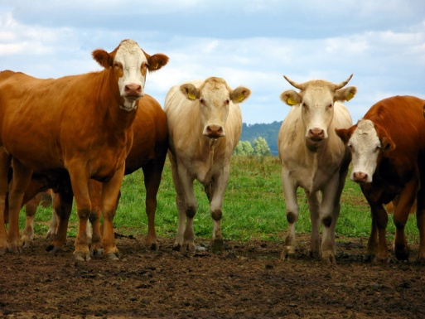
Indirect Exchange
Traders will begin to carry
an inventory of various
media of exchange.
Over time they notice some
media of exchange are more
marketable than others.
Traders pick the more marketable
medium of exchange.

Slide 19
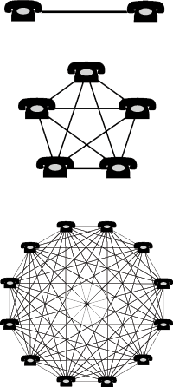
Indirect Exchange
network effect –
the value of a good increases
the more people use it
Money has a network effect.
The more people use a medium
of exchange, the more marketable
that medium of exchange is,
the more other people will adopt it.

Slide 20
Money
money –
commonly accepted
medium of exchange

Slide 21
Money
When a circulating medium of exchange becomes commonly accepted (that is, widely adopted by most traders as the preferred media of exchange), it becomes money.

Slide 22
Historical Monies
Many forms of commodity money have been adopted around the world.
The commodity chosen tends to be the main production good or ornamental.

Slide 23
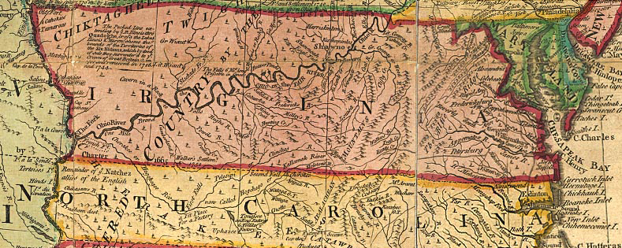
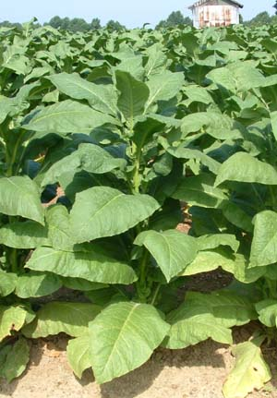
Historical Monies
Where?
What?
Colonial Virginia
tobacco

Slide 24
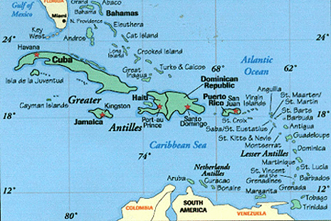
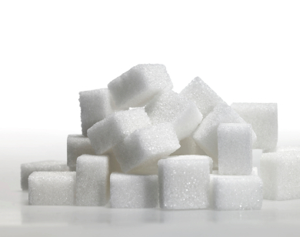
Historical Monies
Where?
What?
West Indies
sugar

Slide 25
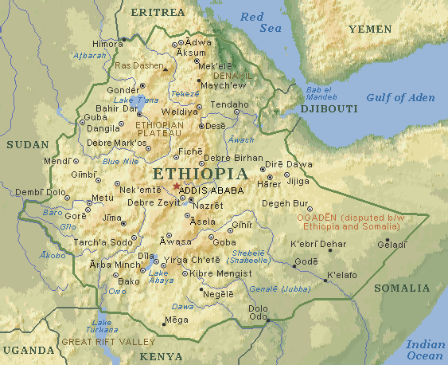
Historical Monies
Where?
What?
Abyssinia
(Ethiopia)
salt

Slide 26
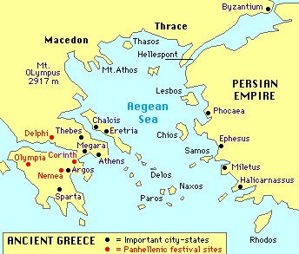
Historical Monies
Where?
What?
Ancient Greece
cattle

Slide 27
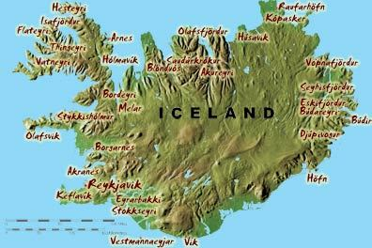
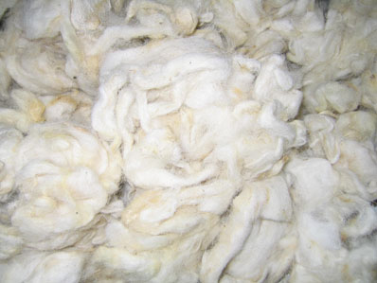
Historical Monies
Where?
What?
Midieval Iceland
wool

Slide 28
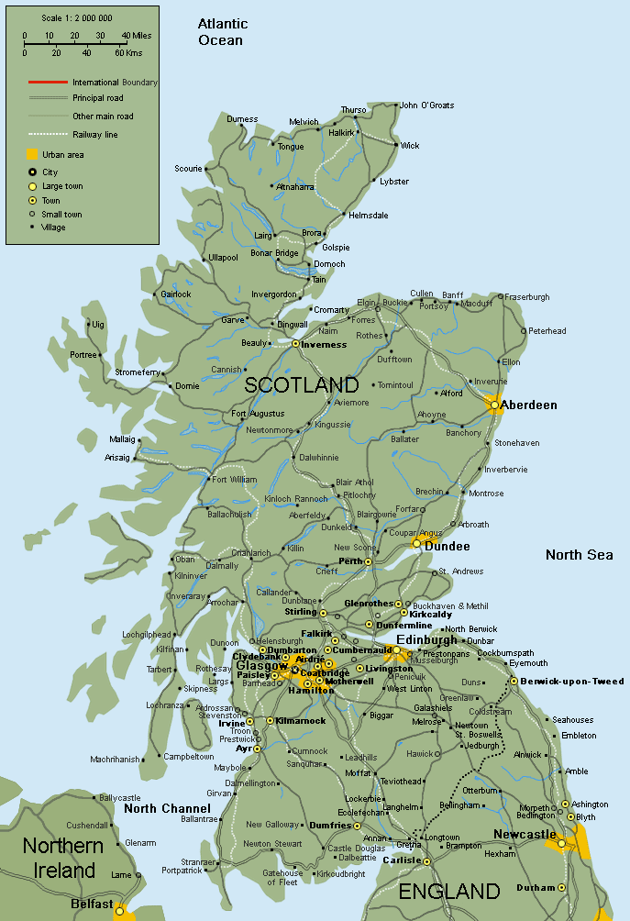
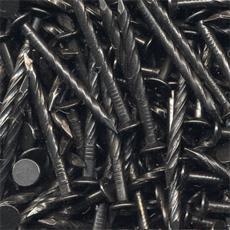
Historical Monies
Where?
What?
Scotland
nails

Slide 29
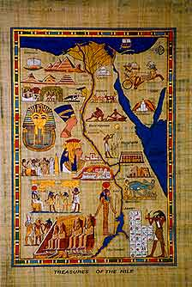
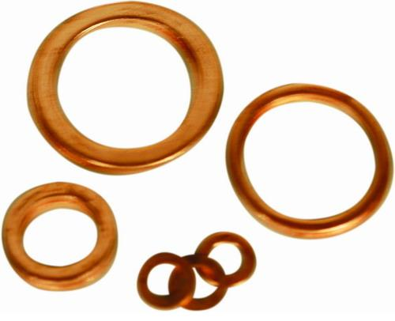
Historical Monies
Where?
What?
Ancient Egypt
copper rings

Slide 30
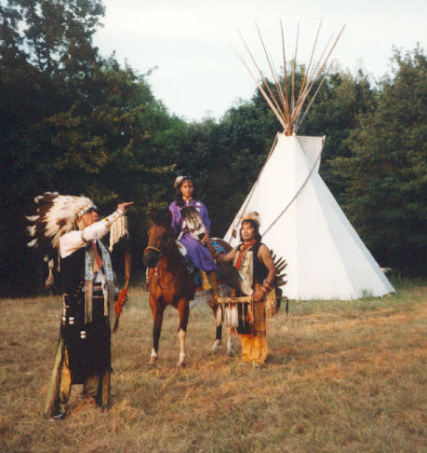
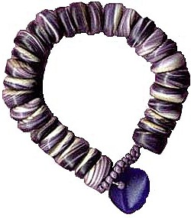
Historical Monies
Where?
What?
Native Americans
Wampum
(beads on a string)

Slide 31
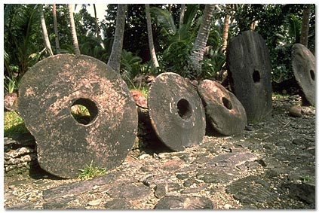
Historical Monies
Where?
What?
Island of Yap
(South Pacific)
Fei
(large stone wheels)

Slide 32
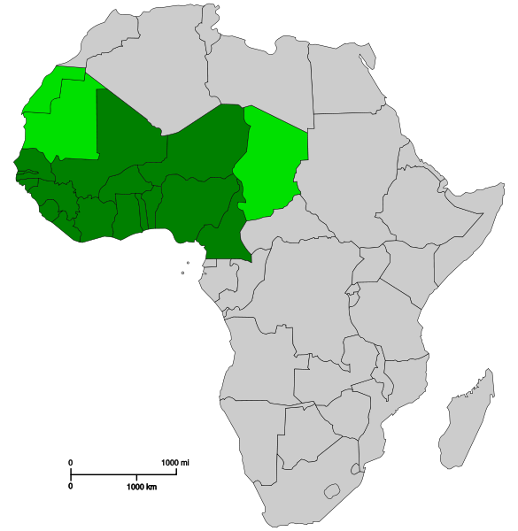
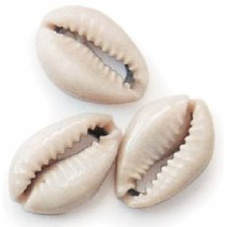
Historical Monies
Where?
What?
West Africa, China
cowrie shells

Slide 33
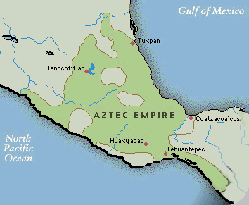
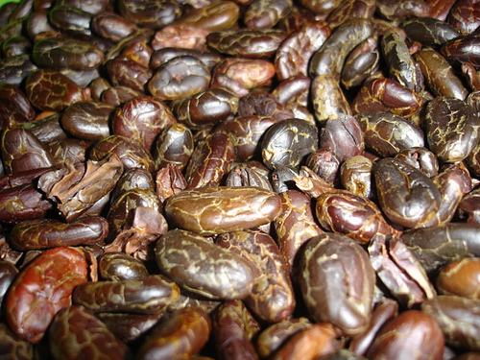
Historical Monies
Where?
What?
Aztecs
caoca beans
(chocolate)

Slide 34
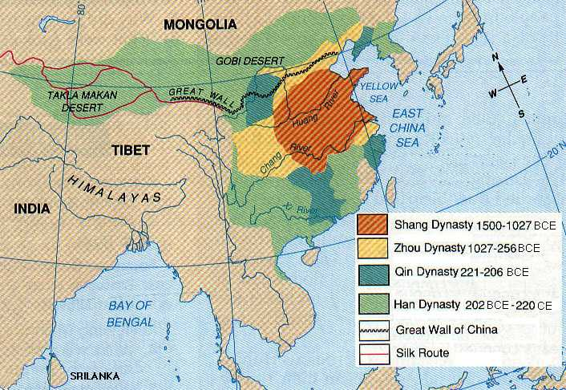
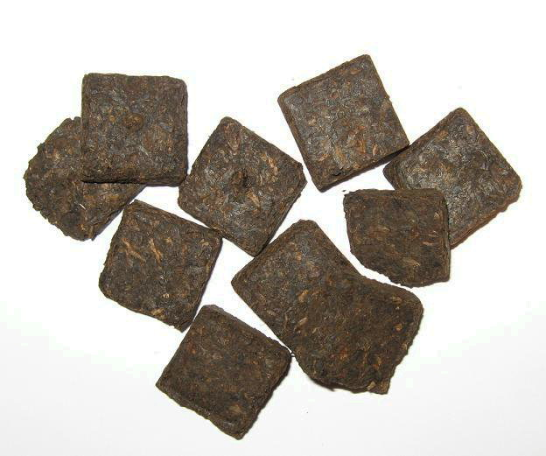
Historical Monies
Where?
What?
China, Mongolia, Siberia
tea

Slide 35
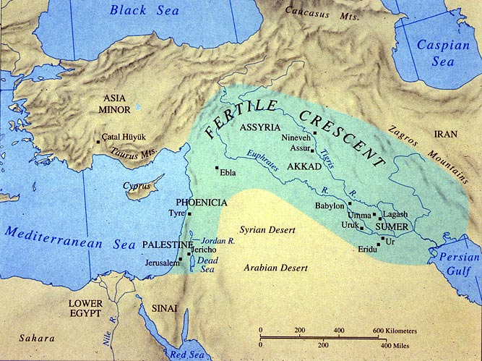
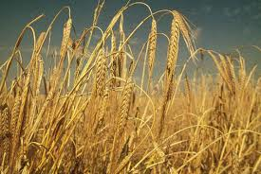
Historical Monies
Where?
What?
Mesopotamia
barley (grain)

Slide 36
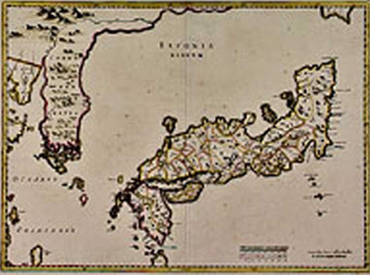
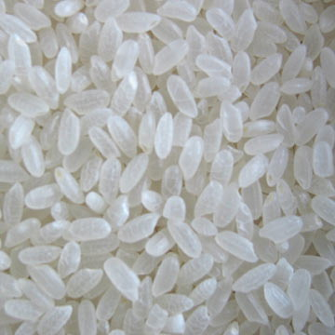
Historical Monies
Where?
What?
Ancient Japan
rice

Slide 37
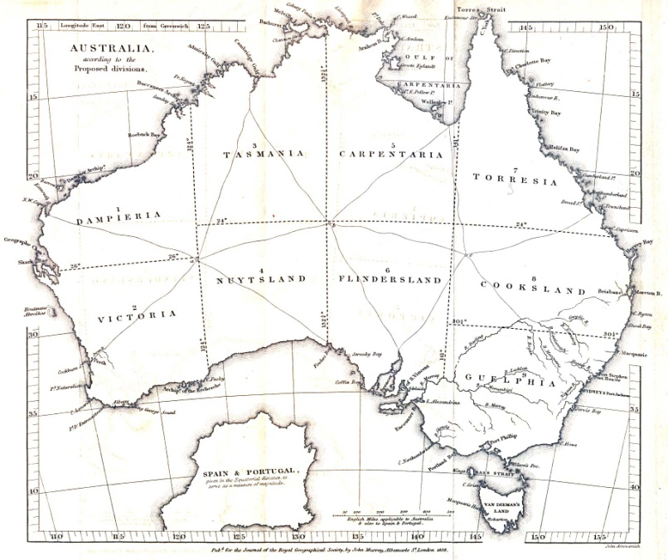
Historical Monies
Where?
What?
Colonial Australia
rum

Slide 38
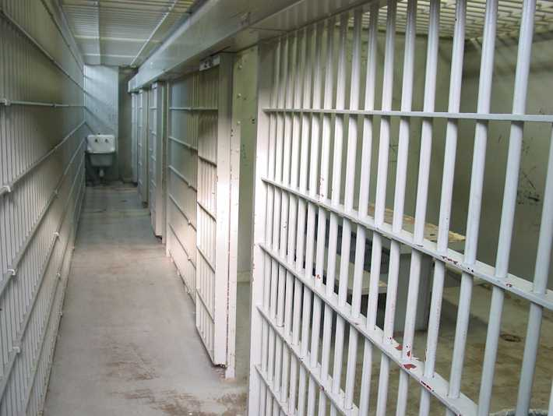
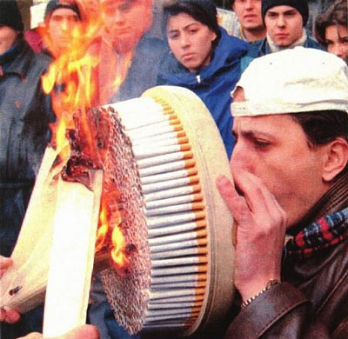
Historical Monies
Where?
What?
prisons
cigarettes

Slide 39
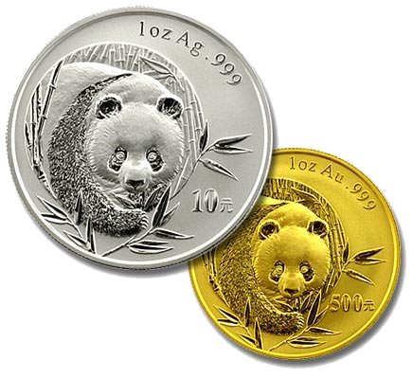
Convergence
Why did most civilizations
converge to gold or silver?

Slide 40
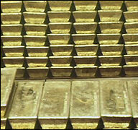
Convergence
Gold is more marketable due to several characteristics.
Characteristics
uniform
durable
divisible
portable
stable value

Slide 41
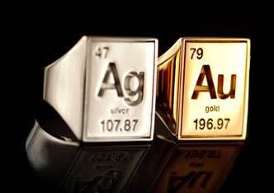
Convergence
uniform –
purity can be tested at low cost
(biting, sounding, or assaying)
Gold and silver are both pure elements on the Periodic Table.
assay – chemically test
the quality of metals

Slide 42
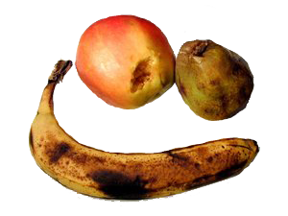
Convergence
durable –
no extra carrying cost due to spoilage
Food commodities such as
grains and olive oil could spoil.
Preventing spoilage had a cost.
Checking the quality of spoilable items during transactions had a cost
(see uniformity).

Slide 43
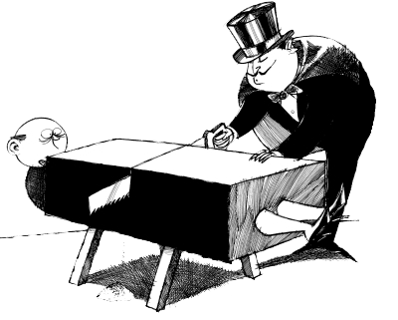
Convergence
divisible (and fusible) – payment can
be tailored to purchase size
Large pieces can be
separated into small pieces.
Small pieces can be
combined into large pieces.
(Not true of livestock.)

Slide 44
Convergence
portable –
high ratios of value to bulk
In Sweden copper plate money
weighed 44 pounds.
1 ship of gold = 15 ships of silver

Slide 45
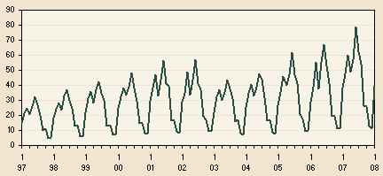
Convergence
stable value –
not subject to seasonal variations
Food commodities harvested a
certain time of year could
experience large swings in price
depending on the time of year.

Slide 46
Convergence
Silver oxen barley
durable (no spoilage) ✓ ✓ ✓
portable (high value/bulk) ✓ ✓
divisible ✓ ✓
uniform (easy to grade) ✓(coined) ✓
stable value (non-seasonal) ✓

Slide 47
Convergence
When traders from two regions
with different commodity monies came into contact,
the better of the two monies
spread to the other region.

Slide 48
Mengerian
Barter (Direct)
Medium of Exchange (Indirect)
Money (CAMOE)

Slide 49
Neo-Mengerian
Money
Gold & Silver
Coin
Bank Notes

Slide 50
Coins
Coins first appeared in ancient Lydia (Turkey) and China.
The earliest coins were punched,
later coins were stamped,
finally coins were minted.

Slide 51
Coins
coinage –
the process of fashioning monetary metal into standardized marked discs
Merchants had to assess weight and quality when receiving payment. They would mark a piece of assessed gold to avoid the cost of re-assessing upon payout. Other traders would come to rely on the mark.

Slide 52
Coins
When metal commodity standard would replace another medium of exchange, often the old medium of exchange would be stamped on the coin.
Here an ox head is stamped on a coin replacing a cattle commodity standard.

Slide 53
Coins
Private mints were common
around gold and silver mines.
Marketability of coins was
discontinuously greater than
marketability of unminted gold.
Marketability of money was
discontinuously greater than
that of other commodities.

Slide 54
Coins
seigniorage –
profit that results from producing coins
(difference between
face value and metal value)
Governments seized a
monopoly on mints to reap
seigniorage income.

Slide 55
Coins
Government mint monopolies
had a number of public
interest justifications.
Justifications
seigniorage
propaganda
ending debasement

Slide 56
Money
commodity money –
money with a close relationship between money value and commodity value
fiat money –
money in which monetary
value far exceeds commodity value

Slide 57
Fiat Money
Ha Ha!
Typical path to fiat money
government gives a monopoly on
note issue to a single institution
its liabilities become widely accepted
government suspends redemption permanently

Slide 58
Fiat Money
“Over the years, all the governments in the world, having discovered that gold is, like, rare, decided that it would be more convenient to back their money with something that is easier to come by, namely: nothing.”
– Dave Barry

Slide 59
Functions of Money
Main function of money
medium of exchange
Subsidiary functions of money
medium of account
store of value
standard of deferred payment

Slide 60
Functions of Money
unit of account –
common numerator of all prices
More properly:
medium of account –
good used as a pricing or accounting unit
unit of account –
specific quantity of the
good used as a pricing or accounting unit

Slide 61
Functions of Money
store of value –
separates act of buying from selling
(saving with low transaction costs)
standard of deferred payment –
money is a good way of paying back loans

Slide 62
Monetary Aggregates
Money supply
MB – monetary base (total currency)
M1 – very liquid assets
M2 – somewhat liquid assets
M3 – even less liquid assets
MZM – money with zero maturity

Slide 63
Stock vs. Flow
wealth is a stock value
(oz. Au)
income is a flow value
(oz. Au / year)

Slide 64
Equation of Exchange
The equation of exchange is the fundamental mathematical idea of monetary theory.
M^{S}V = Py

Slide 65
Definitions
P
purchasing power of money (PPM) –
the basket of goods and services that a
single dollar can buy (“price” of money)
price level (P) –
weighted average of prices in the economy
PPM ≡ 1/P

Slide 66
Definitions
Price level is stated in terms of price indexes.
Price indexes are inherently imprecise because you have to pick goods to include in the index and weight them.
There is no price index that includes everything.
Government price indexes
consumer price index (CPI)
producer price index (PPI)
GDP deflator

Slide 67
Definitions
inflation –
a rise in the price level (fall in PPM)
deflation –
a fall in the price level (rise in PPM)

Slide 68
Definitions
relative prices –
implicit barter ratios between goods
Price levels move independently of relative prices.
If the relative price of one thing goes up, logically the relative price of another thing must go down.

Slide 69
Definitions
real variables – “constant” dollars
nominal variables – “current” dollars
Capital letter variables are nominal. Lowercase letter variables are real.
nominal/P = real
Y/P = y

Slide 70
Definitions
y
aggregate output –
total production of final
goods and services in the economy
aggregate income –
Total income of factors of production
(land, labor, capital) in the economy
Usually they are equal
(except in Balance of Payment analysis):
y ≡ aggregate output = aggregate income

Slide 71
Definitions
y
Y ≡ nominal output
y ≡ real output
Y/P = y
Py = Y
In the equation of exchange,
we use a lowercase y (real output)
rather than capital Y (nominal output).

Slide 72
Definitions
M^{S}
M^{S} ≡ money supply
The money supply can be
in terms of any of the
monetary aggregates:
M1, M2, M3, MB, MZM.

Slide 73
Definitions
M^{S}/P ≡ real money stock
real money balance –
quantity of money in real terms
Real money balance is an important concept in the Keynesian money demand
theory and in seigniorage.
M^{S}/P

Slide 74
Definitions
V
velocity of money (V) –
average number of times a unit of money turns over in a given period
Velocity is defined as total spending divided by the quantity of money:
V ≡ Py/M^{S}
So the equation of exchange is an identity:
M^{S}V = Py

Slide 75
Equation of Exchange
M^{S}V = Py
Important notes
an identity, not a theory (V ≡ Py/M^{S})
right side is nominal output (Y = Py)
M^{S} can be any monetary aggregate
(changing the aggregate changes V)

Slide 76
Quantity Theory of Money
The quantity theory of money conceived by Irving Fisher makes two important assumptions.
Assumptions
velocity is constant
wages and prices are completely flexible
V

Slide 77
Quantity Theory of Money
If velocity is constant‾V then ΔM^{S} → ΔPy
(doubling M^{S} will double Py).
‾VM^{S} = Py
If P is completely flexible and y is sticky,
assume‾y: ΔM^{S} → ΔP
(doubling M^{S} will double P).
‾VM^{S} = ‾yP

Slide 78
Graphical Version
The graphical version uses the money demand equation and the money supply equation to find equilibrium.
Money demand:
M^{D} = Py/V
Money supply:
M^{S} = C
(C is a constant)

Slide 79
Graphical Version
M^{S}
M^{D} = Py/V
M^{S} = C
PPM
(1/P)
M^{D}
M

Slide 80
Graphical Version
M^{S}↑ → PPM↓ →P↑
increasing the
money supply
shifts the M^{S} curve out
move along M^{D}
PPM goes down
P = 1/PPM P goes up
PPM
(1/P)
M^{S}
M^{S}'
PPM₁
PPM₂
M^{D}
M

Slide 81
Graphical Version
PPM
(1/P)
M^{S}
M^{S}'
M^{S}↑ → PPM↓ →P↑
matches the math:
M^{S}V = Py
‾V(M^{S}↑) = ‾y(P↑)
PPM₁
PPM₂
M^{D}
M

Slide 82
Graphical Version
M^{D} = Py/V
V↓ → M^{D}↑
→ PPM↑ → P↓
decreasing velocity
shifts the M^{D} curve out
move along M^{S}
PPM goes up
P = 1/PPM P goes down
PPM
(1/P)
M^{S}
PPM₂
PPM₁
M^{D}
M^{D}'
M

Slide 83
Graphical Version
M^{D} = Py/V
V↓ → M^{D}↑
→ PPM↑ → P↓
matches the math:
M^{S}V = Py
‾M^{S}(V↓) =‾y(P↓)
PPM
(1/P)
M^{S}
PPM₂
PPM₁
M^{D}
M^{D}'
M

Slide 84
Graphical Version
M^{D} = Py/V
y↑ → M^{D}↑
→ PPM↑ → P↓
increasing real output
shifts the M^{D} curve out
move along M^{S}
PPM goes up
P = 1/PPM P goes down
PPM
(1/P)
M^{S}
PPM₂
PPM₁
M^{D}
M^{D}'
M

Slide 85
Graphical Version
M^{D} = Py/V
y↑ → M^{D}↑
→ PPM↑ → P↓
matches the math:
M^{S}V = Py
‾M^{S}‾V = (y↑)(P↓)
PPM
(1/P)
M^{S}
PPM₂
PPM₁
M^{D}
M^{D}'
M

Slide 86
Graphical Version
PPM
(1/P)
M^{S}
Important insight
If something doesn’t affect M^{S} or M^{D}, then it can’t effect the price level.
M^{D}V = Py
M^{S} = C
M^{D}
M

Slide 87
Graphical Version
PPM
(1/P)
M^{S}
The real money stock is the area of the rectangle.
M^{S}/P = (M^{S})(1/P)
= (M^{S})(PPM)
M^{D}
M^{S}/P
real money stock
M

Slide 88
Liquidity Preference Theory
V
But empirical evidence shows that velocity is not a constant.
Velocity declines during severe economy contractions.
Even in the short run velocity fluctuates too much to be viewed as constant.
This paved the way for a new theory.

Slide 89
Liquidity Preference Theory
John Maynard Keynes,
the father of macroeconomics, wrote The General Theory of Employment, Interest, and Money in 1936.
His theory of demand for money, which he called the liquidity preference theory, explored the question
“Why do individuals hold money?”

Slide 90
Liquidity Preference Theory
Keynes’ reasons individuals hold money
transactions motive
precautionary motive
speculative motive

Slide 91
Liquidity Preference Theory
transactions motive –
money is a medium of exchange
that can be used to carry out
everyday transactions
Keynes believed transactions
were proportional to income.
Thus the transactions component
of M^{D} depends entirely on y.

Slide 92
Liquidity Preference Theory
precautionary motive –
people hold money as a cushion against an unexpected purchase need
Keynes thought precautionary balances were based on future transactions, and thus were proportional to income.
Thus the precautionary component
of M^{D} depends entirely on y.

Slide 93
Liquidity Preference Theory
speculative motive –
people hold money as an
alternative store of wealth to bonds
Keynes thought people would switch from bonds to money when they believed bond values would fall.
Thus the speculative component
of M^{D} depends on the interest rate.

Slide 94
Liquidity Preference Theory
Keynes thought interest rates should be in a narrow band. When interest rates are higher than the band, people expect them to fall. When lower than the band, people expect them to rise.
If interest rates rise, then the price of a bond falls. So if you expect interest rates to rise, you expect a capital loss from holding bonds.

Slide 95
Liquidity Preference Theory
Keynes’ reasons individuals hold money
transactions motive (positively related to y)
precautionary motive (positively related to y)
speculative motive (negatively related to i)
M^{D}/P = f(i,y)
f_{i} = –
f_{y} = +
P/M^{D} = 1/f(i,y)
Py/M^{D} = y/f(i,y)
V = y/f(i,y)

Slide 96
Liquidity Preference Theory
average cash balance halves
velocity doubles
gained interest from bonds
William Baumol and James Tobin showed transactions and precautionary money demand are also sensitive to the interest rate because people will vary how frequently they visit the bank based on interest rates.

Slide 97
Liquidity Preference Theory
transactions demand –
money demand for transactions
Vectors
population: N↑ → y↑ → M^{D}↑ → P↓
output/person: y/N↑ → y↑ → M^{D}↑ → P↓
vertical integration: merge↑ → M^{D}↓ → P↑
clearing system efficiency: eff.↑ → M^{D}↓ → P↑

Slide 98
Liquidity Preference Theory
Vectors
population: e.g., black death, baby boom
output/person: e.g., Internet revolution (productivity)
vertical integration: e.g., oil company buys gas stations
clearing system efficiency: e.g., credit card use

Slide 99
Liquidity Preference Theory
portfolio demand –
money demand as a store of value
(captures precautionary and speculative)
Vectors
wealth: W↑ → M^{D}↑ → P↓
uncertainty: uncertainty↑ → M^{D}↑ → P↓
interest differential: i↑ → M^{D}↓ → P↑
anticipations about inflation: π^{e}↓ → M^{D}↑ → P↓

Slide 100
Liquidity Preference Theory
Vectors
wealth: e.g., win the lottery
uncertainty: e.g., travel to a foreign country
interest differential: i.e., interest rate soars
anticipations about inflation: e.g., print money non-stop

Slide 101
Graphical Version
i
M^{S}
M^{D}
M

Slide 102
Graphical Version
i
M^{S}
M^{S}'
M^{S}↑ → i↓
increasing the
money supply
shifts the M^{S} curve out
move along M^{D}
i goes down
i₁
i₂
M^{D}
M

Slide 103
Graphical Version
M^{D} = Py/V
i
M^{S}
y↑ → M^{D}↑ → i↑
increasing real output
shifts the M^{D} curve out
move along M^{S}
i goes up
i₂
i₁
M^{D}
M^{D}'
M

Slide 104
Graphical Version
M^{D} = Py/V
i
M^{S}
P↑ → M^{D}↑ → i↑
increasing price level
shifts the M^{D} curve out
move along M^{S}
i goes up
i₂
i₁
M^{D}
M^{D}'
M

Slide 105
Modern Quantity Theory
Milton Friedman is a Nobel prize winning economist from the Chicago school who led the free market fight against Keynesianism in the 60’s, 70’s, and 80’s. He developed a modern quantity theory of money based on his permanent income hypothesis and an expanded asset demand theory.

Slide 106
Modern Quantity Theory
The permanent income hypothesis is that people spend money based on perceived average life income.
The life-cycle hypothesis is one variant: young and old spend more than they earn, middle age earn more than they spend.

Slide 107
Modern Quantity Theory
M^{D}/P = f(y_{P}, r_{b} – r_{m}, r_{e} – r_{m}, π^{e} – r_{m})
M^{D}/P = demand for real money balances
y_{P} = present discounted value of all future earnings
r_{m} = expected return on money
r_{b} = expected return on bonds
r_{e} = expected return on equity (stocks)
π^{e} = expected inflation rate
M^{D} positively correlated to y_{P}
M^{D} negatively correlated to other terms

Slide 108
Modern Quantity Theory
M^{D}/P = f(y_{P}, r_{b} – r_{m}, r_{e} – r_{m}, π^{e} – r_{m})
Under Friedman’s theory, changes
in interest rates have little effect
on the demand for money.
Therefore, his money demand
equation can be approximated by:
M^{D}/P = f(y_{P})

Slide 109
Modern Quantity Theory
V
M^{D}/P = f(y_{P})
P/M^{D} = 1/f(y_{P})
Py/M^{D} = y/f(y_{P})
V = y/f(y_{P})
Friedman’s velocity isn’t constant, but it is much more stable than Keynes’ velocity because the relationship between y_{P} and y is very predictable.

Slide 110
Empirical Evidence
V
Empirical evidence shows that
velocity is not constant.
Velocity is sensitive to interest rates,
but is not ultra-sensitive to interest rates when interest rates are non-zero
(i.e., there is no liquidity trap).

