Slide 1

Unit 3: Exchange Rates
Balance of Payments
3/2/2012

Slide 2

Balance of Payments
balance of payments (BoP) –
net movement of funds between a nation and a foreign country
BoP identity
CA + FA + KA = 0

Slide 3
Gross National Expenditure
gross national expenditure (GNE) –
total national spending on final goods and services
GNE = C + I + G

Slide 4
Gross National Expenditure
personal consumption (C) –
total household spending on final goods and services

Slide 5
Gross National Expenditure
gross private domestic investment (I) –
total spending by firms and households on final goods and services that add to the nation’s capital stock

Slide 6
Gross National Expenditure
government consumption expenditures and gross investment (G) –
government spending on final goods and services, including additions to the capital stock

Slide 7
Gross Domestic Product
gross domestic product (GDP) –
total value added of all production
value added –
income paid to factors of production;
sales – intermediate purchases

Slide 8
Gross National Income
gross national income (GNI) –
income of all nationals
within a country

Slide 9
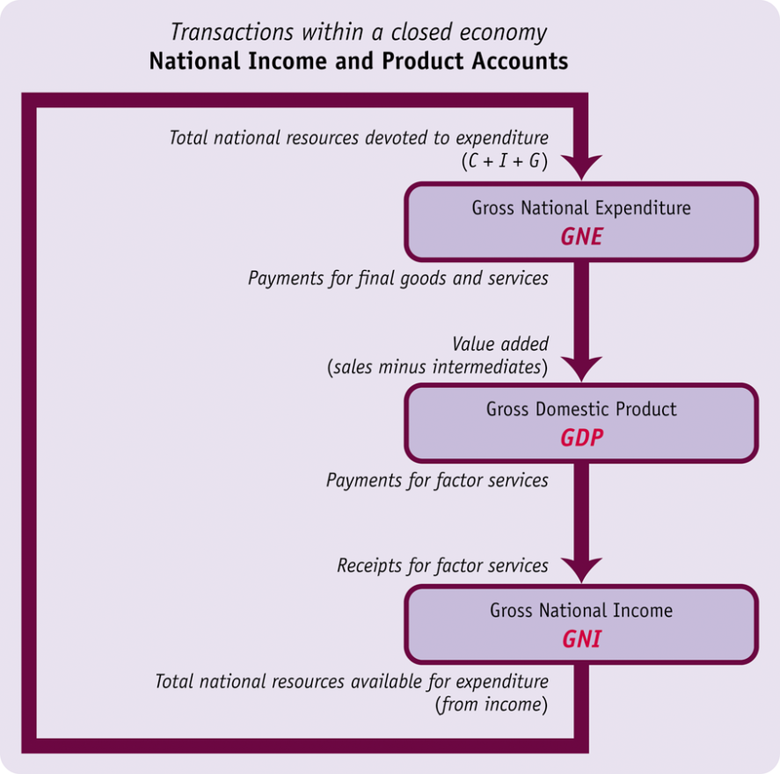
Closed vs. Open Economy
In a closed economy there is no international trade and no international financial movements; therefore:
GNE = GDP = GNI = GNDI
TB = NFIA = NUT = 0

Slide 10
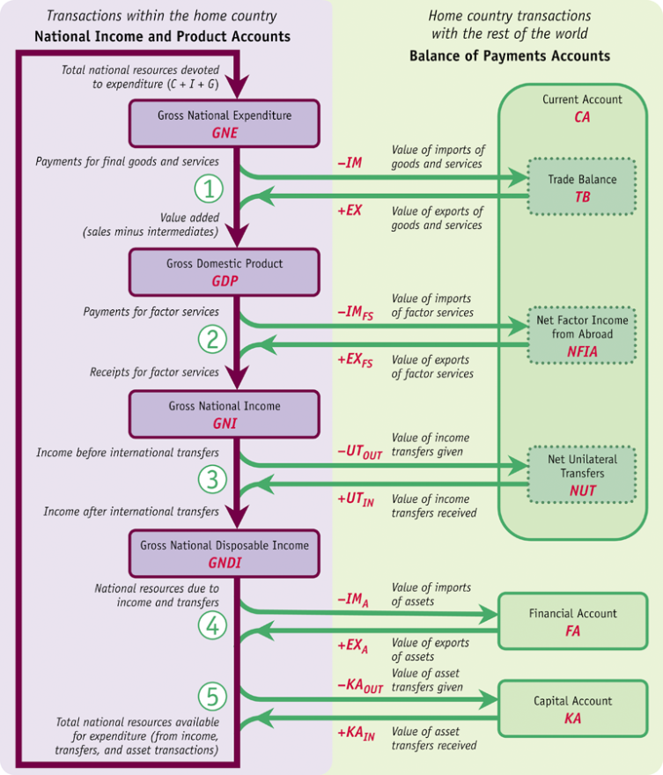
Closed vs. Open Economy
In an open economy GNE, GDP, and GNI need not be equal.
Transactions in the
balance of payments
affect the flow of spending, income, and production.

Slide 11
Trade Balance
trade balance (TB) –
exports minus imports
GNE + TB = GDP
TB = EX – IM

Slide 12
Trade Balance
Some home spending is on foreign goods and some foreign spending is on home goods.
We must deduct imports and adds exports to GNE to calculate the total payments received by home firms.

Slide 13
Trade Balance

Slide 14
Factor Income
net factor income from abroad (NFIA) –
one country is paid income by another, in compensation for labor, capital, and land
(e.g., wages, interest, dividends);
GDP + NFIA = GNI
NFIA = EX_{FS} – IM_{FS}

Slide 15
Factor Income
Some home GDP might be produced using “imported” foreign factors and some foreign GDP might be produced using “exported” home factor.
We must subtract factor service imports and add factor service exports to GDP to calculate income received by home.

Slide 16
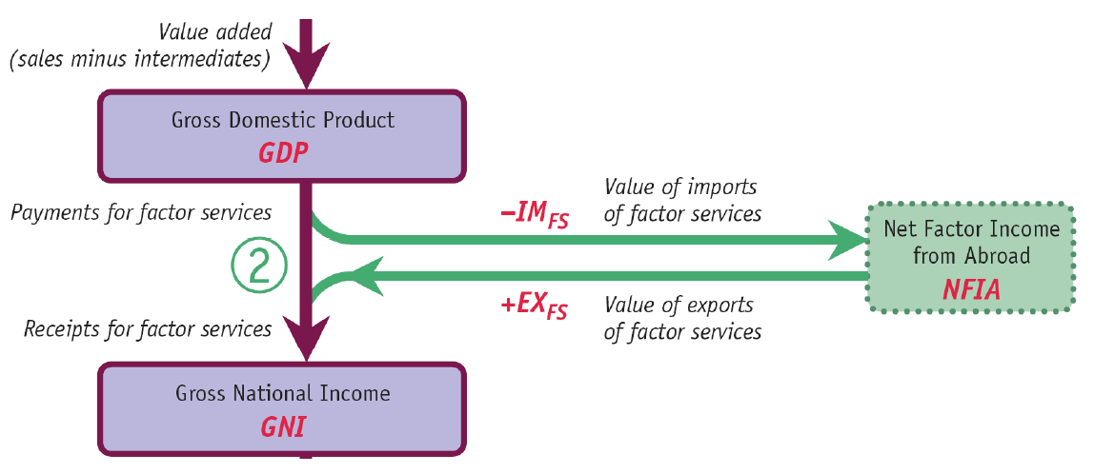
Factor Income

Slide 17
Unilateral Transfers
net unilateral transfers (NUT) –
net amount of transfers
the country receives from
the rest of the world
GNI + NUT = GNDI
NUT = UT_{IN} – UT_{OUT}

Slide 18
Unilateral Transfers
Country’s disposable income may differ from income earned due to unilateral transfers paid to and received from abroad (e.g., foreign aid).
gross national disposable income (GNDI) –
income available
including transfers

Slide 19
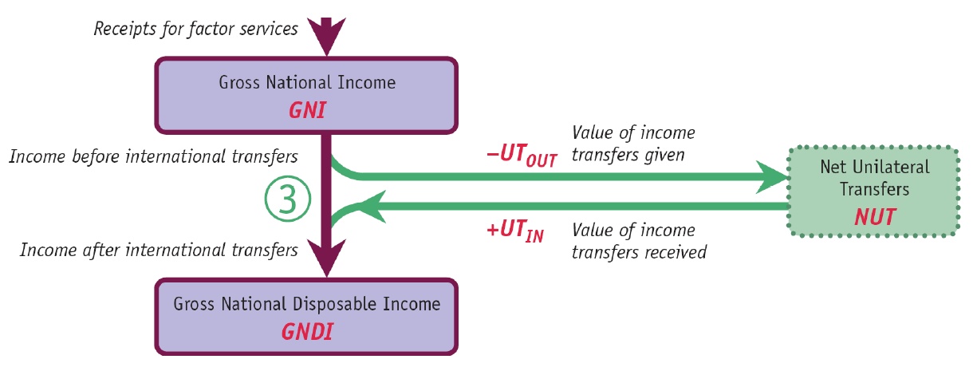
Unilateral Transfers

Slide 20
Assets
financial account (FA) –
asset exports minus
asset imports
capital account (KA) –
assets transferred /
received as gifts
GNDI + FA + KA = GNE
FA = EX_{A} – IM_{A}
KA = KA_{IN} – KA_{OUT}

Slide 21
Assets
Income is not the only resource by which an open economy can finance expenditure.
The economy can affect its spending power by exporting or importing assets internationally. Alternatively spending power can be affected by transferring or receiving assets as gifts.

Slide 22
Assets

Slide 23
Closed vs. Open Economy
So in the open economy you can go from GNE to GDP to GNI to GNDI and back to GNE.
Expenditure approach
  GNE = C + I + G
Product approach
  GDP = GNE + TB
Income approach
  GNI = GDP + NFIA

Slide 24
Balance of Payments
Balance of Payments Identity
CA + FA + KA = 0
TB + NFIA + NUT + FA + KA = 0

Slide 25
Assets
current account (CA) –
net movement of goods and services between a nation and a foreign country;
sum of the trade balance, net factor income from abroad, and net unilateral transfers
CA = TB + NFIA + NUT

Slide 26
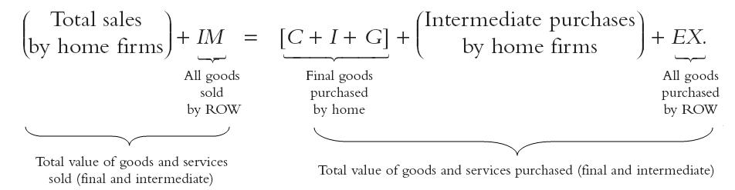
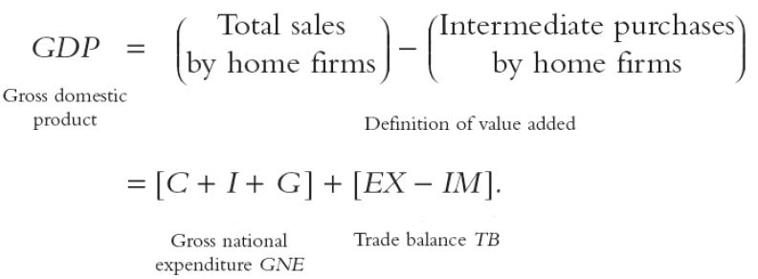
From GNE to GDP

Slide 27
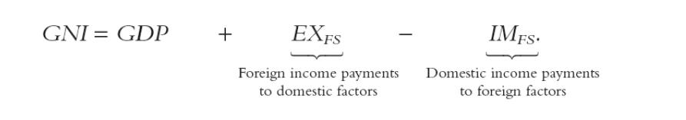
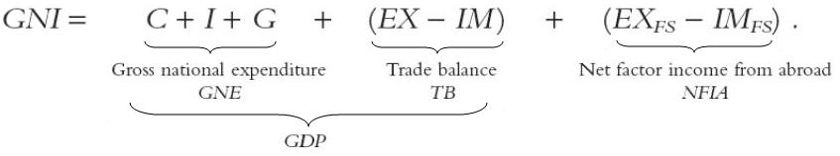
From GDP to GNI

Slide 28
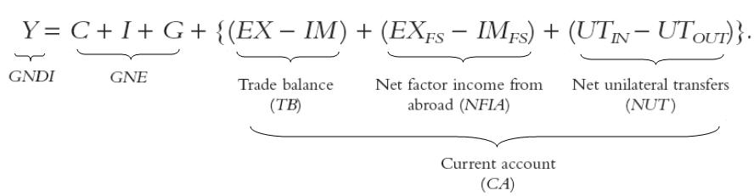
From GNI to GNDI

Slide 29
Account Balances
TB > 0 ≡ trade surplus
TB < 0 ≡ trade deficit
CA > 0 ≡ current account surplus
CA < 0 ≡ current account deficit
FA > 0 ≡ financial account surplus
FA < 0 ≡ financial account deficit

Slide 30
Saving
S = S_{P} + S_{G}
S = Y – C – G
S_{P} = Y – T – C
S_{G} = T – G
S = S_{P} + S_{G} = (Y – T – C) + (T – G)
S ≡ total saving
S_{P} ≡ private saving
S_{G} ≡ government saving

Slide 31
Saving
Y = C + I + G + CA
Y – C – G = I + CA
S = I + CA
S > I if and only if CA > 0
(current account surplus)
S < I if and only if CA < 0
(current account deficit)

Slide 32
Saving
Twin deficit
S_{P} + S_{G} = I + CA
CA = (S_{P} – I) + S_{G}
S_{G} > 0 government budget surplus
S_{G} < 0 government budget deficit
CA > 0 current account surplus
CA < 0 current account deficit

