Slide 1
Unit 2: Trade Policy
Trade Policy Controversies
2/29/2012

Slide 2
Activist Trade Policy
An activist trade policy usually means export subsidies or general subsidies to exporting industries.
Activist trade policies are justified using a market failure argument:
externalities
appropriability problem
monopoly profits

Slide 3
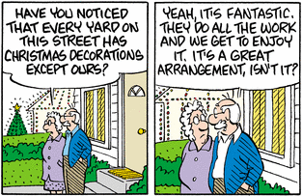
Externalities: Technology
externality –
benefits or costs that accrue to parties other than the one that generates it

Slide 4
Externalities: Technology
Firms that invest in new technology generally create knowledge that other firms can use without paying for it.
This is an appropriability problem (an externality in which marginal social benefit of investment is not represented by producer surplus).

Slide 5
Externalities: Technology
In theory governments may want to actively encourage investment in technology when externalities in new technologies create a high marginal social benefit.

Slide 6
Externalities: Technology
Problems with intervention
Can (or will) governments to subsidize the right activity?
Much activity by high tech firms does not generate knowledge.
(e.g., equipment, non-tech workers)
Knowledge & innovation can be created in non- high tech industries.

Slide 7
Externalities: Technology
Problems with intervention
It’s difficult to measure the marginal social benefit of externalities.
Therefore, it hard to know by what amount activities that create externalities ought to be subsidized.

Slide 8
Externalities: Technology
Problems with intervention
Externalities can also occur
across countries.
No individual country would
have an incentive to subsidize industries if all countries could
take advantage of the externalities.

Slide 9
Externalities: Technology
The case for government
subsidizing technology is quite dubious given those problems.
The U.S. subsidizes R&D
through the tax code instead of subsidizing specific industries.
(Research and development expenses are tax deductible.)

Slide 10
Externalities: Technology
In contrast, Japan deliberately promoted key industries.
In the 1980s many people feared Japan’s dominance of the RAM market would translate into dominance of all semiconductors.
It turns out Japan did not takeover all semiconductors and South Korea challenged Japan’s RAM dominance.

Slide 11
Externalities: Technology
The decline in U.S. employment in the production of information, communication, and technology goods and large U.S. trade deficits in those goods have renewed fears about U.S. high tech industries.
But innovation in the U.S. coupled with manufacturing in low cost countries isn’t really a problem.

Slide 12
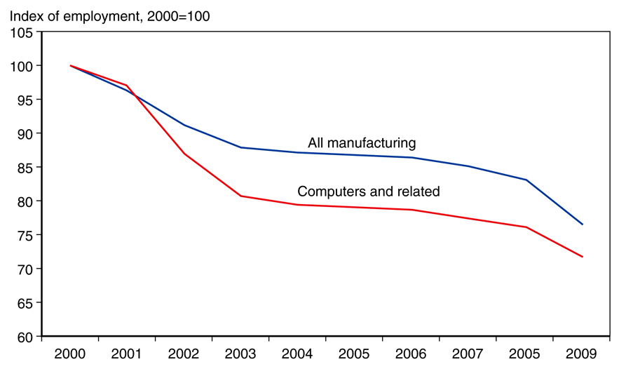
Manufacturing Jobs
Fig. 12-2: U.S. Manufacturing Employment
More generally, decline in manufacturing employment
is not a bad thing.

Slide 13
Manufacturing Jobs
Fig. 12-2: U.S. Manufacturing Employment
Although manufacturing employment is down, manufacturing output continues to rise.
Technology makes each worker more productive
(machines replace workers).

Slide 14
Manufacturing Jobs
Additionally, there is nothing inherently better about manufacturing jobs.
As manufacturing jobs decline, service jobs rise. Service jobs tend to require more education, involve less physical labor, and
pay higher salaries.
Fig. 12-2: U.S. Manufacturing Employment

Slide 15
Strategic Trade Policy
strategic trade policy –
government policy to give a domestic firm a strategic advantage in production
beggar-thy-neighbor policy –
increase own welfare at another country’s expense

Slide 16
Strategic Trade Policy
Imperfectly competitive industries are typically dominated by a few firms with monopoly profits.
But government subsidies can shift monopoly profits from a foreign firm to a domestic firm.

Slide 17
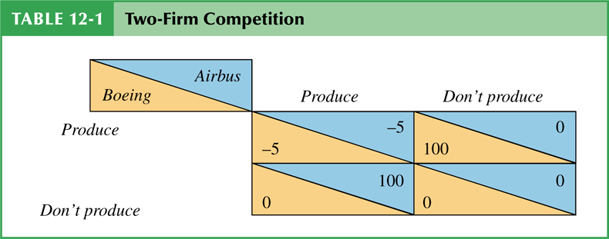
Strategic Trade Policy
Brander-Spencer analysis
Two firms compete in the international market but are located in different countries.
Each firm’s profits depends on the actions of the other.
Each firm decides to produce or not depending on profits.

Slide 18
Strategic Trade Policy
Brander-Spencer analysis
The predicted outcome depends on which firms invest/produce first.
If Boeing produces first,
then Airbus won’t produce.
If Airbus produces first,
then Boeing won’t produce.

Slide 19
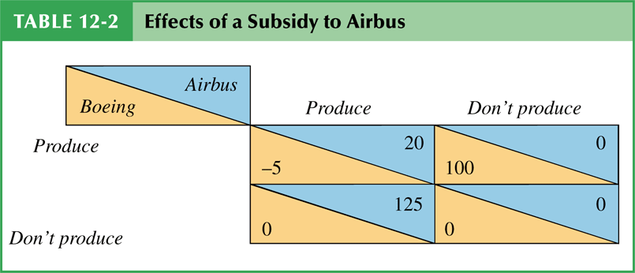
Strategic Trade Policy
Brander-Spencer analysis
But a subsidy by the European Union can alter the outcome by making it profitable for Airbus to produce regardless of Boeing’s action (+25 sub).
Boeing will then be deterred from entering the industry.

Slide 20
Strategic Trade Policy
Brander-Spencer analysis
The EU subsidy of 25 gives Airbus profits of 125.
Here the subsidy raises
profits more than the
amount of the subsidy.
This is due to its deterrent effect on foreign competition.

Slide 21
Strategic Trade Policy
Criticisms of strategic trade policy
requires too much information about firms
foreign governments could retaliate
manipulable by politically powerful groups

Slide 22
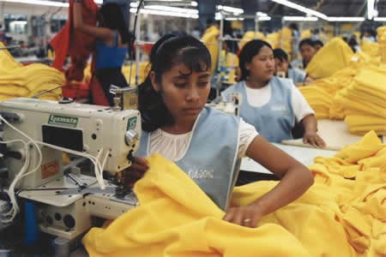
Low Wage Labor
This chapter talked about low wage labor, but we already covered that material in the lecture on Sweatshops / Child Labor.

Slide 23
Environment
Externalities
positive externality
technology
negative externality
environmental damage
Unless someone like you
cares a whole awful lot,
nothing is going to get better.
It’s not!

Slide 24
Environment
Compared to rich-country standards, environmental standards in developing countries are very lax.
Some oppose free trade because production increases in countries that have lax environmental standards.
Unless someone like you
cares a whole awful lot,
nothing is going to get better.
It’s not!

Slide 25
Environment
Environmental activists want environmental standards to be part of trade negotiations.
But developing countries oppose such standards.
Unless someone like you
cares a whole awful lot,
nothing is going to get better.
It’s not!

Slide 26
Environment
Standards can be used as an excuse for protectionism.
There is also resentment that developed countries such as the United States had lax environmental standards during their growth, but now want to make growth harder for developing countries.
Unless someone like you
cares a whole awful lot,
nothing is going to get better.
It’s not!

Slide 27
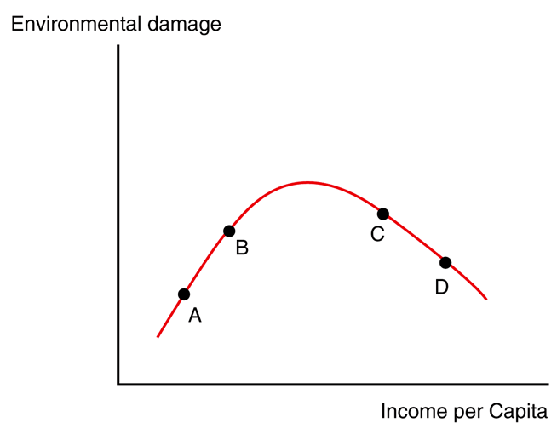
Environment
Fig. 12-3: The Environmental
Kuznets Curve
environmental Kuznets curve
As poor countries grow richer they produce more and can consume more, increasing environmental degradation.
But as countries grow richer, they want to pay for more environmental protection.

Slide 28
Environment
Fig. 12-3: The Environmental
Kuznets Curve
Very poor countries start at the left side of the curve. Increases in per capita income are associated with damage to the environment.
Eventually they move to the right side of the curve when they get sufficiently rich to care about the environment.

Slide 29
Environment
Fig. 12-3: The Environmental
Kuznets Curve
The environmental Kuznets curve shows being green is a normal good: people demand more of it as income goes up.
This suggests the best way to improve the environment long term is to increase real incomes until all are rich.

Slide 30
Environment
pollution haven –
an economic activity subject to strict environmental controls in some countries is moved to other countries with less strict regulation

Slide 31
Environment
Evidence shows the pollution haven effect on international trade is relatively small.
Production that seems to move due to havens for lax regulation is more often attracted to low wages.

Slide 32
Environment
To the extent that pollution is limited to a country, it isn’t other countries’ problem.
When that pollution causes
a negative externality for other countries, it should be included in international trade negotiations.

Slide 33
Environment
Air pollution in Mexico City is a problem for Mexico, but it’s not clear why it should be a United States interest.
A better case can be made that global warming affects all countries, and thus all should collectively limit carbon dioxide emissions.

Slide 34
Environment
Unilaterally limiting carbon emissions from a country like the U.S. would have little effect because production would shift to other countries (like China) in a pollution haven effect.

Slide 35
Environment
Only taxes or tariffs applied to the whole world could effectively curb it.
However the cure could be worse than the disease in terms of lower growth rates
(e.g., to countries on the left side of Kuznets curve).

Slide 36
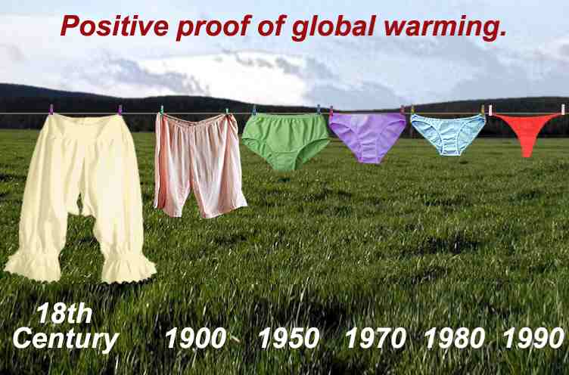
Global Warming
My rant on global warming
(not on the exam).
Global warming is widely misunderstood by the public – mostly because many severable questions are habitually conflated into one.

Slide 37
Global Warming
The usual question:
Is there global warming?
If yes, then you must be for a worldwide carbon tax and all sorts of regulations.
If no, then you must be some anti-science nutcase.

Slide 38
Global Warming
Real questions
Is the earth warming?
Is it warming a lot?
What are the consequences?
Is that good or bad for mankind?
Is the warming caused by man?
Is it stoppable / reversible?
How can it be stopped cheapest?
Is intervening worth the cost?

Slide 39
Global Warming
Is the earth warming?
Evidence is dubious.
Models keep getting disproven.
Many temperatures are measured near cities where asphalt and other heat sinks interfere.
The earth naturally has temperature cycles (see ice ages).

Slide 40
Global Warming
Is it warming a lot?
The earth seems to be getting slightly hotter, but this effect is complicated by time of year, time of day, location, etc. For example, while the northern hemisphere is getting hotter, the southern hemisphere is getting colder.

Slide 41
Global Warming
Is it warming a lot?
The best evidence shows most temperatures are flat, but it is getting hotter in the middle of Canada & Siberia in the middle of the night in the middle of winter.

Slide 42
Global Warming
What are the consequences?
Sea levels don’t seem to be rising. When icebergs melt, that doesn’t change the water level at all.
When ice on land melts that can in theory change the water level.
Even though glaciers are receding, they are also getting thicker.
So very little net change in water.

Slide 43
Global Warming
What are the consequences?
Suppose the global temp rises.
Some land in warm places will become dessert (uninhabitable).
Other land (in cold places) will thaw and become habitable.
The net change would probably be negligible – or even good.

Slide 44
Global Warming
Is that good or bad for mankind?
Far more people in the world die from cold related illnesses like hypothermia than heat related illnesses such as heat stroke.
Rising temperatures could be
a huge net positive.

Slide 45
Global Warming
Is the warming caused by man?
Even if the earth is warming, evidence that it is caused by carbon dioxide or man is dubious.
Water vapor is another possibility. Or cyclic activity of the sun.

Slide 46
Global Warming
Is it stoppable / reversible?
Carbon is released by most activity of people (e.g. breathing). Stopping or significantly curbing carbon emissions could mean sacrificing a lot of technology and comfort we have come to expect.

Slide 47
Global Warming
Is it stoppable / reversible?
That said, the earth has enormous built in negative feedback loops.
It has been far hotter and far cooler in other periods.
In fact, we are just recovering from the little ice age which followed the medieval warming.

Slide 48
Global Warming
How can it be stopped cheapest?
Many proposals advocated to address global warming
(such as tradable carbon credits) have been convincingly shown to be far more economically costly than other alternatives.

Slide 49
Global Warming
Is intervening worth the cost?
Any intervention will have a cost in terms of economic growth. This cost can be quite steep (depending on the specific plan).
Remember, the goal should be to move countries to the right side of the Kuznets curve, which is much harder with less growth.

Slide 50
Global Warming
Also of interest…
Politics seems to be driving the science more than the science is driving the politics. Research funding and journal publication is significantly easier for those who agree with global warming
(see hacked climate emails).
Global cooling scare in the 1970s.

Slide 51
Global Warming
All put together, I’m a skeptic.
I can be convinced on several of the questions with good peer reviewed evidence, which is very different from science groupies yelling that anyone who doesn’t believe must be anti-science.
Other questions belong in the realm of economics, not science.

