Slide 1
Unit 2: Trade Policy
Trade in Developing Countries
2/27/2012

Slide 2
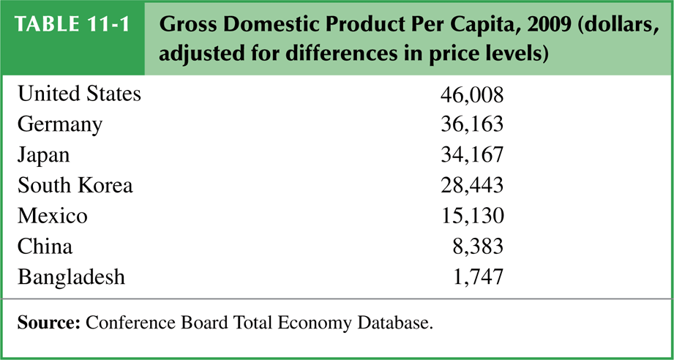
Developing Countries
Developing countries has no precise definition, but it generally refers to low and middle income countries.
There is a large disparity between high and low income countries.

Slide 3
Import Substitution
infant industry argument –
temporary protection of industries allows them to gain experience and thus economies of scale

Slide 4
Import Substitution
import-substituting industrialization –
the strategy of encouraging domestic industry by limiting imports of manufactured goods

Slide 5
Import Substitution
Import-substituting industrialization was a trade policy adopted by many low- and middle-income countries before the 1980s.
It aimed to encourage domestic industries by
limiting competing imports.

Slide 6
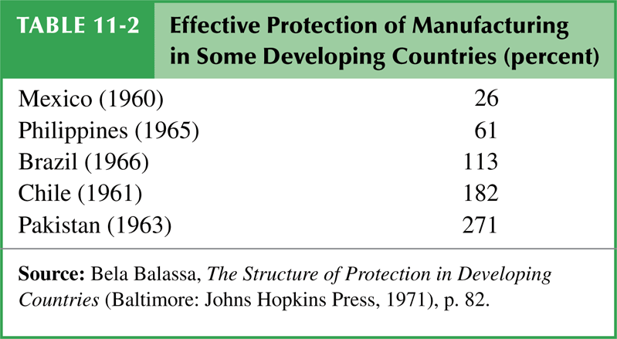
Import Substitution

Slide 7
Import Substitution
Countries may have a potential comparative advantage in certain industries, but they cannot initially compete with well-established competitors in other countries.
Therefore governments should temporarily support them until they can compete internationally.

Slide 8
Import Substitution
Infant industry argument problems
It may be wasteful to support industries now that will have a comparative advantage in the future.
With protection, infant industries may never grow up or become competitive.

Slide 9
Import Substitution
Infant industry argument problems
There is no justification for government intervention unless there is a market failure that prevents the private sector from investing in the infant industry.

Slide 10
Import Substitution
Possible market failures
Because of poorly working financial markets, firms cannot save and borrow to invest in their production processes.
High tariffs could be a second-best policy instead of fixing financial market.
Of course a far better solution is the first-best policy: fix the financial market.

Slide 11
Import Substitution
Possible market failures
Firms may not be able to privately appropriate the benefits of their investment in new industries because those benefits are public goods.
The knowledge created when starting an industry may not be appropriable (may be a public good) because of a lack of property rights.

Slide 12
Import Substitution
Possible market failures
High tariffs could be a second-best policy instead of establishing a
system of property rights.
Of course as always a far better solution is the first-best policy: establish a system of property rights.

Slide 13
Import Substitution
Import-substituting industrialization
in Latin American countries worked
to encourage manufacturing
industries in the 1950s and 1960s.
But high tariff import substituting countries grew slower than low tariff countries with export oriented growth.

Slide 14
Import Substitution
The infant industry argument was not as valid as some had initially believed.
New industries did not become competitive due to of trade restrictions.
Import-substitution was very wasteful:
complex, time-consuming regulations
high tariff rates for consumers
high tariff rates for firm inputs
inefficiently small industries.

Slide 15
Trade Liberalization
Countries that had relatively free trade had higher average economic growth than import-substituting countries.
Many governments lost faith in import substitution and began to liberalize.
In the mid-1980s India and Brazil dramatically lowered their tariff rates.

Slide 16
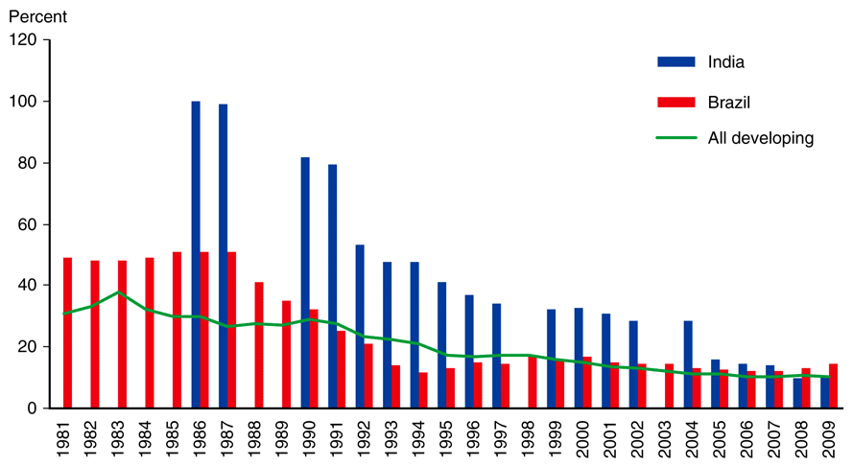
Trade Liberalization
Fig. 11-1: Tariff Rates in Developing Countries

Slide 17
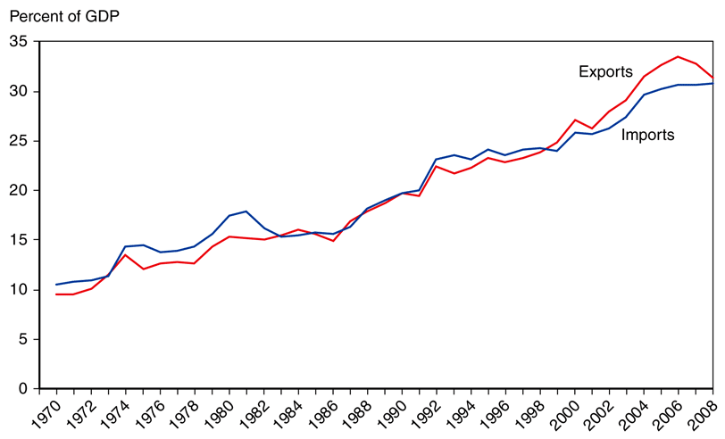
Trade Liberalization
Fig. 11-2: The Growth of Developing-Country Trade

Slide 18
Trade Liberalization
The empirical evidence on trade liberalization is mixed.
Growth rates in Brazil and other Latin American countries have been slower than under import-substitution.
This slowness may be attributable to other bad policies though (lack of property rights and financial crises).

Slide 19
Trade Liberalization
India has grown rapidly.
The Asian miracles Japan, Hong Kong, Taiwan, South Korea, Singapore, Malaysia, Thailand, Indonesia, and China have also grown rapidly – both in their export sectors and overall.
Other factors may have played a role
in the amazing Asian growth.

Slide 20
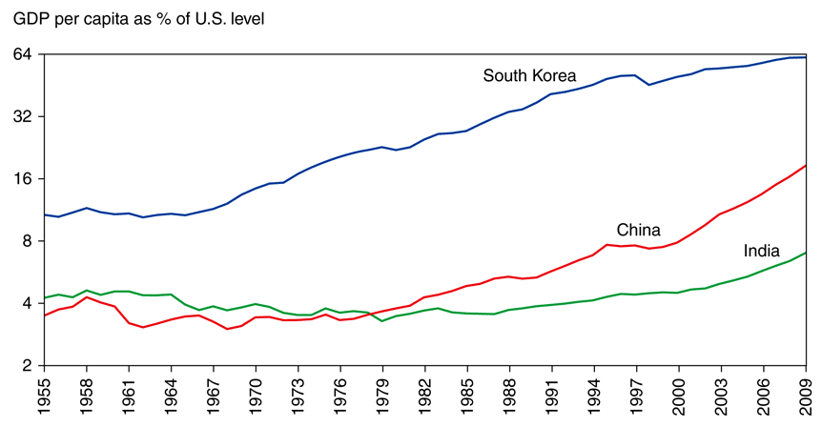
Trade Liberalization
Fig. 11-3: The Asian Takeoff

Slide 21
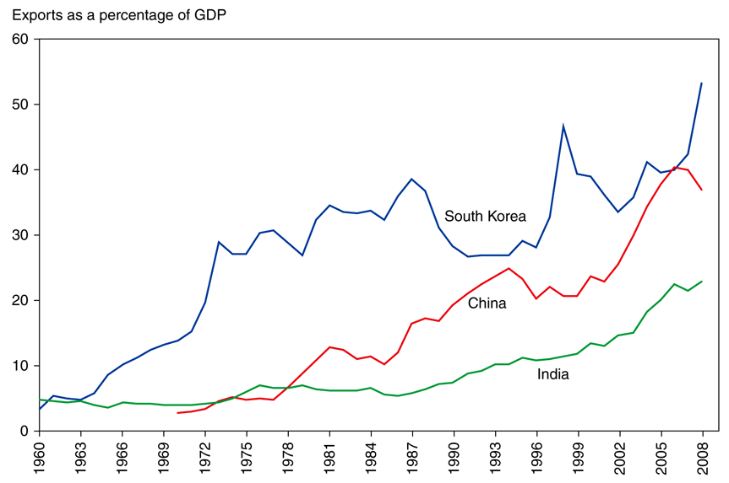
Trade Liberalization
Fig. 11-4: Asia’s Surging Trade

Slide 22
Trade Liberalization
It’s unclear if the high volume of exports and imports caused rapid economic growth or was merely correlated with rapid growth.
Other possibilities
High saving and investment rates.
Rapid growth in education.
Other economic reforms.

