Slide 1
Unit 2: Trade Policy
Free Trade
2/24/2012

Slide 2
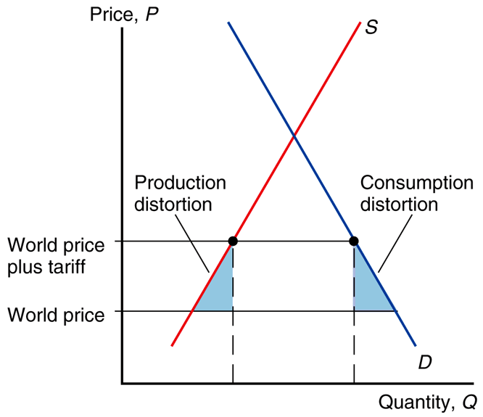
Free Trade – Arguments in Favor
Fig. 10-1: The Efficiency
Case for Free Trade
Producers and consumers allocate resources most efficiently when governments don’t distort market prices through trade policy.
Thus small country welfare is highest with free trade.

Slide 3
Free Trade – Arguments in Favor
But tariff rates are already low, so the estimated benefits of moving to free trade are small.
Remaining protection costs less than 1% of world GDP.
Gains would be larger for developing countries than advanced countries.

Slide 4
Free Trade – Arguments in Favor
Free trade allows firms or industry to take advantage of economies of scale.
Protected markets limit gains from industry concentration. (Too many firms to enter, so
firm production is inefficient.)

Slide 5
Free Trade – Arguments in Favor
Free trade provides dynamic benefits: competition and opportunities for innovation.
Entrepreneurs have an incentive to export more or compete with imports.

Slide 6
Free Trade – Arguments in Favor
Free trade avoids rent seeking.
rent seeking –
people and firms spend time and resources seeking quota rights and associated profits
(often through bribes and political contributions)

Slide 7
Free Trade – Arguments in Favor
The political argument for free trade says that free trade is the best feasible political policy, even though there may be better policies in principle.
Any deviating policy would be quickly manipulated by political groups, leading to decreased national welfare.

Slide 8
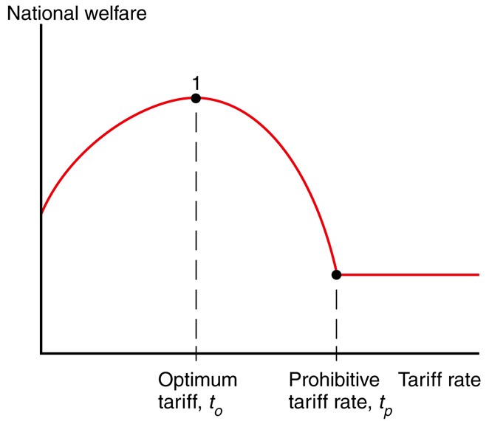
Free Trade – Arguments Against
Fig. 10-2: The Optimum Tariff
Tariffs generate terms of trade gains for a large countries.
This benefit may exceed the losses caused by production and consumption distortions.

Slide 9
Free Trade – Arguments Against
Fig. 10-2: The Optimum Tariff
A small tariff will lead to an increase in national welfare, but at some tariff rate, the national welfare will begin to decrease as efficiency loss exceeds terms of trade gain.
There is an optimal tariff rate t_{O} that maximizes welfare.

Slide 10
Free Trade – Arguments Against
export tax –
negative export subsidy
For a large country an export subsidy lowers the terms of trade; while an export tax raises the terms of trade.
There is an optimal export tax rate e_{O} that maximizes welfare.
Fig. 10-2: The Optimum Tariff

Slide 11
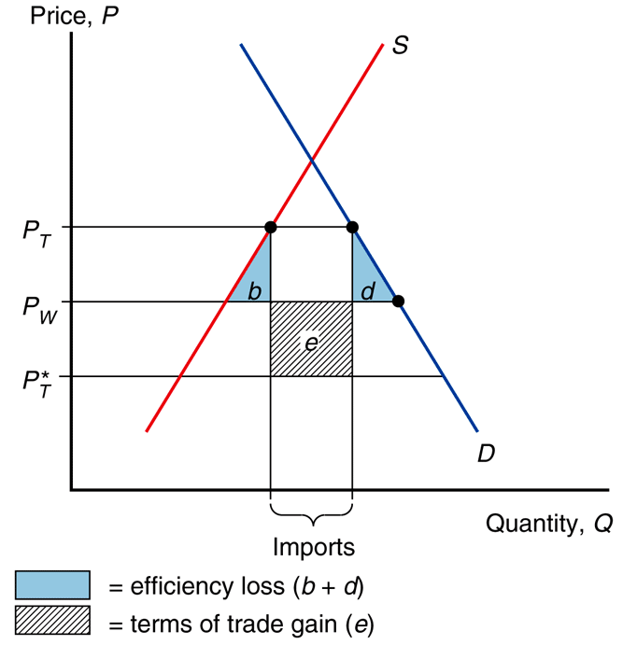
Free Trade – Arguments Against
For large countries, an import tariff and/or export tax could improve national welfare at the expense of other countries.
This ignores the likelihood that other countries will retaliate by enacting their own trade restrictions, reducing welfare.

Slide 12
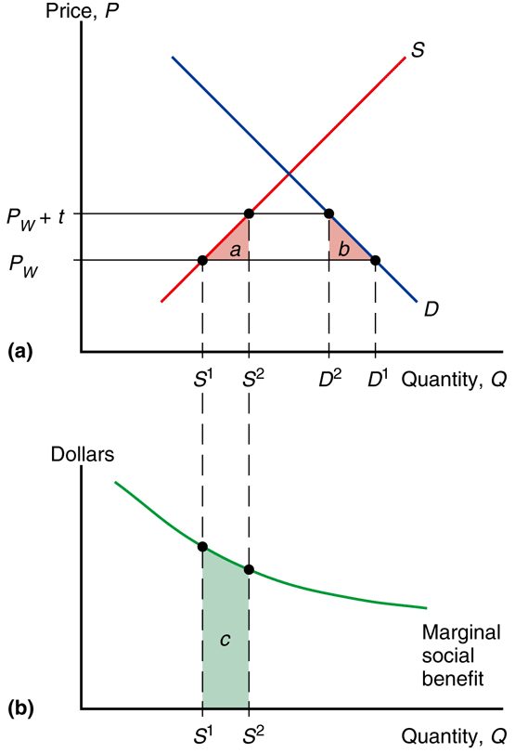
Free Trade – Arguments Against
Fig. 10-3: The Domestic Market Failure Argument for a Tariff
Domestic market failures may exist that cause free trade to be a suboptimal policy.
Welfare calculations using consumer and producer surplus assume markets function well.

Slide 13
Free Trade – Arguments Against
Fig. 10-3: The Domestic Market Failure Argument for a Tariff
types of failures
high unemployment
underutilized capital
bad property rights
technological benefits
environmental costs
uninformed buyers/sellers

Slide 14
Free Trade – Arguments Against
Fig. 10-3: The Domestic Market Failure Argument for a Tariff
marginal social benefit –
additional benefit to society from private production
With a market failure,
marginal social benefit
is not accurately measured
by the producer surplus,
so welfare analysis misleads.

Slide 15
Free Trade – Arguments Against
Fig. 10-3: The Domestic Market Failure Argument for a Tariff
When a tariff increases domestic production,
it’s possible the benefit to domestic society will increase due to the marginal social benefit compensating
for a market failure.

Slide 16
Free Trade – Arguments Against
Fig. 10-3: The Domestic Market Failure Argument for a Tariff
theory of the second-best –
if the best policy (fixing the market failures) is ruled out, then government intervention in an entirely different market may be a second-best way of fixing the problem

Slide 17
Free Trade – Arguments Against
Fig. 10-3: The Domestic Market Failure Argument for a Tariff
The domestic market failure argument is an example of the theory of the second-best.
Government intervention distorting market incentives in one market may increase national welfare by offsetting the consequences of market failures elsewhere.

Slide 18
Free Trade – Arguments Against
Fig. 10-3: The Domestic Market Failure Argument for a Tariff
The counter: domestic market failures should be corrected by a first-best policy: a domestic policy aimed directly at the source of the problem.
For example, correct high unemployment with domestic subsidies instead of tariffs.

Slide 19
Free Trade – Arguments Against
Fig. 10-3: The Domestic Market Failure Argument for a Tariff
It’s unclear when a market failure exists in the real world.
Politically powerful groups can manipulate government policies to address market failures.
Unintended consequences from trade policies can make things worse (e.g., swallow a fly).

Slide 20
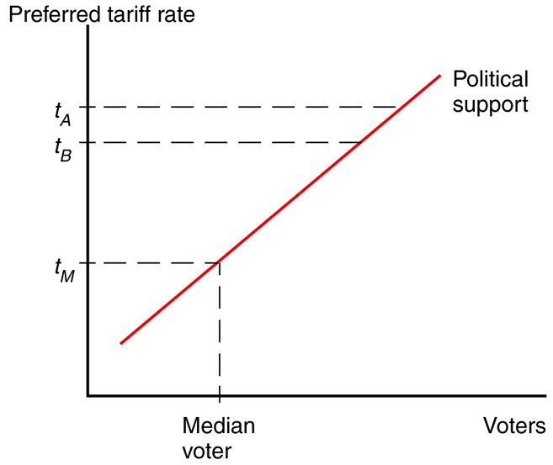
Political Models of Trade Theory
Public choice theory shows us that political actors try to maximize their re-election chances rather than working for the national welfare.
Models
Median Voter Theory
Collective Action Problem
Mix of the 2
Fig. 10-4: Political Competition

Slide 21
Political Models of Trade Theory
Fig. 10-4: Political Competition
median voter theory –
political parties pick their policies to court the voter in
the middle of the ideological spectrum (the median voter)

Slide 22
Political Models of Trade Theory
MVT assumptions
2 competing political parties
both want majority vote
Line up all the voters according to the tariff rate they prefer.
Both parties will offer the same policy to capture the most votes courting the median voter.
Fig. 10-4: Political Competition

Slide 23
Political Models of Trade Theory
MVT implies that a democracy should enact trade policy based on how many voters it pleases.
MVT predicts no tariffs because a few producers lose but a large number consumers benefit.
That prediction is wrong.
Fig. 10-4: Political Competition

Slide 24
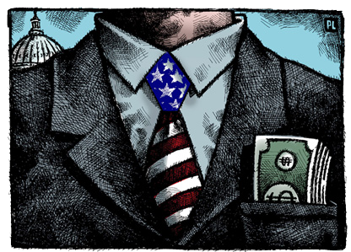
Political Models of Trade Theory
collective action problem –
a group of individuals has an incentive to act, but each individual alone has no incentive to act because costs
of acting (time & resources) exceed tiny benefit

Slide 25
Political Models of Trade Theory
Consumers as a group have an incentive to advocate free trade, but each individual consumer has no incentive
(individual benefits tiny).
Thus consumers are not a strong opposition to tariffs.

Slide 26
Political Models of Trade Theory
politicians value
popular policies
median voter theory
campaign funds
special interests
collective action problem

Slide 27
Political Models of Trade Theory
Campaign funds often come from groups that don’t suffer from a collective action problem (special interests).
Advocates for high tariffs (opponents of free trade)
are one such special interest.

Slide 28
Protected Interests
agriculture
small fraction of electorate
generous subsidies
trade protection
Common Agricultural Policy
European Union
1000% tariff on rice (Japan)
sugar quota (USA)

Slide 29
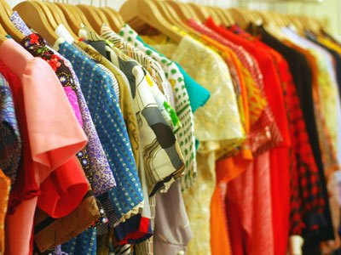
Protected Interests
clothing (textiles & apparel)
Multi-Fiber Agreement
multilateral w/ USA
quota licenses
phased out
total tariff reduction
2001 to 2013
$14.1b (11.8b cloth)
to $4.6b ($2.3b cloth)

Slide 30
Protected Interests

Slide 31
Trade Agreements
unilateral tariff reduction –
reduction in tariffs without regard to what others do
bilateral tariff reduction –
reduction in tariffs if a 2nd country does likewise
multilateral tariff reduction–
reduction in tariffs if a 3 or more countries do likewise

Slide 32
Trade Agreements
We saw in our earlier welfare analysis that unilaterally reducing trade barriers benefits countries.
So why are bilateral or multilateral agreements useful (even necessary)?

Slide 33
Trade Agreements
Multilateral negotiations mobilize exporters to support free trade if they believe export markets will expand. This overcomes the collective action problem which biased the political process toward protection.

Slide 34
Trade Agreements
Multilateral negotiations also help avoid a trade war between countries.
A trade war could result if each country has an incentive to adopt protection, regardless of what other countries do.

Slide 35
Trade Agreements
Game theory shows an example of that situation.
Each country individually is better off with protection (20 > 10 and -5 > -10), but both are better off if both chose free trade than if both choose protection (10 > –5).

Slide 36
Trade Agreements
A binding agreement to maintain (or transition to) free trade avoids the specter of both choosing protection.

Slide 37
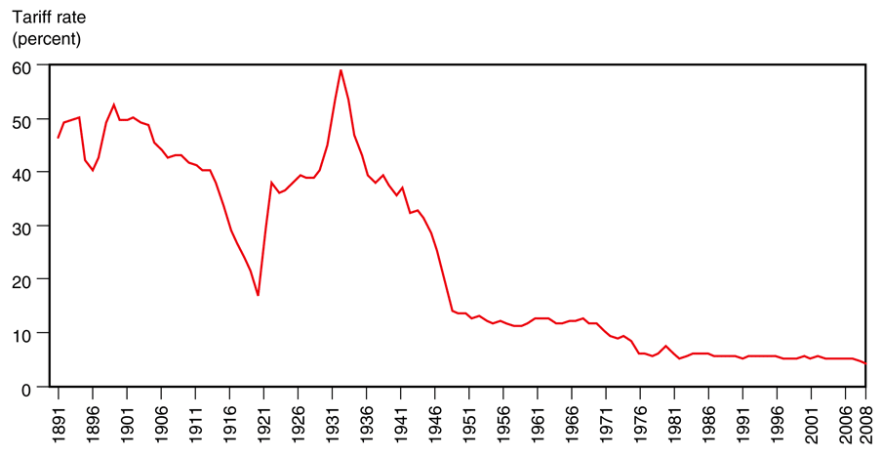
History of Trade Agreements
Fig. 10-5: The U.S. Tariff Rate
In 1930, the United States passed the Smoot-Hawley tariff, which dramatically hiked tariff rates, causing trade to fall precipitously.

Slide 38
History of Trade Agreements
The U.S. attempted to unravel some of the damage through bilateral trade negotiations (offering to lower tariffs on U.S. imports if another country lowered its tariffs on U.S. exports).
Fig. 10-5: The U.S. Tariff Rate

Slide 39
History of Trade Agreements
Bilateral negotiations don’t take full advantage of international coordination.
Countries that have not made any concessions can benefit from others’ bilateral agreements (free riding on others’ low tariffs).

Slide 40
History of Trade Agreements
In 1947, a group of 23 countries began trade negotiations under the General Agreement on Tariffs and Trade (GATT).

Slide 41
History of Trade Agreements
In 1995 the World Trade Organization (WTO) was established as a formal organization to negotiate, implement, and police multilateral trade agreements.

Slide 42
World Trade Organization
goals
reduce tariff rates
multilateral negotiations
bind tariff rates
agree to no future hikes
eliminate nontariff barriers
convert others to tariffs
subsidies and quotas
more obvious
easier to negotiate

Slide 43
World Trade Organization
There are a few exceptions to the general rules:
Subsidies for agricultural exports are allowed.
Countries are also allowed to temporarily hike tariffs to address market disruptions caused by an import surge.

Slide 44
World Trade Organization
WTO agreements
General Agreement on Tariffs and Trade (GATT)
trade in goods
General Agreement on Tariffs and Services (GATS)
trade in services
Agreement on Trade-Related Aspects of IP (TRIPS)
international property rights

Slide 45
World Trade Organization
The WTO also adds a dispute settlement procedure to GATT.
Countries in a trade dispute can bring their case to a panel of WTO experts, which rules on whether member counties are breaking their agreements.

Slide 46
World Trade Organization
If a country doesn’t the panel’s decision, the WTO can punish it by letting other countries impose trade restrictions on it.

Slide 47
World Trade Organization
The last successful GATT multilateral negotiations was the Uruguay Round (ratified in 1994) which reduced agricultural subsidies and phased out quotas on textiles and clothing (the Multi-Fiber Arrangement).

Slide 48
World Trade Organization
Unfortunately quotas on imports from China were temporarily re-imposed by the U.S. due to surge in Chinese clothing exports when the MFA expired.
This is an example of the market disruption exception.

Slide 49
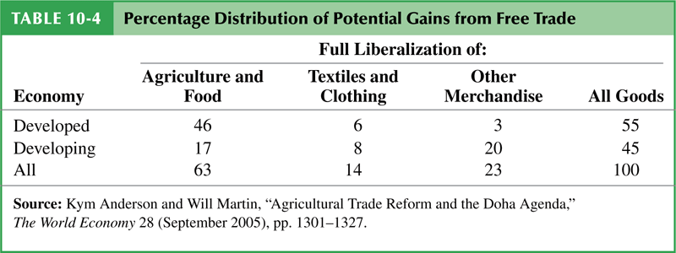
World Trade Organization
The latest round of negotiations (started in Doha, Qatar 2001) haven’t produced an agreement.
Most remaining protection is in agriculture, textiles, and clothing — industries that are well organized politically.

Slide 50
Preferential Trade Agreements
preferential trade agreement –
trade agreements between countries in which they lower tariffs for each
other but not for
the rest of the world

Slide 51
Preferential Trade Agreements
most favored nation
(MFN) principle –
WTO members pledge all member countries will pay tariffs no higher than the nation that pays the lowest

Slide 52
Preferential Trade Agreements
Under the WTO preferential trade agreements are generally not allowed.
Each country in the WTO is granted most favored nation status by other members.
However, preferential trade agreements are allowed if the lowest rate is zero.

Slide 53
Preferential Trade Agreements
free trade area –
free trade among members, individual trade policies towards non-members
(e.g., NAFTA)
customs union –
free trade among members, a common external trade policy towards non-members
(e.g., European Union)

Slide 54
Preferential Trade Agreements
Two types of preferential trade agreements have zero tariff rates: a free trade area and a customs union.
Counter-intuitively, preferential trade agreements can actually reduce national welfare.

Slide 55
Preferential Trade Agreements
Preferential trading agreements increase national welfare when new trade is created, but not when existing trade from
the outside world is diverted to trade with member countries.

Slide 56
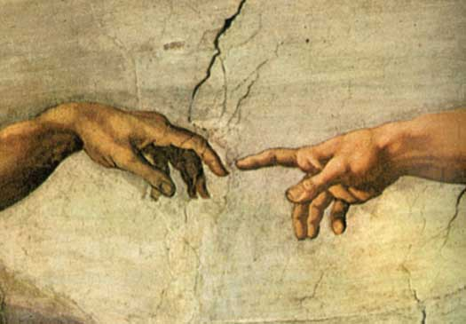
Preferential Trade Agreements
trade creation –
high-cost domestic production is replaced
by low-cost imports
from other members
trade diversion–
low-cost imports from nonmembers are diverted to high-cost imports from member nations

