Slide 1
Unit 2: Trade Policy
Trade Policy (Tariffs, Subsidies, VERs)
2/22/2012

Slide 2
Tariffs
tariff –
a tax on an import or export
specific tariff –
levied as a fixed charge for each unit of import or export
ad valorem tariff –
levied as a fraction of the value of imported or exported goods

Slide 3
Trade
Suppose in autarky the price of wheat is higher in home than it is in foreign.
With trade wheat will be shipped from foreign to home until prices in both countries are the same.

Slide 4
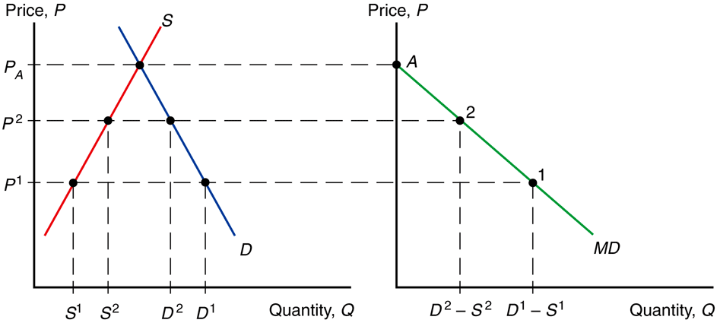
Trade
import demand –
the difference between the quantity of a good that home consumers demand and the quantity that home producers supply at any price
Fig. 9-1: Deriving Home’s Import Demand Curve

Slide 5
Trade
Fig. 9-1: Deriving Home’s Import Demand Curve
MD = D – S
MD ≡ import demand
D ≡ home demand
S ≡ home supply

Slide 6
Trade
Fig. 9-1: Deriving Home’s Import Demand Curve
The MD curve is downward sloping
(as price increases, quantity of imports demanded decreases).

Slide 7
Trade
Fig. 9-1: Deriving Home’s Import Demand Curve
MD intersects the
P axis at P_{A} (home price
in autarky) because imports demanded
are zero there.

Slide 8
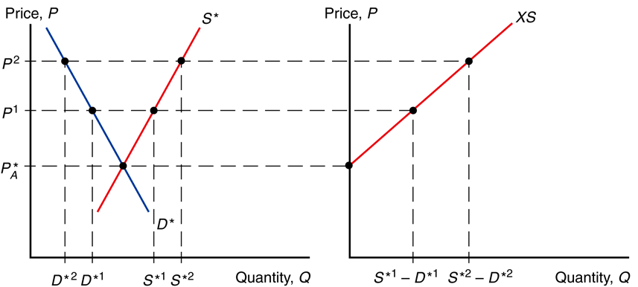
Trade
export supply –
the difference between the quantity of a good that foreign producers supply and the quantity that foreign consumers demand at any price
Fig. 9-2: Deriving Foreign’s Export Supply Curve

Slide 9
Trade
Fig. 9-2: Deriving Foreign’s Export Supply Curve
XS* = S* – D*
XS* ≡ export supply
D* ≡ foreign demand
S* ≡ foreign supply

Slide 10
Trade
Fig. 9-2: Deriving Foreign’s Export Supply Curve
The XS* curve is upward sloping
(as price increases, quantity of exports demanded increases).

Slide 11
Trade
Fig. 9-2: Deriving Foreign’s Export Supply Curve
XS* intersects the
P axis at P_{A}* (foreign price in autarky) because exports supplied are zero.

Slide 12
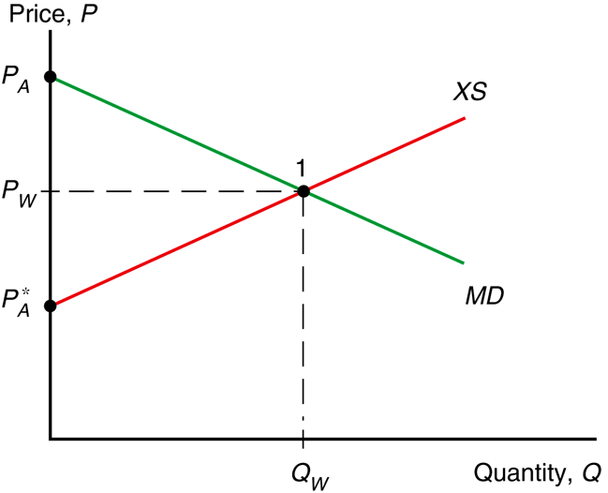
Trade
Equilibrium
MD = XS*
D – S = S* – D*
D + D* = S + S*
D^{W} = S^{W}
MD ≡ import demand
XS* ≡ export supply
D^{W} ≡ world demand
S^{W} ≡ world supply
Fig. 9-3: World Equilibrium

Slide 13
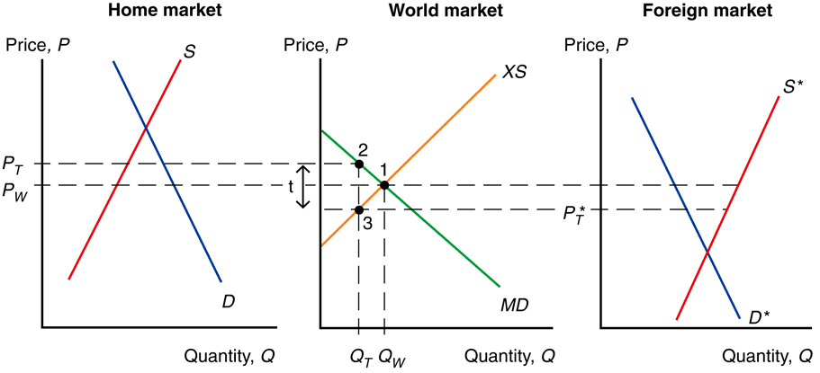
Tariffs
Fig. 9-4: Effects of a Tariff
A tariff acts like a transportation cost.
Sellers won’t ship goods unless home price exceeds foreign price by the amount of the tariff.

Slide 14
Tariffs
Fig. 9-4: Effects of a Tariff
P_{T} – t = P_{T}*
P_{T} ≡ home price w/ tariff
P_{T}* ≡ foreign price w/ tariff
P_{W} ≡ world price free trade
t ≡ tariff

Slide 15
Tariffs
Fig. 9-4: Effects of a Tariff
A tariff drives a wedge between the prices in home and foreign.
The price in home rises and the price in foreign falls relative to free trade.

Slide 16
Tariffs
Fig. 9-4: Effects of a Tariff

Slide 17
Tariffs
Because the price with a tariff rises in the home country relative to free trade, home producers supply more and home consumers demand less.
Home thus imports less
(falls from Q_{W} to Q_{T}).
Fig. 9-4: Effects of a Tariff

Slide 18
Tariffs
Because the price with a tariff falls in the foreign country relative to free trade, foreign consumers demand more and foreign producers supply less.
Foreign thus exports less
(falls from Q_{W} to Q_{T}).
Fig. 9-4: Effects of a Tariff

Slide 19
Tariffs
Fig. 9-4: Effects of a Tariff
Note on the graph that the quantity of home imports demanded equals the quantity of foreign exports supplied (at Q_{T}) when P_{T} – P_{T}* = t.

Slide 20
Tariffs
Fig. 9-4: Effects of a Tariff
The home price may not rise by the full amount of the tariff because it partly causes the foreign export price to decline.
The size of the home country matters here.

Slide 21
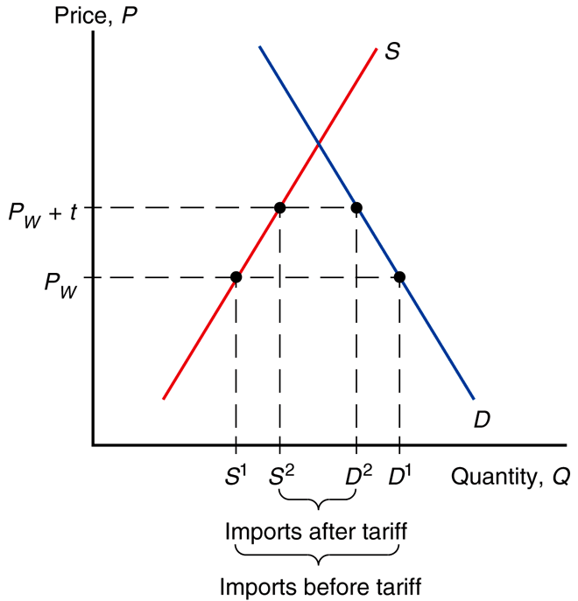
Tariffs
Fig. 9-5: A Tariff in a Small Country
When the home country is small, it has no effect on the foreign export price (which stays constant at the world price) because it is an insignificant part of the good’s world demand.
P_{T} = P_{W} + t

Slide 22
Tariffs
Fig. 9-4: Effects of a Tariff

Slide 23
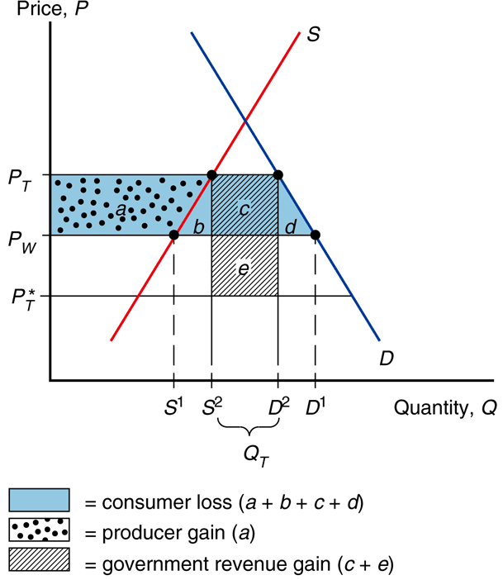
Welfare Effects of Tariffs
Fig. 9-9: Costs and Benefits of a Tariff for the Importing Country
A tariff raises the price
of the protected good, hurting consumers and benefiting producers.
Also the government
gains tariff revenue.
What is the net effect
of the tariff?

Slide 24
Welfare Effects of Tariffs
Fig. 9-9: Costs and Benefits of a Tariff for the Importing Country
To analyze welfare effects of a tariff we look at changes in producer and consumer surpluses.

Slide 25
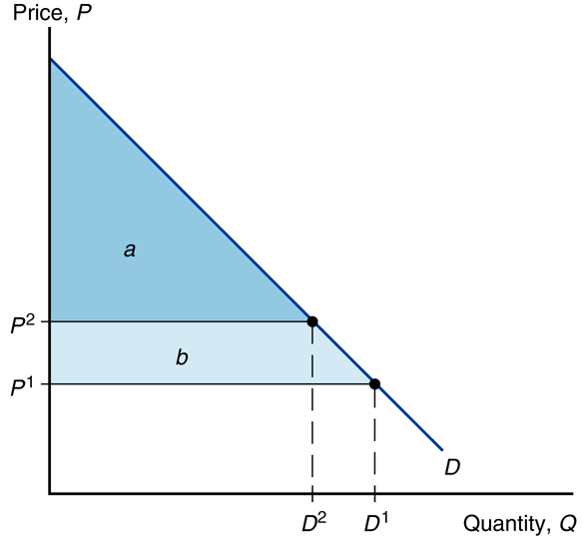
Welfare Effects of Tariffs
Fig. 9-7: Geometry of
Consumer Surplus
consumer surplus –
amount that consumers gain from purchases;
difference between the price actually paid and the maximum price at which they would be willing to buy

Slide 26
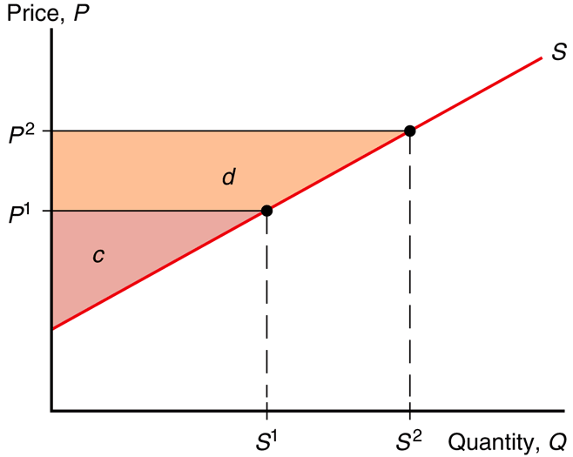
Welfare Effects of Tariffs
Fig. 9-7: Geometry of
Consumer Surplus
producer surplus –
amount that producers
gain from sales;
difference between the price actually received and the minimum price at which they would be willing to sell

Slide 27
Welfare Effects of Tariffs
Fig. 9-9: Costs and Benefits of a Tariff for the Importing Country
Effects of a tariff
consumer surplus decreases
consumers worse off
producer surplus increases
producers better off
government collects revenue
tariff rate x imports
t Q_{T} = (P_{T} – P_{T}*)(D₂ – S₂)

Slide 28
Welfare Effects of Tariffs
Effects of a tariff
consumer surplus decreases
– (a + b + c + d)
producer surplus increases
+ a
government collects revenue
+ (c + e)
net benefit
– a – b – c – d + a + c + e
e – b – d
Fig. 9-9: Costs and Benefits of a Tariff for the Importing Country

Slide 29
Welfare Effects of Tariffs
Fig. 9-9: Costs and Benefits of a Tariff for the Importing Country
Effects of a tariff
a – transfer to producers
b – production distortion loss
c – transfer to government
d – consumption distortion loss
e – terms of trade gain
Net welfare effect: e – b – d
This is usually negative (a loss).

Slide 30
Welfare Effects of Tariffs
Fig. 9-9: Costs and Benefits of a Tariff for the Importing Country
Effects of a tariff
a – at expense of consumers
b – at expense of consumers
c – at expense of consumers
d – at expense of consumers
e – at expense of foreigners
Net welfare effect: e – b – d
This is usually negative (a loss).

Slide 31
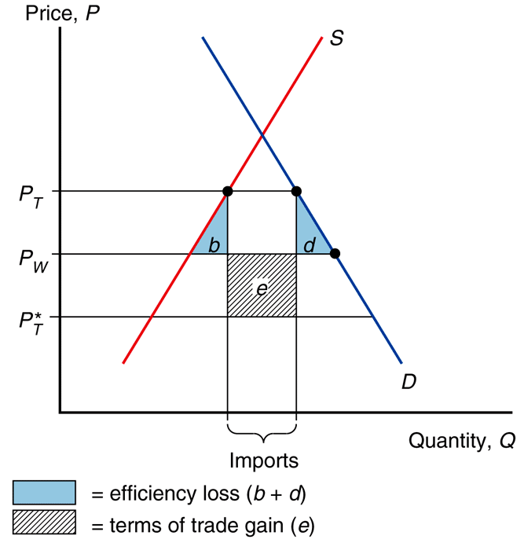
Welfare Effects of Tariffs
Fig. 9-10: Net Welfare
Effects of a Tariff
production distortion loss –
too much produced
at higher price
consumption distortion loss –
too little consumed
at higher price

Slide 32
Welfare Effects of Tariffs
Fig. 9-10: Net Welfare
Effects of a Tariff
Effects of a tariff
a – transfer to producers
b – production distortion loss
c – transfer to government
d – consumption distortion loss
e – terms of trade gain
Net welfare effect: e – b – d
This is usually negative (a loss).

Slide 33
Export Subsidies
export subsidy –
a payment awarded to producers for exports
specific subsidy –
awarded as a fixed payment
for each unit of export
ad valorem subsidy –
awarded as a fraction of the value of exported goods

Slide 34
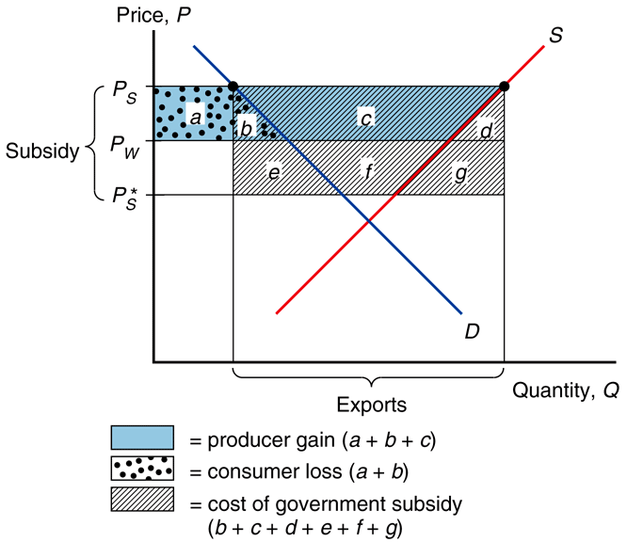
Welfare Effects of Export Subsidies
An export subsidy raises the price of the subsidized good in the exporting country, hurting consumers and benefiting producers.
Also the government loses from the subsidy payment.
What is the net effect
of the subsidy?
Fig. 9-11: Effects of
an Export Subsidy

Slide 35
Welfare Effects of Export Subsidies
Fig. 9-11: Effects of
an Export Subsidy
An export subsidy lowers the price paid in importing countries P_{S}* = P_{S} – s.
In contrast to a tariff, an export subsidy worsens
the terms of trade by lowering the price of exports in world markets.

Slide 36
Welfare Effects of Export Subsidies
Fig. 9-11: Effects of
an Export Subsidy
Effects of a subsidy
consumer surplus decreases
consumers worse off
producer surplus increases
producers better off
government pays subsidy
subsidy rate x exports
s Q_{S} = (P_{S} – P_{S}*)(S₂ – D₂)

Slide 37
Welfare Effects of Export Subsidies
Fig. 9-11: Effects of
an Export Subsidy
Effects of a subsidy
consumer surplus decreases
– (a + b)
producer surplus increases
+ (a + b + c)
government pays subsidy
– (b + c + d + e + f + g)
net benefit
– b – d – e – f – g

Slide 38
Welfare Effects of Export Subsidies
Fig. 9-11: Effects of
an Export Subsidy
Effects of a subsidy
a – transfer to producers
b – production distortion loss
c – transfer to producers
d – consumption distortion loss
e/f/g – terms of trade loss
Net effect: – b – d – e – f – g
This is always negative (a loss).

Slide 39
Welfare Effects of Export Subsidies
Fig. 9-11: Effects of
an Export Subsidy
Effects of a subsidy
a – at expense of consumers
b – at expense of both
c – at expense of government
d – at expense of government
e – at expense of government
f – at expense of government
g – at expense of government

Slide 40
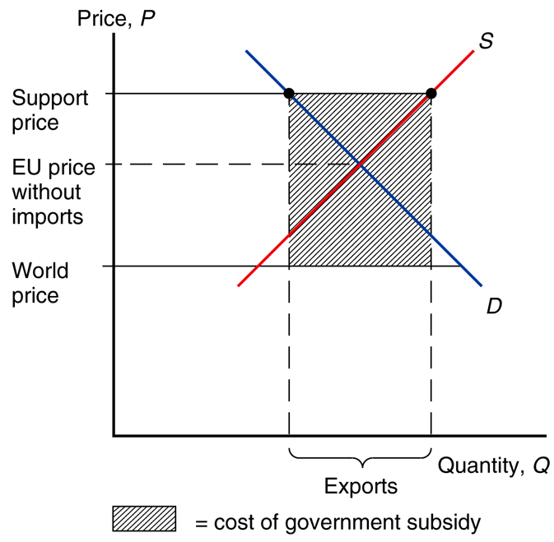
Export Subsidies in Europe
Fig. 9-12: Europe’s Common Agricultural Program
The European Union subsidizes exports of agricultural products.
This reduces world prices, costing European taxpayers $30 billion more than the benefits (in 2007).

Slide 41
Import Quotas
import quotas –
a restriction on the quantity of a good that may be imported
(enforced by issuing licenses
or quota rights)
quota rents –
extra revenue that accrues
to license holders.

Slide 42
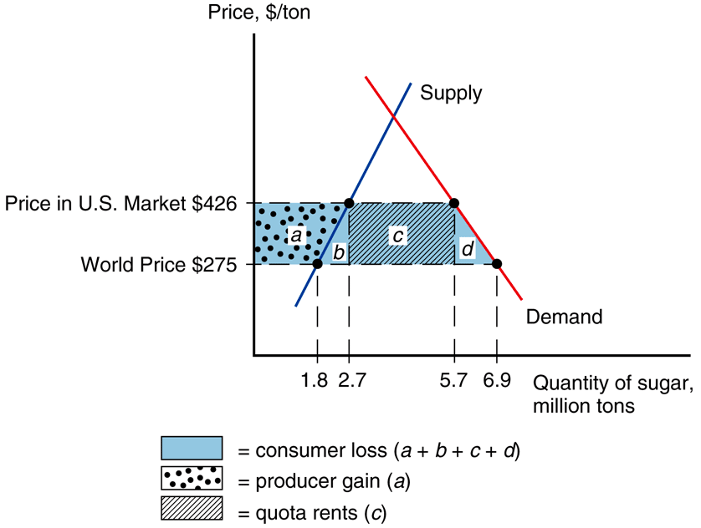
Import Quotas
Fig. 9-13: Effects of the U.S. Import Quota on Sugar
A binding import quota pushes up the price of the import because the quantity demanded exceeds the quantity supplied.

Slide 43
Import Quotas
Fig. 9-13: Effects of the U.S. Import Quota on Sugar
When a quota is used instead of a tariff,
the government
receives no revenue.
Instead, revenue accrues to license holders (through quota rents).

Slide 44
Import Quotas
Fig. 9-13: Effects of the U.S. Import Quota on Sugar
Effects of a quota
consumer surplus decreases
– (a + b + c + d)
producer surplus increases
+ a
licensees get quota rents
+ c
net benefit
– b – d

Slide 45
Voluntary Export Restraints
voluntary export restraint –
works like an import quota, except imposed by exporting rather than importing country

Slide 46
Voluntary Export Restraints
These restraints are usually requested by the importing country
(with the implicit or explicit threat of a tariff
if the exporting country doesn’t comply).

Slide 47
Voluntary Export Restraints
The profits or rents from this policy are earned by foreign governments or foreign producers.
The exporter sells licenses instead of the importer.

Slide 48
Local Content Requirement
local content requirement –
a regulation that requires a specified fraction of a final good to be produced domestically

Slide 49
Local Content Requirement
The local content requirement may be specified in value terms, by requiring that some minimum share of the value of a good represent home value added, or in physical units.

Slide 50
Local Content Requirement
Viewpoints
domestic producers
protects like import quota
firms w/ local content mandate
no strict import limit
↑(home parts) → ↑imports

Slide 51
Local Content Requirement
Local content requirement provides neither government revenue nor quota rents.
The difference between the prices of home goods and imports is averaged into the price of the final good and is passed on to consumers.

Slide 52
Other Trade Policies
Other trade policies
export credit subsidies
subsidized loan to exporters
U.S. Export-Import Bank
government procurement
buy American
bureaucratic regulations
safety, health, quality
customs

Slide 53
Summary
price up in adopting country
home producers
supply more & gain
home consumers
demand less & lose
size of home country
large
world price falls
small
world price fixed
government revenue
tariffs
increase
export subsidies
drain
import quotas
no effect
all create distortions
production loss
consumption loss

Slide 54
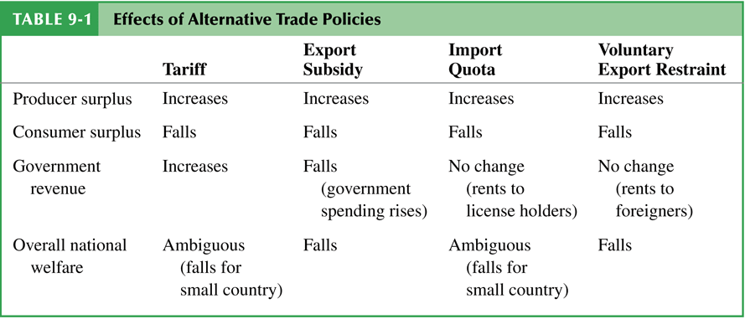
Summary

Slide 55
Effective Protection
effective rate of protection –
measures how much protection a trade policy provides;
(change in value that firms
in an industry add to
the production process
when trade policy changes, which depends on
the change in prices)

Slide 56
Terms of Trade: Import Tariffs

Slide 57
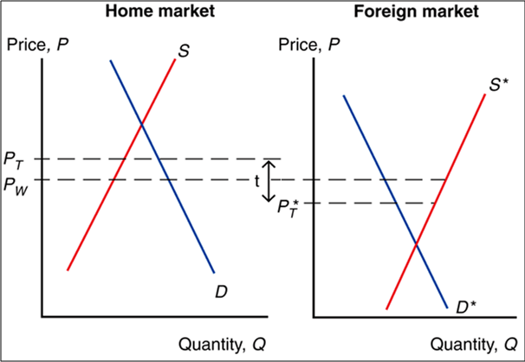
Terms of Trade: Import Tariffs
Graphs showing the cost benefit analysis of tariffs came from the home market in the world map.
Let’s look at foreign too.

Slide 58
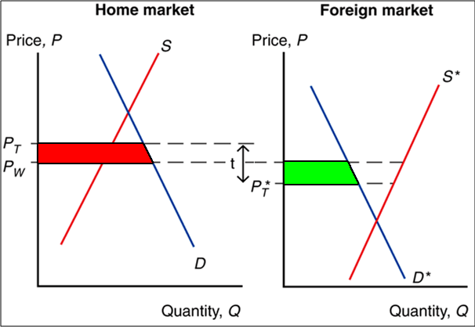
Terms of Trade: Import Tariffs
With a tariff
home consumers lose, but foreign consumers gain.

Slide 59
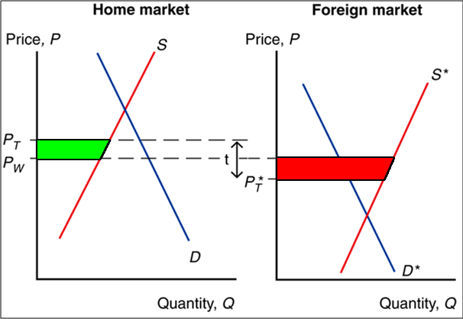
Terms of Trade: Import Tariffs
With a tariff
home producers gain, but foreign producers lose.

Slide 60
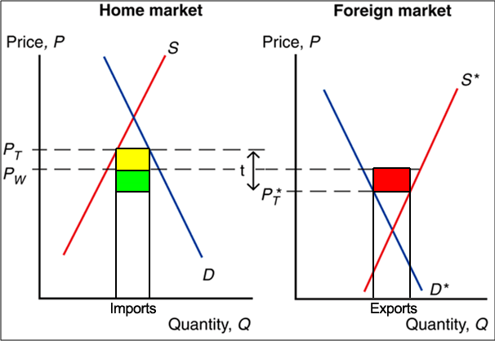
Terms of Trade: Import Tariffs
The tariff means revenue for the home government: imports x tariff
(yellow + green).

Slide 61
Terms of Trade: Import Tariffs
The yellow is a transfer from home consumers to government.
But what is green?

Slide 62
Terms of Trade: Import Tariffs
Because the price has gone down for each unit of export from foreign, foreign producers lose while home government gains.

Slide 63
Terms of Trade: Import Tariffs
This is a terms of trade gain for home (green) & a terms of trade loss for foreign (red).
Note that the red area is exactly the same size as the green area.

Slide 64
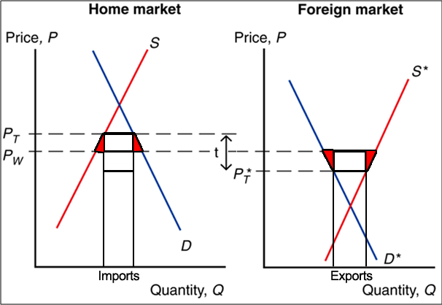
Terms of Trade: Import Tariffs
Loss to the world is the red triangles: production and consumption distortion loss in home and foreign.

Slide 65
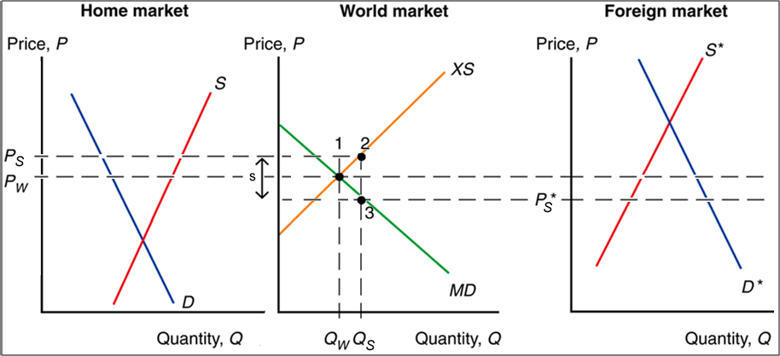
Terms of Trade: Export Subsidies

Slide 66
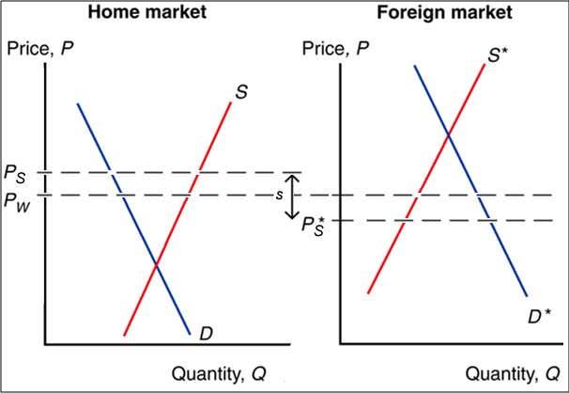
Terms of Trade: Export Subsidies
Graphs showing
the cost benefit analysis of subsidies
came from the
home market in the world map.
Let’s look at
foreign too.

Slide 67
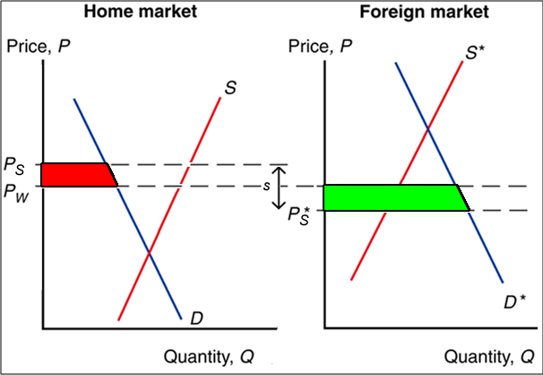
Terms of Trade: Export Subsidies
With a subsidy
home consumers lose, but foreign consumers gain.

Slide 68
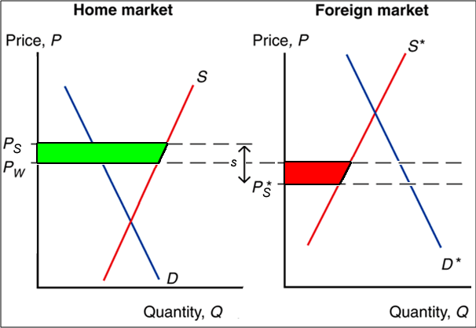
Terms of Trade: Export Subsidies
With a subsidy
home producers gain, but foreign producers lose.

Slide 69
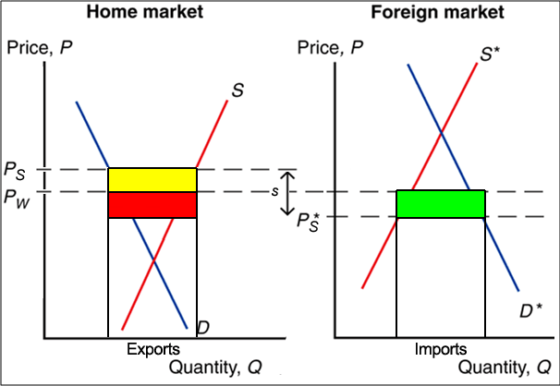
Terms of Trade: Export Subsidies
The subsidy means a cost for the home government: exports x subsidy
(yellow + red).

Slide 70
Terms of Trade: Export Subsidies
Yellow includes a transfer from home government to home producers and 2 deadweight loss triangles
(see later diagram).
But what is red?

Slide 71
Terms of Trade: Export Subsidies
Because the price has gone down for each unit of import from foreign, foreign consumers win while home government loses.

Slide 72
Terms of Trade: Export Subsidies
This is a terms of trade loss for home (red) & a terms of trade gain for foreign (green).
Note that the red area is exactly the same size as the green area.

Slide 73
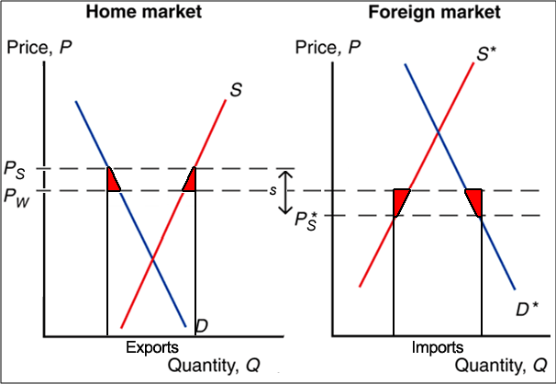
Terms of Trade: Export Subsidies
Loss to the world is the red triangles: production and consumption distortion loss in home and foreign.

Slide 74
Terms of Trade: Export Subsidies
Here the red triangles from before are colored orange to see where they fit in.

Slide 75
Terms of Trade: Export Subsidies
In home the yellow is a transfer from government to producers.

Slide 76
Terms of Trade: Export Subsidies
The orange in home is a loss because too much is produced & too little is consumed at the higher price.

Slide 77
Terms of Trade: Export Subsidies
The orange in foreign is a loss because too little is produced & too much is consumed at the lower price.

