Slide 1
Unit 2: Trade Policy
Sweatshops / Child Labor
2/20/2012

Slide 2
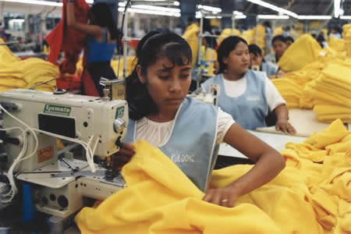
Sweatshops
Although sweatshops intuitively appear bad, unfair, and immoral to those of us accustomed
to much higher wages
and appreciably better working conditions, these workers don’t actually have that option.

Slide 3
Sweatshops
Invariably the next best alternative to working at a sweatshop in developing (3rd world) countries is something much worse
(lower wages, harsher conditions, or both).

Slide 4
Sweatshops
For example, many of the workers who moved to cities or towns to work in sweatshops previously were laborers on tiny farms with even longer hours for lower (often subsistence) wages.

Slide 5
Sweatshops
Fallacy of seen & unseen
sweatshop conditions
highly visible
caused by buyers
next best alternative
less obvious
unrelated to buyers

Slide 6
Sweatshops
Next best alternative
subsistence farming
scavenging for trash
prostitution
etc.

Slide 7
Sweatshops
Workers voluntarily choose to work at sweatshops.
They do so to maximize
their welfare given the choices available to them.

Slide 8
Sweatshops
Similarly the choice of children often is not between labor and school.
Instead it can be between child labor and starving.
Working in sweatshops is their best alternative to eat and improve their lives.

Slide 9
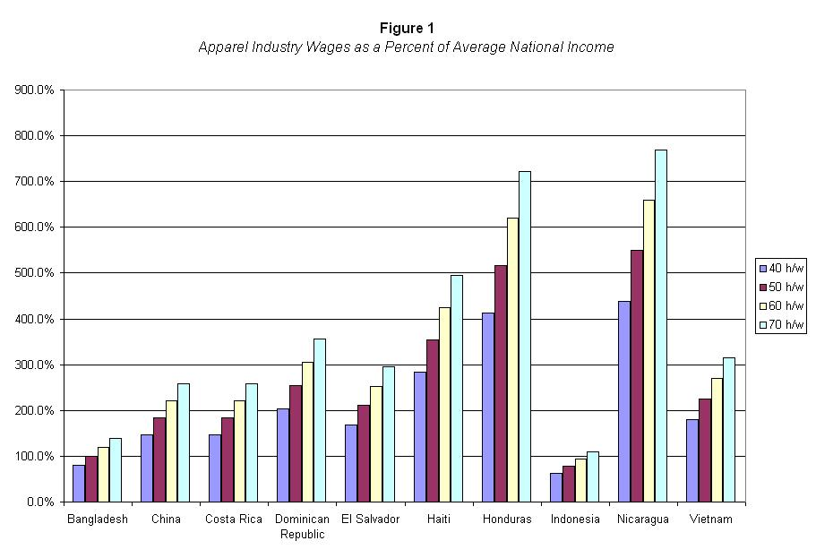
Sweatshops
Wages in the apparel industry are higher than average wages in all of the countries in this chart.
(70 hour work
week is normal)

Slide 10
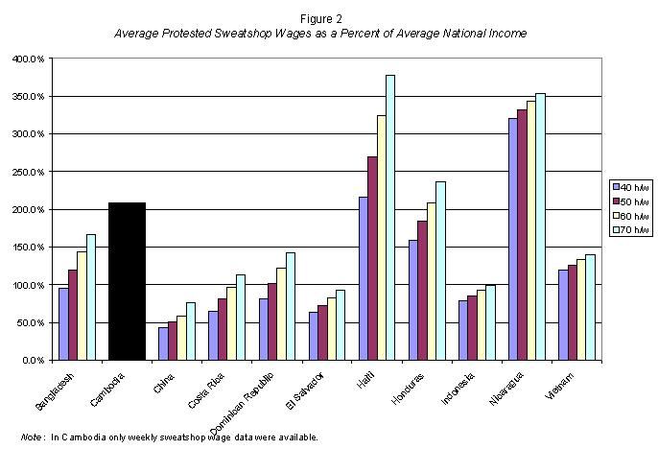
Sweatshops
In 9 of 11 countries checked, sweatshop waged exceeded average income.

Slide 11
Sweatshops
In Cambodia, Haiti, Nicaragua, and Honduras, wages paid by sweatshops are > double average income.

Slide 12
Sweatshops
The maximum each worker is paid is his productivity
(otherwise the company would be taking a loss on each worker hired).

Slide 13
Sweatshops
The minimum each
worker is paid is his
next best alternative
(otherwise the worker would take a different job).

Slide 14
Sweatshops
w_{alt} < w < P_{g}MPL_{g}
w_{alt} ≡ best alternative wage
w ≡ sweatshop wage
P_{g} ≡ sweatshop good price
MPL_{g} ≡ marginal product

Slide 15
Sweatshops
Wages are low in the third world because productivity is low.
Insisting on wages above productivity (so-called “fair wages”) makes workers unemployable.

Slide 16
Sweatshops
Sweatshop owners are indifferent between providing wages to workers and providing benefits of the same value.

Slide 17
Sweatshops
Possible benefits
health
safety
comfort
longer breaks
fewer working hours

Slide 18
Sweatshops
Comfort and safety is a normal good, which
means as income goes
up workers demand more.
Because their wages are low, workers demand most of their compensation in wages instead of benefits.

Slide 19
Sweatshops
When sweatshop owners are forced to provide better working conditions (by outside lobbying) they must lower wages.
This makes workers worse off because they would have preferred the wages.

Slide 20
Sweatshops
Anti-sweatshop movement
unions
student groups
politicians
celebrities
religious groups
(all in first world countries like the United States).

Slide 21
Sweatshops
Violating labor standards determines whether a factory is a sweatshop.
Labor standards
no child labor
minimum wages
occupational safety
maximum hours

Slide 22
Sweatshops
Some of anti-sweatshop groups want to prohibit imports from sweatshops.
While their intentions may be good, anti-sweatshop activists do not understand
basic economics.

Slide 23
Sweatshops
Boycotts and import bans reduce demand for the product, which reduces demand for workers.
This also cuts wages by lowering the product price.

Slide 24
Sweatshops
Boycotting sweatshop goods thus hurts the “exploited” workers.
“Someone who intentionally gets you fired is not your friend.”
– David Henderson

Slide 25
Sweatshops
Minimum wages or mandated benefits raise compensation – potentially above productivity.
Employers will respond by laying off workers.
To afford benefit mandates they will cut wages.

Slide 26
Sweatshops
In 1993 Senator Tom Harkin proposed banning imports from countries had child labor in sweatshops.
In response a factory in Bangladesh laid of 50,000 workers, many of whom became prostitutes.

Slide 27
Sweatshops
Shutting down sweatshops is not the best way to lift workers out of poverty.
The best way to lift sweatshop workers out
of poverty is for countries
to fix their institutions to respect private property and the rule of law.

Slide 28
Sweatshops
Good institutions encourage entrepreneurs to invest in more factories.
More sweatshops and other opportunities will bid up wages. Experience increases workers’ productivity.

