Slide 1
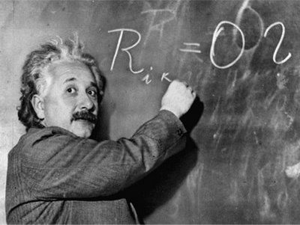
Unit 1: Trade Theory
Internal Economies of Scale
2/10/2012

Slide 2
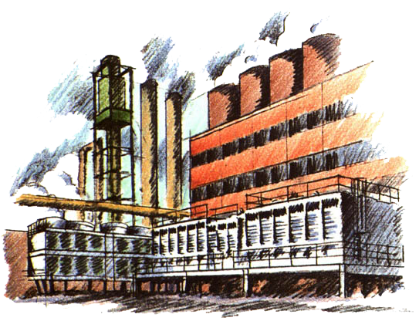
Definitions
internal economies of scale –
cost per unit of output
depends on the size of a firm
(a firm’s average cost
decreases with more output)

Slide 3
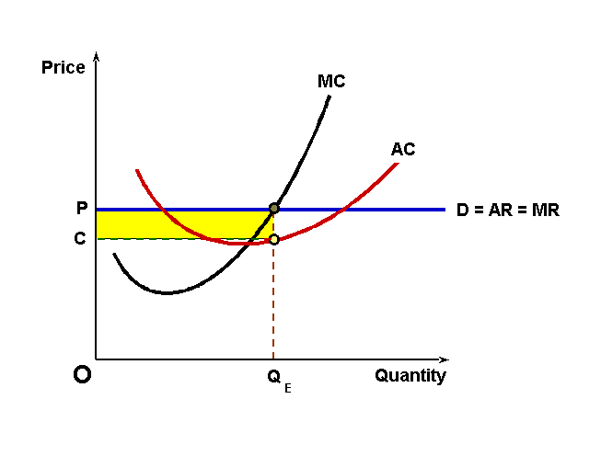
Definitions
perfect competition –
firms are price takers;
firms face horizontal
demand curves

Slide 4
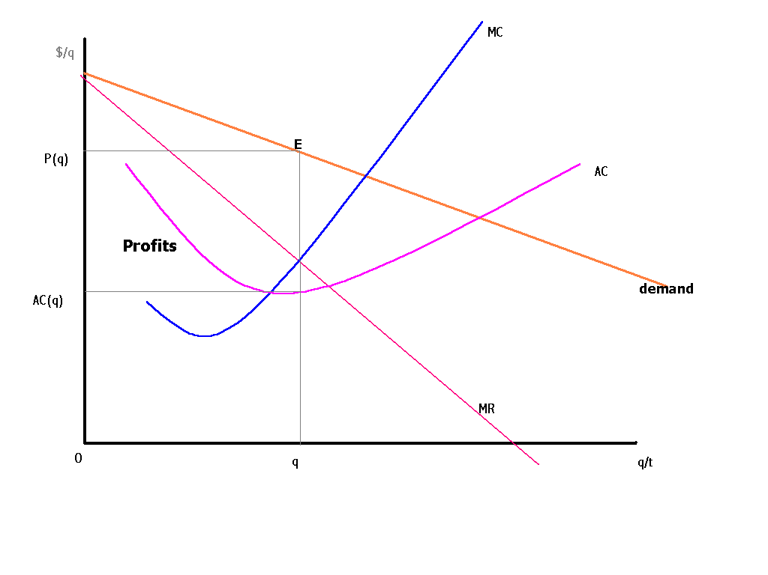
Definitions
imperfect competition –
firms are price setters;
firms face downward
sloping demand curves

Slide 5
Definitions
pure monopoly –
industry with only 1 firm
oligopoly –
industry with only a few firms

Slide 6
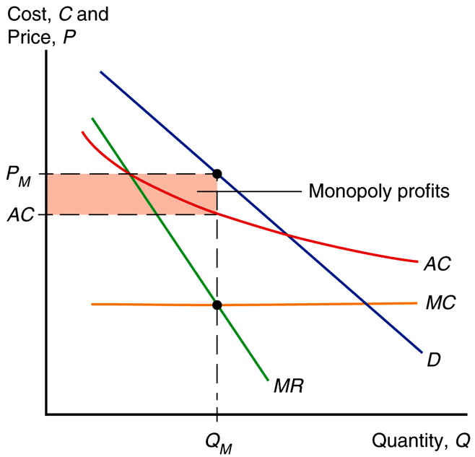
Definitions
Definitions
marginal revenue –
revenue from producing an
additional unit of output
marginal cost –
cost of producing an
additional unit of output

Slide 7
Krugman
Krugman (the textbook author) won the Nobel prize in economics for showing trade is caused not only by comparative advantages, but also by external and internal economies of scale.

Slide 8
Internal Economies of Scale
Internal economies of scale result when large firms have a cost advantage over small firms
(a firm’s average cost decreases the more output it produces).

Slide 9
Internal Economies of Scale
Unlike perfect competition,
goods are differentiated from
each other and there are other differences across firms.
Integration causes the better-performing firms to thrive and expand, while the worse-performing firms contract.

Slide 10
Internal Economies of Scale
This is an additional source
of gains from trade:
As production is concentrated toward better-performing firms (larger firms with lower AC),
the overall efficiency of the industry improves.
(a.k.a., Smithean)

Slide 11
Internal Economies of Scale
In imperfect competition, firms are aware that they can influence the prices of their products and that they can sell more only by reducing their price (they are price setters).
Thus there are only a few producers or goods are differentiated
(rather than homogenous).

Slide 12
Monopoly Review
pure monopoly –
industry with only 1 firm
oligopoly –
industry with only a few firms

Slide 13
Monopoly Review
"Now let me state the present rules,"
The lawyer then went on,
"These very simple guidelines,
You can rely upon:
You're gouging on your prices if
You charge more than the rest.
But it's unfair competition if
You think you can charge less!
A second point that we would make
To help avoid confusion...
Don't try to charge the same amount,
That would be Collusion!
You must compete. But not too much,
For if you do you see,
Then the market would be yours -
And that's Monopoly!"
- R.W. Grant

Slide 14
Monopoly Review
Fig. 8-1: Monopolistic Pricing
and Production Decisions
In imperfectly competitive industries, marginal revenue is less than price (to sell more, a firm must lower the price of all units, not just additional ones).
Therefore the MR curve
lies below the D curve.

Slide 15
Monopoly Review
Fig. 8-1: Monopolistic Pricing
and Production Decisions
marginal revenue –
revenue from producing an
additional unit of output
marginal cost –
cost of producing an
additional unit of output

Slide 16
Monopoly Review
Fig. 8-1: Monopolistic Pricing
and Production Decisions
Demand
Q = A – BP
Q ≡ units produced
P ≡ price per unit
A & B ≡ constants

Slide 17
Monopoly Review
Fig. 8-1: Monopolistic Pricing
and Production Decisions
Marginal Revenue
MR = P – Q/B
MR ≡ marginal revenue
Q ≡ units produced
P ≡ price per unit
B ≡ constant

Slide 18
Monopoly Review
Fig. 8-1: Monopolistic Pricing
and Production Decisions
Total Cost
C = F + cQ
C ≡ total costs
F ≡ fixed costs
c ≡ marginal cost per unit
Q ≡ units produced

Slide 19
Monopoly Review
Fig. 8-1: Monopolistic Pricing
and Production Decisions
Average Cost
AC = C/Q = F/Q + c
AC ≡ average costs
C ≡ total costs
F ≡ fixed costs
c ≡ marginal cost per unit
Q ≡ units produced

Slide 20
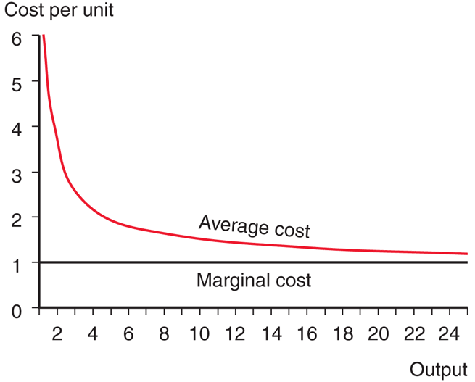
Monopoly Review
Fig. 8-2: Average Versus Marginal Cost
Larger firms are more
efficient because average
cost falls as output rises
(internal economies of scale).

Slide 21
Monopoly Review
Fig. 8-1: Monopolistic Pricing
and Production Decisions
Profit is maximized when marginal revenue = marginal cost.
At the intersection of the MC and MR curves, the revenue gained from selling an extra unit equals the cost of producing that unit.
Monopoly profits are earned (shaded box) because P > AC.

Slide 22
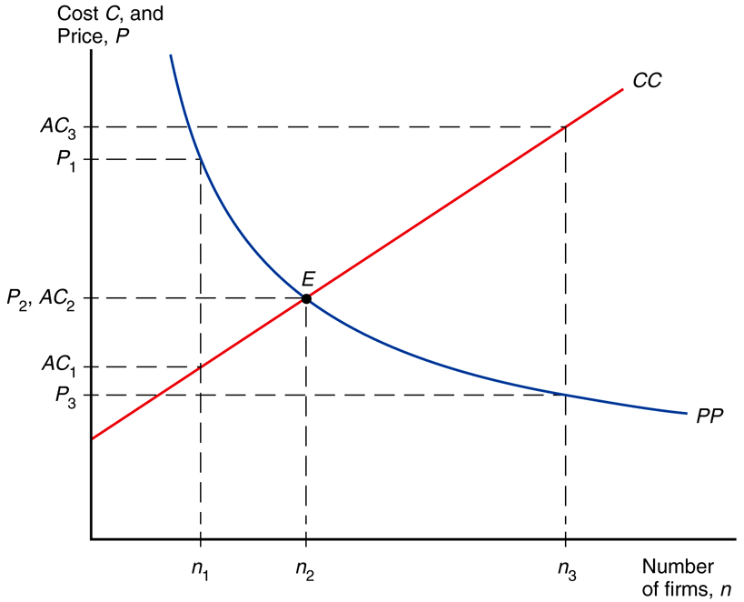
Monopolistic Competition
Fig. 8-3: Equilibrium in a Monopolistically Competitive Market
Monopolistic competition is a simple model of an imperfectly competitive industry.
Assumptions
Firms differentiate their products from competitors.
Firms take prices charged by rivals as given.

Slide 23
Monopolistic Competition
Fig. 8-3: Equilibrium in a Monopolistically Competitive Market
Firm sales are positively related to industry sales, competitors’ price;
firm sales are negatively related to the number of firms and the firm’s price.
S↑ → Q↑, P_{C}↑ → Q↑,
n↑ → Q↓, P↑ → Q↓

Slide 24
Monopolistic Competition
Fig. 8-3: Equilibrium in a Monopolistically Competitive Market
Model
Q = S[1/n – b(P – P_{C})]
Q ≡ firm units sold
S ≡ total sales by the industry
n ≡ # of firms in the industry
b ≡ sales/price responsiveness
P ≡ price charged by firm
P_{C} ≡ competitors’ price

Slide 25
Monopolistic Competition
Fig. 8-3: Equilibrium in a Monopolistically Competitive Market
Assume that firms are symmetric: all firms face the same demand function and have the same cost function.
All firms should charge the same price and have equal share of the market Q = S/n

Slide 26
Monopolistic Competition
Fig. 8-3: Equilibrium in a Monopolistically Competitive Market
Average Costs
AC = C/Q = F/Q + c
AC = F/(S/n) + c
AC = n(F/S) + c
Average costs depends on the size of the market and the number of firms.

Slide 27
Monopolistic Competition
AC = n(F/S) + c
As # of firms n increases, the AC increases for each firm because each produces less.
As total sales of the industry S increases, AC decreases for each firm because each produces more.
Fig. 8-3: Equilibrium in a Monopolistically Competitive Market

Slide 28
Monopolistic Competition
Fig. 8-3: Equilibrium in a Monopolistically Competitive Market
Demand
Q = A – BP
Q ≡ firm units sold
A ≡ constant
B ≡ constant
Assume firms face linear demand functions.

Slide 29
Monopolistic Competition
Fig. 8-3: Equilibrium in a Monopolistically Competitive Market
Demand
Q = A – BP
Q = S[1/n – b(P – P_{C})]
Q = (S/n + SbP_{C}) – SbP
Model demand function was similar to linear demand.
Rearrange to find A & B.

Slide 30
Monopolistic Competition
Fig. 8-3: Equilibrium in a Monopolistically Competitive Market
Demand
Q = A – BP
Q = (S/n + SbP_{C}) – SbP
A = S/n + SbP_{C}
B = Sb

Slide 31
Monopolistic Competition
Fig. 8-3: Equilibrium in a Monopolistically Competitive Market
Profit Maximization
MR = MC
P – Q/B = c
P – Q/(Sb) = c
When firms maximize profits, they should produce until marginal revenue equals marginal cost.

Slide 32
Monopolistic Competition
Fig. 8-3: Equilibrium in a Monopolistically Competitive Market
Profit Maximization
P – Q/(Sb) = c
P = c + Q/(Sb)
P = c + (S/n)/(Sb)
P = c + 1/(nb)
Rearrange in terms of price.
Then plugin Q = S/n.

Slide 33
Monopolistic Competition
Fig. 8-3: Equilibrium in a Monopolistically Competitive Market
Profit Maximization
P = c + 1/(nb)
As the # of firms increases, the price that each firm charges decreases because of increased competition.

Slide 34
Monopolistic Competition
Fig. 8-3: Equilibrium in a Monopolistically Competitive Market
Equilibrium # of firms
AC = P
If AC > P, firms will leave
firms take losses
If AC < P, firms will enter
firms make profits
If AC = P, equilibrium
firms break even

Slide 35
Monopolistic Competition
Equilibrium # of firms
AC = P
n(F/S) + c = c + 1/(nb)
The price that firms charge P decreases as n rises; the average cost that firms pay increases as n rises.
(See graph on left.)
Fig. 8-3: Equilibrium in a Monopolistically Competitive Market

Slide 36
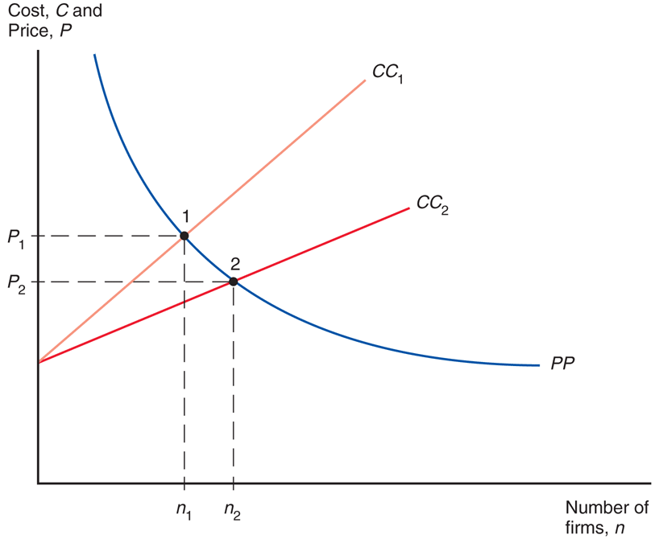
Trade w/ Monopolistic Comp.
Fig. 8-4: Effects of a Larger Market
Because trade increases market size, trade decreases average cost in an industry monopolistically competitive.
Industry sales increase with trade (S↑ → AC↓).
AC = n(F/S) + c

Slide 37
Trade w/ Monopolistic Comp.
Fig. 8-4: Effects of a Larger Market
Trade increases consumer welfare in two ways:
The variety of goods available increases.
Price drops because average cost falls.

Slide 38
Trade w/ Monopolistic Comp.
Fig. 8-4: Effects of a Larger Market
As a result of trade, the number of firms in a new international industry is increases relative to each national market.
Integrating markets has the same effects as growth of a single country’s market.

Slide 39
Trade w/ Monopolistic Comp.
a < b < c < a + b
a ≡ # of firms in country A
b ≡ # of firms: country B
c ≡ # of firms: integrated
The new # of firms will be greater than each country’s # of firms in autarky, but less than the 2 countries’ # of firms in autarky totaled.
Fig. 8-4: Effects of a Larger Market

Slide 40
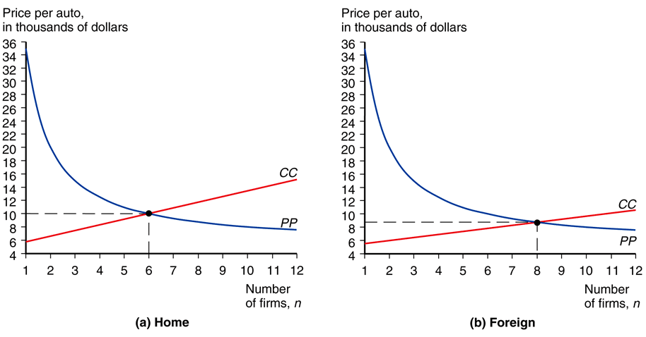
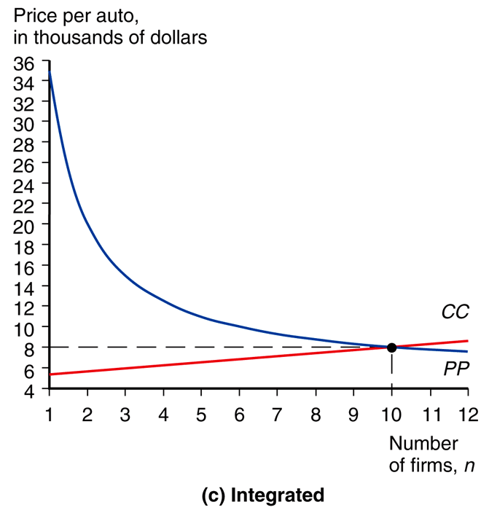
Trade w/ Monopolistic Comp.
Fig. 8-5: Equilibrium in the Automobile Market

Slide 41
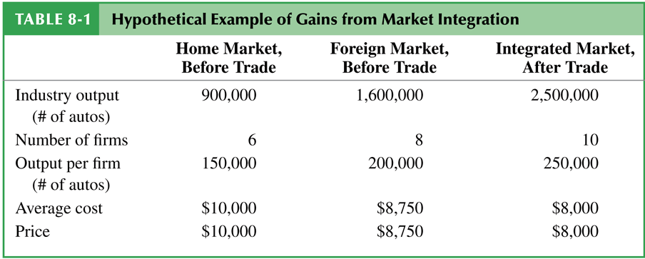
Trade w/ Monopolistic Comp.

Slide 42
Trade w/ Monopolistic Comp.
Fig. 8-4: Effects of a Larger Market
What country firms will locate in when the market is integrated cannot be determined by this model.
(Depends on other factors like comparative advantage.)

Slide 43
Trade w/ Monopolistic Comp.
Fig. 8-4: Effects of a Larger Market
Product differentiation and internal economies of scale lead to trade between similar countries with no comparative advantage differences between them.

Slide 44
Trade w/ Monopolistic Comp.
Fig. 8-4: Effects of a Larger Market
This is a very different kind of trade than the one based on comparative advantage, where each country exports its comparative advantage good because countries often will not specialize.

Slide 45
Intra-Industry Trade
intra-industry trade –
two way exchange of similar goods

Slide 46
Intra-Industry Trade
New benefits from trade
more variety at a lower price
firms consolidate production
EoS: lower AC
Small countries gain more from integration than a large countries.
(Larger variety increase, price drop.)

Slide 47
Intra-Industry Trade
25–50% of world trade is
intra-industry trade.
The lion’s share of intra-industry trade is manufactured goods among advanced industrial nations.

Slide 48
Intra-Industry Trade

Slide 49
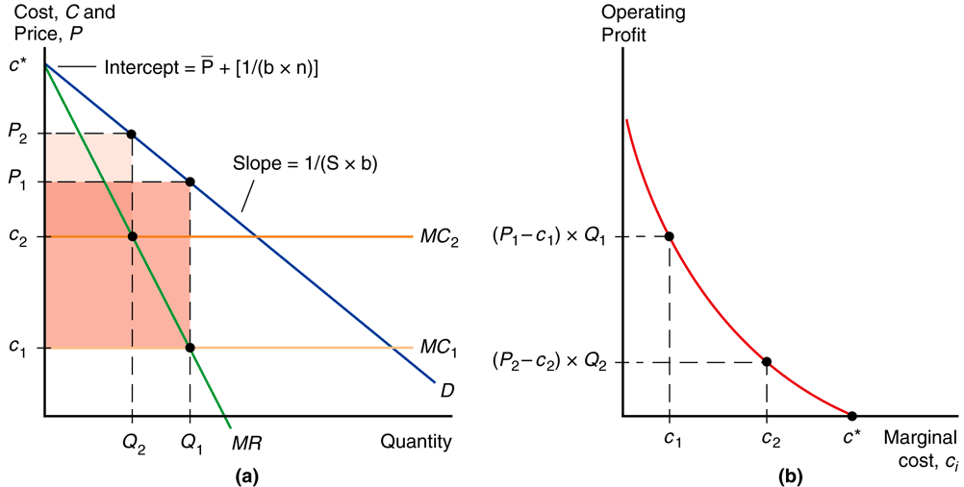
Firm Winners & Losers
Fig. 8-6: Performance Differences Across Firms
Increased competition hurts the worst-performing firms (high MC) — they are forced to exit.

Slide 50
Firm Winners & Losers
Fig. 8-6: Performance Differences Across Firms
The best-performing firms (low MC) benefit from new sales opportunities and expand the most.

Slide 51
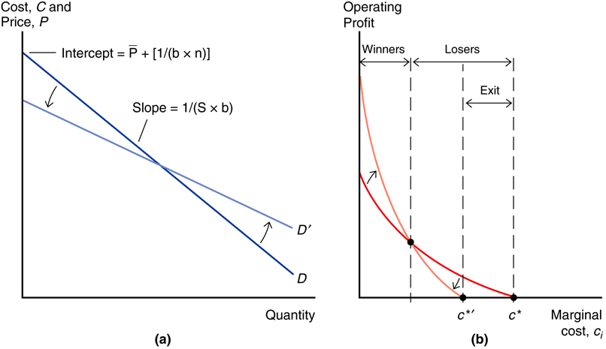
Firm Winners & Losers
Fig. 8-7: Winners and Losers
from Economic Integration
When the better firms expand and the worse ones contract or exit, overall industry performance improves.

Slide 52
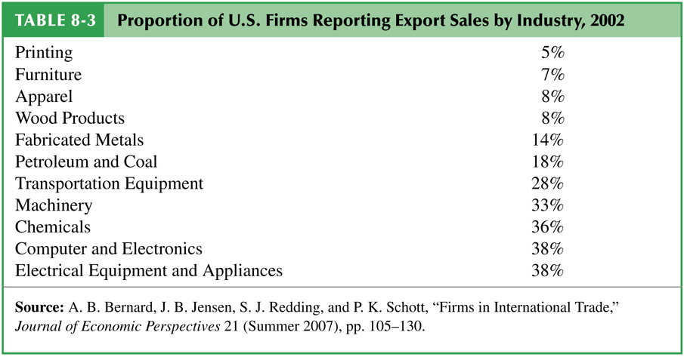
Trade Costs
Most U.S. firms don’t export – they only sell to U.S. customers.
(e.g., in 2002 only 18% of manufacturing firms in the U.S. exported).

Slide 53
Trade Costs
Even in industries that export much of what they produce (e.g., chemicals, machinery, electronics, transportation), fewer than 40% of firms export.

Slide 54
Trade Costs
Trade costs both reduce the number of firms within an industry that export and reduce the volume of exports from firms that still export.

Slide 55
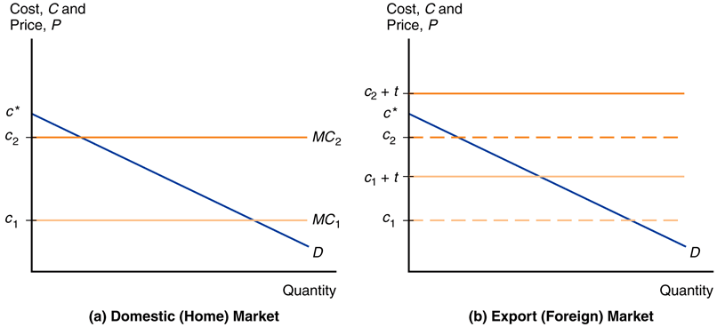
Trade Costs
Fig: 8-8: Export Decisions with Trade Costs
The graph shows that trade costs can price firms out of foreign (export) markets by pushing the cost curve above the demand curve.

Slide 56
Trade Costs
Fig: 8-8: Export Decisions with Trade Costs
Exporting firms are bigger and more productive than firms in the same industry that do not export.

Slide 57
Trade Costs
Empirical evidence is overwhelming:
U.S. exporting firms are 2x larger on average than non-exporting firms.
The disparity is even larger in Europe.
Fig: 8-8: Export Decisions with Trade Costs

Slide 58
Dumping
dumping –
setting a lower markup for
exports than domestic sales

Slide 59
Dumping
anti-dumping duty –
tax on an import equal to the difference between the actual and “fair” price
(“fair” is the price in the domestic market)

Slide 60
Dumping
Fig. 8-6: Performance Differences Across Firms
A firm with a higher MC sets a lower markup over MC.
Trade costs raise MC.
So exporting firms respond to trade costs by lowering markup for exports.
Fig: 8-8: Export Decisions with Trade Costs

Slide 61
Dumping
Fig. 8-6: Performance Differences Across Firms
Fig: 8-8: Export Decisions with Trade Costs
But this is considered dumping, regarded as an “unfair” trade practice by countries.
Dumping is a profit-maximizing strategy, but it is illegal.

Slide 62
Dumping
A U.S. firm may ask the Commerce Department to investigate if foreign firms are dumping in the U.S.
The Commerce Department may impose an anti-dumping duty to protect the U.S. firm.

Slide 63
Dumping
Next the International Trade Commission (ITC) determines if injury to the U.S. firm has occurred or is likely to occur.
If there is no injury, the anti-dumping duty is not imposed.

Slide 64
Dumping
Most economists believe that the enforcement of dumping claims is misguided.
Trade costs naturally induce firms to lower their markups in export markets.
Anti-dumping duties may be used excessively as an excuse for protectionism.

Slide 65
Dumping
The problematic sort of dumping is a firm selling things below its cost. This is called predatory pricing.
Dumping means consumers get goods cheaper.
Why is that a bad thing?

Slide 66
Dumping
Predatory pricing is not effective an effective strategy in the free market.
Price discrimination is difficult due to arbitrage opportunities
(like Herbert Dow buying cheap Bromide dumped in America to resell in Europe).

Slide 67
Dumping
Additionally potential entrepreneurs can wait out a predatory price setting oligopolist, let it burn through money with massive losses, then re-enter the market once the oligopolist stops.

Slide 68
Foreign Direct Investment
foreign direct investment –
investment in which a firm in one country directly controls or owns a subsidiary in another country

Slide 69
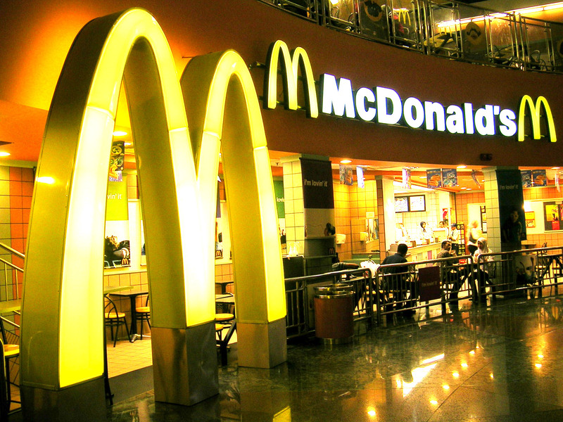
Foreign Direct Investment
multinational corporation –
a foreign company owns at least 10% of the stock of a subsidiary

Slide 70
Foreign Direct Investment
greenfield FDI –
a company builds a new production facility abroad
brownfield FDI –
a domestic firm buys a
controlling stake in
a foreign firm;
cross-border mergers & acquisitions

Slide 71
Foreign Direct Investment
Greenfield FDI has tended to be more stable, while cross-border mergers and acquisitions tend to occur in surges.

Slide 72
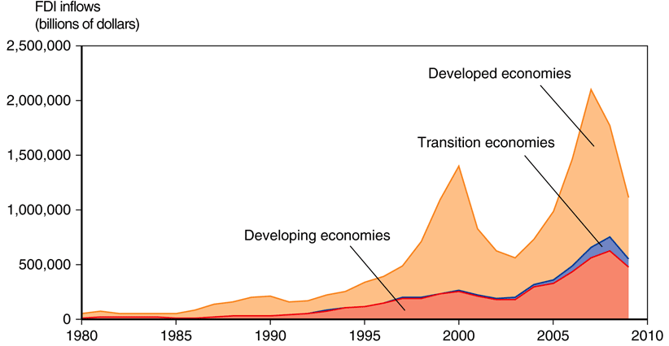
Foreign Direct Investment
Developed countries receive more FDI than developing and transition economies.
The share of FDI flowing to developing and transition countries has been steadily expanding.
Fig. 8-9: Inflows of Foreign
Direct Investment, 1980-2009

Slide 73
Foreign Direct Investment
horizontal FDI –
the affiliate replicates the
entire production process elsewhere in the world
vertical FDI –
the production chain is broken up, and parts of the production processes are transferred to the affiliate location

Slide 74
Foreign Direct Investment
Vertical FDI is mainly driven by production cost differences between countries (for those parts of the production process that can be performed in another location).

Slide 75
Foreign Direct Investment
Horizontal FDI is driven by flows between developed countries.
The main reason for this type of FDI is to locate production near a firm’s large customer bases (trade and transport costs more important than production cost differences).

Slide 76
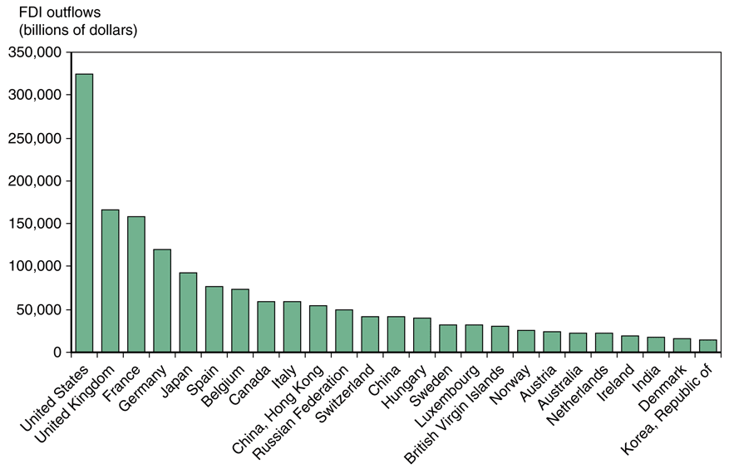
Foreign Direct Investment
Fig. 8-10: Outward Foreign Direct Investment
for Top Countries, 2007-2009

Slide 77
Foreign Direct Investment
Firms face a proximity-concentration trade-off.
High trade costs incentivize locating near customers (FDI).
Increasing returns to scale in incentivize concentration in fewer locations (exporting).

Slide 78
Foreign Direct Investment
Multinationals tend to be much larger and more productive than other firms in the same country
(even exporters) .

Slide 79
Foreign Direct Investment
The horizontal FDI decision involves a t & F trade-off.
If tQ > F, build a plant abroad.
If tQ < F, export.
t ≡ export cost per unit
F ≡ fixed cost of FDI plant
Q ≡ amount exported

Slide 80
Foreign Direct Investment
The horizontal FDI decision involves a cost savings & fixed cost trade-off.
Cost savings can come from comparative advantages like cheaper labor. If the savings from relocating a line exceeds the fixed cost of the new plant, then relocate.

Slide 81
Foreign Direct Investment
outsourcing (offshoring) –
a firm contracts with an independent firm to produce in the foreign location

Slide 82
Foreign Direct Investment
Firms face both location and internalization decisions.
location decision –
where (country) to produce?
internalization decision –
keep production in one firm,
or produce by separate firms?

Slide 83
Foreign Direct Investment
Internalization occurs when it is more profitable to conduct transactions and production within a single organization.
reasons
technology transfers
vertical integration

Slide 84
Foreign Direct Investment
Technology transfers
Transfer of knowledge or technology may be easier within a single organization.
Why?
Weak patent/property rights.
Hard to sell knowledge.

Slide 85
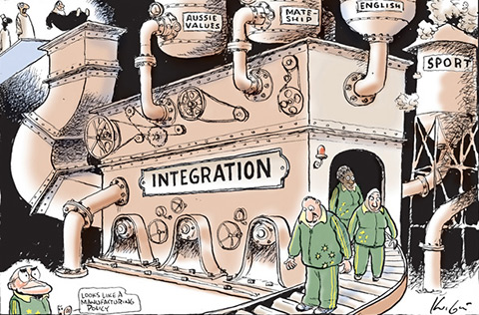
Foreign Direct Investment
vertical integration –
consolidation of different stages of a production process
Consolidating an input within a firm can avoid holdup problems.
But an independent supplier could benefit from economies of scale with many clients.

Slide 86
Foreign Direct Investment
Welfare
Relocating production (or parts of production) to take advantage of cost differences leads to overall gains from trade.

