Slide 1
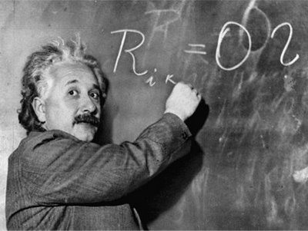
Unit 1: Trade Theory
External Economies of Scale
2/8/2012

Slide 2
Definitions
constant returns to scale –
increases in output are
proportional to increases in inputs
F(aK,aL) = aF(K,L)

Slide 3
Definitions
increasing returns to scale
(economies of scale) –
increases in output are more than
proportional to increases in inputs
F(aK,aL) > aF(K,L)

Slide 4
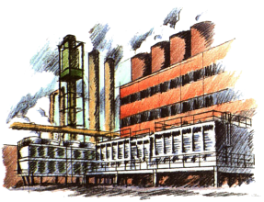
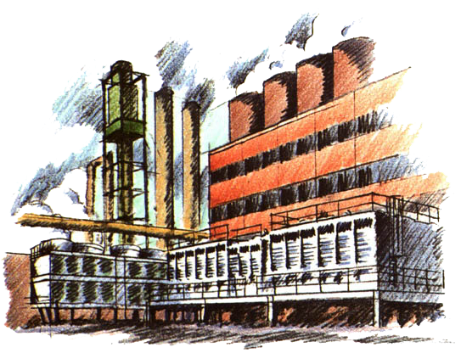
Definitions
external economies of scale –
cost per unit of output depends on the size of the industry
internal economies of scale –
cost per unit of output depends on the size of a firm

Slide 5
Definitions
specialized suppliers –
a single firm would not be a large enough market to support specialized equipment or support services, but an entire industry concentrated in one location is large enough

Slide 6
Definitions
labor pooling –
a large and concentrated industry may attract a pool
of workers, reducing
employee search and hiring costs for each firm

Slide 7
Definitions
knowledge spillovers –
workers from different firms may more easily share ideas that benefit each firm when a large and concentrated industry exists

Slide 8
Definitions
Fig. 7-1: External Economies and Market Equilibrium
forward-falling (downward
sloping) supply curve –
average cost of production falls
as industry output rises

Slide 9
Definitions
dynamic increasing returns to scale
(dynamic economies of scale) –
average costs fall as cumulative
output over time rises
compare with:
increasing returns to scale
(economies of scale) –
average costs fall as current output rises

Slide 10
Definitions
infant industry argument –
temporary protection of industries allows them to gain experience and thus economies of scale

Slide 11
Definitions
economic geography –
the study of international trade, interregional trade and the organization of economic activity in metropolitan and rural areas

Slide 12
Returns to Scale
Previous models (Ricardian, specific factors, Heckscher-Ohlin, & standard trade) assumed constant returns to scale.
The next two models assume increasing returns to scale (economies of scale).

Slide 13
Definitions
increasing returns to scale
(economies of scale) –
increases in output are more than
proportional to increases in inputs
F(aK,aL) > aF(K,L)

Slide 14
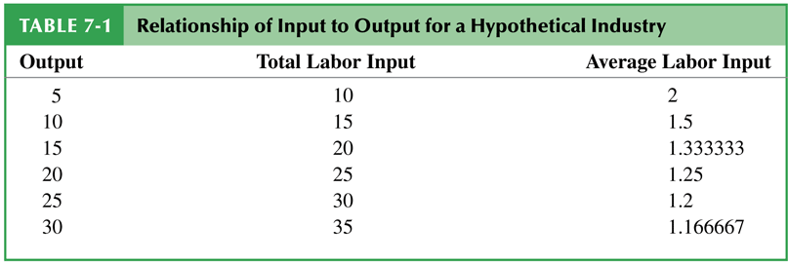
Returns to Scale
The above example shows increasing returns to scale (doubling inputs more than doubles output).
Notice also that average amount of labor to produce each unit of output falls as output rises (more efficient).

Slide 15
Returns to Scale
Mutually beneficial trade can arise as a result of economies of scale.
International trade permits each country to produce a limited range of goods (taking advantage of economies of scale to produce more efficiently) without sacrificing variety in consumption.

Slide 16
Definitions
external economies of scale –
cost per unit of output depends on the size of the industry
internal economies of scale –
cost per unit of output depends on the size of a firm

Slide 17
Returns to Scale
External & internal economies of scale are important causes of international trade.
External EoS will typically consist of many perfectly competitive small firms.
Internal EoS will typically consist of imperfectly competitive large firms.
This lecture (ch. 7) deals with external;
the next lecture (ch. 8) deals with internal.

Slide 18
External EoS: Theory
External EoS examples
Silicon Valley, CA, USA
semiconductors
Hollywood, CA, USA
entertainment
New York City, NY, USA
investment banking
Qiaotou, China
buttons

Slide 19
External EoS: Theory
Reasons for External EoS
specialized suppliers
labor market pooling
knowledge spillovers

Slide 20
Definitions
specialized suppliers –
a single firm would not be a large enough market to support specialized equipment or support services, but an entire industry concentrated in one location is large enough

Slide 21
Definitions
labor pooling –
a large and concentrated industry may attract a pool
of workers, reducing
employee search and hiring costs for each firm

Slide 22
Definitions
knowledge spillovers –
workers from different firms may more easily share ideas that benefit each firm when a large and concentrated industry exists

Slide 23
Definitions
Fig. 7-1: External Economies and Market Equilibrium
forward-falling (downward
sloping) supply curve –
average cost of production falls
as industry output rises

Slide 24
External EoS: Theory
Fig. 7-1: External Economies and Market Equilibrium
External economies of scale can be represented by assuming the larger the industry, the lower the industry’s cost. This means average cost (AC) is declining.
Because the supply curve is AC, the supply curve is forward-falling (downward sloping).

Slide 25
External EoS: International Trade
Before international trade equilibrium prices and output for each country are at the intersection of domestic supply and domestic demand.
Here China has a lower price for butons.
Fig. 7-2: External Economies Before Trade

Slide 26
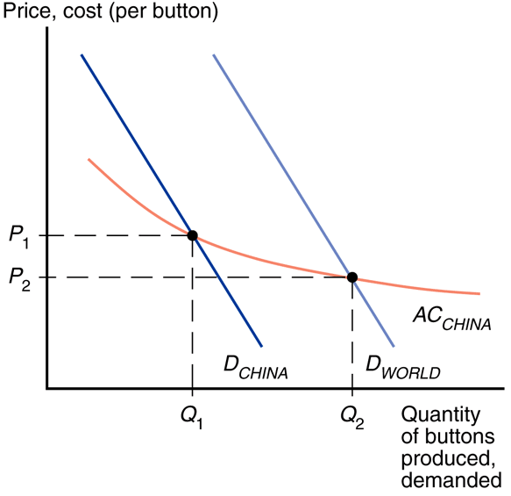
External EoS: International Trade
After trade the Chinese button industry will expand and the U.S. button industry will contract (China’s button prices are lower).
As China’s button industry expands, its costs fall & its button prices fall;
As U.S.’s button industry contracts, its costs rise & its button prices rise.
China gets all button production.
Fig. 7-3: Trade and Prices

Slide 27
External EoS: International Trade
Fig. 7-3: Trade and Prices
Before trade Chinese button prices were lower than U.S. button prices.
Because China’s supply curve is slopes down, increased production leads to an even lower price.
Trade leads to prices that are lower than either country’s autarky prices!

Slide 28
External EoS: International Trade
Fig. 7-3: Trade and Prices
In the standard trade model relative prices converge: the effect of trade is to raise prices in the relatively cheap country and reduce them in the relatively expensive country.
With external economies of scale trade reduces prices everywhere!

Slide 29
External EoS: International Trade
What causes initial price advantages?
comparative advantage
differences in technology & resources
historical accidents
start as large producers

Slide 30
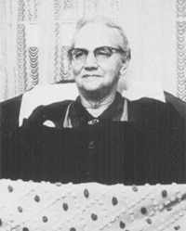
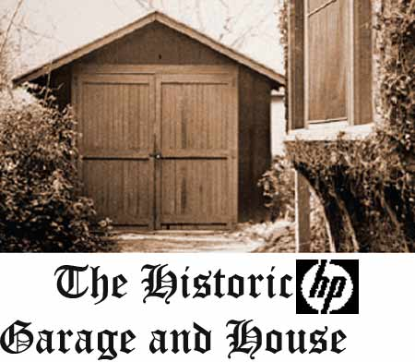
External EoS: International Trade
Historical Accidents
A tufted blanket wedding gift by a 19th-century teenager gave rise to the cluster of carpet manufacturers around Dalton, Georgia.
Silicon Valley may owe its existence to two Stanford graduates named Hewlett and Packard who started a business in a garage there.

Slide 31
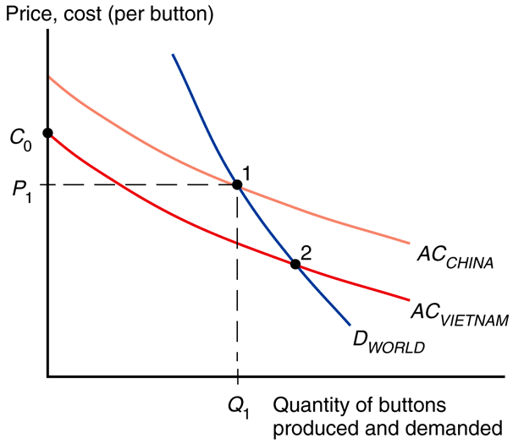
External EoS: International Trade
Fig. 7-4: The Importance of Established Advantage
There is no guarantee that the right country will produce a good that is subject to external economies.
Consider this example:
Vietnam’s AC curve is below China’s AC curve (perhaps due to lower wages in Vietnam).

Slide 32
External EoS: International Trade
Fig. 7-4: The Importance of Established Advantage
At any given level of production, Vietnam could manufacture buttons more cheaply than China.
Does this mean Vietnam will supply the world market?
Not necessarily if China has enough of a head start!

Slide 33
External EoS: International Trade
Fig. 7-4: The Importance of Established Advantage
China produces at point 1.
If Vietnam won the industry, it could produce at point 2.
But when Vietnam starts it will produce at C₀ (at a price above P₁), so Vietnam can’t takeover the world market.

Slide 34
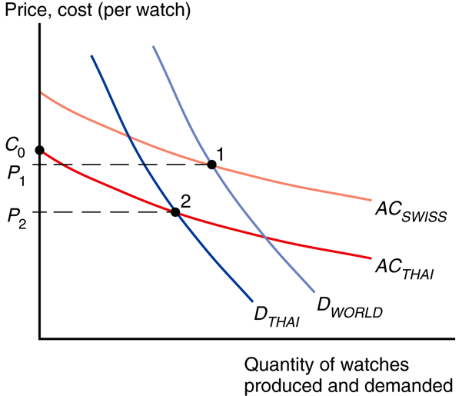
External EoS: International Trade
Fig. 7-5: External Economies
and Losses from Trade
There will be gains to the world economy by concentrating production of industries with external economies
But with external economies of scale it is theoretically possible for a country to be better of in autarky than with trade.

Slide 35
External EoS: International Trade
Here Thailand could make watches more cheaply, but Switzerland got there first.
The price of watches could be lower in Thailand with no trade.
In practice it is very hard to ex ante identify industries that would have a lower cost than the world’s if trade were blocked.
Fig. 7-5: External Economies
and Losses from Trade

Slide 36
External EoS: International Trade
Fig. 7-5: External Economies
and Losses from Trade
Even though autarky can increase a country’s welfare, it’s still to the benefit of the world to take advantage of the gains from concentrating industries.
Each industry with external economies should be concentrated somewhere.

Slide 37
Definitions
dynamic increasing returns to scale
(dynamic economies of scale) –
average costs fall as cumulative
output over time rises
increasing returns to scale
(economies of scale) –
average costs fall as current output rises

Slide 38
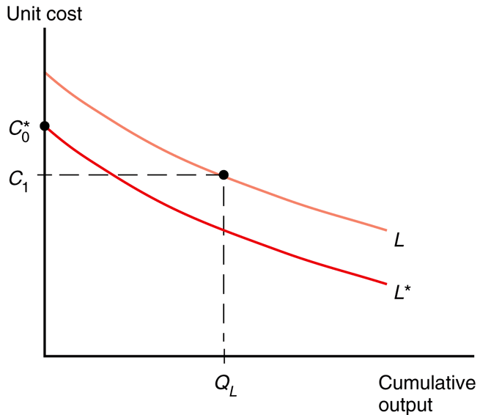
Dynamic Increasing Returns
Fig. 7-6: The Learning Curve
Dynamic increasing returns to scale can arise if production cost depends on the accumulation of knowledge and experience.
The learning curve is a graphical representation of dynamic increasing returns to scale.

Slide 39
Definitions
infant industry argument –
temporary protection of industries allows them to gain experience and thus economies of scale

Slide 40
Dynamic Increasing Returns
Fig. 7-6: The Learning Curve
Like external economies of scale, dynamic increasing returns to scale can lock in an initial advantage in an industry.
This can be used to justify protectionism through the
infant industry argument.

Slide 41
Dynamic Increasing Returns
Fig. 7-6: The Learning Curve
The infant industry argument leads to over-protectionism.
“Temporary” protection often persists for many, many years.
It is hard to identify ex ante when (dynamic) external economies of scale really exist.

Slide 42
Economic Geography
External economies may be important for interregional trade within a country.
For example: entertainment in Hollywood, financial firms in New York City, etc.

Slide 43
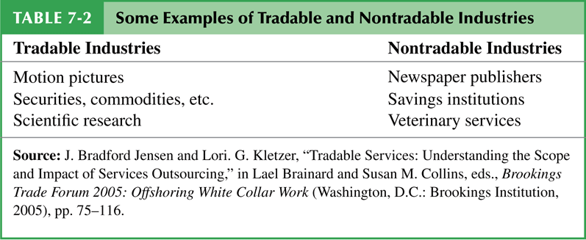
Economic Geography
Some nontradable goods like newspapers and haircuts must be supplied locally.
If external economies exist, the pattern of trade may be due to historical accidents

Slide 44
Definitions
economic geography –
the study of international trade, interregional trade and the organization of economic activity in metropolitan and rural areas

