Slide 1
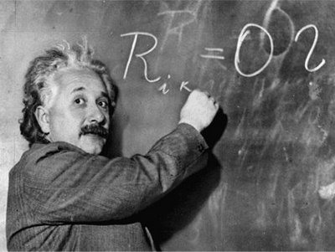
Unit 1: Trade Theory
Heckscher-Ohlin Model
2/3/2012

Slide 2
Heckscher-Ohlin Model
Trade occurs due to differences in resources.
Countries have different relative abundance of
factors of production.
Production processes use factors of production with different relative intensity.

Slide 3
Heckscher-Ohlin: assumptions
2 countries: home & foreign.
2 goods: cloth & food.
2 factors of production: labor & capital.
Mix of labor and capital used varies across goods.
Supply of labor and capital:
constant in each country
varies across countries
Both labor and capital are mobile factors (long run).
equalize returns (wage & rental rate) across sectors

Slide 4
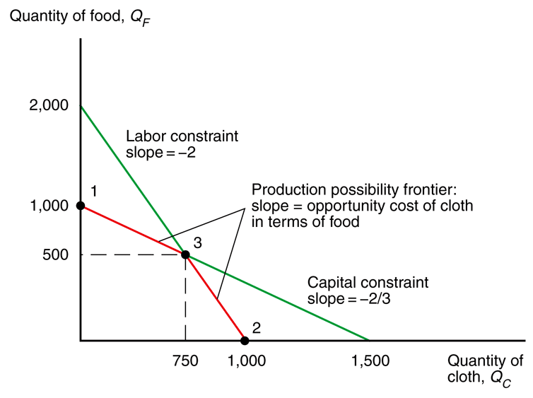
Heckscher-Ohlin: production
Fig. 5-1: The Production Possibility Frontier Without Factor Substitution
with more than 1 factor
OC no longer constant
PPF no longer straight line
Why?
PPF subject to 2 constraints:
capital and labor

Slide 5
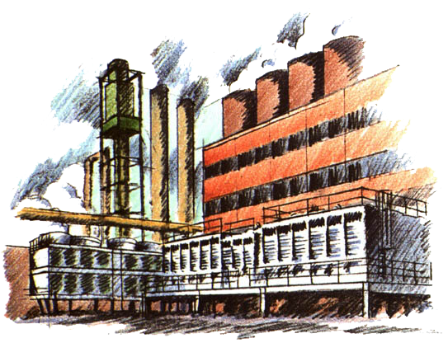
Ricardian Model: unit labor
unit capital requirement –
number of units of capital required to produce a unit of product
a_{KC} ≡ unit capital requirement for cloth
a_{KF} ≡ unit capital requirement for food
a_{LC} ≡ unit labor requirement for cloth
a_{LF} ≡ unit labor requirement for food

Slide 6
Heckscher-Ohlin: production
Fig. 5-1: The Production Possibility Frontier Without Factor Substitution
a_{KC}Q_{C} + a_{KF}Q_{F} ≤ K
a_{LC}Q_{C} + a_{LF}Q_{F} ≤ L
Q_{C} ≡ output of cloth
Q_{F} ≡ output of food
K ≡ capital stock
L ≡ labor stock

Slide 7
Heckscher-Ohlin: production
Fig. 5-1: The Production Possibility Frontier Without Factor Substitution
The production possibilities frontier is subject to both constraints (capital & labor).
Without factor substitution, the PPF is the interior of the two factor constraints.

Slide 8
Heckscher-Ohlin: production
Fig. 5-1: The Production Possibility Frontier Without Factor Substitution
Max food (point 1) fully uses capital with excess labor.
Max cloth (point 2) fully uses labor with excess capital.
Intersection of labor and capital constraints (point 3) fully uses capital and labor.

Slide 9
Heckscher-Ohlin: production
Fig. 5-1: The Production Possibility Frontier Without Factor Substitution
This example has 2 opportunity costs:
low OC (2/3) when the PPF
is on the capital constraint with low cloth / high food
high OC (2) when the PPF
is on the labor constraint
with high cloth / low food

Slide 10
Heckscher-Ohlin: production
Fig. 5-1: The Production Possibility Frontier Without Factor Substitution
a_{KC}Q_{C} + a_{KF}Q_{F} ≤ K
a_{LC}Q_{C} + a_{LF}Q_{F} ≤ L
PPF equations don’t allow for factor substitution
(unit factor requirements are constant on constraints).

Slide 11
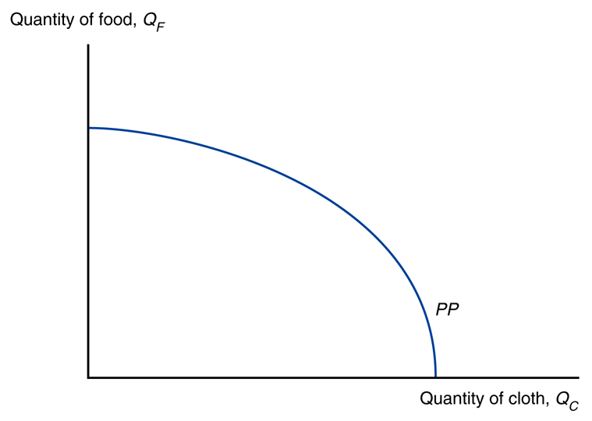
Heckscher-Ohlin: production
Fig. 5-2: The Production Possibility Frontier with Factor Substitution
Allowing factor substitution leads to a curved PPF.
Opportunity cost increases continuously as producers make more cloth.

Slide 12
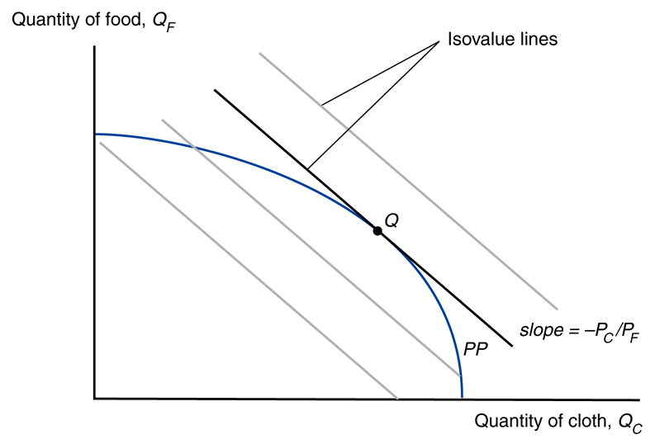
Heckscher-Ohlin: production
Economy produces at the point that maximizes the value of production.
This occurs where an isovalue line is tangent
to the PPF (point Q):
relative price (-P_{C}/P_{F}) =
opportunity cost
(PPF slope)
Fig. 5-3: Prices and Production

Slide 13
Heckscher-Ohlin: production
Fig. 5-3: Prices and Production
V = P_{C}Q_{C} + P_{F}Q_{F}
Q_{C} ≡ output of cloth
Q_{F} ≡ output of food
P_{C} ≡ price of cloth
P_{F} ≡ price of food
V ≡ total value
-P_{C}/P_{F} ≡ slope of isovalue

Slide 14
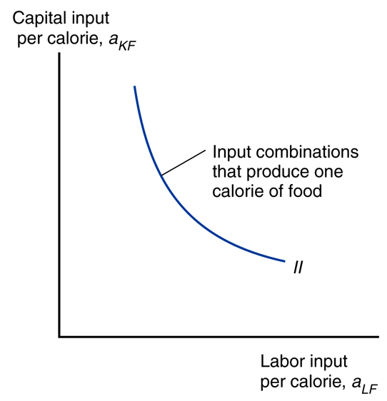
Heckscher-Ohlin: mix of inputs
Fig. 5-4: Input Possibilities in Food Production
With factor substitution producers can choose
different mixes of labor
and capital to produce food:
less capital & more labor; or
more capital & less labor

Slide 15
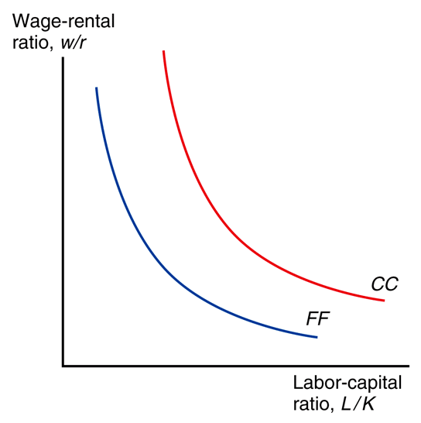
Heckscher-Ohlin: factor prices
Fig. 5-5: Factor Prices
and Input Choices
Producers’ choice of factor mixes will depend on the
wage rate (w) and the
rental rate of capital (r).
As w increases relative
to r, producers will use
more capital and less labor.

Slide 16
Heckscher-Ohlin: factor prices
Fig. 5-5: Factor Prices
and Input Choices
Assume at any given w/r:
a_{LC}/a_{KC} > a_{LF}/a_{KF} or
L_{C}/K_{C} > L_{F}/K_{F}
So cloth uses more labor relative to capital than food.
Cloth is labor-intensive;
food is capital-intensive.
Cloth curve right of food curve.

Slide 17
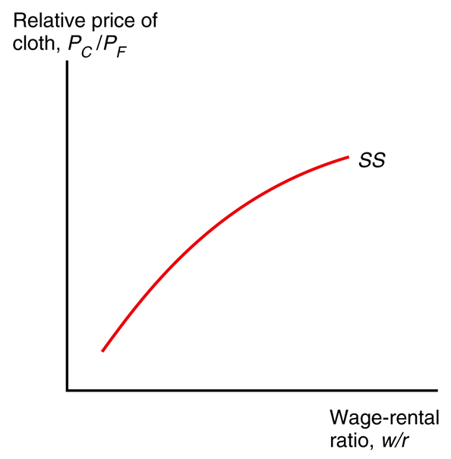
Heckscher-Ohlin: factor prices
Fig. 5-6: Factor Prices
and Goods Prices
In competitive markets, the price of a good depends on its cost of production, which depends on the price of factors.

Slide 18
Heckscher-Ohlin: factor prices
Fig. 5-6: Factor Prices
and Goods Prices
Changes in w/r are tied
to changes in P_{C}/P_{F}:
change in r affects capital-intensive good more,
change in w affects labor-intensive good more.

Slide 19
Heckscher-Ohlin: factor prices
Fig. 5-6: Factor Prices
and Goods Prices
Stolper-Samuelson theorem If the relative price of a good increases, then the real wage or rental rate of the factor used intensively in the production of that good increases, while the real wage or rental rate of the other factor decreases.

Slide 20
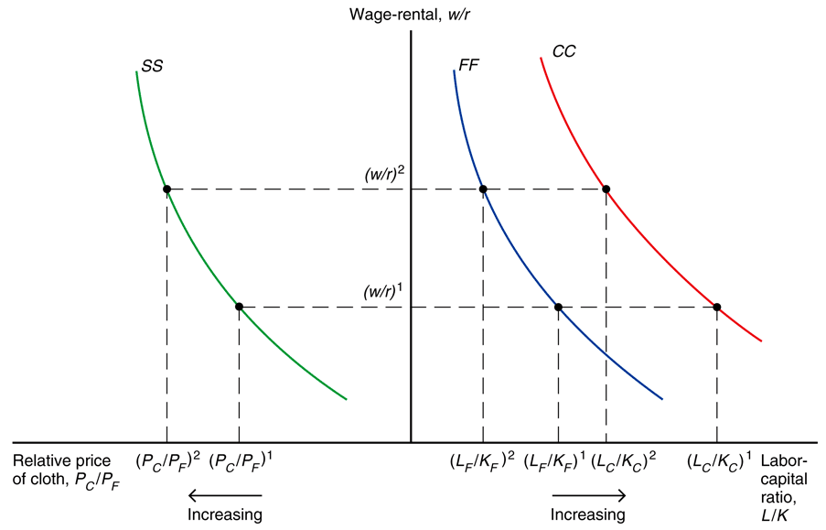
Heckscher-Ohlin: factor prices
Fig. 5-7: From Goods Prices to Input Choices
By rotating the graph in figure 5-6 it can be combined with the graph from figure 5-5 (both have w/r as the y-axis).

Slide 21
Heckscher-Ohlin: factor prices
Fig. 5-7: From Goods Prices to Input Choices
Increasing the relative price P_{C}/P_{F} moves to the left on the SS curve in the left graph, which increases w/r. When w/r increases, move to the left on the FF and CC curves in the right graph, decreasing L/K.

Slide 22
Heckscher-Ohlin: factor prices
Fig. 5-7: From Goods Prices to Input Choices
Increasing the relative price P_{C}/P_{F} increases w/r (the relative nominal income of workers to capital owners).

Slide 23
Heckscher-Ohlin: factor prices
Fig. 5-7: From Goods Prices to Input Choices
Increasing the relative price P_{C}/P_{F} decreases L/K (ratio of labor to capital)
in both cloth and food, which means K/L goes up
(ratio of capital to labor) in both cloth and food.

Slide 24
Heckscher-Ohlin: factor prices
Fig. 5-7: From Goods Prices to Input Choices
More capital per unit of labor increases MPL
(labor more productive).
Less labor per capital decreases MPK
(capital less productive).

Slide 25
Heckscher-Ohlin: factor prices
Fig. 5-7: From Goods Prices to Input Choices
In perfect competition
factor price =
factor productivity
x good price.
w = MPL_{C}P_{C}
w = MPL_{F}P_{F}
r = MPK_{C}P_{C}
r = MPK_{F}P_{F}

Slide 26
Heckscher-Ohlin: factor prices
Fig. 5-7: From Goods Prices to Input Choices
Real income of factors will equal factor productivity.
w/P_{C} = MPL_{C}
w/P_{F} = MPL_{F}
r/P_{C} = MPK_{C}
r/P_{F} = MPK_{F}

Slide 27
Heckscher-Ohlin: factor prices
We saw that increasing P_{C}/P_{F} leads to increasing w/r, which decreases L/K for both goods.
Decreasing L/K means MPL_{C} & MPL_{F} increase; MPK_{C} & MPK_{F} decrease.
So w/P_{C} & w/P_{F} increase;
r/P_{C} & r/P_{F} decrease.
Fig. 5-7: From Goods Prices to Input Choices

Slide 28
Heckscher-Ohlin: factor prices
Fig. 5-7: From Goods Prices to Input Choices
So increasing P_{C}/P_{F} means:
raise income of workers relative to capital owners,
lower ratio of labor to capital in both industries,
raise real income of workers and lower real income of capital owners.

Slide 29
Heckscher-Ohlin: factor prices
Fig. 5-7: From Goods Prices to Input Choices
P_{C}/P_{F}↑ →
(w/r)↑,
(L/K)↓, (K/L)↑,
(w/P_{C})↑, (w/P_{F})↑,
(r/P_{C})↓, (r/P_{F})↓

Slide 30
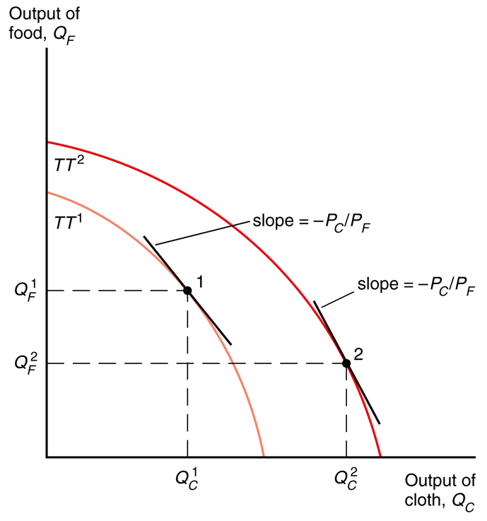
Heckscher-Ohlin: resources
Fig. 5-8: Resources and Production Possibilities
Rybczynski theorem
If you hold output prices constant as the amount of a factor of production increases, then the supply of the good that uses this factor intensively increases and the supply of the other good decreases.

Slide 31
Heckscher-Ohlin: resources
Fig. 5-8: Resources and Production Possibilities
Assume L grows, L/K increases.
PPF expands, biased towards cloth.
(increase in L/K rises max cloth more than max food because
cloth is more labor-intensive)
P_{C}/P_{F} stays constant, so L/K used in both sectors remains constant.

Slide 32
Heckscher-Ohlin: resources
Fig. 5-8: Resources and Production Possibilities
To employ the additional workers, the economy expands production of the relatively labor-intensive good cloth and contracts production of the relatively capital-intensive good food.

Slide 33
Heckscher-Ohlin: resources
Fig. 5-8: Resources and Production Possibilities
Each shift of a unit of capital from food to cloth employs more units of labor because cloth is more labor intensive.
This soaks up excess labor
until all resources are fully employed.

Slide 34
Heckscher-Ohlin: resources
Fig. 5-8: Resources and Production Possibilities
An economy with a high ratio of labor to capital produces a high output of cloth relative to food.

Slide 35
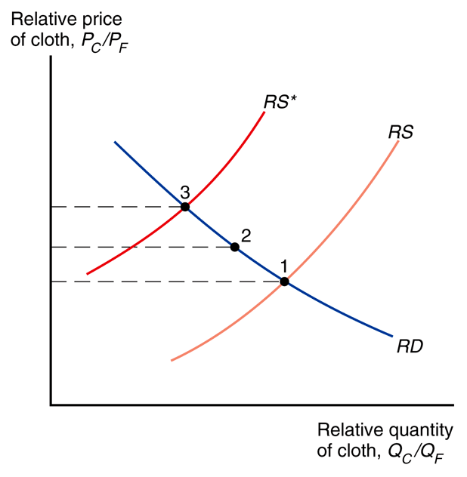
Heckscher-Ohlin: trade
Fig. 5-9: Trade Leads to a Convergence of Relative Prices
L/K > L*/K*
Home is relatively
abundant in labor
Foreign is relatively abundant in capital

Slide 36
Heckscher-Ohlin: trade
Fig. 5-9: Trade Leads to a Convergence of Relative Prices
L/K > L*/K*
Home is relatively
scarce in capital
Foreign is relatively
scarce in labor

Slide 37
Heckscher-Ohlin: trade
Fig. 5-9: Trade Leads to a Convergence of Relative Prices
L/K > L*/K*
Home will be relatively efficient at producing cloth because cloth is relatively labor intensive.
Foreign will be relatively efficient at producing food because food is relatively capital intensive.

Slide 38
Heckscher-Ohlin: trade
Fig. 5-9: Trade Leads to a Convergence of Relative Prices
Countries are assumed to have
the same tastes and therefore identical relative demands.
Countries are assumed to have the same technology and therefore a given mix of capital and labor yields the same output of cloth and food in the two countries.

Slide 39
Heckscher-Ohlin: trade
Fig. 5-9: Trade Leads to a Convergence of Relative Prices
Each economy has a comparative advantage in producing the good that relatively intensively uses the factors of production in which the country is relatively well endowed.
Home is labor abundant.
Foreign is capital abundant.

Slide 40
Heckscher-Ohlin: trade
Fig. 5-9: Trade Leads to a Convergence of Relative Prices
Since cloth is relatively labor intensive, at each P_{C}/P_{F}, Home’s Q_{C}/Q_{F} will be higher than Foreign.
Home’s relative supply curve
lies to the right of Foreign’s.

Slide 41
Heckscher-Ohlin: trade
Fig. 5-9: Trade Leads to a Convergence of Relative Prices
The Heckscher-Ohlin model predicts a convergence of
relative prices with trade.
With trade, P_{C}/P_{F} rises in the relatively labor abundant (home) country and falls in the relatively labor scarce (foreign) country.

Slide 42
Heckscher-Ohlin: trade
Fig. 5-9: Trade Leads to a Convergence of Relative Prices
Home: the rise in P_{C}/P_{F} leads to a rise in the relative production
of cloth and a fall in relative consumption of cloth.
Home becomes an exporter of cloth and an importer of food.

Slide 43
Heckscher-Ohlin: trade
Fig. 5-9: Trade Leads to a Convergence of Relative Prices
Foreign: the fall in P_{C}/P_{F} leads to a fall in the relative production
of cloth and a rise in relative consumption of cloth.
Foreign becomes an exporter of food and an importer of cloth.

Slide 44
Heckscher-Ohlin: trade
Heckscher-Ohlin theorem
An economy has a comparative advantage in producing, and thus will export, goods that are relatively intensive in using its relatively abundant factors of production and will import goods that are relatively intensive in using its relatively scarce factors of production.
Fig. 5-9: Trade Leads to a Convergence of Relative Prices

Slide 45
Heckscher-Ohlin: factor converge
Unlike the Ricardian model, the Heckscher-Ohlin model predicts that factor prices will be equalized among countries that trade.
Free trade equalizes relative output prices; the model links output prices to factor prices; thus factor prices are also equalized.

Slide 46
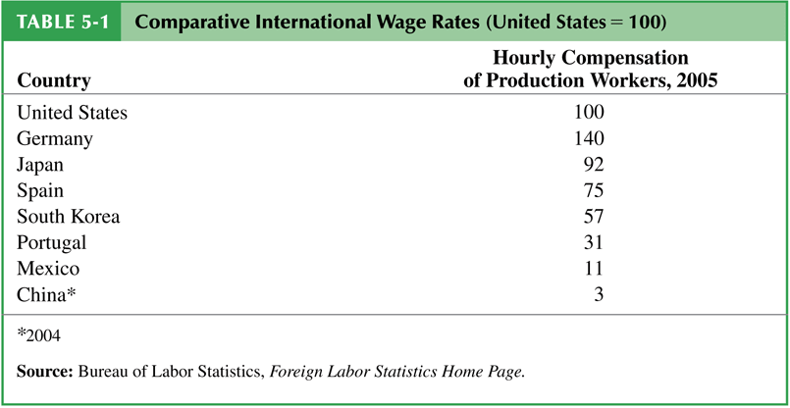
Heckscher-Ohlin: factor converge
In the real world, factor prices are not equal across countries.
Why not?
Some model assumptions are wrong.

Slide 47
Heckscher-Ohlin: factor converge
Assumptions… realities
countries produce the same goods
may specialize (different goods)
countries have same technologies
may have different technology
price equalization in goods due to trade
trade barriers & transport costs
factors instantly move among sectors
short run factor stickiness

Slide 48
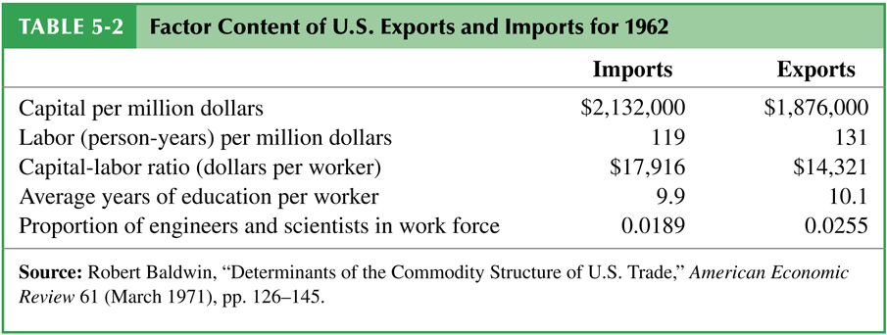
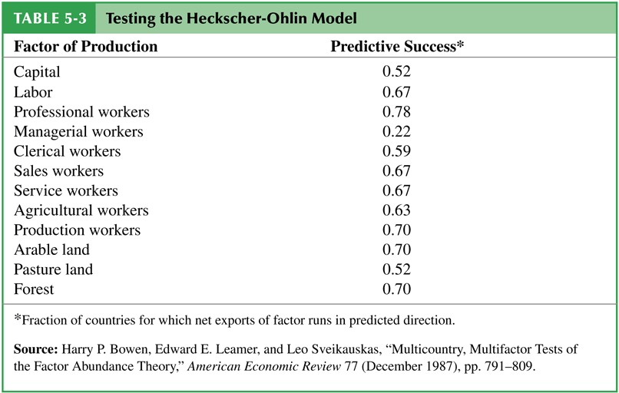
Heckscher-Ohlin: empirical tests
Leontief paradox –
U.S. exports were less capital-intensive than U.S. imports, even though the U.S. is the most capital-abundant country in the world
This holds internationally: trade often doesn’t run in the direction predicted by Heckscher-Ohlin.

Slide 49
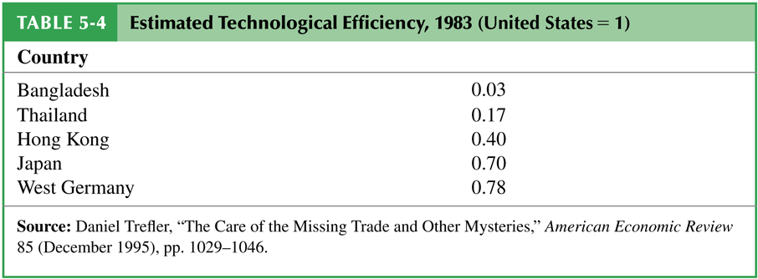
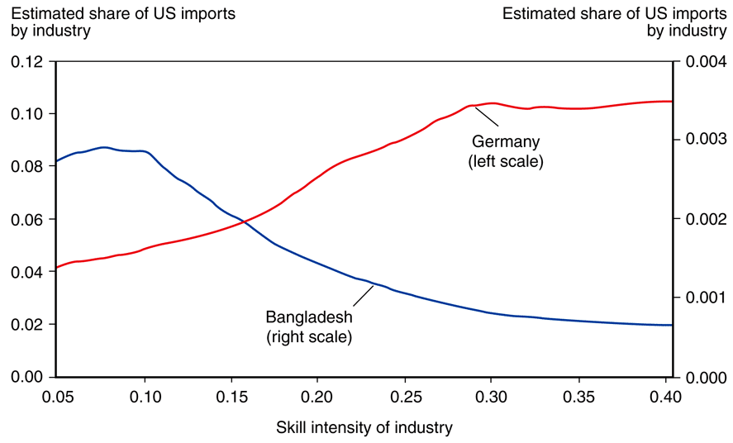
Heckscher-Ohlin: empirical tests
The model also predicts a larger volume of trade than is found.
These problems probably stem from the assumption of common technology, which is unrealistic.
Patterns of exports between developed (high income) and developing (low income) countries fit the theory quite well.
Fig. 5-12: Skill Intensity and the Pattern of Imports from 2 Countries

Slide 50
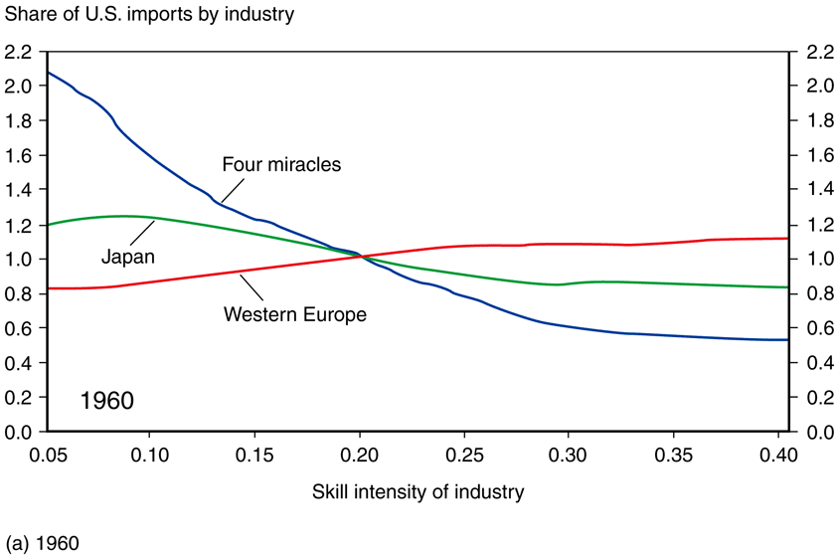
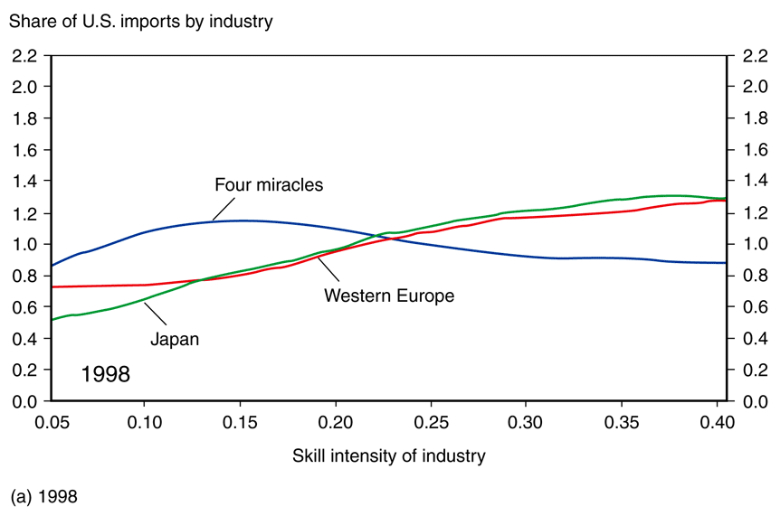
Heckscher-Ohlin: empirical tests
Fig. 5-13: Changing Patterns
of Comparative Advantage
Fig. 5-13: Changing Patterns
of Comparative Advantage
As Japan and the four Asian “miracle” countries became more skill-abundant, U.S. imports shifted from less skill-intensive industries toward more skill-intensive industries.

