Slide 1
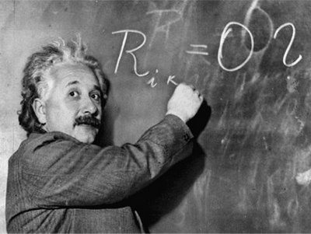
Unit 1: Trade Theory
Specific Factors Model
2/1/2012

Slide 2
Definitions
specific factor –
factor that can only be used in the production of a particular good
mobile factor –
factor that can move
between sectors

Slide 3
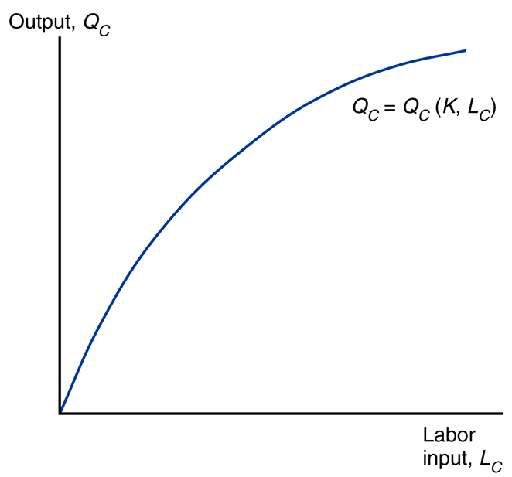
Definitions
production function –
relates output of a good to amount of inputs (factors)

Slide 4
Definitions
marginal product of labor –
addition to output generated
by adding 1 person hour

Slide 5
Definitions
diminishing marginal returns –
decrease in marginal (per unit) output as the amount of a single factor of production is increased while other factors of production stay constant

Slide 6
Definitions
budget constraint –
combinations of goods available for consumption given an income

Slide 7
Definitions
capital
owners
workers
income distribution –
division of revenues among factors of production
landowners

Slide 8
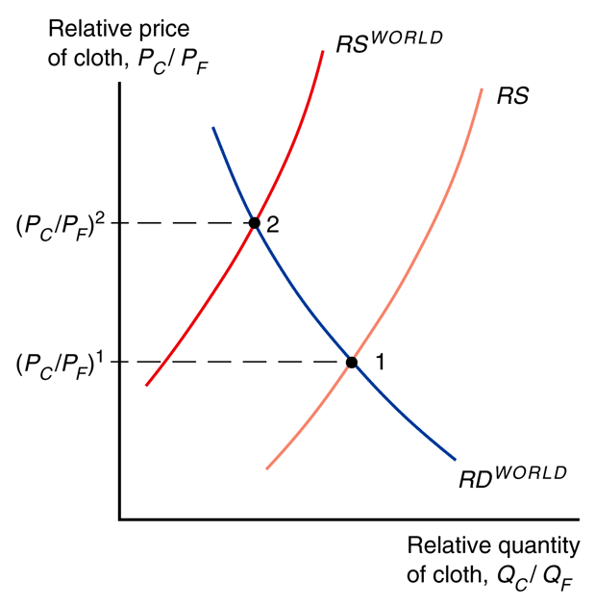
Specific Factors Model
The Specific Factors Model aims to explore how trade affects income distribution.
reasons for income distribution effects
resources can’t move instantly/
costlessly between industries
industries use different mixes of
factors of production they demand.

Slide 9
Specific Factors: assumptions
2 goods: cloth & food.
3 factors of production: labor (L), capital (K), & land (T).
Perfect competition in all markets.
Cloth produced using capital and labor (not land).
Food produced using land and labor (not capital).
Labor is a mobile factor.
can move between sectors
Land and capital are both specific factors.
used only in the production of one good

Slide 10
Specific Factors: production
Fig. 4-1: The Production Function for Cloth
Q_{C} = Q_{C}(K, L_{C})
Q_{F} = Q_{F}(T, L_{C})
Q_{C} ≡ output of cloth
Q_{F} ≡ output of food
L_{C} ≡ labor force in cloth
L_{F} ≡ labor force in food
K ≡ capital stock
T ≡ supply of land

Slide 11
Specific Factors: production
Fig. 4-1: The Production Function for Cloth
Q_{C} = Q_{C}(K, L_{C})
The production function for cloth gives the quantity of cloth that can be produced given any input of capital and labor.
Capital is a specific factor.
Labor is a mobile factor.

Slide 12
Specific Factors: production
Fig. 4-1: The Production Function for Cloth
Q_{F} = Q_{F}(T, L_{F})
The production function for food gives the quantity of food that can be produced given any input of land and labor.
Land is a specific factor.
Labor is a mobile factor.

Slide 13
Specific Factors: production
Fig. 4-1: The Production Function for Cloth
When labor moves from food
to cloth, output of food falls while output of cloth rises.
The shape of the production function reflects the law of diminishing marginal returns.

Slide 14
Specific Factors: production
diminishing marginal returns –
decrease in marginal (per unit) output as the amount of a single factor of production is increased while other factors of production stay constant

Slide 15
Specific Factors: production
Fig. 4-1: The Production Function for Cloth
Adding one worker (without increasing the amount of capital) means that each worker has less capital with which to work.
Therefore, each unit of labor adds less output than the last.

Slide 16
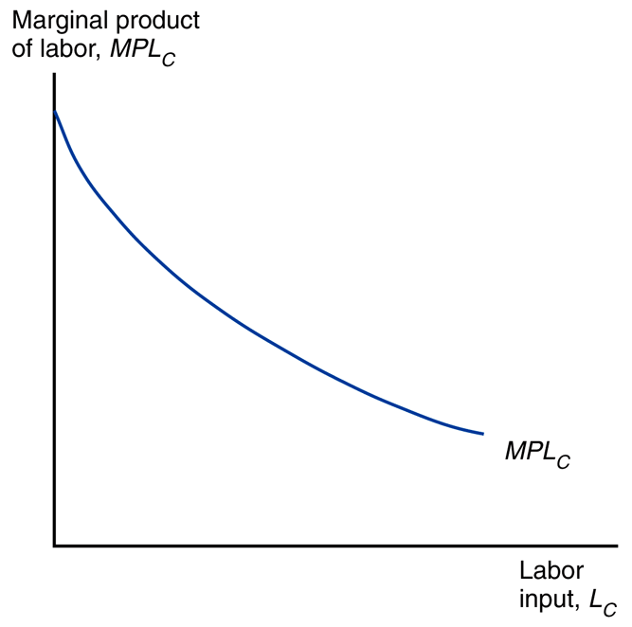
Specific Factors: production
The marginal product of labor is the first partial derivative for labor of the production function.
Here we see MPL_{C} is downward sloping because of diminishing marginal returns to labor.
MPL ≡ marginal product of labor MPL_{C} ≡ MPL for cloth
MPL_{F} ≡ MPL for food
Fig. 4-2: The Marginal Product of Labor

Slide 17
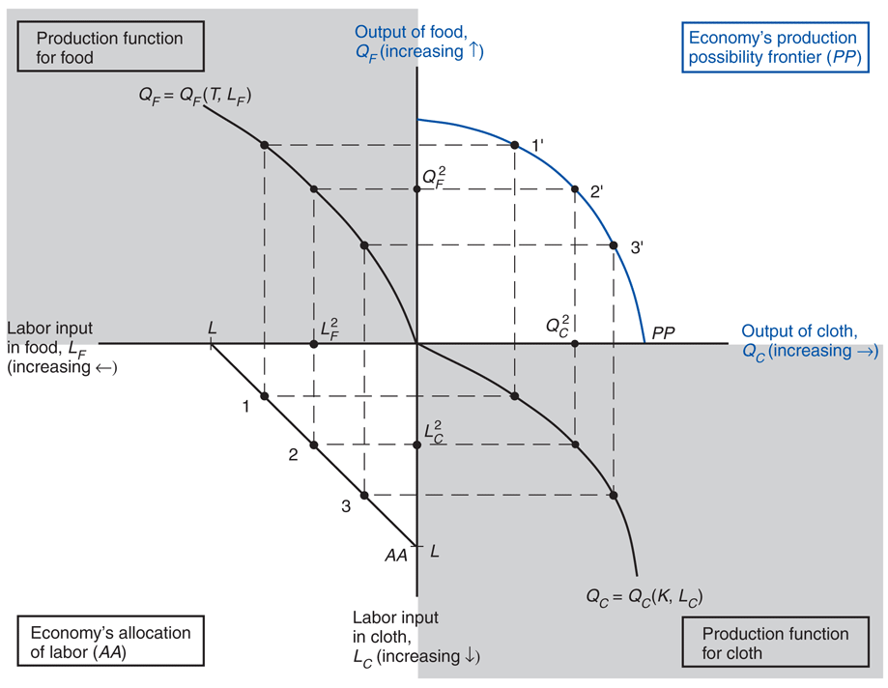
Specific Factors: production
Fig. 4-3: The Production Possibility Frontier in the Specific Factors Model
Here we see the production possibilities frontier (PPF) derived using a 4 quadrant diagram. This shows how diminishing marginal returns to labor leads to a curved PPF.
Follow the dotted lines from points on the allocation of labor line to the PPF.

Slide 18
Specific Factors: production
Fig. 4-3: The Production Possibility Frontier in the Specific Factors Model
lower left quadrant:
allocation of labor
L_{C} + L_{F} = L
lower right quadrant:
cloth production function
upper left quadrant:
food production function
upper right quadrant:
PPF for cloth and food

Slide 19
Specific Factors: production
Fig. 4-3: The Production Possibility Frontier in the Specific Factors Model
The slope of the PPF is the opportunity cost of cloth in terms of food: MPL_{F}/MPL_{C}.
1 more unit of cloth requires
1/MPL_{C} more units of labor.
1 more unit of labor requires
MPL_{F} less units of food.
So the OC of cloth in food is
MPL_{F}/MPL_{C} units of food.

Slide 20
Specific Factors: production
Fig. 4-3: The Production Possibility Frontier in the Specific Factors Model
To produce less food and more cloth, employ less workers in food and more in cloth. Due to diminishing marginal returns to labor, this causes MPL_{F} to rise and MPL_{C} to fall (MPL_{F}/MPL_{C} rises).
Thus the slope of the PPF is steeper with more cloth.

Slide 21
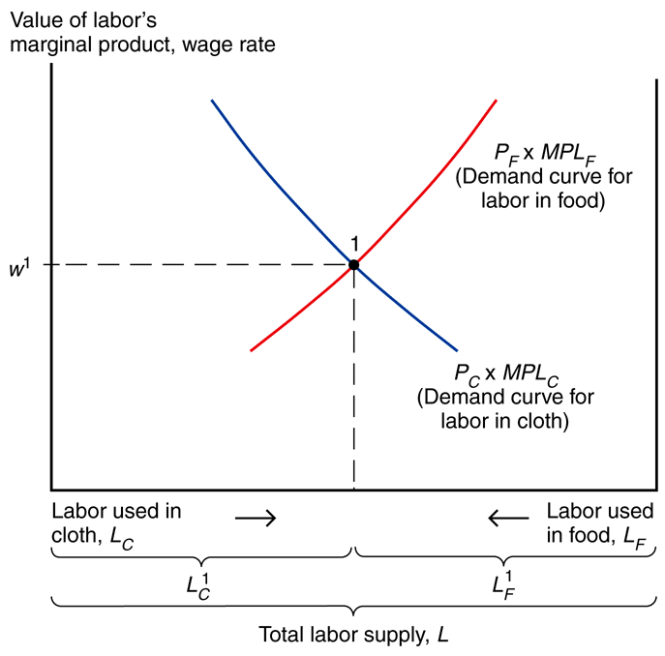
Specific Factors: prices/wages
MPL_{C}P_{C} = w
MPL_{F}P_{F} = w
MPL ≡ marginal product of labor
MPL_{C} ≡ MPL for cloth
MPL_{F} ≡ MPL for food
P_{C} ≡ price of cloth
P_{F} ≡ price of food
w ≡ wage rate
Fig. 4-4: The Allocation of Labor

Slide 22
Specific Factors: prices/wages
MPL_{C}P_{C} = w
MPL_{F}P_{F} = w
Employers maximize profits by demanding labor up to the point where the value produced by an additional hour equals the marginal cost of employing a worker for that hour.
Fig. 4-4: The Allocation of Labor

Slide 23
Specific Factors: prices/wages
MPL_{C}P_{C} = w
MPL_{F}P_{F} = w
The wage equals the value of the marginal product of labor in manufacturing and food sectors.
Figure 4-4 shows the demand for labor in the two sectors.
Fig. 4-4: The Allocation of Labor

Slide 24
Specific Factors: prices/wages
Fig. 4-4: The Allocation of Labor
Demand for labor in the
cloth sector is MPL_{C}P_{C}.
(measured left to right)
Demand for labor in the
food sector is MPL_{F}P_{F}.
(measured right to left)
Horizontal axis is total L supply.

Slide 25
Specific Factors: prices/wages
The cloth and food labor demand curves intersect at w and the allocation of labor between sectors.
The two sectors must pay the same wage because labor can move between sectors, so workers paid a lower wage would shift to the other sector.
Fig. 4-4: The Allocation of Labor

Slide 26
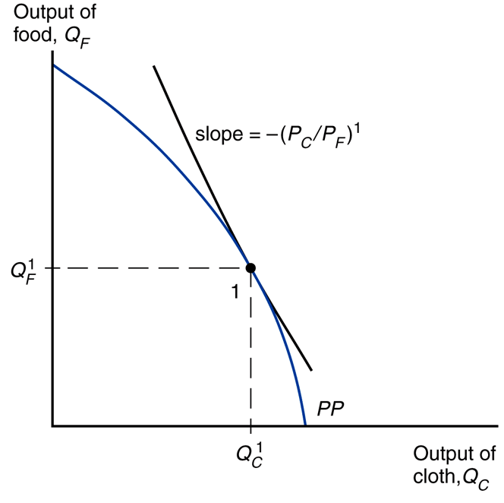
Specific Factors: prices/wages
MPL_{C}P_{C} = w, MPL_{F}P_{F} = w
MPL_{C}P_{C} = MPL_{F}P_{F}
P_{C}/P_{F} = MPL_{F}/MPL_{C}
-P_{C}/P_{F} = -MPL_{F}/MPL_{C}
At the production point, the production possibility frontier must be tangent to a line whose slope is minus the price of cloth divided by that of food.
Fig. 4-5: Production in the Specific Factors Model

Slide 27
Specific Factors: income dist.
What happens to the allocation of labor and the distribution of income when the prices of food and cloth change?
2 cases
equal (proportional) change
change in relative prices

Slide 28
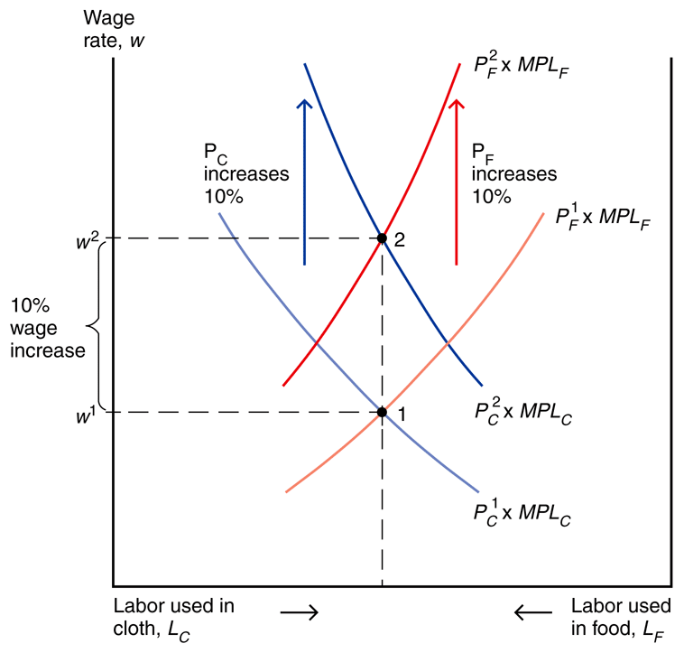
Specific Factors: income dist.
Fig. 4-6: An Equal-Proportional Increase in the Prices of Cloth and Food
When both prices change
in the same proportion,
no real changes occur.
w rises in the same proportion as P_{C} & P_{F}, so real wages
(w/P_{C} & w/P_{F}) are unaffected.

Slide 29
Specific Factors: income dist.
revenue = costs
Q_{C}P_{C} = Kr_{K} + L_{C}w
Q_{F}P_{F} = Tr_{T} + L_{F}w
Kr_{K} = Q_{C}P_{C} – L_{C}w
Tr_{T} = Q_{F}P_{F} – L_{F}w
Kr_{K} ≡ income of capital owners
r_{K} ≡ rental rate of capital
Tr_{T} ≡ income of landowners
r_{T} ≡ rental rate of land
Fig. 4-6: An Equal-Proportional Increase in the Prices of Cloth and Food

Slide 30
Specific Factors: income dist.
Fig. 4-6: An Equal-Proportional Increase in the Prices of Cloth and Food
Because P_{C} & P_{F} rise by the same proportion, quantities produced (Q_{C} & Q_{F}) are unaffected.
Because P_{C} & P_{F} rise by the same proportion, labor used
(L_{C} & L_{F}) are unaffected.

Slide 31
Specific Factors: income dist.
P_{C}² = 1.1P_{C}¹, w² = 1.1w¹
(Kr_{K})² = Q_{C}P_{C}² – L_{C}w²
(Kr_{K})² = Q_{C}(1.1)P_{C}¹ – L_{C}(1.1)w¹
(Kr_{K})² = (1.1)(Q_{C}P_{C}¹ – L_{C}w¹)
(Kr_{K})² = 1.1 (Kr_{K})¹
Because P_{C}, P_{F}, & w rise by
the same proportion as each other, rental incomes (Kr_{K} & Tr_{T}) also rise by that proportion.
Fig. 4-6: An Equal-Proportional Increase in the Prices of Cloth and Food

Slide 32
Specific Factors: income dist.
P_{C}² = 1.1P_{C}¹, (Kr_{K})² = 1.1(Kr_{K})¹
(Kr_{K})²/P_{C}² = 1.1(Kr_{K})¹/1.1P_{C}¹
(Kr_{K})²/P_{C}² = (Kr_{K})¹/P_{C}¹
Real incomes of capital
owners and landowners
(Kr_{K}/P_{C}, Kr_{K}/P_{F}, Tr_{T}/P_{C}, Tr_{T}/P_{F})
also remain the same
because Kr_{K} & Tr_{T} rise by the
same proportion as P_{C} & P_{F}.
Fig. 4-6: An Equal-Proportional Increase in the Prices of Cloth and Food

Slide 33
Specific Factors: income dist.
capital
owners
workers
Thus when both prices
change in the same proportion, no real changes occur.
The real incomes of workers, capital owners, and landowners are unaffected.
landowners

Slide 34
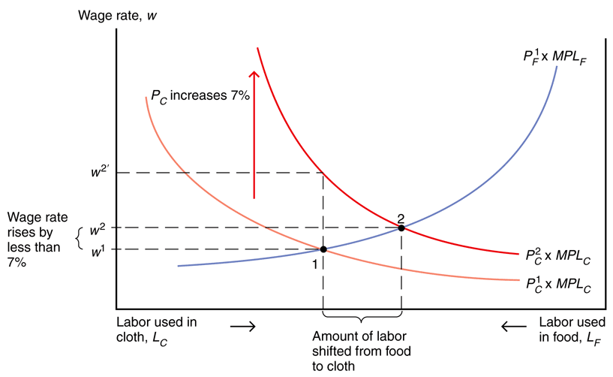
Specific Factors: income dist.
When only the price
of cloth rises, real changes occur.
Labor shifts from the food sector to the cloth sector and the output of cloth rises while the output of food falls.
Fig. 4-7: A Rise in the Price of Cloth

Slide 35
Specific Factors: income dist.
Fig. 4-7: A Rise in the Price of Cloth
w does not rise as much as P_{C} since L_{C} increases and thus MPL_{C} falls.
As L_{C} increases, L_{F} decreases and
thus MPL_{F} rises.

Slide 36
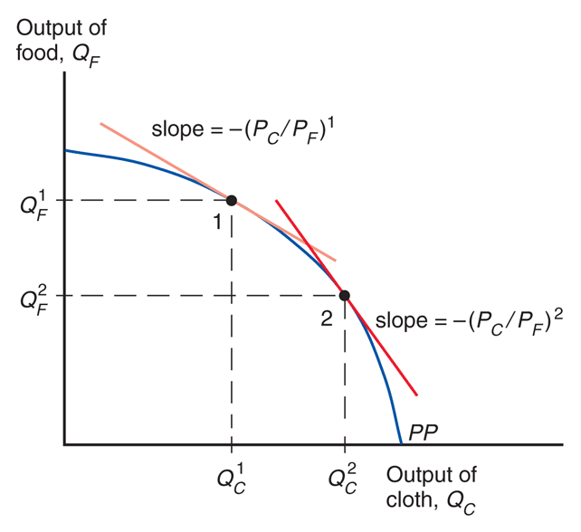
Specific Factors: income dist.
Fig. 4-8: Response of Output to a Change in the Relative Price of Cloth
The shift in output of more cloth and less food due to shifts in relative prices is evident here.

Slide 37
Specific Factors: income dist.
ΔP_{C}/P_{C} > Δw/w > ΔP_{F}/P_{F}
7% > ~2.5% > 0%
w/P_{C} falls
w/P_{F} rises
Thus the welfare
change for workers
is ambiguous.
Fig. 4-7: A Rise in the Price of Cloth

Slide 38
Specific Factors: income dist.
w = MPL_{C}P_{C} = MPL_{F}P_{F}
Kr_{K} = Q_{C}P_{C} – L_{C}w
Tr_{T} = Q_{F}P_{F} – L_{F}w
Kr_{K} = Q_{C}P_{C} – L_{C}(MPL_{C}P_{C})
Tr_{T} = Q_{F}P_{F} – L_{F}(MPL_{F}P_{F})
Kr_{K} = P_{C}(Q_{C} – L_{C}MPL_{C})
Tr_{T} = P_{F}(Q_{F} – L_{F}MPL_{F})
(Kr_{K})/P_{C} = Q_{C} – L_{C}MPL_{C}
(Tr_{T})/P_{F} = Q_{F} – L_{F}MPL_{F}
Fig. 4-7: A Rise in the Price of Cloth

Slide 39
Specific Factors: income dist.
Fig. 4-7: A Rise in the Price of Cloth
(Kr_{K})/P_{C} = Q_{C} – L_{C}MPL_{C}
(Tr_{T})/P_{F} = Q_{F} – L_{F}MPL_{F}
Mathematically, real income of capital owners rises because the quantity
(Q_{C} – L_{C}MPL_{C}) rises.
Elaboration…

Slide 40
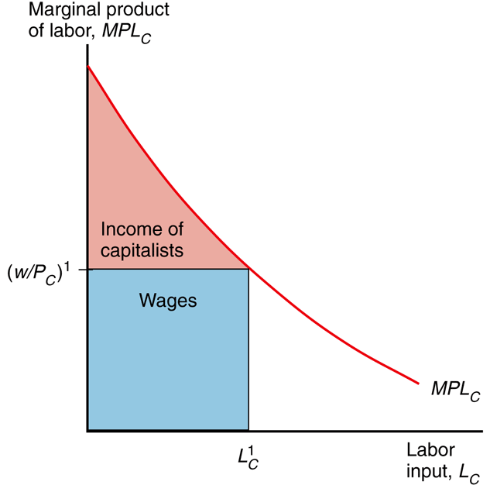
Specific Factors: income dist.
Fig. 4A-2: The Distribution of Income Within the Cloth Sector
Total quantity produced is the sum of the marginal products of all workers. Workers have different marginal products. The marginal product of labor declines, so the last worker has the lowest MPL.
Q_{C} = area under the MPL_{C} curve.

Slide 41
Specific Factors: income dist.
Fig. 4A-2: The Distribution of Income Within the Cloth Sector
L_{C}MPL_{C} would give a quantity assuming every worker is as productive as the last worker. In reality other workers are more productive, so Q_{C} > L_{C}MPL_{C}, (Q_{C} – L_{C}MPL_{C} is positive).

Slide 42
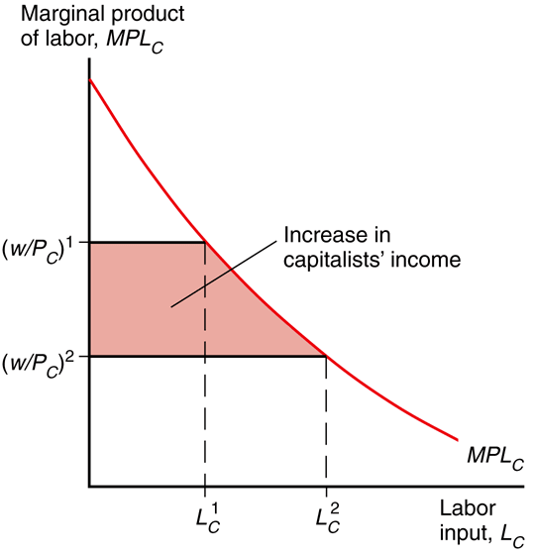
Specific Factors: income dist.
(Kr_{K})/P_{C} = Q_{C} – L_{C}MPL_{C}
In this case Q_{C} rises,
L_{C} rises, and MPL_{C} falls.
Adding more workers like this will make the quantity (Q_{C} – L_{C}MPL_{C}) even larger.
So the real income of capital in terms of cloth (Kr_{K}/P_{C}) rises.
Fig. 4A-3: A Rise in PC
Benefits the Owners of Capital

Slide 43
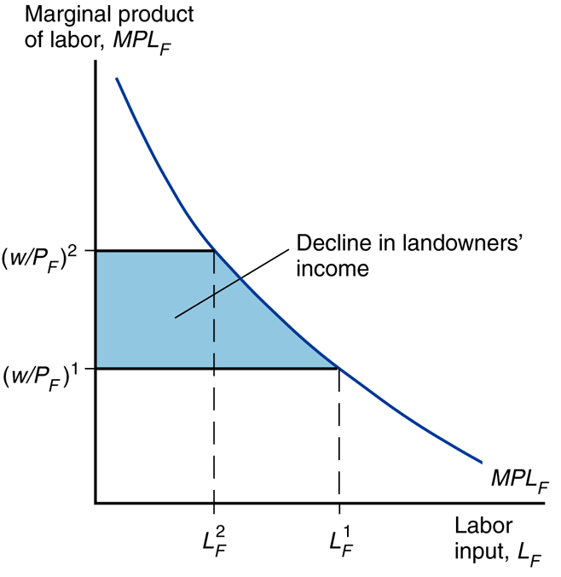
Specific Factors: income dist.
(Tr_{T})/P_{F} = Q_{F} – L_{F}MPL_{F}
In this case Q_{F} falls,
L_{F} falls, and MPL_{F} rises.
Subtracting workers like
this will make the quantity
(Q_{F} – L_{F}MPL_{F}) fall.
So the real income of
land in terms of food
(Tr_{T}/P_{F}) falls.
Fig. 4A-4: A Rise in PC
Hurts Landowners

Slide 44
Specific Factors: income dist.
Fig. 4A-3: A Rise in PC
Benefits the Owners of Capital
Kr_{K}/P_{C} rises.
P_{C}/P_{F} rises.
(Kr_{K}/P_{F}) = (Kr_{K}/P_{C})(P_{C}/P_{F})
So the real income of capital in terms of food (Kr_{K}/P_{F}) rises too.

Slide 45
Specific Factors: income dist.
Fig. 4A-4: A Rise in PC
Hurts Landowners
Tr_{T}/P_{F} falls.
P_{F}/P_{C} falls.
(Tr_{T}/P_{C}) = (Tr_{T}/P_{F})(P_{F}/P_{C})
So the real income of
land in terms of cloth
(Tr_{T}/P_{C}) falls too.

Slide 46
Specific Factors: income dist.
Fig. 4A-2: The Distribution of Income Within the Cloth Sector
Changes in income of capital owners and landowners are easier
to see graphically as consumer surpluses
on the MPL curves.

Slide 47
Specific Factors: income dist.
Fig. 4A-3: A Rise in PC
Benefits the Owners of Capital
Fig. 4A-4: A Rise in PC
Hurts Landowners

Slide 48
Specific Factors: income dist.
Fig. 4-7: A Rise in the Price of Cloth
r_{K} = MPK_{C}P_{C} = MPK_{F}P_{F}
r_{T} = MPT_{F}P_{F} = MPT_{F}P_{F}
K(r_{K}/P_{C}) = K(MPK)
T(r_{T}/P_{F}) = T(MPT)
Another way to think of it is capital productivity.

Slide 49
Specific Factors: income dist.
Fig. 4-7: A Rise in the Price of Cloth
K(r_{K}/P_{C}) = K(MPK_{C})
With more labor per the same capital, each unit is more productive.
MPK rises, thus real income of capital
in terms of cloth rises.

Slide 50
Specific Factors: income dist.
Fig. 4-7: A Rise in the Price of Cloth
T(r_{T}/P_{F}) = T(MPT_{F})
With less labor per the same land, each unit is less productive.
MPT falls, thus real income of land in terms of both food falls.

Slide 51
Specific Factors: income dist.
Fig. 4-7: A Rise in the Price of Cloth
Real incomes
of capital owners
(Kr_{C}/P_{C}, Kr_{C}/P_{F}) rise.
Real incomes
of landowners
(Tr_{F}/P_{C}, Tr_{F}/P_{F}) fall.

Slide 52
Specific Factors: income dist.
capital
owners
workers
Thus when only the
price of cloth rises,
real changes occur.
Capital owners are better off, landowners are worse off,
and the welfare change of workers is ambiguous.
landowners

Slide 53
Specific Factors: gains from trade
Fig. 4-10: Trade and Relative Prices
Assume preferences are the same across countries, so relative demand is RD^{W}.
Before trade P_{C}/P_{F} is at the intersection of a RS & RD^{W}.
After trade P_{C}/P_{F} is the intersection of RS^{W} & RD^{W}.

Slide 54
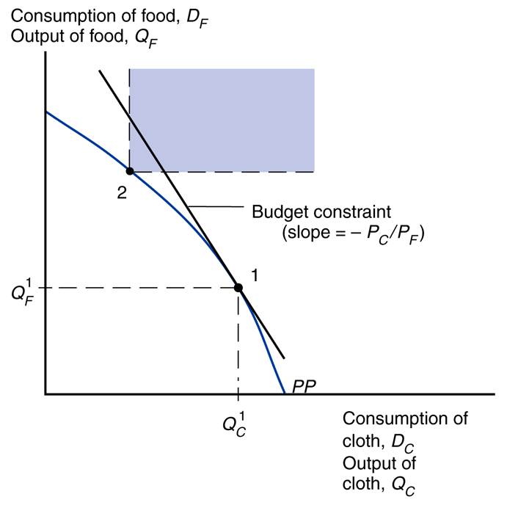
Specific Factors: gains from trade
Fig. 4-11: The Budget Constraint for a Trading Economy and Gains from Trade
Without trade, consumption must equal production.
International trade allows the mix of cloth and food consumed to differ from the mix produced.

Slide 55
Specific Factors: gains from trade
Fig. 4-11: The Budget Constraint for a Trading Economy and Gains from Trade
Budget constraint
P_{C}D_{C} + P_{F}D_{F} = P_{C}Q_{C} + P_{F}Q_{F}
P_{C} ≡ price of cloth
P_{F} ≡ price of food
D_{C} ≡ cloth consumed
D_{F} ≡ food consumed
Q_{C} ≡ cloth produced
Q_{F} ≡ food produced

Slide 56
Specific Factors: gains from trade
Fig. 4-11: The Budget Constraint for a Trading Economy and Gains from Trade
P_{C}D_{C} + P_{F}D_{F} = P_{C}Q_{C} + P_{F}Q_{F}
P_{C}D_{C} – P_{C}Q_{C} = P_{F}Q_{F} – P_{F}D_{F}
P_{C}(D_{C} –Q_{C}) = P_{F}(Q_{F} – D_{F})
(D_{F} – Q_{F}) = (P_{C}/P_{F})(Q_{C} – D_{C})
(D_{F} – Q_{F}) ≡ imports of food
(Q_{C} – D_{C}) ≡ exports of cloth
(P_{C}/P_{F}) ≡ relative price of cloth

Slide 57
Specific Factors: gains from trade
Fig. 4-11: The Budget Constraint for a Trading Economy and Gains from Trade
Country can afford amounts of cloth and food it can’t produce.
Budget constraint with trade lies above the production possibilities frontier.

Slide 58
Specific Factors: gains from trade
International trade shifts P_{C}/P_{F}, so factor prices change.
Trade benefits the factor specific to the export sector in both countries, but hurts the factor specific to the import sector in both countries.
Trade has ambiguous effects on mobile factors.
Fig. 4-10: Trade and Relative Prices

Slide 59
Specific Factors: gains from trade
capital
owners
workers
It is possible to redistribute income so that everyone gains.
Those who gain from trade could compensate those who lose and still be better off.
Possible doesn’t mean it happens… hard to implement.
landowners

Slide 60
Specific Factors: political economy
capital
owners
workers
Trade produces both winners and losers. In spite of these income distribution effects, economists overwhelmingly favor free trade policies.
Why?
3 main reasons…
landowners

Slide 61
Specific Factors: political economy
capital
owners
workers
3 reasons for free trade
distribution effects are not specific to international trade
allowing trade and compensating losers better than blocking trade
winners from trade are less politically organized than losers
landowners

Slide 62
Specific Factors: political economy
capital
owners
workers
There are winners and losers in all trade – not just international trade. Every change in the economy, including shifting consumer preferences and technology advances, helps some and hurts others.
So don’t focus on distribution.
landowners

Slide 63
Specific Factors: political economy
capital
owners
workers
If the government is going to intervene, it is better to compensate the losers than to block all trade. This preserves more of the gains for society than blocking trade would.
landowners

Slide 64
Specific Factors: political economy
capital
owners
workers
Those who gain from trade are typically less concentrated, informed, and organized than those who lose. Losers can convince politicians to block trade with tariffs and quotas.
As a counterweight, should favor free trade in general.
landowners

Slide 65
Specific Factors: unemployment
Fig. 4-10: Trade and Relative Prices
Trade shifts jobs from the import sector to the export sector (labor is a mobile factor).
This is not instantaneous though… there can be temporary unemployment.

Slide 66
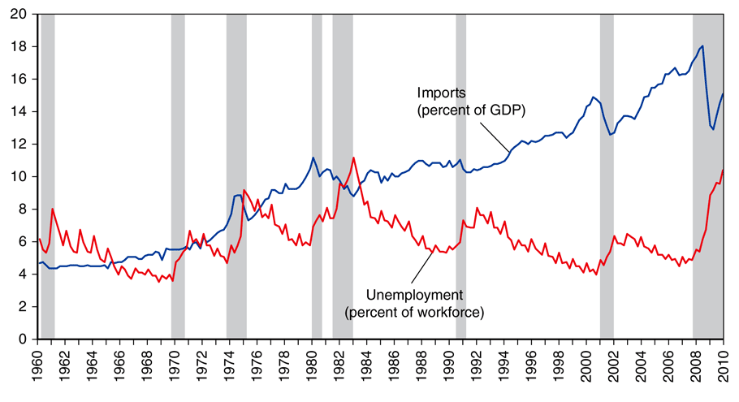
Specific Factors: unemployment
Fig. 4-12: Unemployment and Import Penetration in the U.S.
There is no obvious correlation between imports (trade) and unemployment in the U.S.
From 1996 to 2008 only 2.5% of involuntary displacements stemmed from plants moved overseas / import competition.

Slide 67
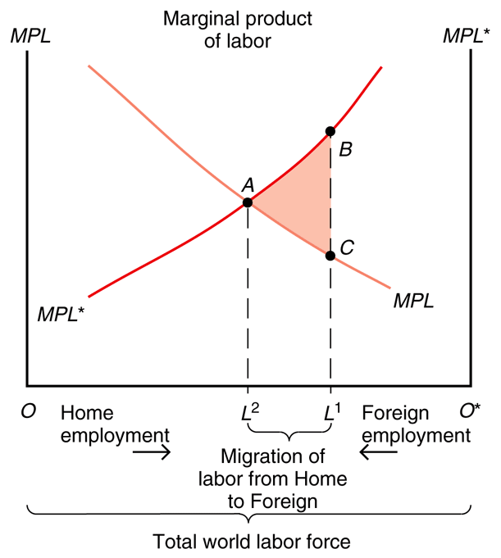
Specific Factors: labor mobility
Fig. 4-13: Causes and Effects of International Labor Mobility
Workers migrate to where wages are highest.
Suppose 2 countries produce
a non-traded good (food)
using a mobile factor (labor)
and a specific factor (land).

Slide 68
Specific Factors: labor mobility
Fig. 4-13: Causes and Effects of International Labor Mobility
Without migration:
Workers in the Home country earn a low real wage (point C);
workers in the Foreign country earn a high real wage (point B).
With migration:
Real wages in Home and Foreign reach equilibrium (point A).

Slide 69
Specific Factors: labor mobility
Fig. 4-13: Causes and Effects of International Labor Mobility
The lower wage without migration is reflected as a lower MPL, resulting from less land per worker (lower productivity).
Emmigration from Home reduces L and raises Home real wages.
Immigration to Foreign increases L* and lowers Foreign real wages.

Slide 70
Specific Factors: labor mobility
Fig. 4-13: Causes and Effects of International Labor Mobility
World output rises: labor moves to where it is more productive.
Foreign gains the area under
the trapezoid ABL¹L².
Home loses the area under
the trapezoid ACL¹L².
Thus total output increases
by the triangle ABC.

Slide 71
Specific Factors: labor mobility
Fig. 4-13: Causes and Effects of International Labor Mobility
World output rises: labor moves to where it is more productive.
World output is maximized at the equilibrium (A) where real wages of Home and Foreign are equal.
But wages don’t actually equalize due to immigration restrictions.

Slide 72
Specific Factors: labor mobility
Fig. 4-13: Causes and Effects of International Labor Mobility
Workers initially in Home
benefit (real wages rise) while
workers initially in Foreign
lose (real wages decline).

Slide 73
Specific Factors: labor mobility
Fig. 4-13: Causes and Effects of International Labor Mobility
Landowners in Foreign gain from the inflow of workers (output increases, real wages decline) while landowners in Home lose from the outflow (output decreases, real wages rise).

Slide 74
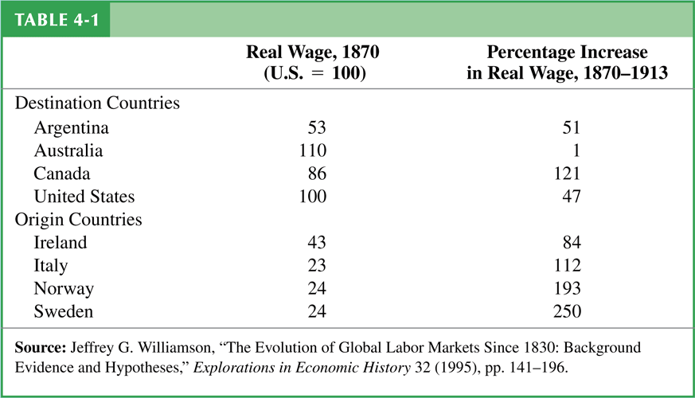
Specific Factors: labor mobility
Empirically there has been real wage convergence due to international migration.
Real wages start out higher in destination countries than in origin countries.
Real wages rose faster in origin countries than in destination countries.

