Slide 1
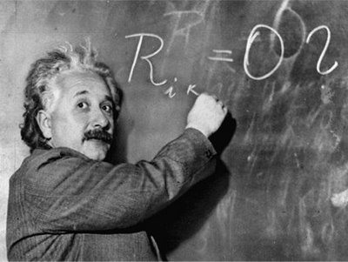
Unit 1: Trade Theory
Ricardian Model
1/30/2012

Slide 2
Definitions
opportunity cost –
the cost of an activity in terms of a forgone alternative

Slide 3
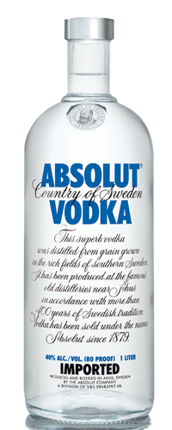
Definitions
absolute advantage –
the ability of a country to produce a product using fewer resources than other countries

Slide 4
Definitions
comparative advantage –
the ability of a country to produce a product at a lower opportunity cost than other countries

Slide 5
Definitions
productivity –
amount of product produced in a unit of time

Slide 6
Definitions
unit labor requirement –
number of hours of labor required to produce a unit of product

Slide 7
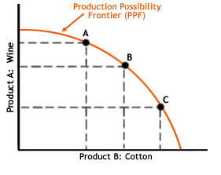
Definitions
production possibilities frontier –
maximum possible production of two products at different mixes

Slide 8
Definitions
nontraded goods –
goods each country produces for itself (no imports or exports)

Slide 9
Definitions
relative wage –
ratio of the amount workers are paid per hour in two countries

Slide 10
Definitions
autarky –
economic self-sufficiency;
no trade

Slide 11
Why Trade?
Two reasons for trade (micro and macro)
Smithean: efficiency / economies of scale
Ricardian: comparative advantage

Slide 12
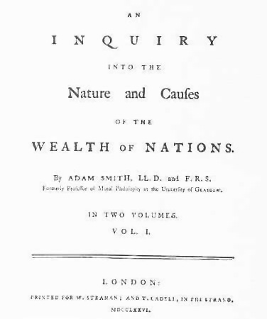
Why Trade?
Adam Smith detailed the
benefits of specialization
and division of labor in his
book The Wealth of Nations.
Each worker could become
an expert in a small area,
greatly increasing efficiency.

Slide 13
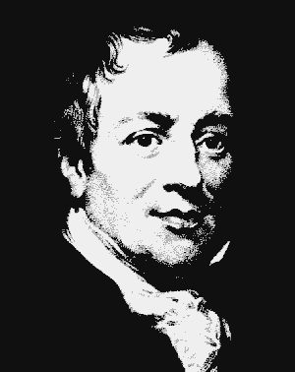
Why Trade?
Law of Association
(comparative advantage) –
Even if someone is absolutely more
productive at 2 activities, if he is
comparatively more productive at 1
activity than another relative to a
2nd person, he will be better off
specializing and trading than
producing in isolation.
David Ricardo

Slide 14
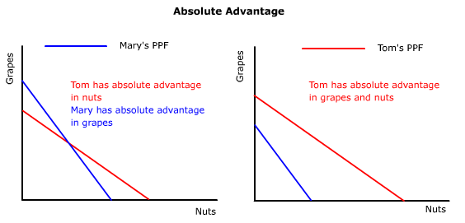
Why Trade?
Tom is better off specializing and trading
even though he has an absolute advantage.

Slide 15
Why Trade?
Suppose two countries each produce two goods: potatoes (which we will abbreviate as “pot”) and Coca-Cola (which we will abbreviate as “coke”).

Slide 16
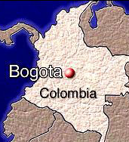
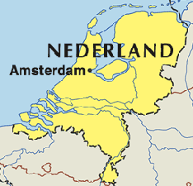
Why Trade?
These two countries (Columbia and the Netherlands) have different production possibilities and relative efficiencies due to differences in labor productivity.

Slide 17
Why Trade?
The opportunity cost of producing pot is the coke not produced.
The opportunity cost of producing coke is the pot not produced.

Slide 18
production
possibilities
frontier
production
possibilities
frontier
Why Trade?
Country | pot
Columbia | 100
Netherlands | 400
Total | 500
Country | coke
Columbia | 100
Netherlands | 200
Total | 300
Columbia chooses between 1 pot and 1 coke (1:1).
It has a comparative advantage in coke.
The Netherlands chooses between 2 pot and 1 coke (2:1).
It has a comparative advantage in pot.

Slide 19
production
possibilities
frontier
production
possibilities
frontier
Why Trade?
Country | pot
Columbia | 100
Netherlands | 400
Total | 500
Country | coke
Columbia | 100
Netherlands | 200
Total | 300
Specializing and trading
here gains 50 pot.
consumption + production
in autarky
production
before trade
consumption
after trade
Country | pot | coke
Columbia | 50 | 50
Netherlands | 200 | 100
Total | 250 | 150
Country | pot | coke
Columbia | 0 | 100
Netherlands | 300 | 50
Total | 300 | 150
Country | pot | coke
Columbia | 75 | 50
Netherlands | 225 | 100
Total | 300 | 150

Slide 20
Why Trade?
One of the benefits of trade is an increase in overall world production.
By specializing and trading,
Columbia and the Netherlands together can produce more pot (without sacrificing any coke)
than if they hadn’t specialized.
More coke was another alternative.

Slide 21
production
possibilities
frontier
production
possibilities
frontier
Why Trade?
Country | pot
Columbia | 100
Netherlands | 400
Total | 500
Country | coke
Columbia | 100
Netherlands | 200
Total | 300
Specializing and trading
here gains 25 coke.
consumption + production
in autarky
production
before trade
consumption
after trade
Country | pot | coke
Columbia | 50 | 50
Netherlands | 200 | 100
Total | 250 | 150
Country | pot | coke
Columbia | 0 | 100
Netherlands | 250 | 75
Total | 250 | 175
Country | pot | coke
Columbia | 50 | 62.5
Netherlands | 200 | 112.5
Total | 250 | 175

Slide 22
Climate Advantages
One of the reasons countries specialize in a
particular good is because of climate.
This specialization may even be time dependent!
When it is winter in the northern hemisphere, it is summer in the southern hemisphere – and vice-versa.

Slide 23
Climate Advantages
This means agricultural products may be shipped from Brazil to the U.S. when out of season in the U.S. and from the U.S. to Brazil when out of season in Brazil.
We can have fresh fruit all year round!

Slide 24
Climate Advantages
They could have been grown domestically in heated greenhouses.
You can grow oranges in Alaska with heat lamps, but that would be very inefficient!

Slide 25
Climate Advantages
As the book pointed out, it is hard to have roses grown for Valentine’s Day (in the middle of winter!), so many flowers are imported from other countries.

Slide 26
Ricardian Model: assumptions
Labor is the only factor of production
Labor productivity varies across countries
due to differences in technology
Labor productivity in each country is constant
Supply of labor in each country is constant
Two goods: wine and cheese
Labor gets all good revenues through wages
Works in industry paying highest wage
Two countries: home and foreign

Slide 27
Ricardian Model: unit labor
unit labor requirement –
number of hours of labor required to produce a unit of product
(inverse of productivity)
a_{LC} ≡ unit labor requirement for cheese in home country
a_{LC}* ≡ unit labor requirement for cheese in foreign country
a_{LW} ≡ unit labor requirement for wine in home country
a_{LW}* ≡ unit labor requirement for wine in foreign country

Slide 28
Ricardian Model: unit labor
a_{LC} = 1
Means it takes 1 labor hour to produce 1 unit of cheese in the home country.
a_{LW}* = 3
Means it takes 3 labor hours to produce 1 unit of wine in the foreign country.
High unit labor requirement means low labor productivity.

Slide 29
Ricardian Model: definitions
L ≡ labor supply
(total number of hours worked
in the home country)
Q_{C} ≡ cheese production
(pounds of cheese produced)
Q_{W} ≡ wine production
(bottles of wine produced)

Slide 30
Ricardian Model: PPF
Production possibilities frontier
a_{LC}Q_{C} + a_{LW}Q_{W} ≤ L
L ≡ labor supply
Q_{C} ≡ cheese production
Q_{W} ≡ wine production
a_{LC} ≡ unit labor requirement for cheese
a_{LW} ≡ unit labor requirement for wine
a_{LC} Q_{C} ≡ total cheese labor
a_{LW} Q_{W} ≡ total wine labor

Slide 31
Ricardian Model: PPF
Maximum cheese production
Q_{C} = L/a_{LC} when Q_{W} = 0
Maximum wine production
Q_{W} = L/a_{LW} when Q_{C} = 0
“Captain, we’ve hit
maximum cheese!”

Slide 32
Ricardian Model: PPF
a_{LC}Q_{C} + a_{LW}Q_{W} ≤ L
Suppose L = 1000, a_{LC} = 1, and a_{LW} = 2
Then the equation becomes
Q_{C} + 2Q_{W} ≤ 1000
Max cheese: 1000 pounds
Max wine: 500 bottles

Slide 33
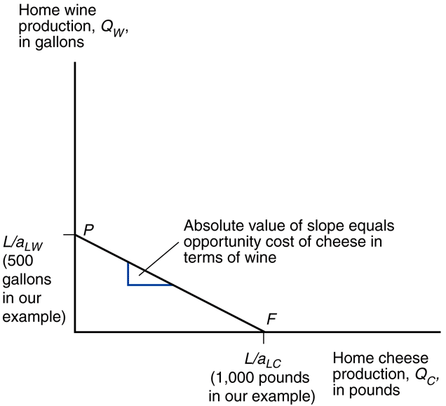
Ricardian Model: PPF
Fig. 3-1: Home’s Production Possibility Frontier

Slide 34
Ricardian Model: opportunity cost
Opportunity cost of cheese
a_{LC} ≡ hours to produce 1 unit of cheese
a_{LW} ≡ hours to produce 1 unit of wine
1/a_{LW} ≡ units of wine produced in 1 hour
a_{LC}(1/a_{LW}) ≡ (hours to produce 1 unit of cheese)x
(units of wine produced in 1 hour)
∴
a_{LC}/a_{LW} ≡ opportunity cost of cheese

Slide 35
Ricardian Model: opportunity cost
PPF:
a_{LC}Q_{C} + a_{LW}Q_{W} = L
Solving for Q_{W} (y-axis):
a_{LW}Q_{W} = L – a_{LC}Q_{C}
Q_{W} = L/a_{LW} – (a_{LC}/a_{LW})Q_{C}
The y-intercept is L/a_{LW} (max wine production).
The slope of the PPF is -a_{LC}/a_{LW} (negative of the opportunity cost of cheese).

Slide 36
Ricardian Model: PPF
Fig. 3-1: Home’s Production Possibility Frontier

Slide 37
Ricardian Model: prices & supply
With constant prices, the prices will dictate the proportions of the goods produced.
P_{C} ≡ unit price of cheese
P_{W} ≡ unit price of wine
In a single factor economy all the profit accrues to that factor (labor).

Slide 38
Ricardian Model: prices & supply
(hourly wage for cheese) =
(price of a unit of cheese)/
(hours to produce unit of cheese)
w_{C} ≡ hourly wage for cheese
w_{W} ≡ hourly wage for wine
w_{C} = P_{C}/a_{LC}
w_{W} = P_{W}/a_{LW}

Slide 39
Ricardian Model: prices & supply
Labor will go to where it can earn the highest wages.
If P_{C}/a_{LC} > P_{W}/a_{LW} (if w_{C} > w_{W}) produce only cheese.
If P_{C}/a_{LC} < P_{W}/a_{LW} (if w_{C} < w_{W}) produce only wine.
If P_{C}/a_{LC} = P_{W}/a_{LW} (if w_{C} = w_{W}) produce both.

Slide 40
Ricardian Model: prices & supply
Relative prices vs. opportunity cost view of the concept.
If P_{C}/P_{W} > a_{LC}/a_{LW} (if w_{C} > w_{W}) produce only cheese.
If P_{C}/P_{W} < a_{LC}/a_{LW} (if w_{C} < w_{W}) produce only wine.
If P_{C}/P_{W} = a_{LC}/a_{LW} (if w_{C} = w_{W}) produce both.

Slide 41
Ricardian Model: trade
unit labor requirement –
number of hours of labor required to produce a unit of product
(inverse of productivity)
a_{LC} ≡ unit labor requirement for cheese in home country
a_{LC}* ≡ unit labor requirement for cheese in foreign country
a_{LW} ≡ unit labor requirement for wine in home country
a_{LW}* ≡ unit labor requirement for wine in foreign country

Slide 42
Ricardian Model: trade
Absolute advantage
If a_{LC} < a_{LC}*, home country has an absolute advantage in producing cheese (takes less hours to produce).
Comparative advantage
If a_{LC}/a_{LW} < a_{LC}*/a_{LW}*, home country has a comparative advantage in producing cheese (opportunity cost of producing cheese relative to wine is less in home country than foreign country). If a_{LC}/a_{LW} = a_{LC}*/a_{LW}*, no trade.

Slide 43
Ricardian Model: trade
absolute advantage –
the ability of a country to produce a product using fewer resources than other countries

Slide 44
Ricardian Model: trade
comparative advantage –
the ability of a country to produce a product at a lower opportunity cost than other countries

Slide 45
Ricardian Model: trade
Comparative advantage
a_{LC}/a_{LW} < a_{LC}*/a_{LW}*
Lower opportunity cost means:
If home country increases cheese production, it needs to reduce wine production less than foreign country would.

Slide 46
Ricardian Model: trade
Suppose:
a_{LC} < a_{LC}*
a_{LW} < a_{LW}*
a_{LC}/a_{LW} < a_{LC}*/a_{LW}*
The home country has an absolute advantage in both wine and cheese. But it has a comparative advantage in cheese, so trade is beneficial.

Slide 47
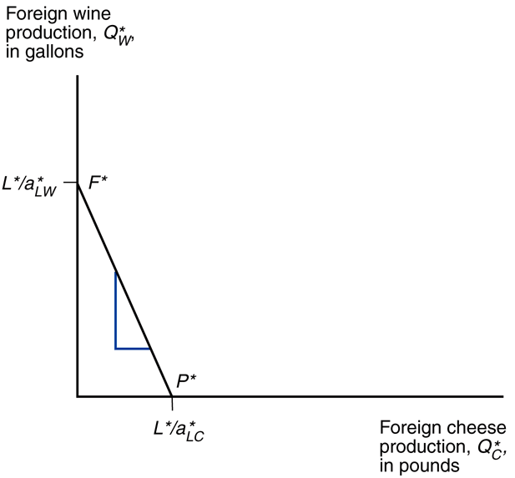
Ricardian Model: trade
Fig. 3-1: Home’s Production Possibility Frontier
Fig. 3-2: Foreign’s Production Possibility Frontier
a_{LC}/a_{LW} < a_{LC}*/a_{LW}* means foreign PPF steeper.

Slide 48
Ricardian Model: trade
Suppose:
P_{C}/P_{W} = a_{LC}/a_{LW}
P_{C}*/P_{W}* = a_{LC}*/a_{LW}*
Pre-trade the relative prices of goods in the two countries are determined by their relative unit labor requirements.

Slide 49
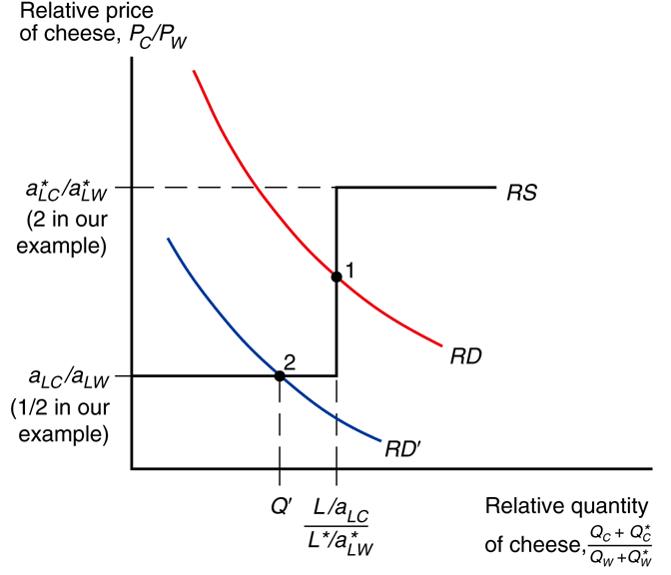
Ricardian Model: RS & RD
Fig. 3-3: World Relative Supply and Demand
This graph shows relative world supply and demand in the Ricardian model.
We’ll explore the math to see why RD and RS are shaped the way they are.

Slide 50
Ricardian Model: RS & RD
world relative supply of cheese (RS) –
quantity of cheese supplied by all countries relative to the quantity of wine supplied by all countries
RS = (Q_{C} + Q_{C}*)/(Q_{W} + Q_{W}*)

Slide 51
Ricardian Model: prices & supply
Recall:
If P_{C}/P_{W} > a_{LC}/a_{LW}
produce only cheese.
If P_{C}/P_{W} < a_{LC}/a_{LW}
produce only wine.
If P_{C}/P_{W} = a_{LC}/a_{LW}
produce both.

Slide 52
Ricardian Model: RS & RD
Fig. 3-3: World Relative Supply and Demand
Explaining RS shape
If P_{C}/P_{W} < a_{LC}/a_{LW} < a_{LC}*/a_{LW}*
Wine only in both countries.
(Wine wage > cheese wage.)
(see green line)

Slide 53
Ricardian Model: RS & RD
Fig. 3-3: World Relative Supply and Demand
Explaining RS shape
If P_{C}/P_{W} = a_{LC}/a_{LW} < a_{LC}*/a_{LW}*
Domestic workers indifferent.
(Produce both in home.)
Wine only in foreign.
(see green line)

Slide 54
Ricardian Model: RS & RD
Fig. 3-3: World Relative Supply and Demand
Explaining RS shape
If a_{LC}/a_{LW} < P_{C}/P_{W} < a_{LC}*/a_{LW}*
Cheese only in home.
Wine only in foreign.
(see green line)

Slide 55
Ricardian Model: RS & RD
Fig. 3-3: World Relative Supply and Demand
Explaining RS shape
Cheese only home means:
Q_{C} = L/a_{LC}, Q_{W} = 0
Wine only foreign means:
Q_{W}* = L*/a_{LW}*, Q_{C}* = 0
RS = (Q_{C} + Q_{C}*)/(Q_{W} + Q_{W}*)
= (L/a_{LC} + 0)/(0 + L*/a_{LC}*)
= (L/a_{LC})/(L*/a_{LC}*)

Slide 56
Ricardian Model: RS & RD
Fig. 3-3: World Relative Supply and Demand
Explaining RS shape
If a_{LC}/a_{LW} < a_{LC}*/a_{LW}* = P_{C}/P_{W}
Cheese only in home.
Foreign workers indifferent.
(Produce both in foreign.)
(see green line)

Slide 57
Ricardian Model: RS & RD
Fig. 3-3: World Relative Supply and Demand
Explaining RS shape
If a_{LC}/a_{LW} < a_{LC}*/a_{LW}* < P_{C}/P_{W}
Cheese only in both countries.
(Cheese wage > wine wage.)
(see green line…
really line would be at x=∞)

Slide 58
Ricardian Model: RS & RD
Fig. 3-3: World Relative Supply and Demand
Explaining RS shape
1st step: P_{C}/P_{W} = a_{LC}/a_{LW}
Jumps: RS = (L/a_{LC})/(L*/a_{LC}*)
2nd step: P_{C}/P_{W} = a_{LC}*/a_{LW}*

Slide 59
Ricardian Model: RS & RD
Fig. 3-3: World Relative Supply and Demand
Explaining RD shape
As price of cheese drops relative to wine, people prefer more cheese and less wine.
(i.e., downward sloping RD)
[P_{C}/P_{W} ]↓ →
[(Q_{C} + Q_{C}*)/(Q_{W} + Q_{W}*)]↑

Slide 60
Ricardian Model: RS & RD
As relative world demand shifts (e.g., people want less cheese at every relative price), world production will change accordingly by the model.
Shown as RD shifted to RD’.
Can move from total world specialization to only foreign specializing.
Fig. 3-3: World Relative Supply and Demand

Slide 61
Gains from Trade
Trade makes both
countries better off.
3 ways to conceptualize it:
indirect production
expanded consumption
conservation of resources

Slide 62
Gains from Trade
Indirect production
A country can produce wine, or produce cheese and trade it for wine. The latter is indirectly producing wine.

Slide 63
Gains from Trade
Indirect production
Direct wine production:
1/a_{LW}
Indirect wine production:
(1/a_{LC})(P_{C}/P_{W})
Indirect production better if:
(1/a_{LC})(P_{C}/P_{W}) > 1/a_{LW}
Equivalent to: P_{C}/P_{W} > a_{LC}/a_{LW}
True if countries specialize.

Slide 64
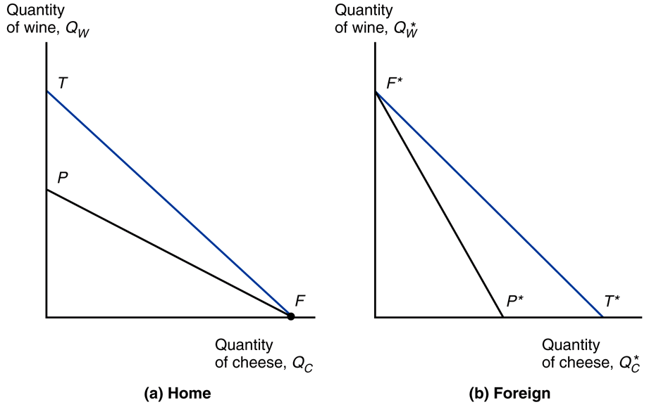
Gains from Trade
Fig. 3-4: Trade Expands Consumption Possibilities
Expanded consumption
Trade allows each country to expand its consumption possibilities beyond its production possibilities.

Slide 65
Gains from Trade
Conservation of resources
Instead of expanding production and consumption, the world can produce the same amount as before but do it more efficiently.
In the Ricardian model this means leftover labor hours (liesure); it could mean saved land/capital in other models.

Slide 66
Relative Wages
relative wage –
ratio of the amount workers are paid per hour in two countries

Slide 67
Relative Wages
Home specializes in cheese.
Its wage will be:
P_{C}/a_{LC}
Foreign specializes in wine.
Its wage will be:
P_{W}/a_{LW}*
Relative wage:
(P_{C}/a_{LC})/(P_{W}/a_{LW}*)

Slide 68
Relative Wages
Numerical example
P_{C} = P_{W} = 12
a_{LC} = 1
a_{LW} = 2
a_{LC}* = 6
a_{LW}* = 3
Home: P_{C}/a_{LC} = 12/1 = 12
Foreign: P_{W}/a_{LW}* = 12 /3 = 4
Relative: (P_{C}/a_{LC})/(P_{W}/a_{LW}*) = 12/4 = 3

Slide 69
Relative Wages
Cheese productivity advantage:
a_{LC}*/a_{LC} = 6/1 = 6
Wine productivity advantage:
a_{LW}*/a_{LW} = 3/2 = 1.5
Relative wage:
(P_{C}/a_{LC})/(P_{W}/a_{LW}*) = 12/4 = 3
In general the relative wage will be between the productivity advantages.

Slide 70
Relative Wages
Both countries have a cost advantage.
Home: high productivity, but high wage.
Foreign: low wage, but low productivity.
Even with home’s high productivity (1.5-6x) foreign can compete using low wage.
Even with foreign’s low wage (1/3) home can compete using high productivity.

Slide 71
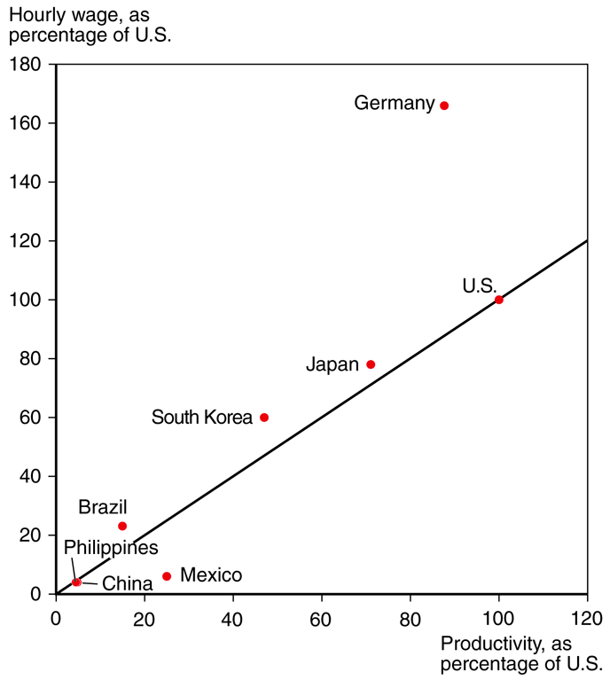
Relative Wages
Empirically wages are proportional to productivity.
South Korea’s wages rose with its productivity from 5% of U.S. levels in 1975 to 50% by 2007.

Slide 72
Myths
These myths are false
Free trade is beneficial only if a country is more productive than foreign countries.
Free trade with countries that pay low wages hurts high wage countries.
Free trade exploits less productive countries.

Slide 73
Myths
Free trade is beneficial only if a country is more productive than foreign countries.
unproductive countries
get cheaper goods
absolute advantage is irrelevant; it is comparative advantage that matters

Slide 74
Myths
Free trade with countries that pay low wages hurts high wage countries.
trade benefits consumers
trade benefits workers in the efficient industries

Slide 75
Myths
Free trade exploits less productive countries.
poverty and exploitation even worse without trade
workers get higher wages than without trade
trade benefits consumers

Slide 76
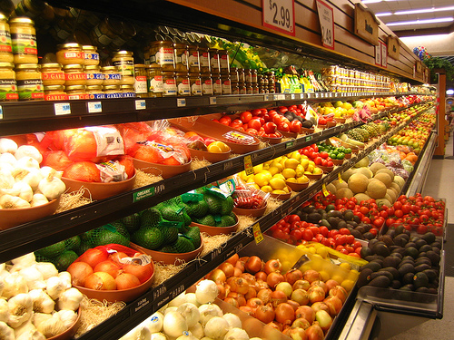
Ricardian Model: Many Goods
What if instead of
2 goods there are many goods?
Who produces what?

Slide 77
Ricardian Model: Many Goods
Can calculate relative home productivity for each good.
a_{Li}*/a_{Li}
Reorder goods by this ratio.
a_{L1}*/a_{L1} > a_{L2}*/a_{L2}* > … > a_{LN}*/a_{LN}

Slide 78
Ricardian Model: Many Goods
w ≡ wage rate in home
w* ≡ wage rate in foreign
Home cost: wa_{Li}
Foreign cost: w*a_{Li}*
Cheaper home if:
wa_{Li} < w*a_{Li}*
a_{Li}*/a_{Li} > w/w*

Slide 79
Ricardian Model: Many Goods
a_{L1}*/a_{L1} > a_{L2}*/a_{L2} > a_{L3}*/a_{L3} > a_{L4}*/a_{L4} > a_{L5}*/a_{L5}
Cut the lineup at the relative wage rates:
a_{L1}*/a_{L1} > a_{L2}*/a_{L2} > w/w* > a_{L3}*/a_{L3} > a_{L4}*/a_{L4} > a_{L5}*/a_{L5}
Red (> w/w*) produced home.
Blue (< w/w*) produced foreign.

Slide 80
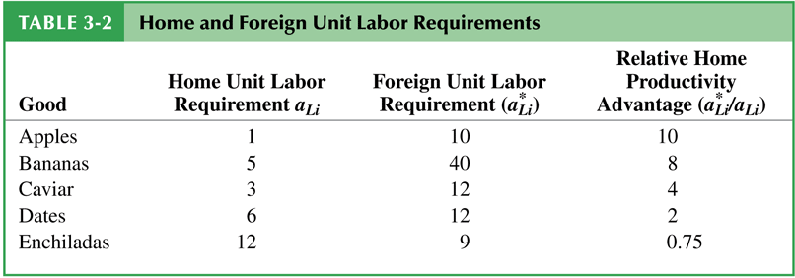
Ricardian Model: Many Goods
If w/w* = 3, then home would produce apples, bananas, and caviar. Foreign would produce dates and enchiladas.

Slide 81
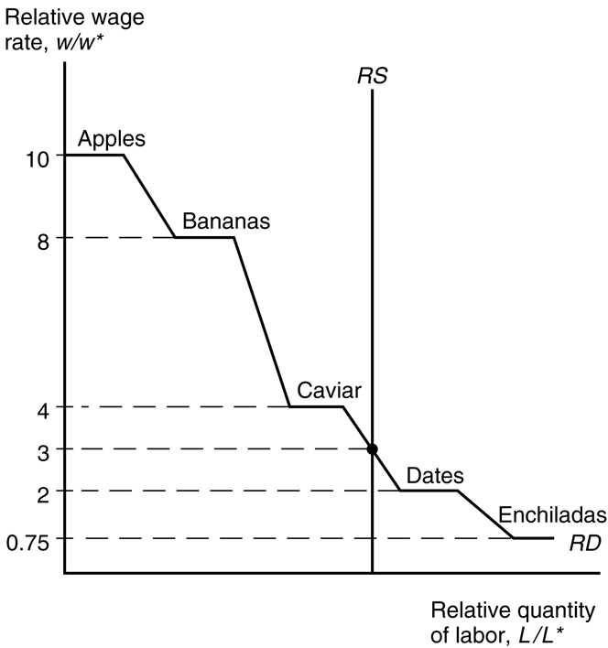
Ricardian Model: Many Goods
Fig. 3-5: Determination of Relative Wages
Relative wage is determined by the relative supply and relative demand for labor (RS and RD).
Relative supply of labor is fixed at L/L* (the relative labor hours in the home and foreign countries.

Slide 82
Ricardian Model: Many Goods
Fig. 3-5: Determination of Relative Wages
Relative demand for labor is a derived demand. As the relative wage rate falls, labor demand rises (more goods are produced in the home country).
It is a step function with steps where a_{Li}*/a_{Li} = w/w* for particular products.
(Both countries produce.)

Slide 83
Ricardian Model: Problems
In actuality countries don’t completely specialize nearly as much as the Ricardian model predicts. Why?
>1 factor of production
protectionism
transportation costs

Slide 84
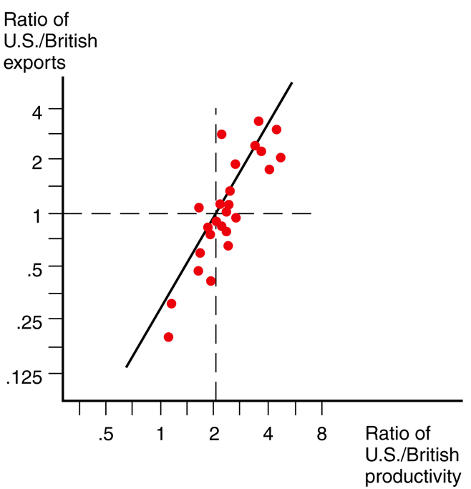
Empirical Support
Fig. 3-6: Productivity and Exports
U.S. productivity exceeded British productivity in all 26 of these industries.
U.S. exported in most productive of them, imported in least
productive of them

