Slide 1
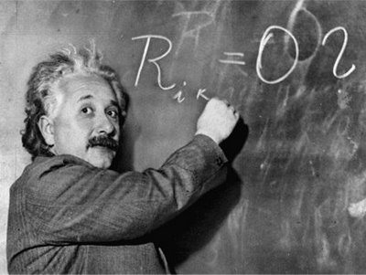
Unit 1: Trade Theory
Introduction, World Trade
1/25/2012

Slide 2
Definitions
import –
a good or service brought
into a country for sale

Slide 3
Definitions
export –
a good or service sent
out of a country for sale

Slide 4
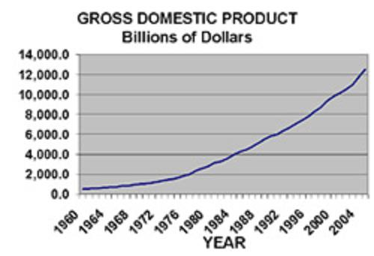
Definitions
gross domestic product (GDP) –
total market value of all final goods and services produced in a country in a given period

Slide 5
Definitions
Note: gross domestic product is different from gross national product; GDP is scoped by location, GNP is scoped by ownership.
A U.S. citizen living in China is
in Chinese GDP, but in U.S. GNP.
We will use GDP, not GNP.

Slide 6
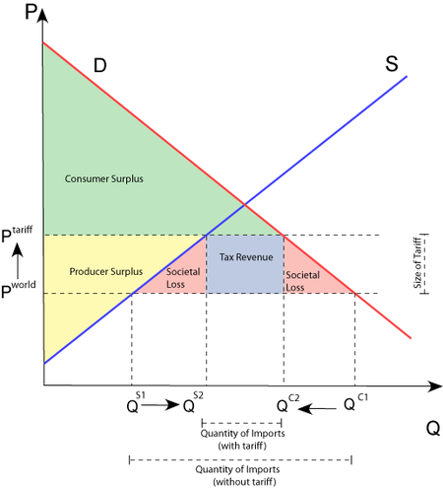
Definitions
tariff –
a tax on imports or exports

Slide 7
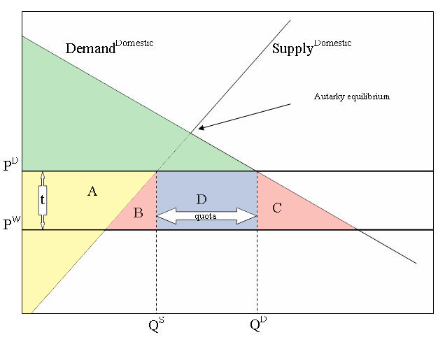
Definitions
quota –
a quantity restriction
on imports or exports

Slide 8
Definitions
export subsidy –
a payment to
producers that export

Slide 9
Krugman
The Krugman textbook has the clearest diagrams and explanations.
However, because Krugman says some crazy things (mainly outside the field of International Economics), I will inoculate you against them early on.

Slide 10
Krugman
Krugman is a classic Keynesian. He believes fiscal stimulus (more government spending) is the solution to pretty much every problem.
(See the Paul Krugman poem linked to from the course website.)

Slide 11
Krugman Stimulus
Recently Krugman suggested the U.S. could get out of its recession if we were invaded by space aliens.
(I am not making this up.)
His theory is if the government spends a lot of money defending against space aliens, then the economy would be stimulated.

Slide 12
Krugman Stimulus
“If we discovered that space aliens were planning to attack and we needed a massive buildup to counter the space alien threat and really inflation and budget deficits took secondary place to that, this slump would be over in 18 months. And then if we discovered, oops, we made a mistake, there aren’t any aliens, we’d be better.”
— Paul Krugman (8/12/2011)

Slide 13
Krugman Stimulus
Paul Krugman (along with most Keynesians) believes World War II lifted America out of the Great Depression.

Slide 14
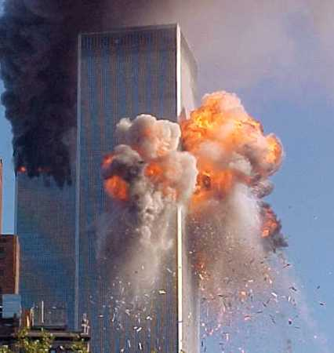
Krugman Stimulus
“Ghastly as it may seem to say this, the terror attack — like the original day of infamy, which brought an end to the Great Depression — could even do some economic good.”
— Paul Krugman (9/14/2001)

Slide 15
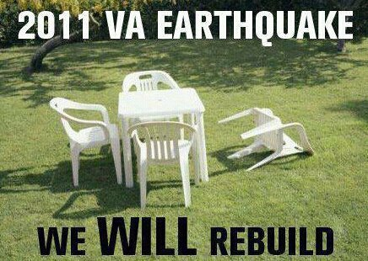
Krugman Stimulus
Krugman didn’t actually say it
(but he probably agrees):
“People on Twitter might be joking, but in all seriousness, we would see a bigger boost in spending and hence economic growth if the [2011 VA] earthquake had done more damage.”
— “Paul Krugman” on Google+

Slide 16
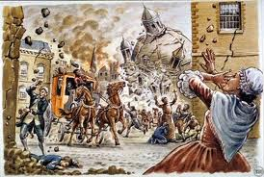
Krugman Stimulus
Voltaire, writing about the great Lisbon earthquake of 1755 remarked :
“philosophers had cried out … ‘all this is productive of general good; the heirs of those who have perished will increase their fortune; masons will earn money by rebuilding the houses, … it contributes to universal good,’ ”

Slide 17
Krugman Stimulus
The idea that disasters are good for the economy is an example of the Broken Window Fallacy, written about by Frederic Bastiat.

Slide 18
Broken Window Fallacy
Some economists suggested that government spending increases output because of a multiplier: if government builds a bridge, the bridge workers buy bread, then bakers buy shoes, etc.

Slide 19
Broken Window Fallacy
Bastiat pointed out by that logic you should break a window
(or break every window in France), because then the homeowner would pay repairmen to fix the window, the repairmen buys bread, then bakers buy shoes, etc.

Slide 20
Broken Window Fallacy
But if the money had not been spent repairing the window, it would have been spent on something else with a similar multiplier. The broken window is “what is seen,” whereas the alternative purchase is “what is unseen” (the opportunity cost).

Slide 21
Broken Window Fallacy
So breaking windows doesn’t really help the economy. Nor does wasting money on useless public projects such as digging ditches – the lost multiplier is collected taxes that could have been spent by consumers.

Slide 22
Broken Window Fallacy
broken window fallacy –
fallacy of taking into account easy to see positive effects of a policy, but not taking into account negative hidden effects of a policy

Slide 23
Is Work Good?
Many economists believe the macro goal is to maximize GDP.
At a micro level they believe the goal is to maximize real income.
But is that correct?

Slide 24
Is Work Good?
How many of you aspire to work as much as possible?
How many of you instead aspire to consume as many goods as possible or to maximize your leisure time?
Work is a means to an end,
not an end in and of itself.

Slide 25
Is Work Good?
The professor I had for International Economics explained this as follows:
WORK IS NO DAMN GOOD
CONSUMPTION IS GOOD
LEISURE IS GOOD

Slide 26
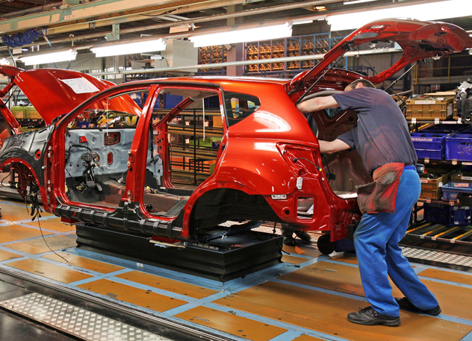
Is Work Good?
A government policy that leads to more production but less consumption often does not increase utility.
We will see later that tariffs decrease consumer surplus more than they increase producer surplus.

Slide 27
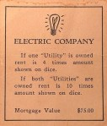
Is Work Good?
utility –
total satisfaction from consuming (or not consuming) a good or service
In economics we talk about utility to indicate happiness. Often real income or GDP is used as a proxy for utility, but it is important to remember it is not a perfect proxy.

Slide 28
Problems with GDP
Statistical Problems
Measurement errors
Price index interaction
Conceptual Problems
Don’t include all output
Underground economy
Non-monetary activity
Don’t accurately measure output
Intermediate goods
Non-market prices
Output is not a perfect proxy for welfare
Leisure
Terms of trade
Marginal utility ≠ total utility
War is bad

Slide 29
Problems with GDP
Measurement errors
There is a “statistical discrepancy” figure included with GDP because when they calculate it different ways (income vs. spending) the results are different.
Initial figures only include 2/3 of spending. 3 years later GDP is revised with all the numbers.

Slide 30
Problems with GDP
Price index interactions
The price index used can affect results.
Price indices determine the relative weights of different goods
(house, car, food, etc.).
1929 weights 1982 weights
real GDP 1940-1944 +30% +50%
real GDP 1944-1946 -5% -30%

Slide 31
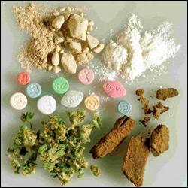
Problems with GDP
Underground economy
Doesn’t include underground economy: drugs, prostitution, pornography
Estimates
US 10% of GDP
Italy 25% of GDP
Peru 50%+ of GDP

Slide 32
Problems with GDP
Non-monetary activity
The contribution of volunteers and housewives is not included.
If a man marries his housekeeper, he reduces real GDP.

Slide 33
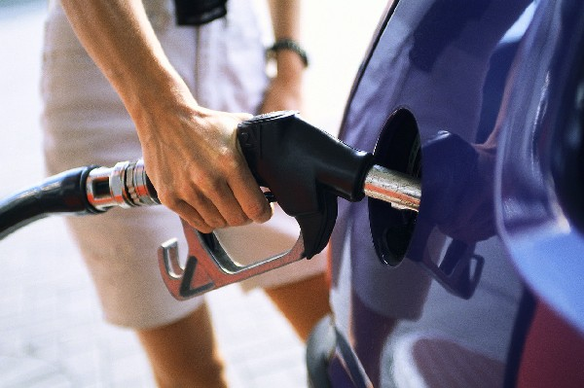
Problems with GDP
Intermediate goods
Classification is somewhat random and different categories are measured different ways.
Example: gas for recreation is a final good (counted), gas to drive to work is an intermediate good (not counted).

Slide 34
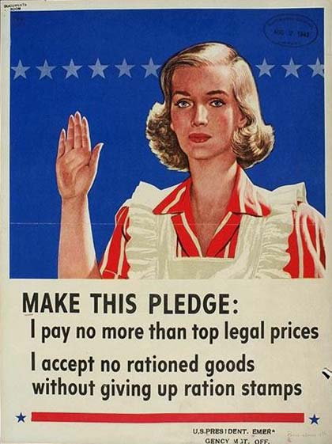
Problems with GDP
Non-market prices
Price controlled items can distort
GDP as a measure of output.
Government spending is measured at cost. In reality what government does is probably overvalued (what would people pay for it in the free market?) or could even be detrimental.

Slide 35
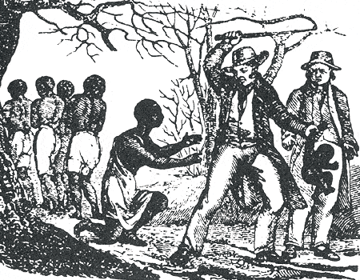
Problems with GDP
Leisure
Leisure is not included in GDP.
Example of this manifesting itself:
Historically wars would cause productivity (GDP/person) to decline, but it would return to the previous trend after the war.

Slide 36
Problems with GDP
Leisure
Example (continued):
But after the Civil War productivity reverted to a lower trend line.
The reason productivity declined was former slaves decided not to work as hard – substituting leisure for work.
Not a bad thing.

Slide 37
Problems with GDP
Leisure
We could raise GDP and achieve full employment by conscripting every unemployed person into the military.
Doing so would sacrifice their freedom and leisure time though.

Slide 38
Problems with GDP
Terms of trade
If Kuwait produces 10 million barrels of oil a year, its GDP can fluctuate a lot year to year depending on the price of oil relative to other goods.

Slide 39
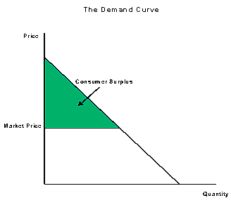
Problems with GDP
Marginal utility ≠ total utility
GDP actually counts marginal utility, not total utility.
Diamonds are expensive but non-essential. Water is cheap but necessary for survival.
Diamonds: high MU, low total U
Water: 0 MU, high total U

Slide 40
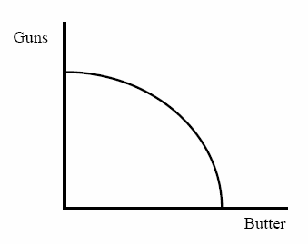
Problems with GDP
War is bad
Wars don’t make people better of regardless of who wins.
But war spending is counted in GDP, which purports to be a proxy for utility.

Slide 41
Problems with GDP
Statistical Problems
Measurement errors
Price index interaction
Conceptual Problems
Don’t include all output
Underground economy
Non-monetary activity
Don’t accurately measure output
Intermediate goods
Non-market prices
Output is not a perfect proxy for welfare
Leisure
Terms of trade
Marginal utility ≠ total utility
War is bad

Slide 42
Valuing Goods
We must distinguish
between price and value:
price is objective
value is subjective

Slide 43
Valuing Goods
When people trade, the price they see is the same.
However, they do not value the items traded equally.
Instead they value the items unequally.
=
≠
There is a reverse inequality of value.

Slide 44
Valuing Goods
reverse inequality of value –
both parties to the trade value what they’re
getting more than what they’re giving up
(everyone is happy)

Slide 45
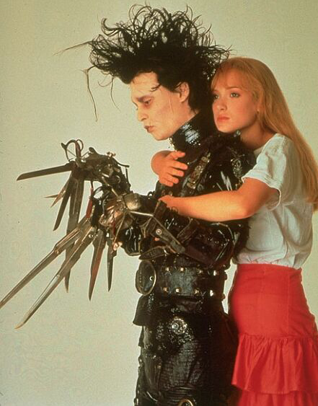
Valuing Goods
Suppose Harry wants to trade a hat to Bob for a haircut.
If the trade occurs,
Harry values
haircut > hat
Bob values
haircut < hat
Harry the
haberdasher
Bob the
barber

Slide 46
Valuing Goods
Reverse inequality of value is what makes trades mutually advantageous, which is why people trade voluntarily.
Trade is not a zero sum game with a winner and a loser.
Trade is a positive sum game. Both parties are winners.
Harry
Bob

Slide 47
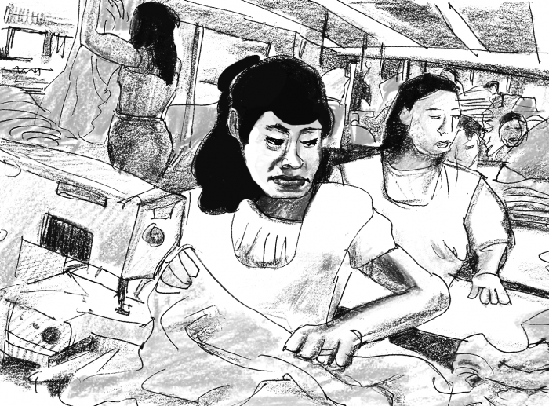
Valuing Goods
Remember the insight that people only enter into voluntary trades if they subjectively believe they are made better off.
For example, sweatshop employees work there because the alternative would be worse.

Slide 48
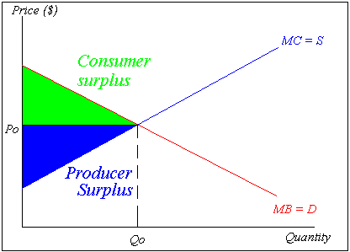
Valuing Goods
Gains from trade can be thought of graphically as consumer surplus and producer surplus.

Slide 49
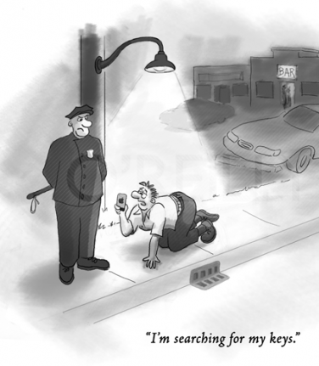
Critique of Models
It’s important to remember the limitations of models. Models simplify, but often economists prefer a simple model to a correct one.
If you lose your keys, you can look where you lost them or look where the light is.

Slide 50
Critique of Models
A model is only as good as its assumptions. Often when you use an economic model frequently you can forget that when assumptions don’t match reality, results won’t either.
Garbage in, garbage out.

Slide 51
Critique of Politicians
Politicians use economists like drunks use lampposts: more for support than illumination.

Slide 52
Overarching Krugman Themes
The Gains from Trade
The Pattern of Trade
How Much Trade?
Balance of Payments
Exchange Rate Determination
International Policy Coordination
The International Capital Market

Slide 53
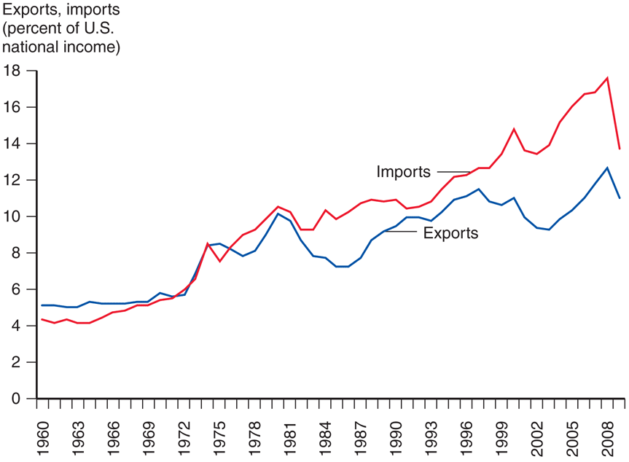
Trade Trends
imports & exports (% of GDP)
rising over the last 40 years
(roughly tripled)
imports > exports
(financed by capital inflows: foreign investment in U.S.)
imports & exports declined
due to sub-prime crisis
Fig. 1-1: Exports and Imports as a Percentage of U.S. National Income

Slide 54
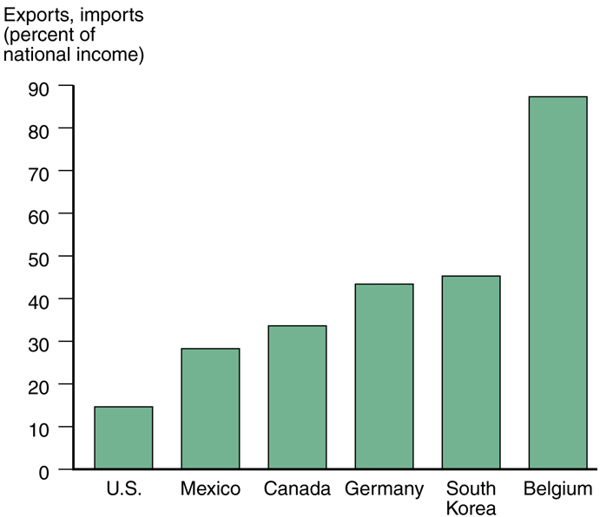
International Trade
Fig. 1-2: Exports and Imports as Percentage of National Income in 2007
other countries rely far more on trade for their GDP
U.S. is a large country with a common language & currency and diverse climates: can rely more on domestic production

Slide 55
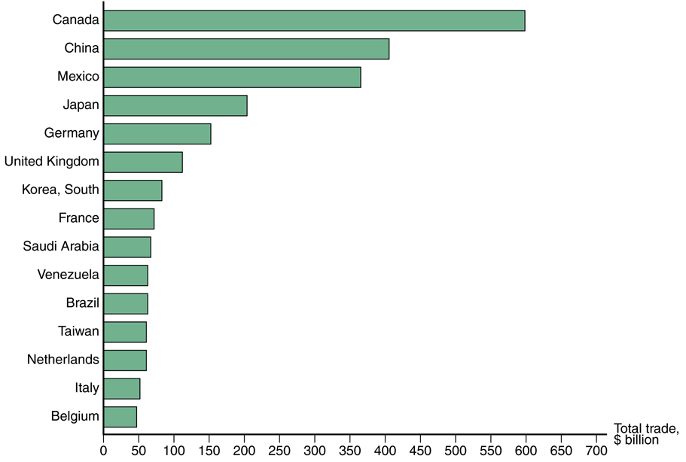
International Trade
Fig. 2-1: Total U.S. Trade with Major Partners, 2008
2008 U.S. trade insights
5 largest trading partners:
Canada, China, Mexico, Japan, & Germany
largest 15 trading partners accounted for 69% of trade

Slide 56
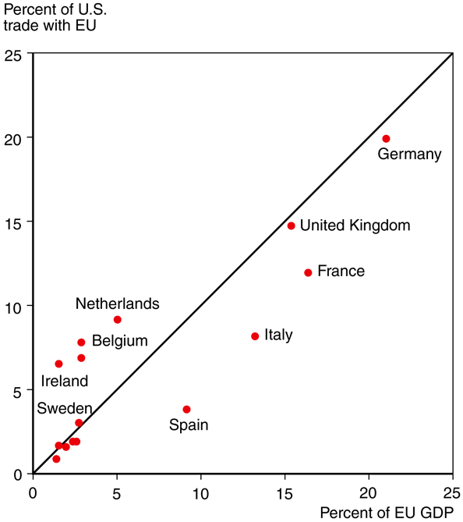
Gravity Model
Fig. 2-2: The Size of European Economies, and the Value of Their Trade with U.S.
size matters
country’s GDP directly related to volume of imports & exports
exports: larger economies produce more goods & services (more to sell)
imports: larger economies generate more income (more to buy)

Slide 57
Gravity Model
other factors
distance – transportation costs, communication
cultural affinity – cultural ties → economic ties
geography – ocean harbors, lack of mountains
multi-national corporations – trade among divisions
borders – tariffs, customs, different language/money

Slide 58
Gravity Model
T_{IJ} = AY_{I}Y_{J}/D_{IJ}
T_{IJ} ≡ value of trade between countries I & J
Y_{I} ≡ GDP of country I
Y_{J} ≡ GDP of country J
D_{IJ} ≡ distance between countries I & J
A ≡ constant term

Slide 59
Gravity Model
The gravity model is named and modeled after Newton’s Universal Law of Gravitation from physics:
F = Gm₁m₂/r²

Slide 60
Gravity Model
T_{IJ} = A(Y_{I})ª(Y_{J})^{b}/(D_{IJ})^{c}
In a more general form of the gravity model Y_{I}, Y_{J}, & D_{IJ} are all raised to a power which is allowed to differ from 1.
Econometrics is used to find a best fit of a, b, & c to actual data. Empirical tests show a, b, & c are pretty close to 1.
So the simpler version is a good approximation.

Slide 61
Gravity Model
Fig. 2-2: The Size of European Economies, and the Value of Their Trade with U.S.
anomalies
Netherlands & Belgium:
geography (near mouth of Rhine, Western Europe’s longest river)
Ireland:
cultural affinity & multi-national corporations (low corporate taxes)

Slide 62
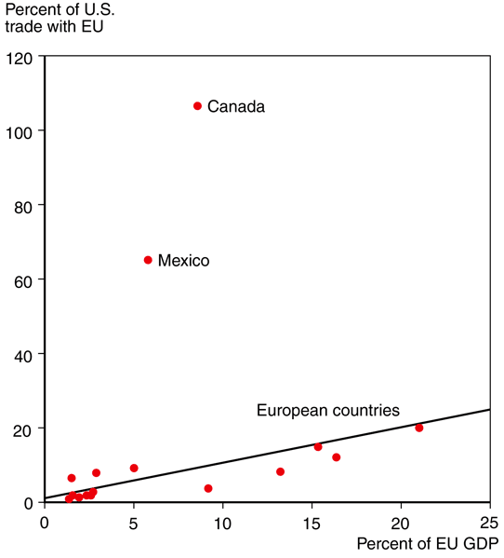
Gravity Model
estimates of model
1% increase in distance causes
0.7% to 1% decrease in trade
Canada & Mexico are much closer to the U.S. than Europe,
so there is much more trade
(also the U.S., Canada, & Mexico have a free trade agreement: NAFTA)
Fig. 2-3: Economic Size and Trade with the United States

Slide 63
Gravity Model
Also the U.S., Canada, & Mexico have a free trade agreement: the North American Free Trade Agreement (NAFTA, signed 1994).
Even with free trade though,
borders matter.

Slide 64
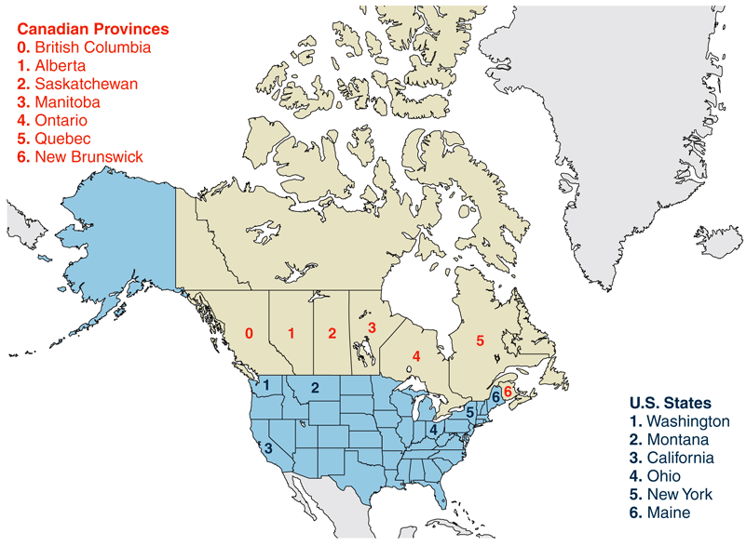
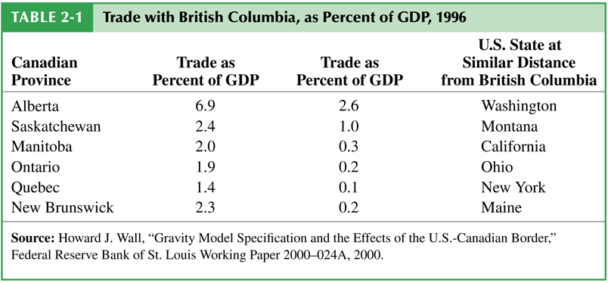
Gravity Model
Fig. 2-4: Canadian Provinces and U.S. States That Trade with British Columbia
Table 2-1: Trade with British Columbia, as Percent of GDP, 1996
Trade with U.S. states of equivalent distance as provinces is far lower.

Slide 65
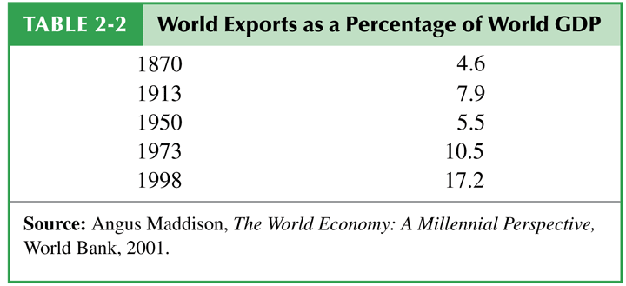
Has the World Become Smaller?
The negative effect of distance is decreasing due to modern transportation and communication.
World trade grew rapidly from 1870 to 1913, then declined due to world wars and the Great Depression.
It recovered around 1970.
Table 2-2: World Exports as a Percentage of World GDP

Slide 66
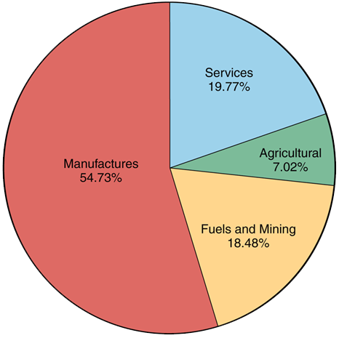
World Trade
Fig. 2-5: The Composition of World Trade, 2008
The bulk of world trade is manufactured products.

Slide 67
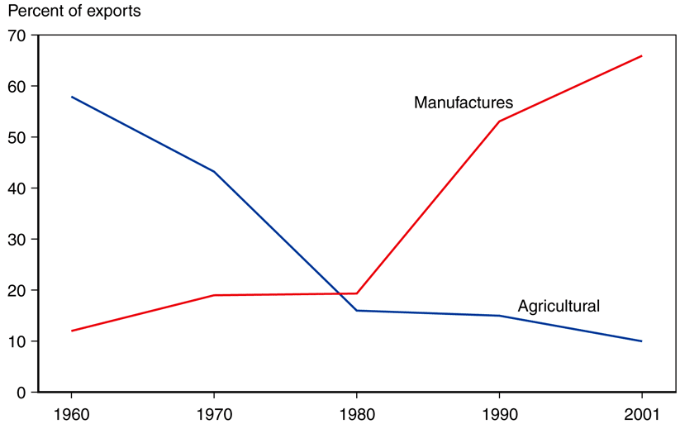
World Trade
Table 2-3: Manufactured Goods as a Percent of Merchandise Trade
Fig. 2-6: The Changing Composition of Developing-Country Exports
100 years ago most trade was agricultural & mineral products.
Developing countries are trending away from agriculture to manufacturing.

Slide 68
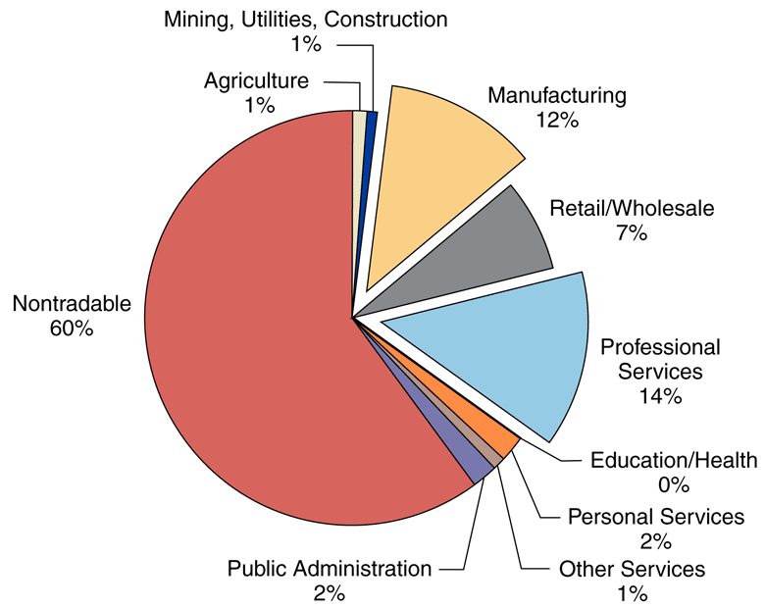
World Trade
Fig. 2-7: Tradable Industries’ Share of Employment in U.S.
A lot more services could be offshored / outsourced.

