Slide 1
International
Economics
Econ 390-001
Mon., Wed., & Fri.
12:30-1:20 pm
University Hall, 1202

Slide 2
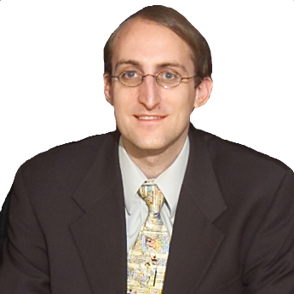
Professor
Chuck Moulton
Contact Info
chuck@moulton.org
888-MOULTON
Office Hours
by appointment
Ent. Hall, Work. 342
http://www.chuckmoulton.org/gmu/econ390/

Slide 3
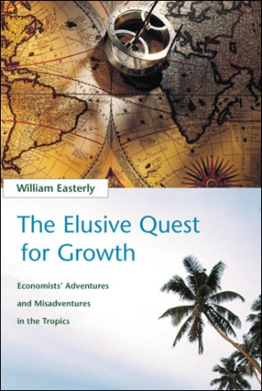
Textbooks
The Choice: A Fable of Free Trade
and Protectionism
by Russell Roberts
The Elusive Quest
for Growth
by William Easterly
International Economics
by Paul Krugman et al.
required
required
required

Slide 4
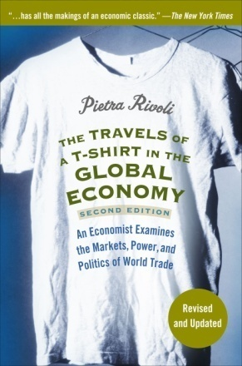
Textbooks
The Travels of
a T-shirt in the
Global Economy
by Pietra Rivoli
Economic Sophisms
by Frederic Bastiat
recommended
recommended

Slide 5
Grades
20% quizzes
40% midterms
40% final exam
quizzes (5 question) on the readings, 10 lowest dropped
3 non-comprehensive midterms on the lectures, lowest dropped
comprehensive final exam (5/14/2012, 10:30 am – 1:15 pm)
no make-up quizzes or tests, quizzes and tests will be curved
might be extra credit for field trips or speakers

Slide 6
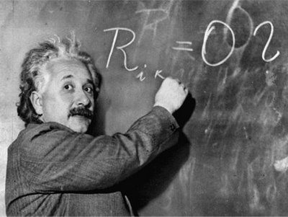
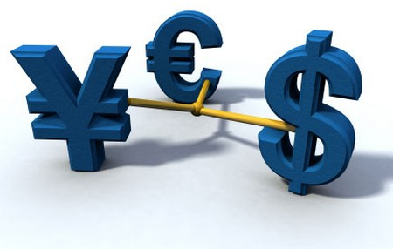
Course Overview
Unit 1: International Trade Theory
Unit 2: International Trade Policy
Unit 3: Exchange Rates
Unit 4: Miscellaneous Stuff
Theory
Policy
Exchange Rates
Miscellaneous

Slide 7
Sample Quiz
We’re going to take a sample quiz on the
syllabus to familiarize with the process.

Slide 8
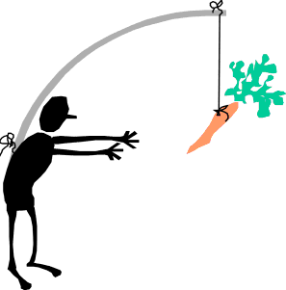
Teaching Philosophy
I aim to align student incentives with course goals,
so that quiz grades correlate with book knowledge
and midterms/final correlate with lecture knowledge .

Slide 9
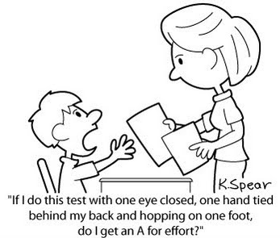
Teaching Philosophy
I don’t subscribe to a
labor theory of value.
You will be graded on your output of demonstrated grasp of course material, not on your input of effort.

Slide 10
Teaching Philosophy
In my opinion notes became obsolete with
the invention of the printing press in 1440.

Slide 11
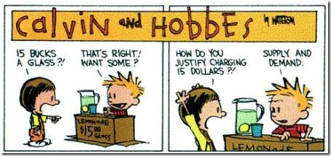
Teaching Philosophy
Learning should be fun.
If it isn’t fun, you aren’t doing it right.

Slide 12
Cheating
cheating will not be tolerated
all cheaters will be
discovered
reported to the Honor Committee
issued F’s for the course
suspended or expelled from GMU
honor code
you must not cheat yourself
you must report cheating of others

Slide 13
Calculators
There will be no calculators on exams
You should know basic math:
addition
subtraction
multiplication
division
fractions (+, –, ×, ÷)
simple algebra

Slide 14
Bias Disclosure
Libertarian
(politically)
anarcho-capitalist
(philosophically)

Slide 15
Government
government –
a legitimized monopoly on coercion

Slide 16
Why Take International Economics?
economy is increasingly global / interconnected
public is dangerously clueless of good policies:
free trade, open immigration, & sound money
develops knowledge base for high income jobs

Slide 17
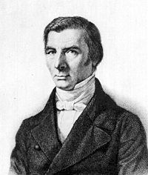
Quotes
“When goods don’t cross borders, armies will.” – Frederic Bastiat

Slide 18
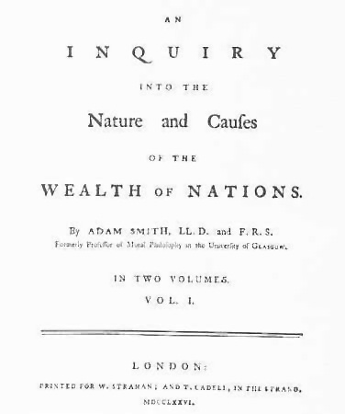
Quotes
“It is not from the benevolence of the butcher, the brewer, or the baker that we expect our dinner, but from their regard to their own interest.” – Adam Smith

Slide 19
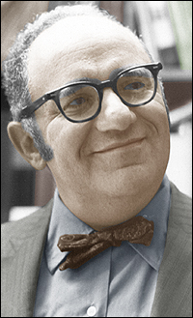
Quotes
“It is no crime to be ignorant of economics, which is, after all, a specialized discipline and one that most people consider to be a dismal science. But it is totally irresponsible to have a loud and vociferous opinion on economic subjects while remaining in this state of ignorance.” – Murray Rothbard

