Slide 1
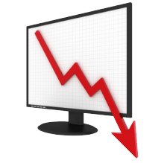
Unit 4: Macro Failures
The Subprime Crisis
5/3/2011

Slide 2
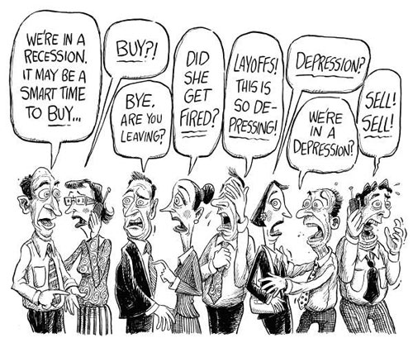
Recessions vs. Depressions
recession –
two consecutive quarters
where GDP falls
depression –
recession where unemployment hits 10%;
recession where
GDP falls 10%

Slide 3
Recessions vs. Depressions
Our current financial crisis is called the Great Recession or the Subprime Crisis.
According to the definitions, the recession began in December 2007 and ended in June 2009.

Slide 4
Recessions vs. Depressions
The unemployment rate maxed out above 10% January-March of 2010, but because that period was not within the recession (ended June 2009), this is not a depression.
Negative ΔGDP maxed out at
-7.9% in the 4th quarter of 2008.

Slide 5
Recessions vs. Depressions
Currently the unemployment rate is around 9.3%.
Unemployment is higher in places that had a lot of construction (e.g., CA, FL) and higher among high school dropouts than college graduates.

Slide 6
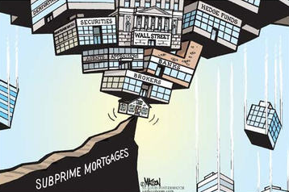
Causes of the Subprime Crisis
causes of subprime crisis
incentivized home ownership
incentivized subprime lending
wrong credit ratings
ABCT boom/bust cycle
housing bubble
pro-cyclical bank regulation
misguided bailouts / stimulus
creates moral hazard

Slide 7
Home Ownership
advantages
building equity
collateral for later loans
disciplines savings
tax benefits
mortgage interest deduction
housing tax credit
disadvantages
not diversified
limits labor mobility

Slide 8
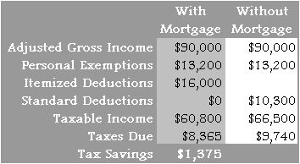
Home Ownership
The mortgage interest deduction on personal income taxes encourages people at the margin to buy houses because they get an interest free loan.

Slide 9
Home Ownership
Other types of interest aren’t deductible (e.g., car loans, credit cards, etc.).
Also stock investments are
disincentivized due to double taxation (corporate income tax + capital gains tax).

Slide 10
Home Ownership
Recently the government
has provided tax credits to encourage home buying.
We will also see that the government incentivizes banks to make home loans.

Slide 11
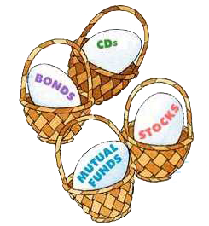
Home Ownership
Diversification of investments is important… you don’t want to put all your eggs in one basket.
But many people have the vast majority of their net worth in their house. They are very vulnerable to housing price fluctuations.

Slide 12
Home Ownership
When unemployed, it often makes sense to seek a job in a different area with a lower unemployment rate.
Renters can move easily.
Home owners have a much higher moving cost.
This limits labor mobility.

Slide 13
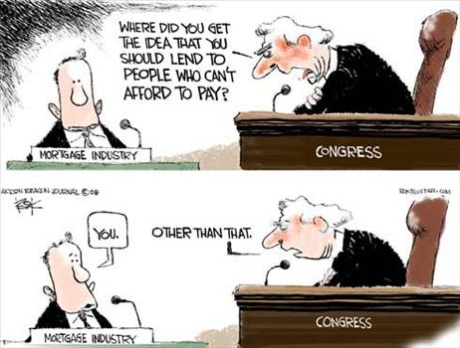
Bank Issues
government incentives
mortgage interest deduction
federal housing tax credit
Community Reinvestment Act
prohibited redlining
encourages subprime loans
government guarantees
Freddie Mac, Fannie Mae
mortgage backed securities

Slide 14
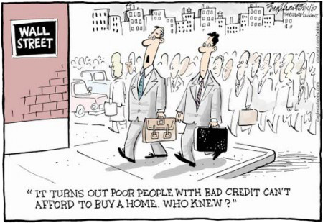
Bank Issues
The Community Reinvestment Act (CRA) prevented banks from redlining areas – they were forced to make loans to the poor.
Because the poor did not have the normal 20% down payment, banks had to innovate other loan structures getting around it.

Slide 15
Bank Issues
Banks not complying with the Community Reinvestment Act would be fined or prevented from merging.
This was at a time when restrictions on branch banking had just been lifted (1994), so mergers were highly desired.

Slide 16
Bank Issues
fixed rate mortgage –
interest rate stays the same
adjustable rate mortgage (ARM) –
interest rate fixed initially,
then adjusts to market rate later

Slide 17
Bank Issues
subprime loan –
loan to people with bad credit
(credit score below 640)
NINJA loan –
no income, no job, no assets

Slide 18
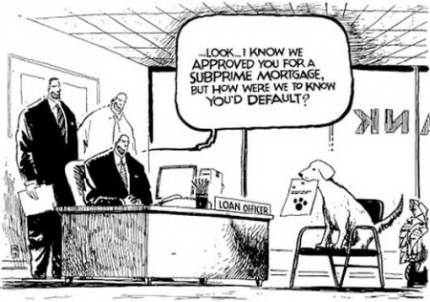
Bank Issues
Banks gave mortgages with 0% down payments to comply with the regulations against redlining.
Adjustable rate mortgages were an innovation allowing home buyers to afford mortgages that wouldn’t have been possible with the high 30 year fixed rate.

Slide 19
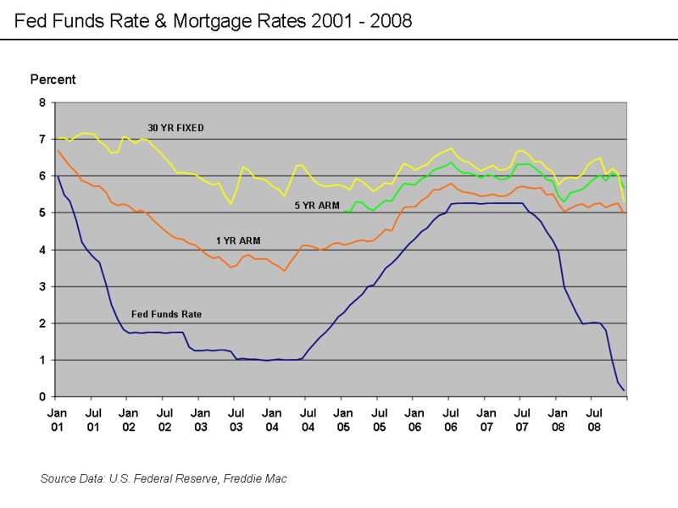
Bank Issues
Adjustable rates were significantly less than fixed rates due to the low federal funds rate. This strongly encouraged ARMs. When rates later went up after the teaser rate ended (1-5 years), rates skyrocketed.

Slide 20
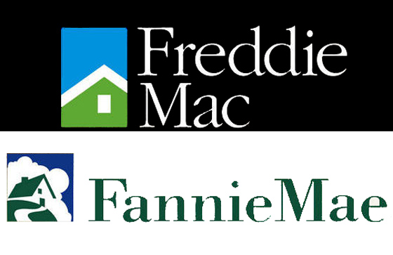
Bank Issues
The government quasi-agencies Freddie Mac and Fannie Mae would implicitly guarantee mortgages from banks (creating moral hazard) and help banks bundle them into mortgage backed securities then sell them to investors (e.g., hedge funds).

Slide 21
Bank Issues
mortgage backed securities –
break up mortgage into tiny pieces,
then bundle many mortgages together
to diversify risk and sell them off

Slide 22
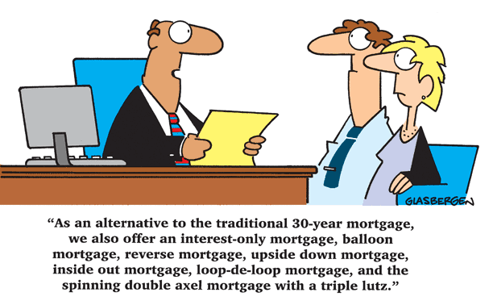
Bank Issues
Securitization of mortgages created a moral hazard problem because the lending bank wouldn’t suffer from defaults (instead the buyer of the MBS suffers).
Banks over-issued
mortgages as a result.

Slide 23
Bank Issues
FDIC deposit insurance is a moral hazard problem because losses are socialized while gains accrue to the bank shareholders. This encourages excessive risk.

Slide 24
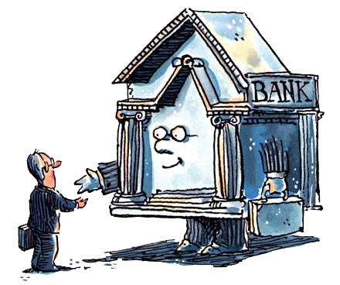
Bank Issues
moral hazard
implicit Freddie Mac guarantee
securitization of mortgages
FDIC insurance
Community Reinvestment Act
prohibited redlining
encourages sub-prime loans
penalties for non-compliance
fines
prevented from merging

Slide 25
Credit Rating Agencies
Credit rating agencies evaluated the risk of mortgage backed securities. These evaluations were grossly wrong.

Slide 26
Credit Rating Agencies
no free market in ratings
government mandates top 3
S&P, Moodys, Fitch
immune from lawsuits
no penalty for wrong ratings
first amendment
contrast: auditors can be sued
conflicts of interest
also provide consulting

Slide 27
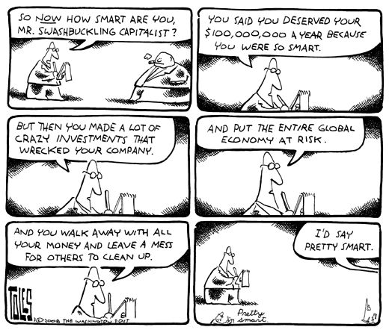
MBS buyers
Investment bankers and hedge fund managers would risk their investors’ money and get large bonuses for short term gains with no penalties for losses.
This equity moral hazard (principal/agent) problem results in excessive risk.

Slide 28
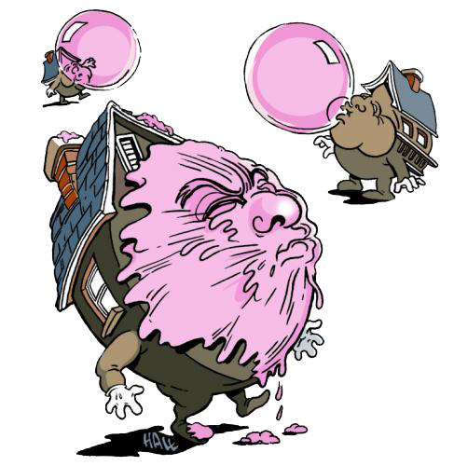
Austrian Business Cycle Theory
Austrian Business Cycle Theory
is actually a mainstream theory
for the Subprime Crisis.
Low interest rates by the Federal Reserve caused a housing bubble, which subsequently crashed. The economy suffered due to those malinvestments in housing.

Slide 29
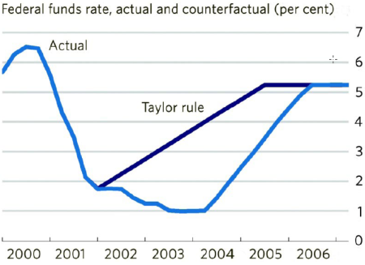
Austrian Business Cycle Theory
In the early 2000’s under Greenspan the federal funds rate was far below the Taylor Rule suggested level.
This low interest rate over-incentivized investment in areas like housing purchases and construction.

Slide 30
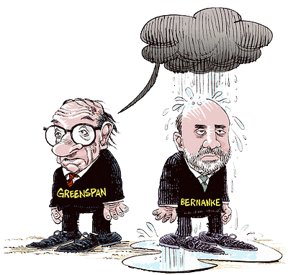
Austrian Business Cycle Theory
Greenspan lowered the federal funds rate from 6.5% in May 2000 to 1% in June 2003 through 13 rate cuts, held the FFR at 1% for a year, and then raised the FFR to 5.25% by June 2006 through 17 rate hikes.

Slide 31
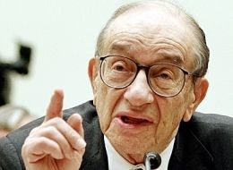
Austrian Business Cycle Theory
Greenspan put –
using monetary policy to
prevent asset price deflation
(i.e., reflate asset bubbles)

Slide 32
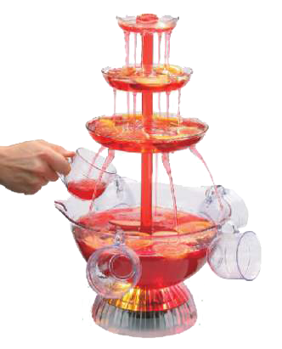
Austrian Business Cycle Theory
Fed Chair William Martin famously said it was his job to take the punch bowl away just when everyone was beginning to have fun.
By that he meant that the Fed is supposed to raise interest rates when the economy heats up to prevent inflation and asset bubbles.

Slide 33
Austrian Business Cycle Theory
Far from taking the punch bowl away when traders begin to make merry, the central bank now spikes it at the first sign of economic sobriety.
Meaning the Fed lowers interest rates when a bubble is discovered and market participants try to correct it.

Slide 34
Austrian Business Cycle Theory
When the tech bubble was bursting, instead of letting prices adjust Fed chair Greenspan lowered the federal funds rate to 2%, then 1%.
Now that the housing bubble is bursting, instead of letting prices adjust Fed chair Bernanke has lowered the federal funds rate to near zero.

Slide 35
Austrian Business Cycle Theory
Austrian business cycle
boom period
low interest rates 2002-2006
inflated housing bubble
bust period
malinvestments discovered
recession 2007-2009

Slide 36
Bursting the Bubble
bankruptcy law change
credit cards debt harder to avoid
pay credit card before mortgage
mortgage payments increased
because interest rates rose
adjustable rate mortgages
mortgage defaults
lower housing prices
mortgages underwater
mortgage defaults

Slide 37
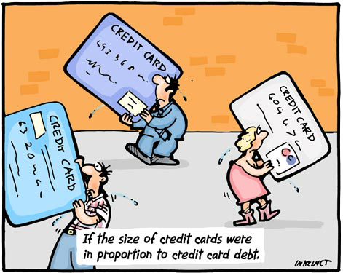
Bursting the Bubble
Congress changed bankruptcy laws making it more difficult to get out of credit card debt. So debtors short on cash began paying off credit cards rather than mortgages.

Slide 38
Bursting the Bubble
Interest rates rose, making payments on ARMs increase significantly. Many people defaulted on their mortgages, lowering home prices.

Slide 39
Bursting the Bubble
Low down payments meant many people were underwater when home prices fell: they owed more on their mortgage than the house was worth. So they just walked away, leading to more defaults and lower prices in the housing sector.

Slide 40
Bank Insolvency
banks were overleveraged
government promoted debt
double tax on dividends
deduction of bond interest
mark to market accounting
assets valued at fire sale prices
pro-cyclical
equity requirements for banks
must reduce leverage
sell off assets

Slide 41
Bank Insolvency
Banks and other companies were overleveraged. This was a result of government incentives: double taxation of dividends (corporate income tax + capital gains tax) coupled with corporate deduction of interest payments.

Slide 42
Bank Insolvency
Thus debt funding is incentivized over equity funding, resulting in low equity cushions and high leverage ratios (debt to equity).

Slide 43
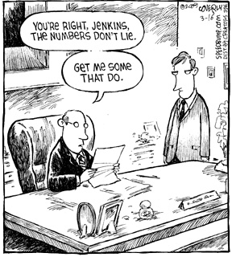
Bank Insolvency
mark to market accounting
(fair value accounting) –
valuing assets based on their current market price rather than their historical price
(i.e., rather than the price the
assets were purchased for)

Slide 44
Bank Insolvency
After Enron, corporations were required to use mark to market accounting of their assets. This meant banks holding mortgage backed securities had to value them at their fire sale prices immediately rather than waiting for a better sale price.

Slide 45
Bank Insolvency
Regulations require adequate capital by a bank to ensure it is solvent – an equity cushion.
With mark to market accounting a bank can become insolvent on paper even though it is not illiquid – the bank can still meet its obligations as they become due.

Slide 46
Bank Insolvency
This forces banks to sell off assets at fire sale losses and scramble for more capital (or for bailouts) even though the bank doesn’t have any actual liquidity problem.

Slide 47
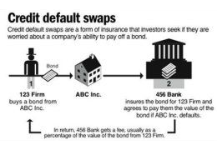
Credit Default Swaps
credit default swap (CDS) –
bet on whether a loan
will be repaid;
type of insurance that
allows hedging

Slide 48
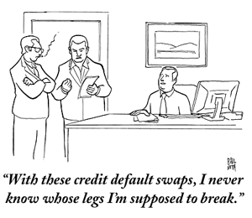
Credit Default Swaps
credit default swaps
bet on whether loan repaid
type of insurance
helped hedging risk
models wrong
housing prices always up
premiums too low
insurers defaulted on CDSs
AIG, Lehman Brothers

Slide 49
Credit Default Swaps
Credit default swaps of MBSs allowed banks to hedge against the risk of mortgage default.
But because models assumed housing prices would always go up, systemic risk wasn’t taken into account and thus premiums were priced too low.

Slide 50
Credit Default Swaps
Additionally the insurers didn’t have enough liquid assets to pay out CDS holders when the credit condition triggered.
This meant AIG and Lehman Brothers were insolvent and all banks that had relied on their CDSs for hedging were screwed.

Slide 51
Credit Default Swaps
Another concern with CDSs was that the holder wasn’t required to have an insurable interest. So a person could bet that MBSs would default even if he held no MBS.

Slide 52
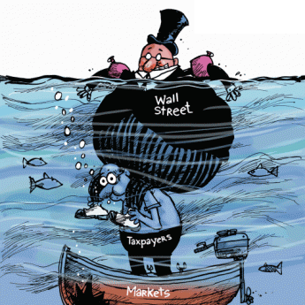
Government Response
government response
bailouts / stimulus spending
Federal Reserve
quantitative easing
quantitative easing 2
Treasury
TARP
regulation
Dodd-Frank Act of 2010

Slide 53
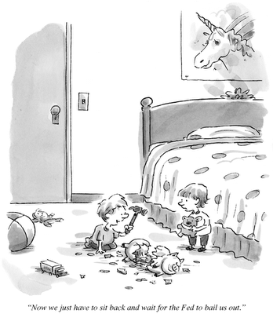
Government Response
In quantitative easing 1 (QE1) the Federal Reserve bought $1.2 trillion in mortgage backed securities to prop up banks and stimulate the economy.
This is unusual in both the amount and in the type of asset. Usually the Fed confines itself to short term treasury securities.

Slide 54
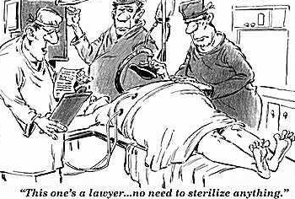
Government Response
The Fed used to sterilize its discount loans and sterilize its purchase of unusual assets
(e.g., mortgage backed securities).
This means the composition of the Fed’s assets would change, but the total monetary base would be the same.

Slide 55
Government Response
But when the Fed got the power to pay interest on reserves,
it stopped sterilizing discount loans and MBS purchases.
The Fed allowed total reserves to balloon, limiting M1 growth by increasing excess reserves.

Slide 56
Government Response
Before QE1:
ER small
D > R
C + D > C + R
M1 > MB
MB = 848 bil.
ER = 2 bil.
e = 0.002
D
C+D = M1
C+R = MB
R
C
B

Slide 57
Government Response
After QE1:
ER large
D < R
C + D < C + R
M1 < MB
MB = 2115 bil.
ER = 1162 bil.
e = 1.45
deposits if e unchanged
C+D = M1
C+R = MB
D
R
C
B

Slide 58
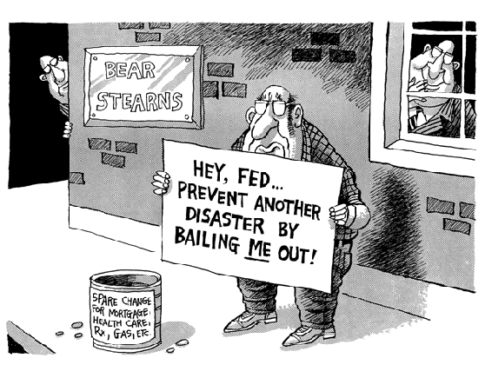
Government Response
The Federal Reserve bailed out AIG, but declined to bail out Lehman Brothers.
It implicitly bailed out Bear Sterns and Merrill Lynch by swapping treasury securities for their mortgage backed securities to encourage mergers.

Slide 59
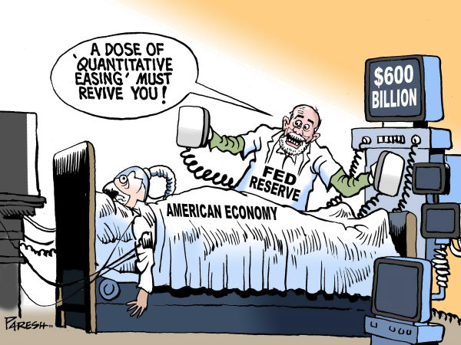
Government Response
In quantitative easing 2 (QE2) the Fed plans to buy $600 billion of long term (30 year) treasury securities. Note that the Fed usually buys short term treasury securities in its open market operations.

Slide 60
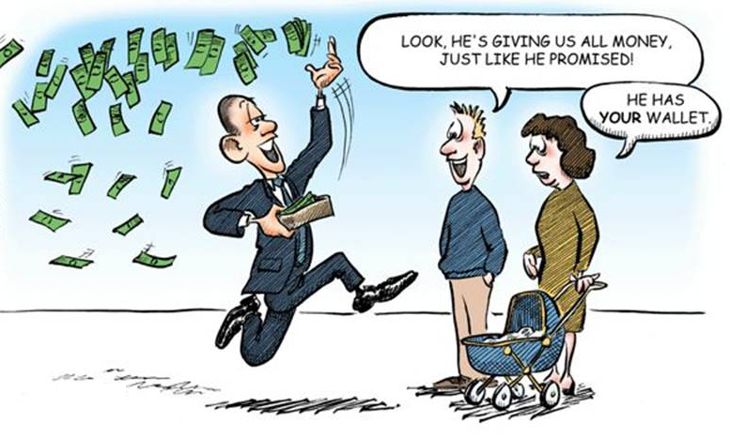
Government Response
The Troubled Asset Relief Program (TARP) was a $700 billion stimulus package bailing out banks and other companies supposedly to stimulate the economy.
Keynesians loved the idea.

Slide 61
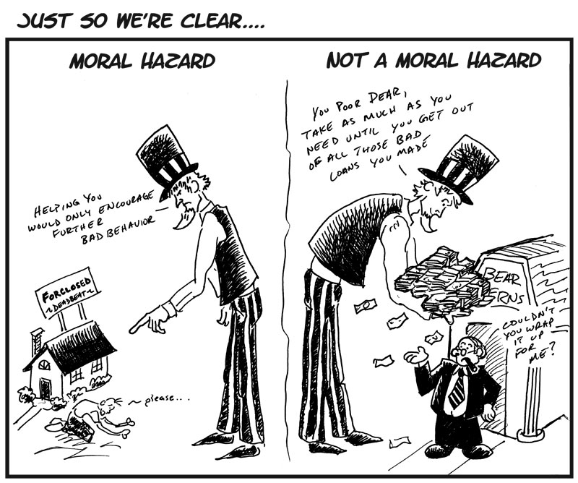
Government Response
Bailouts have created a moral hazard for banks.
The implicit guarantee that banks will be bailed out in the future encourages excessive risk taking.
this is satire…
both are moral hazard

Slide 62
Government Response
Dodd-Frank Wall Street Reform and Consumer Protection Act of 2010
consolidates regulatory agencies
eliminates thrift charter
creates Financial Stability Oversight Council
creates Bureau of Consumer Financial Protection
Volcker rule
regulates derivatives
regulates hedge funds

Slide 63
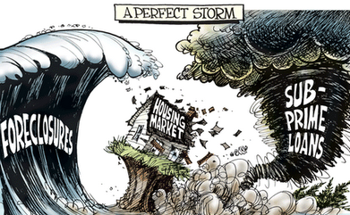
Causes of the Subprime Crisis
causes of subprime crisis
incentivized home ownership
incentivized subprime lending
wrong credit ratings
ABCT boom/bust cycle
housing bubble
pro-cyclical bank regulation
misguided bailouts / stimulus
creates moral hazard

