Slide 1
Unit 4: Macro Failures
Tangential Topics
4/26/2011

Slide 2
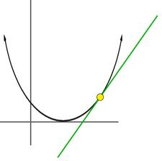
Tangents
I’m going to cover a few concepts that didn’t fit neatly into the broad lecture topics.

Slide 3
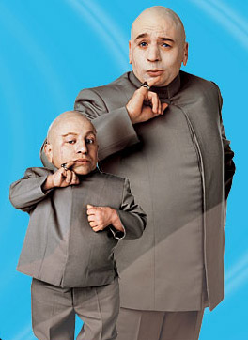
Growth
This class has focused on business cycles because they are impacted by monetary policy.
But in macroeconomics economic growth is far important than business cycles. Government policies aiming to mitigate business cycles often retard growth – a terrible tradeoff.

Slide 4
Growth
Example
begin w/ $3,000 average income
country A
6% growth rate
50 years later: $55,260 income
country B
2% growth rate
50 years later: $8,075 income
6.8x higher standard of living in A

Slide 5
Growth
Government policies of taxes, regulation, and uncertainty cause lower growth rates in the U.S.
Lack of a sound money as well as disrespect for property rights and the rule of law cause low growth rates in developing countries.

Slide 6
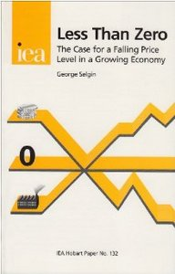
Deflation
As mentioned throughout this course, many economists are afraid of deflation.
It is widely believed that deflation causes recessions.
But some economists (myself included) like deflation.

Slide 7
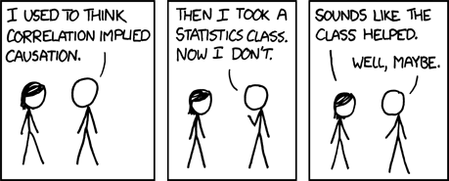
Deflation
Deflation and recessions often go together, but that doesn’t necessarily mean deflation causes recessions. This more likely a case of reverse causation: recessions cause disintermediation, which leads to deflation.

Slide 8
Deflation
George Selgin wrote
Less Than Zero: The Case
for a Falling Price Level
in a Growing Economy.
He advocates letting prices
fall rather than trying to
keep them constant.

Slide 9
Deflation
Selgin believes prices should fall at the rate of productivity growth.
This leaves relative price signals stable and also conveys that productivity is increasing.

Slide 10
Deflation
w = W/P
Letting prices fall leaves nominal wages stable while real wages rise (real wages = labor productivity).
If prices are manipulated to stay constant, nominal wages rise when real wages rise.

Slide 11
Deflation
Tradeoff
falling P, stable W; or
stable P, rising W
Either way you have an unstable macroeconomic variable. But the latter choice (stabilizing P) requires constant government intervention; whereas, the former is natural.

Slide 12
Deflation
Why do prices fall naturally?
As productivity increases, goods can be produced cheaper. That savings is passed on to consumers through lower prices.

Slide 13
Deflation
The best example of this is computers, whose prices fall
at a huge rate year to year as technology improves.
But the same is true of any item. The prices of most items drop slower than computers. And their price drop is often obscured by inflation (a rise in the price level).

Slide 14
Deflation
Policies attempting to stabilize
the price level raise prices.
Nominal wages rise slower, so profits rise until wages catch up.
This causes asset bubbles.

Slide 15
Deflation
Allowing natural deflation
(as occurred during the gold standard at 0.5% per year) means your wages would be stable and you could buy
more and more stuff for
that wage every year.

