Slide 1
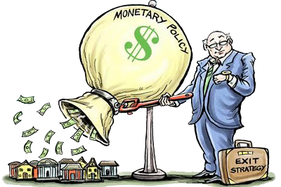
Unit 3: Monetary Policy
International Banking Crises
4/12/2011

Slide 2

International Crises
Types of crises
exchange rate crisis
banking crisis
default crisis
Often these crises occur together (twin or triple crises).

Slide 3
International Crises
exchange rate crisis –
(aka balance of payments crisis)
big depreciation in the currency; drain of foreign reserves
forcing a devaluation
or switch to float

Slide 4
International Crises
banking crisis –
bank panics leading to
massive bank failures;
when banks and other institutions face losses, insolvency, and bankruptcy

Slide 5
International Crises
default crisis –
government default
on sovereign debt;
when governments are
unwilling or unable
to honor principal/interest payments on their debt

Slide 6
International Crises
twin crisis –
2/3 of exchange rate,
banking, and default crises
triple crisis –
3/3 of exchange rate,
banking, and default crises

Slide 7
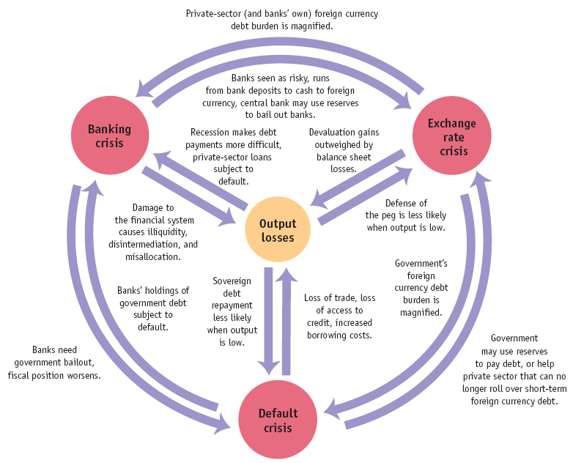
International Crises

Slide 8
International Crises
Types of crises
exchange rate crisis
banking crisis
default crisis
Often these crises occur together (twin or triple crises).

Slide 9

Risk Premiums
currency premium –
exchange rate risk premium;
higher interest rate that
must be paid to compensate
for possibility of fluctuations
in the exchange rate
(i.e., the peg is not credible)

Slide 10
Risk Premiums
So if there is a chance the foreign country will devalue its exchange rate peg, foreign investors will need to be paid a currency premium to get them to invest in spite of that risk – the premium should exactly compensate them for the probability of that event occurring.

Slide 11
Risk Premiums
country premium –
default risk premium;
higher interest rate that
must be paid to compensate
for possibility of government expropriation of private investment or default on sovereign debt

Slide 12
Risk Premiums
Some governments have been known to seize foreign investments nationalizing industries.
To compensate for that risk a country premium must be paid.
A country premium is also paid on government bonds to compensate for the risk of sovereign debt repudiation (refusing to pay it back).

Slide 13
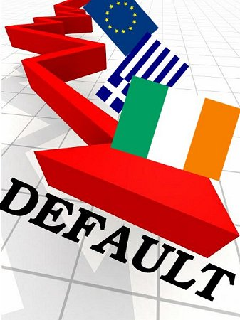
Sovereign Default
sovereign default –
repudiation of debt;
country government
default on its bonds
partial repudiation –
declaration by government
that it won’t pay back
part of its debt

Slide 14
Sovereign Default
Question
When do governments
default on their debt?
Answer
When the benefits of
defaulting exceed the costs.

Slide 15
Sovereign Default
Costs of defaulting
financial market penalties
  can’t borrow until resolved
  downgrade in credit ratings
    higher country risk premium
  can’t borrow in own currency
broader macroeconomic costs
  bank panics
    financial disintermediation
  lost investment, trade, output

Slide 16
Sovereign Default
Output if repays
Y – (1 + r_{L})L
Output if defaults
Y – cY
Y ≡ nominal output
L ≡ amount of loan (bonds)
r_{L} ≡ loan rate of interest
c ≡ % of output lost in default

Slide 17
Sovereign Default
if
Y – (1 + r_{L})L > Y – cY
then repay;
otherwise, default
Y ≡ nominal output
L ≡ amount of loan (bonds)
r_{L} ≡ loan rate of interest
c ≡ % of output lost in default

Slide 18
Sovereign Default
In general countries that default on their sovereign debt get hit with a
4-5% country risk premium for the next 3-10 years. They also have to denominate their future bond issues in a foreign currency (e.g., dollars) and suffer bank panics leading to massive bank failures.

Slide 19

Argentina (2001-2002)
Argentina (2001)
fixed exchange rate
  1:1 peg (peso to dollar)
current account deficit
  imports > exports
  ↓ foreign exchange reserves

Slide 20
Argentina (2001-2002)
Reactions
future devaluation feared
  bank runs began
    convert pesos to dollars
    withdraw money
government devalues peso
  1.4:1 new peg (pesos to dollars)
  force converts bank accounts
    dollar accounts to pesos
    30% of wealth seized

Slide 21
Argentina (2001-2002)
Reactions
devaluation ramifications
  more bank panics
  foreign investors avoid bonds
    don’t roll over debt
  macroeconomic consequences
    tax revenue declines
    social welfare spending up
  government debt unsustainable

Slide 22
Argentina (2001-2002)
Reactions
government repudiates debt
  only default on foreign held debt
    arbitrage opportunity
    people buy foreign at discount
  so default on all debt
  partial repudiation
    pennies on dollar for most
    IMF paid in full

Slide 23
Argentina (2001-2002)
Effects
triple crisis
  exchange rate
  banking
  default
unemployment hit 25%
inflation peaked at 10%/month
all bank accounts frozen for 1 year
massive exchange rate devaluation
  from 1:1 to 4:1 (pesos to dollars)

