Slide 1
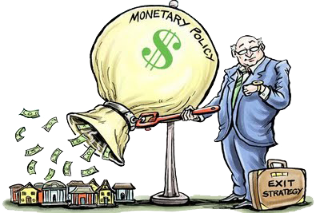
Unit 3: Monetary Policy
International Financial System
4/12/2011

Slide 2
Exchange Rate Regimes
fixed exchange rate –
a currency's value is matched to the value of another single currency or to a commodity (e.g., gold)
floating exchange rate –
a currency's value is allowed to fluctuate to the foreign exchange market

Slide 3
Exchange Rate Regimes
Fixed exchange rates make trade and investment between two countries on the same peg easy (minimize exchange rate risk).
Floating exchange rates have a more flexible monetary policy and don’t have to waste resources defending the peg.

Slide 4
Exchange Rate Regimes
The United States and most other countries were on a fixed exchange rate regime until 1971 (first the gold standard, then Bretton Woods). At Milton Friedman’s urging, the U.S. moved to a floating exchange rate regime, though it is actually a managed float, not a pure float.

Slide 5
Exchange Rate Regimes
managed float (dirty float) –
floating exchange rate:
but government sometimes intervenes (buying or selling foreign assets to influence exchange rates)

Slide 6
Exchange Rate Regimes
crawling peg –
fixed exchange rate:
but allowed to fluctuate between a narrow
band of rates

Slide 7
Exchange Rate Regimes
gold standard –
fixed exchange rate:
currencies pegged to gold
Bretton Woods –
(1944-1971)
fixed exchange rate:
dollar pegged to gold, other currencies pegged to dollar

Slide 8
Exchange Rate Regimes
currency board –
fixed exchange rate:
domestic currency backed 100% by a foreign currency with a permanent peg
(or so they claim)

Slide 9
Exchange Rate Regimes
dollarization –
fixed exchange rate:
adoption of a foreign currency as the domestic currency (e.g., the dollar)

Slide 10
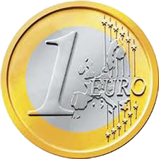
Exchange Rate Regimes
currency union –
fixed exchange rate (inside):
countries join together for a common currency, which operates like a fixed regime (dollarization) among member countries and either fixed or floating with the rest of the world

Slide 11
Exchange Rate Regimes
Exchange rate regimes
gold standard (fixed)
currency union (fixed inside)
dollarization (fixed)
currency board (fixed)
traditional fixed (fixed)
crawling peg (fixed)
managed float (floating)
pure float (floating)

Slide 12
Capital Controls
capital controls –
restrictions on foreign investment; restrictions regulating the flow in and out of the capital account
perfect capital mobility –
no capital controls

Slide 13
Impossible Trinity
impossible trinity –
a country cannot have all 3 of the following at the same time:
fixed exchange rate
capital mobility
independent monetary policy
IMPOSSIBLE

Slide 14
Impossible Trinity
You can only have 2:
IMPOSSIBLE
capital mobility
fixed exchange rate
independent monetary policy

Slide 15
Impossible Trinity
Impossible trinity examples
United states
fixed exchange rate
independent monetary policy
capital mobility
Euro (currency union)
fixed exchange rate
independent monetary policy
capital mobility
IMPOSSIBLE

Slide 16
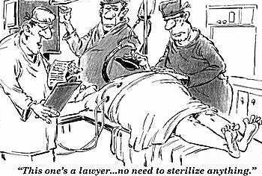
Sterilization
international reserves
(foreign exchange reserves) –
central bank holdings
of assets denominated
in a foreign currency
foreign exchange interventions –
central bank international financial transactions made to influence foreign exchange rates

Slide 17
Sterilization
unsterilized foreign
exchange intervention –
foreign exchange intervention that effects the monetary base
sterilized foreign
exchange intervention –
FEI with an offsetting open market operation that leaves the monetary base unchanged

Slide 18
Sterilization
unsterilized foreign exchange intervention
Assets | Liabilities
FEX reserves -$100 | currency -$100
sterilized foreign exchange intervention
Assets | Liabilities
FEX reserves -$100 bonds +$100 | currency +$0

Slide 19
Fixed Exchange Rate
In order to defend a fixed exchange rate, the central bank must intervene when the exchange rate fluctuates.
Note: These slides use the popular definition of exchange rate rather than Mishkin’s.
e ≡ exchange rate (in $/€)

Slide 20
Fixed Exchange Rate
devaluation –
setting the exchange rate
peg (e) to a higher level
(e.g., more $/€)
revaluation –
setting the exchange rate
peg (e) to a lower level

Slide 21
Fixed Exchange Rate
When the domestic currency depreciates (e↑), the central bank must sell foreign assets (international reserves) to restore the old exchange rate.
If it runs out of reserves, it must either devalue or switch to a floating regime.

Slide 22
Fixed Exchange Rate
When the domestic currency appreciates (e↓), the central bank must buy foreign assets (international reserves) to restore the old exchange rate.
Central banks may accumulate a lot of international reserves
(e.g., China has > $2 trillion).

Slide 23
Speculative Attack
speculative attack –
the massive selling (shorting) of a country’s currency assets,
with the hope of a devaluation,
which would net a huge profit

Slide 24
Speculative Attack
Investors can engage in a speculative attack selling off the currency, then buy back the currency after the devaluation. As more and more speculators sell the currency, the central bank drains its international reserves defending the peg. Eventually it must devalue.

Slide 25
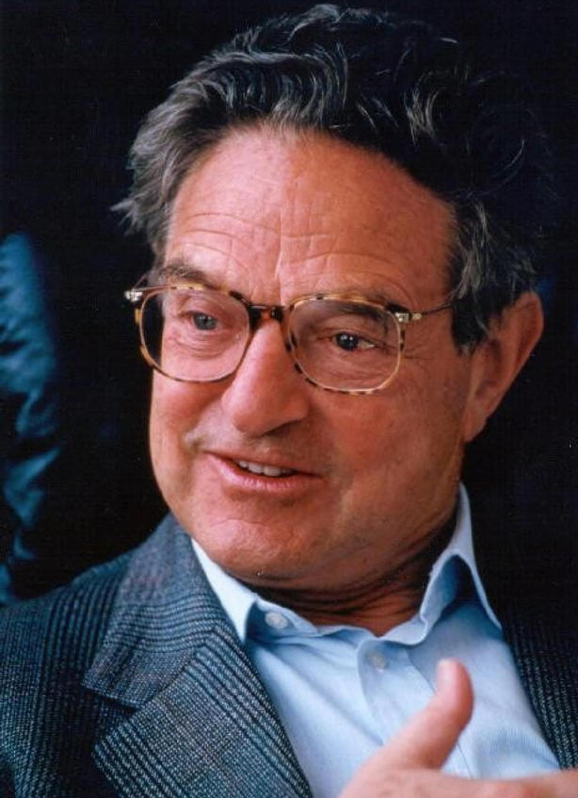
Speculative Attack
Billionaire George Soros made most of his money through speculative attacks on currencies.
For example:
September 16, 1992
sold $10 billion of pounds
Bank of England devalued
$1.1 billion profit for Soros

Slide 26
Balance of Payments
balance of payments (BoP) –
net movement of funds between a nation and a foreign country;
sum of the current account and the financial account
BoP = CA + FA

Slide 27
Balance of Payments
current account (CA) –
net movement of goods and services between a nation and a foreign country;
sum of the trade balance, net factor income from abroad, and net unilateral transfers
CA = TB + NFIA + NUT

Slide 28
Balance of Payments
trade balance (TB) –
exports minus imports
TB = EX – IM
capital account
(financial account, FA) –
net movement of capital (assets) between a nation and a foreign country

Slide 29
Balance of Payments
Equations
BoP = CA + FA
CA = TB + NFIA + NUT
TB = EX – IM
NFIA = EX_{FS} – IM_{FS}
NUT = UT_{IN} – UT_{OUT}
FA = EX_{A} – IM_{A}
KA = KA_{IN} – KA_{OUT}

Slide 30
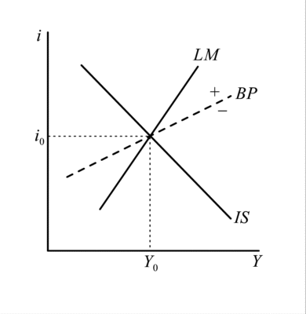
Mundell-Fleming
We will study how BoP interacts with monetary policy and the exchange rate next week when we study the IS/LM model and the Mundell-Fleming model
(the international version of the IS/LM model).

Slide 31
Mundell-Fleming
FP ≡ fiscal policy
MP ≡ monetary policy
0 ≡ ineffective
+ ≡ effective
perfect capital mobility
no capital mobility
 | float | fixed
FP | 0 | +
MP | + | 0
 | float | fixed
FP | + | 0
MP | + | 0

Slide 32
International Monetary Fund
International Monetary Fund –
the IMF was setup under Bretton Woods to help countries maintain their fixed exchange rates (loans to countries with BoP problems);
now it acts as an international lender of last resort (LOLR) during financial crises

Slide 33
World Bank
World Bank
(International Bank
for Reconstruction
and Development) –
provides long-term loans
to developing countries for economic development projects
(e.g., dams, roads, etc.);
setup by Bretton Woods

