Slide 1
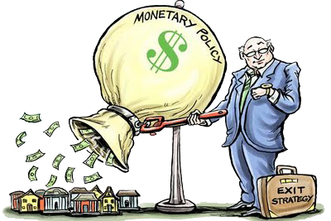
Unit 3: Monetary Policy
Monetary Policy Targets
4/5/2011

Slide 2
Monetary Policy
tools
instruments
targets
goals

Slide 3
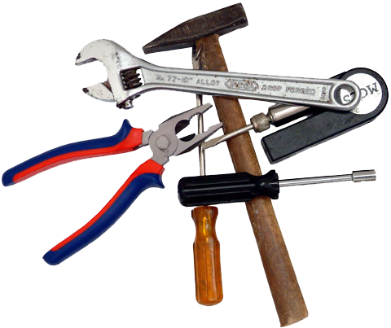
Monetary Policy Tools
open market operations
discount rate
required reserve ratio

Slide 4
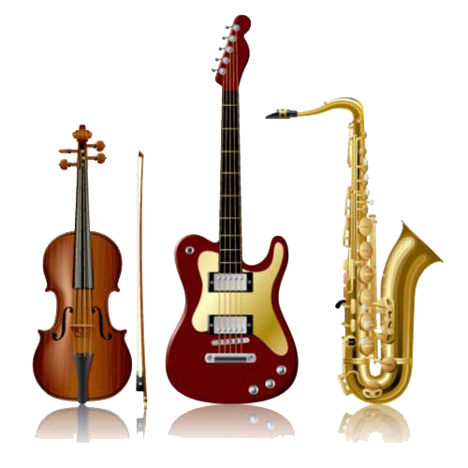
Monetary Policy Instruments
reserve aggregates
  reserves
  non-borrowed reserves
  monetary base
interest rates
  short-term interest rates
    federal funds rate

Slide 5
Monetary Policy Instruments
policy instrument –
variable that responds to
tools and indicates the stance
(easy or tight) of monetary policy

Slide 6

Monetary Policy Targets
monetary aggregates
  M1
  M2
interest rates
  inflation rate
  long-term interest rate
  short-term interest rate

Slide 7
Monetary Policy Targets
intermediate target –
stands between the instruments
and goals of monetary policy

Slide 8

Monetary Policy Goals
price stability
high employment
economic growth
financial market stability
interest-rate stability
foreign exchange stability

Slide 9
Monetary Policy Targets
monetary targeting
inflation targeting
targeting with no nominal anchor

Slide 10

Monetary Targeting
monetary targeting –
central bank announces targets
for the annual growth rate of
a monetary aggregate
(e.g., 5% growth of M1 or
6% growth of M2)

Slide 11
Monetary Targeting
United States
money supply growth targets announced
  Arthur Burns in 1975
  often missed targets
focus on non-borrowed reserves
  Paul Volker in 1979
won’t use monetary aggregates as a guide
  Greenspan in 1993

Slide 12
Monetary Targeting
Japan
“forecasts” for M2 + CDs announced in 1978
performance better than the Fed 1978-1987
switched to a tighter monetary policy 1989
  partially blamed for the “lost decade”

Slide 13
Monetary Targeting
Germany
focus on “central bank money” (early 1970s)
can restrain inflation in the longer run
  even when targets are missed
reason for the relative success
  clearly stated monetary policy objectives
  central bank communication with public

Slide 14
Monetary Targeting
elements
  flexible
  transparent
  accountable
advantages
  immediate signals (inflation expectations)
  immediate accountability
disadvantages
  strong and reliable relationship required
    goal variable : targeted aggregate

Slide 15

Inflation Targeting
medium-term numerical target for inflation
  public announcement
institutional commitment to price stability
  primary, long-run goal of monetary policy
many variables are used in making decisions
increased transparency of the strategy
increased accountability of the central bank

Slide 16
Inflation Targeting
New Zealand (since 1990)
  inflation decreased
  high growth, lower unemployment
Canada (since 1991)
  inflation decreased
  slightly higher unemployment
United Kingdom (since 1992)
  inflation close to target
  high growth, lower unemployment

Slide 17
Inflation Targeting
advantages
  more variables examined
  easily understood
  reduces time-inconsistency problem
  transparency and accountability
disadvantages
  delayed signaling
  too much rigidity
  more output fluctuations possible
  less GDP growth during disinflation

Slide 18
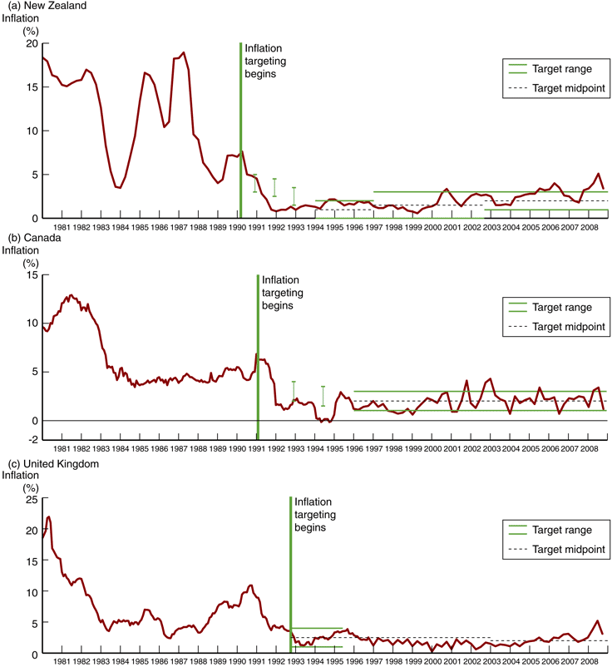
Inflation Targeting

Slide 19
Inflation Targeting

Slide 20
Inflation Targeting

Slide 21

Targeting with no Explicit Anchor
no explicit nominal anchor
  no overriding concern for the Fed
used by the Fed recently
“just do it” approach
forward looking behavior
periodic “preemptive strikes”
goal: prevent inflation from getting started

Slide 22
Targeting with no Explicit Anchor
advantages
  uses many sources of information
  reduces time-inconsistency problem
  demonstrated success
disadvantages
  lack of transparency and accountability
  strong dependence on people in charge
    preferences, skills, trustworthiness
  inconsistent with democratic principles

Slide 23
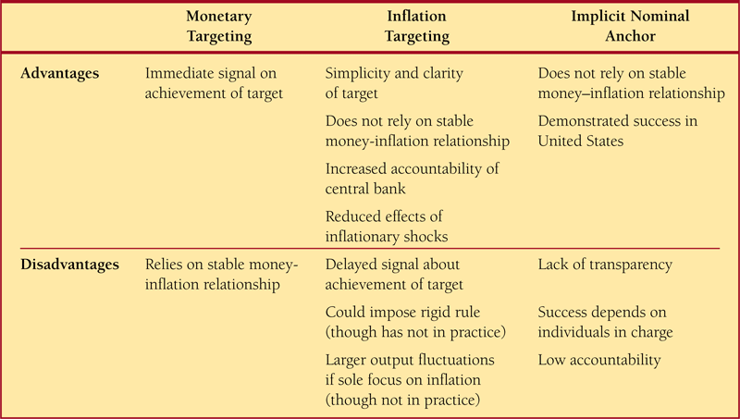
Monetary Policy Strategies

Slide 24
Money Supply Target
Interest Rate, i
M^{s}*
M ^{d} fluctuates between M ^{d}₁ and M ^{d}₂
With M-target at M*, i fluctuates between i₁ and i₂
i₂
i*
M^{d}₂
i₁
M^{d}
M^{d}₁
M*
Quantity of Money, M

Slide 25
Interest Rate Target
Interest Rate, i
M ^{d} fluctuates between M ^{d}₁ and M ^{d}₂
To set i-target at i* M^{s} fluctuates between M₁ and M₂
M₁*
M^{s}
M₂*
i₂
i*
M^{d}₂
i₁
M^{d}
M^{d}₁
M₁
M*
M₂
Quantity of Money, M

Slide 26
Nonborrowed Reserves Target
Federal Funds
Rate
i_{d}
R^{s}
i_{ff}³
1
i_{ff}¹
R^{d}₃
i_{ff}²
i_{er}
R^{d}₂
R^{d}₁
R_{n}
Quantity of Reserves, R

Slide 27
Federal Funds Rate Target
Federal Funds
Rate
i_{d}
R^{s}
1
i_{ff}*
R^{d}₃
i_{er}
R^{d}₂
R^{d}₁
R_{n}²
R_{n}¹
R_{n}³
Quantity of Reserves, R

Slide 28
Monetary Policy Targets
Criteria for choosing targets
measurability
controllability
ability to predictably affect goals
Interest rates aren’t clearly better than M^{s} on 1 & 2
because hard to measure and control real interest rates.

Slide 29
Monetary Policy Instruments
Criteria for choosing instruments
measurability
controllability
ability to predictably affect targets
Reserve aggregates and interest rates about equal on 1 & 2.
If intermediate target is M^{s}, then reserve aggregate is better for 3.

Slide 30


Fed Policy Procedures
Early years of the Fed (1913-1921)
discount loans the primary policy
real bills doctrine
  thoroughly discredited

Slide 31
Fed Policy Procedures
Discovery of OMO (1921-1929)
Federal Reserve needed more revenue
invested in income earning securities
open market operations
  accidentally discovered

Slide 32
Fed Policy Procedures
Great Depression (1929-1941)
raised discount rate too late
  wanted to temper stock boom
  but worried about hurting others
bank failures reduced money supply
  Fed didn’t understand
  M1 contracted 25%
  Fed believed was expanding M^{s}
Fed didn’t act as LOLR

Slide 33
Fed Policy Procedures
Reserve requirements (1933-1941)
Fed got reserve requirements power
  Agricultural Adjustment Act of 1933
Fed RR power expanded
  Banking Act of 1935
excess reserves hurt monetary policy
raised reserve requirements for control
  Aug. 1936, Jan. 1937, May 1937
  caused 1937-1938 recession
  “double dip” of Great Depression

Slide 34
Fed Policy Procedures
Pegging of interest rates (1942-1951)
skyrocketed government spending
  wanted to finance WWII cheaply
pegged interest rates
  Treasury bills: 3/8%
  Treasury bonds: 2.5%
if interest rates on bonds rose
  Fed made open market purchases
  interest rates would then fall
rapid growth in MB & money supply

Slide 35
Fed Policy Procedures
Targeting money market (1950s, 1960s)
intuitive judgment
  based on feel for money market
  i.e., interest rates
William Martin was Fed chairman
pro-cyclical policy (for M)
  Y↑ → i↑ → MB↑ → M↑
  π↑ → π^{e}↑ → i↑ → MB↑ → M↑
  monetarists criticized (e.g., Friedman)

Slide 36


Definitions
procyclical –
economic quantity positively correlated
with state of the economy;
up during booms, down during busts
countercyclical –
economic quantity negatively correlated
with state of the economy;
down during booms, up during busts

Slide 37
Fed Policy Procedures
Targeting monetary aggregates (1970s)
wasn’t really monetary targeting
  actually used fed funds rate
Arthur Burns was Fed chairman
still pro-cyclical policy (for M)
  Y↑ → i↑ → MB↑ → M↑
  π↑ → π^{e}↑ → i↑ → MB↑ → M↑
  monetarists criticized (e.g., Friedman)

Slide 38
Fed Policy Procedures
New operating procedures (1979-1982)
de-emphasis on fed funds rate
non-borrowed reserves main instrument
still used interest rates
Paul Volcker was Fed chair
not serious about monetary aggregates
  avoided blame for high interest rates
anti-inflation strategy

Slide 39
Fed Policy Procedures
De-emphasis of M aggregates (1982-1993)
de-emphasis of monetary aggregates
borrowed reserves main instrument
  discount loans
pro-cyclical policy (for M)
  Y↑ → i↑ → DL↑ → MB↑ → M↑
breakdown in M:GDP relationship

Slide 40
Fed Policy Procedures
Federal funds targeting again (1993-present)
monetary aggregates no longer used
  Greenspan testified before Congress
federal funds rate main instrument/target
  FFR target announced starting 1994

Slide 41
Fed Policy Procedures
Other considerations
pre-emptive strikes against inflation
  1994, 1999, 2004
pre-emptive strikes against recessions
  1996, 1998, 2001, 2007
  1998: Long Term Capital Management
international considerations
  M↑ in 1985 to lower exchange rate
  M↓ in 1987 to raise exchange rate

Slide 42


Active vs. Passive Policy
Advantages of Active Policy
recessions cause economic
Employment Act of 1946
  “It is the continuing policy and
  responsibility of the Federal
  Government to … promote full
  employment and production.”
AD-AS model
  monetary policy can stabilize economy
  fiscal policy can stabilize economy

Slide 43
Active vs. Passive Policy
Advantages of Passive Policy
long & variable lags to policies
  Milton Friedman emphasized this
  inside (implementation) lag
    time between shock and response
    takes time to recognize shock
    takes time to implement policy
  outside (effectiveness) lag
    time it takes policy to affect economy
  may de-stabilize when takes effect

Slide 44

Active vs. Passive Policy
automatic stabilizers –
policies that stimulate or depress the economy when necessary without any deliberate policy change
(designed to reduce lags)
Automatic stabilizer examples
income tax
unemployment insurance
welfare

Slide 45

Forecasting
Because policies act with lags, policymakers must predict future conditions.
Generating forecasts
leading economic indicators
  data series fluctuating before economy
  Index of Leading Economic Indicators
    includes 10 data series
macroeconometric models
  large models w/ estimated parameters
  forecasts response to shocks & policies

Slide 46
Forecasting

Slide 47
Forecasting

Slide 48
Forecasting

Slide 49
Forecasting

Slide 50
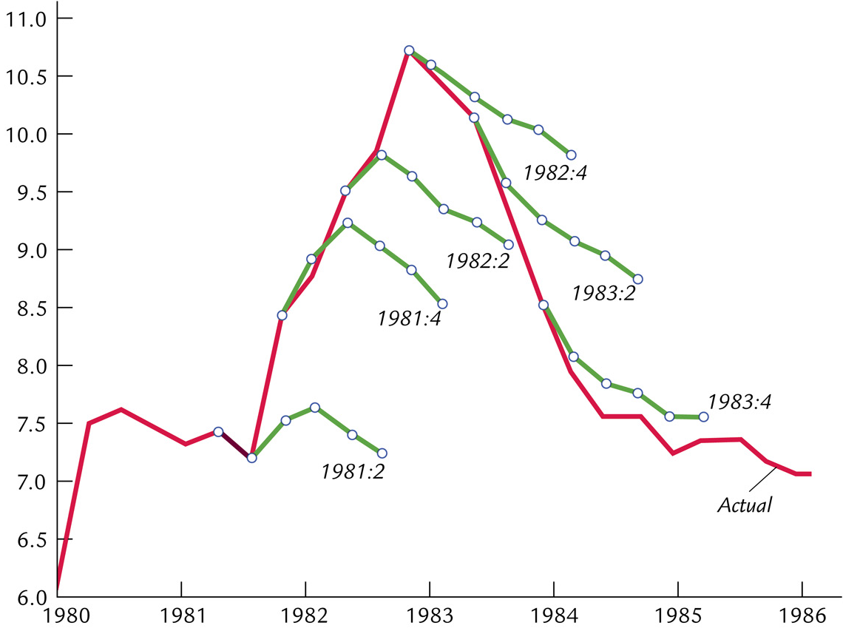
Forecasting
Unemployment rate

Slide 51
Stability
4.0
Volatility
of GDP
3.5
Standard deviation
3.0
2.5
2.0
1.5
1.0
Volatility of Inflation
0.5
0.0
1960
1965
1970
1975
1980
1985
1990
1995
2000
2005

Slide 52
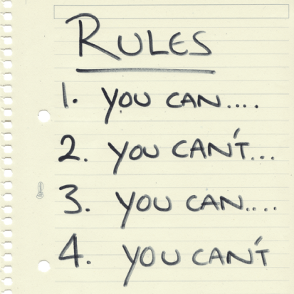

Rules vs. Discretion
rules –
policymakers announce in advance how
policy will respond in various situations,
and commit themselves to following through
discretion –
as events occur and circumstances change, policymakers use their judgment and apply whatever policies seem appropriate at the time

Slide 53
Rules vs. Discretion
Arguments for rules
distrust of policymakers & political process
  misinformed politicians
  politicians & society interests different
time inconsistency
  destroys policymaker credibility
time inconsistency –
policymakers have an incentive to renege on a
previously announced policy once others act

Slide 54
Monetary Policy Rules
constant money supply growth rate
target growth rate of nominal GDP
target the inflation rate
the Taylor Rule

Slide 55
Monetary Policy Rules
Constant money supply growth rate
advocated by monetarists
stabilizes AD only if velocity is stable
Friedman k-percent rule
  4% per year
  gM + gV = gP + gy
  gP = 0, gV = -1%, gy = 3%, k% = gM= 4%

Slide 56
Monetary Policy Rules
Target growth of nominal GDP
automatic
increase money growth
  when nominal GDP grows under target
decrease money growth
  when nominal GDP growth over target

Slide 57
Monetary Policy Rules
Target the inflation rate
automatic
decrease money growth
  when inflation rate over target
increase money growth
  when inflation rate below target
many countries practice inflation targeting
  but allow a little discretion

Slide 58
Monetary Policy Rules
The Taylor Rule
automatic
target the federal funds rate
based on
  inflation rate
  GDP gap (actual & full-employment)
  inflation gap (actual & target)
proposed by John Taylor

Slide 59

Taylor Rule
i_{ff} = inflation rate
+ equilibrium real fed funds rate target
+ 0.5(inflation gap) + 0.5(GDP gap)
i_{ff} ≡ nominal federal funds rate target
π ≡ inflation rate
equilibrium real federal funds rate = 2
inflation gap = π – 2
GDP gap = 100(y – y_{n})/y_{n}
  percent real GDP is below natural rate

Slide 60
Taylor Rule
i_{ff} = π + 2 + 0.5(π – 2) + 0.5(GDP gap)
if π = 2% & y = y_{n}, i_{ff} = 4%
π↑ by 1% → i_{ff}↑ by 1.5%
(y – y_{n})↑ by 1% → i_{ff}↑ by 0.5%

Slide 61
Taylor Rule
12
Percent
Actual
10
8
6
4
2
Taylor’s Rule
0
1987
1990
1993
1996
1999
2002
2005

