Slide 1
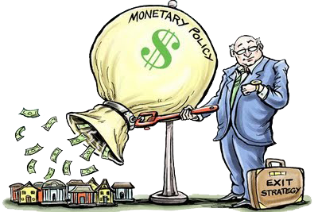
Unit 3: Monetary Policy
Monetary Policy Tools
4/5/2011

Slide 2
Federal Funds Rate
federal funds rate –
interest rate to borrow
from other banks
The federal funds rate is the primary target for monetary policy from the Federal Reserve. It is not set directly –
rather, it is indirectly manipulated
using other policy tools.

Slide 3
Federal Funds Rate
basis point –
1/100 of 1%
0.01% = 1 basis point
Since 1995 the Federal Reserve has explicitly announced a federal funds rate target at each FOMC meeting.
It is commonly reported in the news media as a rise or fall of basis points
(e.g., lowered by 25 basis points).

Slide 4
Federal Funds Rate
The federal funds rate is targeted
by manipulating the supply and
demand for bank reserves.
Tools to manipulate federal funds rate
open market operations
discount rate
required reserve ratio
interest rate paid on reserves

Slide 5
Supply and Demand for Reserves
Federal Funds Rate
i_{d}
R^{s}
i_{ff}*
i_{er}
R^{d}
R_{n}
Quantity of Reserves, R

Slide 6
Supply and Demand for Reserves
definitions
R^{d} ≡ demand for reserves
R^{s} ≡ supply of reserves
i_{ff} ≡ federal funds rate
i_{d} ≡ discount rate
i_{er} ≡ interest rate paid on reserves
DL ≡ discount lending
R_{n} ≡ non-borrowed reserves*
* reserves not borrowed through discount loans

Slide 7
Supply and Demand for Reserves
Federal Funds Rate
i_{d}
R^{s}
i_{ff}*
i_{er}
R^{d}
R_{n}
Quantity of Reserves, R

Slide 8
Demand for Reserves
Federal Funds Rate
i_{er}
R^{d}
R_{n}
Quantity of Reserves, R

Slide 9
Demand for Reserves
reserves are insurance for deposit outflows
the Fed pays interest on reserves
opportunity cost is interest forgone
i_{ff} – i_{er}
as i_{ff} ↓, the opportunity cost falls
demand more reserves
∴ the demand curve slopes down
demand curve perfectly elastic (flat) at i_{er}
if i_{ff} below i_{er}, borrow for certain interest

Slide 10
Demand for Reserves
R = RR + ER
i_{ff} ↓ → opportunity cost of ER↓ → ER↑
∴ the demand curve slopes down
demand curve flat at i_{er}

Slide 11
Demand for Reserves
Federal Funds Rate
i_{er}
R^{d}
R_{n}
Quantity of Reserves, R

Slide 12
Supply of Reserves
Federal Funds Rate
i_{d}
R^{s}
R_{n}
Quantity of Reserves, R

Slide 13
Supply of Reserves
reserve supply = aggregate reserves of banks
two components to reserve supply:
borrowed reserves (from Fed)
non-borrowed reserves
cost of borrowing from Fed is discount rate
substitute for borrowing from banks
if i_{ff} < i_{d}, won’t borrow from Fed
supply curve perfectly inelastic (vertical)
if i_{ff} > i_{d}, won’t borrow from banks
supply curve perfectly elastic (flat)

Slide 14
Supply of Reserves
i_{ff} < i_{d} → R = R_{n}
supply curve flat at i_{d}

Slide 15
Supply of Reserves
Federal Funds Rate
i_{d}
R^{s}
R_{n}
Quantity of Reserves, R

Slide 16
Supply and Demand for Reserves
Federal Funds Rate
i_{d}
R^{s}
i_{ff}*
i_{er}
R^{d}
R_{n}
Quantity of Reserves, R

Slide 17
Supply and Demand for Reserves
market equilibrium is at i_{ff}*
supply and demand curves intersect
R^{d} = R^{s} at i_{ff}*

Slide 18
Supply and Demand for Reserves
Federal Funds Rate
i_{d}
R^{s}
i_{ff}*
i_{er}
R^{d}
R_{n}
Quantity of Reserves, R

Slide 19
Ceiling for Federal Funds Rate
Federal Funds Rate
Rightward shift of R^{d} to R^{d}₂ moves equilibrium to point 2 where i²_{ff} = i_{d} and discount lending rises from zero to DL₂
i_{ff}²=i_{d}
2
R^{s}
1
i_{ff}¹
R^{d}₂
i_{er}
R^{d}₁
Quantity of Reserves, R
R_{n}
DL₂

Slide 20
Floor for Federal Funds Rate
Federal Funds Rate
Leftward shift of R^{d} to R^{d}₂ moves equilibrium to point 2 where i²_{ff} = i_{er}
R^{s}
1
i_{ff}¹
i_{ff}²=
i_{er}
2
R^{d}₂
R^{d}₁
Quantity of Reserves, R
R_{n}

Slide 21
Open Market Operations
intersection on downward sloping portion of R^{d}
OM purchase: lowers fed funds rate
OM sale: raises fed funds rate
intersection on flat portion of R^{d}
OM purchase: no effect on fed funds rate
OM sale: no effect on fed funds rate

Slide 22
Open Market Operations
Open Market Purchase:
Nonborrowed reserves, R_{n}, ↑ and shifts supply curve to right R^{s}₂: i ↓ to i_{ff}²
Federal Funds Rate
i_{d}
R^{s}₁
R^{s}₂
i_{ff}¹
i_{ff}²
i_{er}
R^{d}
R_{n}¹
R_{n}²
Quantity of Reserves, R

Slide 23
Open Market Operations
Open Market Purchase:
Nonborrowed reserves, R_{n}, ↑ and shifts supply curve to right R^{s}₂: i same at i_{ff}²
Federal Funds Rate
i_{d}
R^{s}₁
R^{s}₂
i_{ff}² =
i_{ff}¹=
i_{er}
R^{d}
R_{n}¹
R_{n}²
Quantity of Reserves, R

Slide 24
Discount Window
intersection on flat portion of R^{s}
i_{d}↓: lowers fed funds rate
i_{d}↑: raises fed funds rate
intersection on vertical portion of R^{s}
i_{d}↓: no effect on fed funds rate
i_{d}↑: no effect on fed funds rate

Slide 25
Discount Window
(a) No discount lending:
Lower Discount Rate
Horizontal section ↓ and supply curve just shortens, i_{ff} stays same
Federal Funds Rate
i_{d}¹
R^{s}₁
i_{d}²
R^{s}₂
i_{ff}¹
i_{er}
R^{d}
R_{n}¹
Quantity of Reserves, R

Slide 26
Discount Window
(b) Some discount lending:
Lower Discount Rate
Horizontal section ↓, i_{ff} ↓ to i²_{ff} = i²_{d}
Federal Funds Rate
i_{ff}¹ = i_{d}¹
R^{s}₁
i_{ff}² = i_{d}²
R^{s}₂
i_{er}
R^{d}
R_{n}¹
Quantity of Reserves, R

Slide 27
Required Reserve Ratio
required reserve ratio rises (r↑)
demand for reserves rises
demand curve shifts right
required reserve ratio falls (r↓)
demand for reserves falls
demand curve shifts left
1/10

Slide 28
Required Reserve Ratio
intersection on downward sloping portion of R^{d}
r↑: raises fed funds rate
r↓: lowers fed funds rate
intersection on flat portion of R^{d}
r↑: no effect on fed funds rate
r↓: no effect on fed funds rate
1/10

Slide 29
Required Reserve Ratio
Federal Funds Rate
i_{d}
R^{s}
Required reserve Requirement ↑
Demand for reserves ↑, R^{d} shifts right and i_{ff} ↑ to i_{ff}²
2
i_{ff}²
1
i_{ff}¹
R^{d}₂
i_{er}
R^{d}₁
R_{n}
Quantity of Reserves, R

Slide 30
Required Reserve Ratio
Federal Funds Rate
Required reserve Requirement ↑
Demand for reserves ↑, R^{d} shifts right and i_{ff} stays same at i_{er}
i_{d}
R^{s}
2
1
R^{d}₂
i_{ff} = i_{er}
R^{d}₁
R_{n}
Quantity of Reserves, R

Slide 31
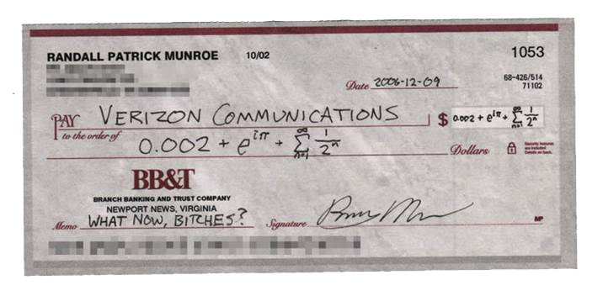
Float
float –
temporary net increase in
the total amount of reserves:
the Federal Reserve system
credits a check to the depositing bank before it debits the withdrawing bank
(affects monetary base)

Slide 32
Treasury Deposits
treasury deposits –
temporary net decrease in
the total amount of reserves:
U.S. Treasury takes deposits
out of banks and deposits them
with the Federal Reserve instead
(affects monetary base)

Slide 33
Repurchase Agreement
repurchase agreement (repo) –
temporary open market purchase;
short term collateralized loan in which a security is exchanged for cash with the agreement that both parties will reverse the transaction on a specific future date at an agreed upon price

Slide 34
Reverse Repo
matched sale purchase transaction
(reverse repo) –
temporary open market sale
Repos and reverse repos
typically mature in 1-15 days.

Slide 35
Open Market Operations
Types
dynamic
meant to change MB
permanent: normal purchases & sales
defensive
meant to stabilize MB from fluctuations
float
treasury deposits at Fed
temporary: repos & reverse repos

Slide 36
Open Market Operations
Advantages
Federal Reserve has complete control
flexible and precise
easily reversed
implemented quickly

Slide 37
Discount Window
Types of discount loans
primary credit
healthy banks
discount rate (typically 1% above i_{ff})
secondary credit
banks with severe liquidity problems
typically 0.5% (50 BP) above i_{d}
seasonal credit
small banks with seasonal deposits
average of i_{ff} and CD rate

Slide 38
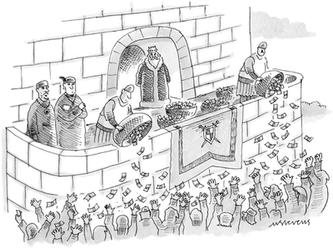
Lender of Last Resort
to prevent banking panics
FDIC fund not big enough
1% of deposits
e.g., Continental Illinois
to prevent non-bank financial panics
e.g., 1987 stock market crash
e.g., 9/11 terrorist attack
creates moral hazard problem

Slide 39
Lender of Last Resort
new permanent lending facilities
Term Auction Facility (12/2007)
Term Securities Lending Facility (3/2008)
new temporary lending facilities (just for crisis)
Primary Dealer Credit Facility (3/2008)
Asset Backed Commercial Paper Money Market
Mutual Fund Liquidity Facility (9/2008)
Money Market Investor Funding Facility (8/2008)
Commercial Paper Funding Facility (8/2008)

Slide 40
Lender of Last Resort
term auction facility –
discount loans via competitive auctions
(less stigma for borrowing banks relative to normal discount window)
term securities lending facility –
lend treasury securities to primary dealers for terms longer than overnight
(to supply more securities for collateral)

Slide 41
Lender of Last Resort
Temporary lending facilities were implemented under a loophole.
§13(3) of Federal Reserve Act allows Fed to lend money to any individual, partnership or corporation, under “unusual and exigent circumstances” as long as certain requirements are met.
This pushed the limit of Fed power.

Slide 42
Discount Window
performs lender of last resort function
puts a ceiling on the federal funds rate
borrowing decision left to member banks

Slide 43
Required Reserve Ratio
same for all depository institutions
Depository Institutions
Deregulation and Monetary
Control Act of 1980
requirement (checkable deposits)
3% of 1st $48.3 million
10% of any over $48.3 million
FOMC can vary
between 8% and 14%
1/10

Slide 44
Required Reserve Ratio
Disadvantages
no longer binding
most banks hold excess reserves
can cause liquidity problems
increases uncertainty for banks
1/10

Slide 45
Interest Paid on Reserves
since October 2008
much longer in Europe, etc.
current rate is 0.25%
advantages
reduces effective tax on deposits
puts a floor on federal funds rate
less fluctuations in excess reserves
less sterilization needed
can expand balance sheet more

Slide 46
European Central Bank Tools
open market operations
main refinancing operations
similar to repos
longer-term refinancing operations
similar to outright purchases/sales
lending to banks
marginal lending rate (1% above)
deposit facility (1% below)
reserve requirements
2% ratio, interest paid on reserves

Slide 47
Money Multiplier
M = mMB
m = (1 + c)/(r + e + c)
M ≡ money supply
MB ≡ monetary base
m ≡ money multiplier
r ≡ required reserve ratio
c ≡ ratio of currency to deposits
e ≡ ratio of excess reserves to deposits

Slide 48
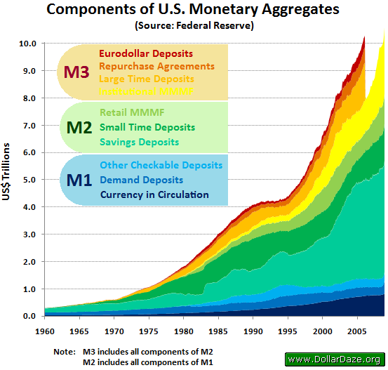
Monetary Aggregates
Money supply
MB – monetary base (total currency)
M1 – very liquid assets
M2 – somewhat liquid assets
M3 – even less liquid assets
MZM – money with zero maturity

Slide 49
Monetary Aggregates
Money supply
MB = currency in circulation + reserves in bank vaults
+ reserves with the Fed
M1 = currency in circulation + travelers checks
+ demand deposits + other checkable deposits
M2 = M1 + time deposits (<$100k) + savings deposits
+ MMMF shares (individuals)

Slide 50
Monetary Aggregates
Money supply
MB = C + R
M1 = C + D
M2 = C + D + STSV + MMMF
STSV ≡ time deposits (<$100k) + savings deposits
MMMF ≡ MMMF shares (individuals)

Slide 51
Money Multiplier
M1 = C + D
M2 = C + D + STSV + MMMF
s ≡ STSV/D
f ≡ MMMF/D
m1 = (1 + c)D = (1 + c)/(c + r + e)
m2 = (1 + c + s + f)D = (1 + c + s + f)/(c + r + e)
M1 = m1MB = [(1 + c)/(c + r + e)]MB
M2 = m2MB = [(1 + c + s + f)/(c + r + e)]MB

Slide 52
Money Multiplier
M1 = m1MB
m1 = (1 + c)/(r + e + c)
M1 ≡ money supply
MB ≡ monetary base
m1 ≡ money multiplier
r ≡ required reserve ratio
c ≡ ratio of currency to deposits
e ≡ ratio of excess reserves to deposits

Slide 53
Money Multiplier
M2 = m2MB
m2 = (1 + c + s + f)/(r + e + c)
M2 ≡ money supply
m2 ≡ money multiplier
r ≡ required reserve ratio
c ≡ ratio of currency to deposits
e ≡ ratio of excess reserves to deposits
s ≡ ratio of STSV to deposits
f ≡ ratio of MMMF to deposits

