Slide 1
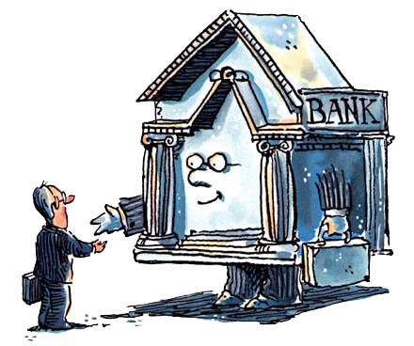
Unit 2: Banking
Money Supply & Money Multiplier
3/29/2011

Slide 2
Money Supply
M = C + D
Money supply is currency in circulation plus
demand deposits (we’ll use M1 for this lecture).
Since the money supply includes demand deposits,
the banking system plays an important role.

Slide 3
Money Supply
Players in the process
Federal Reserve
banks
depositors
borrowers

Slide 4
Federal Reserve Policy Tools
traditional tools
required reserve ratios
discount rate
open market operations
additional (new) tools
interest on reserves
term auction facility
primary dealer credit facility
term securities lending facility

Slide 5
Federal Reserve Policy Tools
required reserve ratio –
required percentage of liabilities
banks must keep as reserves
discount rate –
interest rate to borrow funds
from Federal Reserve
open market operations –
purchase or sale of securities by the Federal Reserve in the open market
1/10

Slide 6
Federal Reserve Balance Sheet
On the Fed’s balance sheet, the
largest and most important asset
is U.S. government securities.
The most important liabilities are
Federal Reserve notes in circulation
and banks’ deposits.
The sum of Federal Reserve notes,
coins, and banks’ deposits at the
Fed is the monetary base.

Slide 7
Federal Reserve Balance Sheet
Assets | Liabilities + Equity
securities | FRNs
gold | coins
loans | bank reserves
FX reserves
(really Federal Reserve + Treasury)

Slide 8
Simplified Fed Balance Sheet
Assets | Liabilities + Equity
securities | currency in circulation
loans | reserves

Slide 9
Securities
forms
held outright
repurchase agreements (repos)
types
US Treasury bills
US Treasury notes
US Treasury bonds
90% of Fed assets pre-2008

Slide 10
Securities
Treasury securities
T bills: terms of less than 1 year
T notes: terms of 2, 3, 5, 10 years
T bonds: terms of 30 years
reintroduced in February 2006

Slide 11
Securities
repurchase agreement –
short term collateralized loan in which a security is exchanged for cash with the agreement that both parties will reverse the transaction on a specific future date at an agreed upon price

Slide 12
Loans
The discount window serves as an avenue for banks in need of reserves to borrow from the Fed (the Fed acts as a lender of last resort).
Historically, banks have been hesitant to borrow from the Fed because of the stigma attached: other financial institutions may draw negative conclusions about their solvency.

Slide 13
Currency in Circulation
Currency in circulation includes both federal reserve notes issued by the Federal Reserve and token coins issued by the Treasury.
But coins make up less than 10% of currency in circulation & they are not actively manipulated, so they can usually be ignored for simplicity.

Slide 14
Currency in Circulation
1/2 to 2/3 of currency in circulation is typically held outside the U.S.
Foreigners use dollars because they don’t trust their domestic currency.

Slide 15
Reserves
reserves –
money physically held by the bank in the medium of redemption (e.g., gold, FRNs)
This includes vault cash (currency held at the bank) and money deposited at the central bank (e.g., the Federal Reserve).

Slide 16
Reserves
Reasons for reserves at Fed
reserve requirements
check clearing
emergency funds
interest on reserves

Slide 17
Controlling the Money Supply
Required reserve ratio
An increase in the required reserve ratio boosts the reserves that banks must hold, decreases their lending, and decreases the quantity of money.
1/10

Slide 18
Controlling the Money Supply
Discount rate
An increase in the discount rate raises the cost of borrowing reserves from the Fed and decreases banks’ reserves, which decreases their lending and decreases the quantity of money.

Slide 19
Controlling the Money Supply
Open market operation
When the Fed conducts an open market operation by buying a government security, it increases banks’ reserves. Banks loan the excess reserves, which creates money.
The reverse occurs when the Fed sells a government security.

Slide 20
Open Market Purchase
Manhattan Commercial Bank
Federal Reserve Bank of NY
Assets
Liabilities
Assets
Liabilities
Securities -$100
Securities +$100
Reserves +$100
The Fed buys securities from a commercial bank…
Reserves +$100
… and pays for the securities by increasing the reserves of the commercial bank
Result: R ↑ $100, MB ↑ $100

Slide 21
Open Market Purchase
Goldman Sachs
Federal Reserve Bank of NY
Assets
Liabilities
Assets
Liabilities
Securities -$100
Securities +$100
Reserves +$100
Deposits at Manhattan Commercial Bank +$100
The Fed buys securities from Goldman Sachs, a member of the general public…
Manhattan Commercial Bank
… and pays for it by writing a check that is deposited to Goldman Sach’s account at Manhattan Commercial Bank and that increases the reserves of the commercial bank
Assets
Liabilities
Reserves +$100
Goldman Sach’s Deposits +$100
Result: R ↑ $100, MB ↑ $100

Slide 22
Open Market Purchase
Public
Federal Reserve Bank of NY
Assets
Liabilities
Assets
Liabilities
Securities -$100
Securities +$100
Currency +$100
The Fed buys securities from a member of the general public…
… and pays for it by writing a check that is cashed either at the local bank or at a Federal Reserve Bank for currency.
Currency +$100
Result: R unchanged, MB ↑ $100

Slide 23
Shift from Deposit to Currency
Public: J Doe
Federal Reserve Bank of NY
Assets
Liabilities
Assets
Liabilities
Currency -$100
Currency +$100
Deposits at Manhattan Commercial Bank -$100
J Doe takes deposits out of his checking account, which lowers Manhattan Commercial’s liabilities and assets…
Reserves -$100
Manhattan Commercial Bank
… by lowering reserves. By switching from reserves to currency, this then increases currency in circulation.
Assets
Liabilities
Reserves -$100
J Doe’s Deposits -$100
Result: R ↓ $100, MB unchanged

Slide 24
Discount Loan
Manhattan Commercial Bank
Federal Reserve Bank of NY
Assets
Liabilities
Assets
Liabilities
Discount -$100 Loan
Discount +$100 Loan
Reserves +$100
Reserves +$100
Commercial bank borrows from Fed in the Discount Market…
… this increases the amount of reserves in the banking system
Result: R ↑ $100, MB ↑ $100

Slide 25
Controlling the Monetary Base
The last few slides addressed control of the monetary base (not the money supply).
Note that the Fed has better control over the monetary base than over reserves!
This is because it is hard to control shifts from deposits to currency and hard to control excess reserves.

Slide 26
Money Multiplier
money multiplier –
amount by which a change in the monetary base is multiplied to calculate the final change in the money supply

Slide 27
Deposit Multiplier
deposit multiplier –
amount by which a change in reserves is multiplied to calculate the final change in deposits
Note: The deposit multiplier differs from the money multiplier.

Slide 28
Currency Drain
currency drain –
increase in currency held outside the banks
Such a drain reduces the amount of banks’ reserves, thereby decreasing the amount that banks can loan and reducing the money multiplier.

Slide 29
Deposit Creation (Single Bank)
Assets
Liabilities
Securities -$100
Reserves +$100

Slide 30
Deposit Creation (Single Bank)
Assets
Liabilities
Securities -$100
Deposits +$100
Reserves +$100
Loans +$100

Slide 31
Deposit Creation (Single Bank)
Assets
Liabilities
Securities -$100
Loans +$100

Slide 32
Deposit Creation (Banking System)
Fleet Bank
Bank One
Assets
Liabilities
Assets
Liabilities
Reserves +$10
Reserves +$100
Deposits +$100
Reserves +$9
Deposits +$90
Reserves +$90
Loans +$90
Loans +$81

Slide 33
Deposit Creation (Banking System)
Bank | Increase in Deposits | Increase in Loans | Increase in Reserves
Manhattan Commercial | 0.00 | 100.00 | 0.00
Fleet Bank | 100.00 | 90.00 | 10.00
Bank One | 90.00 | 81.00 | 9.00
Bank A | 81.00 | 72.90 | 8.10
Bank B | 72.90 | 65.61 | 7.29
Bank C | 65.61 | 59.05 | 6.56
. | . | . | .
Total For All Banks | 1000.00 | 1000.00 | 100.00
(assuming 10% Reserve Requirement and $100 increase in reserves)

Slide 34
Deposit Creation (Banking System)
Note: If a bank buys securities from the public rather than making loans, the check will be deposited at another bank and the same progression will result as for a loan.

Slide 35
Deposit Creation (Banking System)
Banking System
Assets Liabilities
Securities – $100 Deposits + $1000
Reserves + $100
Loans + $1000

Slide 36
Deposit Creation (Simple Model)
ΔD = (1/r) ΔR
D ≡ demand deposits in banking system
r ≡ required reserve ratio
R ≡ reserves in banking system
RR ≡ required reserves in banking system
ER ≡ excess reserves in banking system
deposit multiplier ≡ 1/r

Slide 37
Deposit Creation (Simple Model)
ΔD = (1/r) ΔR
R = RR + ER
R = RR (assume no excess reserves)
RR = rD
R = rD
D = (1/r)R
ΔD = (1/r)ΔR
∴deposit multiplier ≡ 1/r

Slide 38
Critique of Simple Model
Deposit creation stops if:
loan proceeds kept in cash
banks keep excess reserves

Slide 39
Open Market Operation
When the Fed conducts an open market operation, the ultimate change in the money supply is larger than the initiating open market operation.
Banks use excess reserves from the open market operation to make loans, which multiplies the effect.

Slide 40
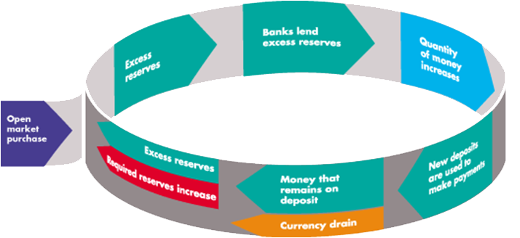
Open Market Operation

Slide 41
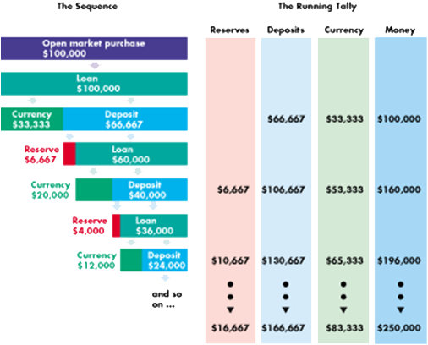
Open Market Operation

Slide 42
Deposit Creation (Extended Model)
A more robust model needs to account for people converting loans to currency (currency drain) and banks holding additional reserves beyond required reserves (excess reserves).

Slide 43
Money Multiplier
M = mMB
M ≡ money supply
m ≡ money multiplier
MB ≡ monetary base

Slide 44
Money Multiplier
M = mMB
D ≡ deposits in the banking system
C ≡ currency in circulation
ER ≡ excess reserves in the banking system
c ≡ ratio of currency to deposits
e = ratio of excess reserves to deposits

Slide 45
Money Multiplier
M = mMB
Assume currency and excess reserves grow proportionally to deposits (i.e., assume c & e are constants in equilibrium).
c = C/D
e = ER/D

Slide 46
Money Multiplier
D = (1/(r+e+c))MB
R = RR + ER
RR = rD
R = rD + ER
MB = R + C = rD + ER + C
MB = rD + eD + cD = (r + e + c)D
D = (1/(r + e + c))MB

Slide 47
Money Multiplier
m = (1 + c)/(r + e + c)
M = D + C
M = D + cD
M = (1 + c)D
M = (1 + c)[(1/(r + e + c))MB]
M = ((1 + c)/(r + e + c))MB
m = (1 + c)/(r + e + c)

Slide 48
Money Multiplier
M = mMB
m = (1 + c)/(r + e + c)
M ≡ money supply
MB ≡ monetary base
m ≡ money multiplier
r ≡ required reserve ratio
c ≡ ratio of currency to deposits
e ≡ ratio of excess reserves to deposits

Slide 49
Money Multiplier
money multiplier is less than deposit multiplier
m < 1/r, (1 + c)/(r + e + c) < 1/r
no multiple expansion for currency
excess reserves rise as deposits rise
money supply is negatively related to:
required reserve ratio (r)
currency ratio (c)
excess reserve ratio (e)

Slide 50
Excess Reserves
Excess reserve ratio (e)
negatively related to market interest rate (i)
positively related to expected deposit outflows

Slide 51
Insights
m = (1 + c)/(r + e + c)
MB↑ → M↑
r↑ → M↓
c↑ → M↓
e↑ → M↓
i↑ → e↓ → M↑
E(deposit outflows)↑ → e↑ → M↓

