Slide 1
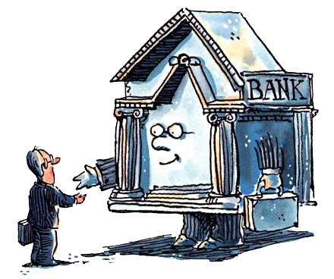
Unit 2: Banking
Pre-FDIC Bank Runs & Panics
3/22/2011

Slide 2
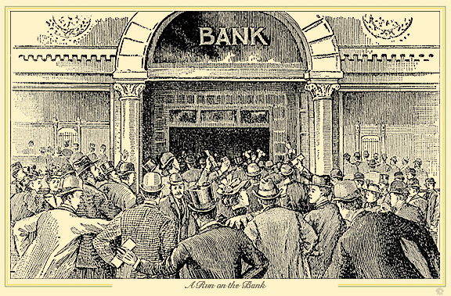
Bank Runs
bank run –
many customers simultaneously
try to cash out deposits
(or banknotes), out of
concern that the bank will
default if they wait

Slide 3
Bank Runs
Reasons bank runs are harmful
shareholders
fire sale losses
selling assets quickly
borrowers
interrupts loans
depositors / note holders
total or partial losses

Slide 4
Bank Runs
A run on an insolvent bank can be good because it can force the bank to close before it squanders more wealth on risky investments.
Additionally, the threat of a bank run incentivizes depositors to monitor how risky bank investments are.

Slide 5
Bank Runs
When nobody runs on insolvent banks, they often become zombie banks that take ever greater gambling risks to get back to even.
For example:
the savings & loan crisis.

Slide 6
Bank Runs
Depositors can run on a solvent bank that subsequently becomes insolvent due to the run
(fire sale losses on assets liquidated to pay withdraws).
So bank runs can become a self-fulfilling prophesy.

Slide 7
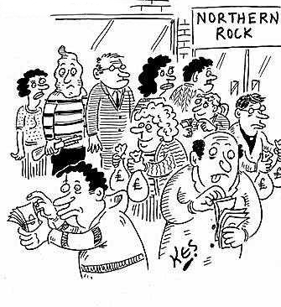
Bank Runs
Banks are run prone because they pay out on a first come, first served basis and they may not have enough money to pay the last person in line.

Slide 8
Bank Runs
Must be a greater expected payoff to arriving sooner rather than later to redeem.
Implications
debt claim
fixed $
unconditional redeemability
first come, first served
default likely on last claim

Slide 9
Bank Runs
Solution: modify any 1 of 3 conditions
debt claim equity claim
money market mutual fund (MMMF)
total claims can’t exceed portfolio
losses shared by all immediately
no reward for first to redeem
uninsured, but never run against
unconditional redeemability
default likely on last claim

Slide 10
Bank Runs
Solution: modify any 1 of 3 conditions
debt claim
unconditional redeemability conditional redeemability
notice-of-withdrawal clause for deposits
2 weeks notice required to withdraw
option clause for banknotes
temporarily suspend redeemability
pay interest on period suspended
default likely on last claim

Slide 11
Bank Runs
Solution: modify any 1 of 3 conditions
debt claim
unconditional redeemability
default likely on last claim solvency assurances
adequate capital, advertised
diversified portfolio of safe assets
extended liability for shareholders
double, triple, unlimited
clearinghouse certification

Slide 12
Bank Panics
bank panic –
many banks experience
runs in the same period

Slide 13
Bank Panics
Reasons bank panics are harmful
spreads runs to other banks
harms of bank runs apply
contracts money supply
disrupts economy
fewer deposits
less intermediation / loans

Slide 14
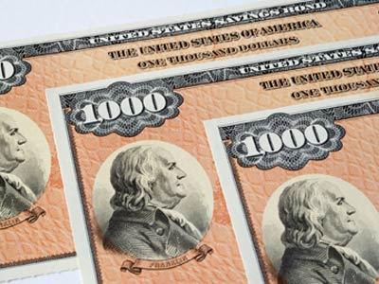
Bank Panics
Historical reasons for contagion
branch banking restrictions
reduced diversification
assets and liabilities
limited capitalization
bond collateral requirement
currency demands unmet
peak demands
seasonal demands

Slide 15
Bank Panics
Bank panics were far more frequent in highly regulated countries
(e.g., U.K. and United States).
Countries with free banking
had very few bank panics
(e.g., Canada, Scotland, & Sweden).
Reason: no contagion problem. Sweden never had a bank panic.

Slide 16
Mechanism of Bank Panics
Recall that seasonal needs like harvests could cause internal drain.
Country banks would have accounts at city banks for safe liquid assets. City banks would have accounts in big city banks (e.g., NYC & Chicago).

Slide 17
Mechanism of Bank Panics
When country banks needed reserves (due to bond collateral restrictions on banknote issue),
they would withdraw from city banks, which would then withdraw from big banks in NYC or Chicago.
Thus runs effected the whole system.

Slide 18
Mechanism of Bank Panics
The National Bank Act of 1863 made the problem worse by mandating this informal pyramid structure.
All banks had to keep their reserves at the reserve city banks.
Reserve clearing city banks had
to keep their reserves at central reserve city banks.

Slide 19
Mechanism of Bank Panics
National Bank Act of 1863
3 central reserve city banks
New York
Chicago
St. Louis
47 reserve city banks
most cities
Federal Reserve Act of 1913
12 reserve banks

Slide 20
Mechanism of Bank Panics
A bad crop could cause locals to believe all banks in the area had bad loans and were insolvent.
This would trigger bank runs, and withdrawals up the chain.
Fire sale losses to pay out bank depositors could then make the city and big city banks insolvent.

Slide 21
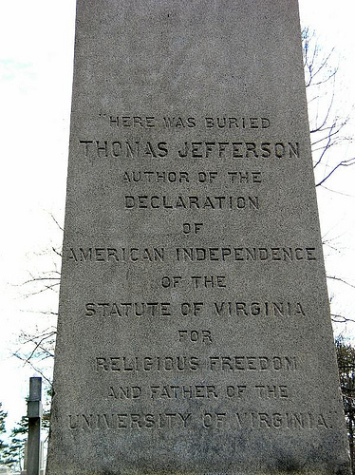
Importance of Economic History
We are going to explore the main banking panics in U.S. history.
These panics may seem trivial relative to the history you know, but economic history is very important to contemporaries.
Thomas Jefferson’s headstone
is a good example.

Slide 22
Importance of Economic History
Jefferson put an embargo on all foreign trade as an isolationist anti-war policy. The resulting reduction in imports and exports destroyed the American economy.
He was so embarrassed about wrecking America’s standard of living that he didn’t list “President of the United States” on his grave.

Slide 23
Bank Panics in the U.S.
The U.S. had major bank panics the following years.
1792
1797
1819
1837
1857
1873
1893
1907
1929-
1933

Slide 24
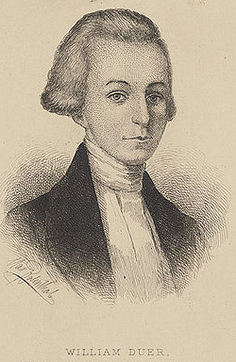
Panic of 1792
speculation on Bank of NY stock
long: Duer with Macomb
short: Duer, Livingston family
William Duer was double-dealing
first insider trader
thrown in debtor’s prison
prices went up a lot, then crashed
Alexander Hamilton intervened
Treasury purchased securities
urged banks not to call in loans

Slide 25
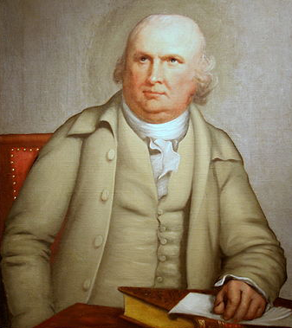
Panic of 1797
land speculation
Robert Morris
3M acres in west NY
6M acres in south
James Wilson
land prices plummeted
demand fell: Napoleonic Wars
BoE suspended specie payments
massive deflation

Slide 26
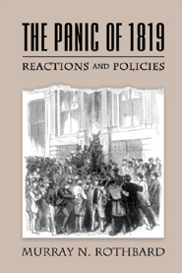
Panic of 1819
Rothbard’s Ph.D. dissertation
boom
inflation: War of 1812 financing
unsustainable investments
bust
Europe demand for food fell
Europe supply had risen
Europe hoarded gold & silver
Mexican supply lines cut off
specie payments suspended

Slide 27
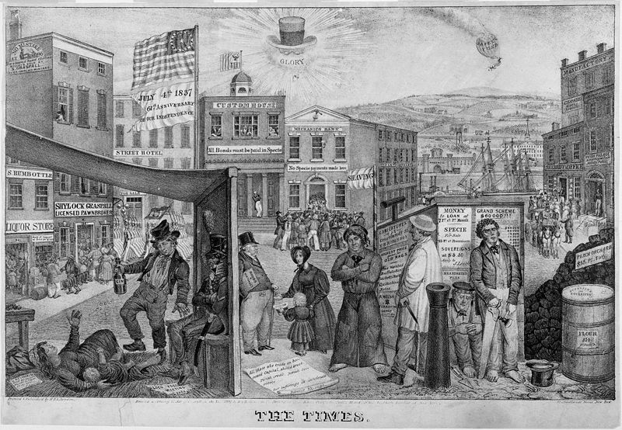
Panic of 1837
Gresham’s Law: silver out of Mexico
state deficit spending
Specie Circular executive order
only specie accepted for land
issued by Andrew Jackson
continued by Martin Van Buren
343/850 banks totally failed
62/850 banks partially failed
specie payments suspended

Slide 28
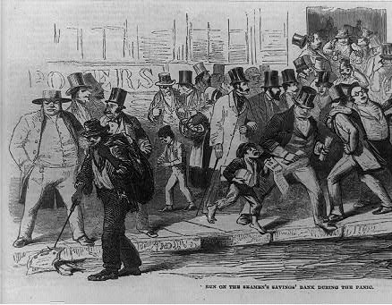
Panic of 1857
western farmer mortgage defaults
because grain prices had fallen
railroad stock prices plummeted
due to less western migration
Ohio Life Insurance & Trust Co. failed
made panic more public
Dred Scott decision on slavery
created uncertainty in west
specie payments suspended
tariff of 1857 lowered tariffs

Slide 29
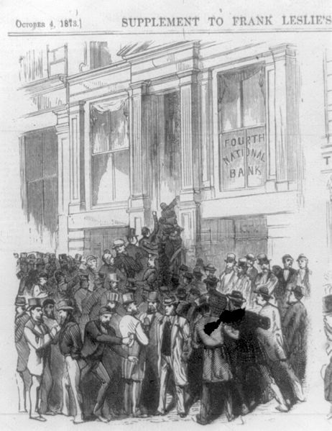
Panic of 1873
Coinage Act of 1873
de-monetized silver in U.S.
reduced money supply
raised interest rates
Jay Cooke & Company failed
bank financing No. Pac. Railroad
89/364 railroads went bankrupt
specie payments suspended
“Great Depression” in Europe

Slide 30
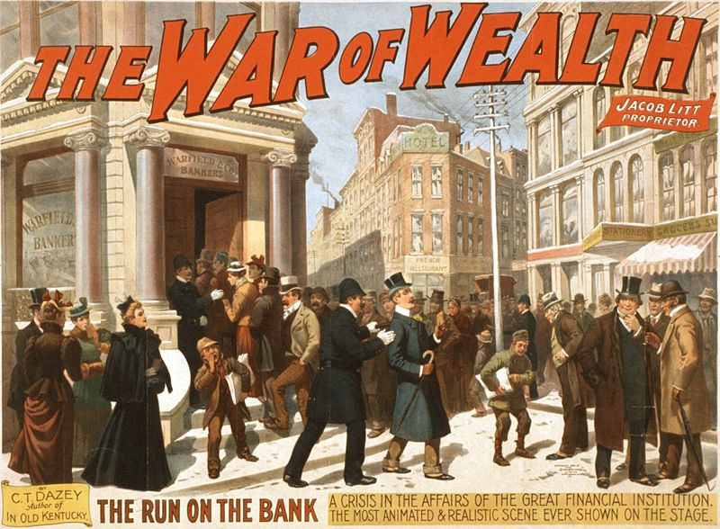
Panic of 1893
Philadelphia and Reading Railroad
failed after overextending
Sherman Silver Purchase Act
repealed by Grover Cleveland
act had promoted silver coinage
National Cordage Company failed
rope co. speculated in hemp
J.P Morgan lent U.S. $65M gold
500 banks failed (many in west)
specie payments suspended

Slide 31
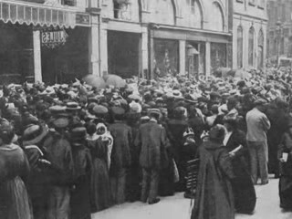
Panic of 1907
speculation on United Copper Co.
Otto & August Heinze, C. Morse
tried to corner, fail spectacularly
runs on all their banks & trusts
forced to resign from all boards
run on Knickerbocker Trust Company
C. Barney friend of the above
3rd largest trust
becomes insolvent and fails
stock market tumbles

Slide 32
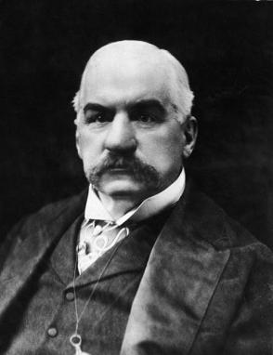
Panic of 1907
J.P. Morgan (banker) intervenes
lends massively to trusts
gets trusts & banks lending
Moore & Schley brokerage
in trouble due to TC&I stock
U.S. Steel buys TC&I
lends NYC $30 million
Rockefeller pledged half his wealth
Treasury deposited $25M in banks
NY CLA issued $100M in bank loans

