Slide 1
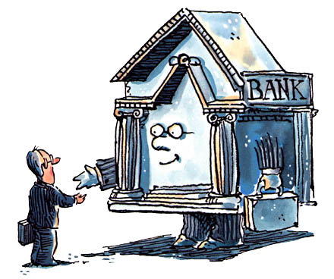
Unit 2: Banking
The Federal Reserve
3/8/2011

Slide 2
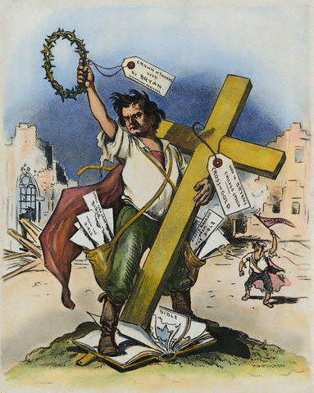
William Jennings Bryan
presidential candidate (Democrat)
  1896, 1900, 1908
“cross of gold” speech
  populist for farmers
  disliked gold standard
  wanted free silver coinage
  hated big banks
Secretary of State under Wilson

Slide 3
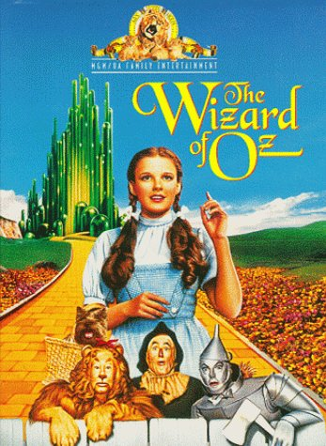
Wizard of Oz
allegory for free silver movement
JPE article by Hugh Rockoff (1990)
dorothy = united states
toto = prohibition
scarecrow = farmer
tin man = workingman
lion = W. J. Bryan
wizard = president
w. of north = Bryan’s VP
w. of west = drought
w. of east = bankers
Emerald City = Washington, D.C.
Emerald Palace = White House
big round room = oval office
yellow brick road = gold standard
Kansas = Democratic convention
cyclone = free silver movement
silver shoes = silver in bimetallic std.
green glasses = money is everything
munchkins = American people

Slide 4
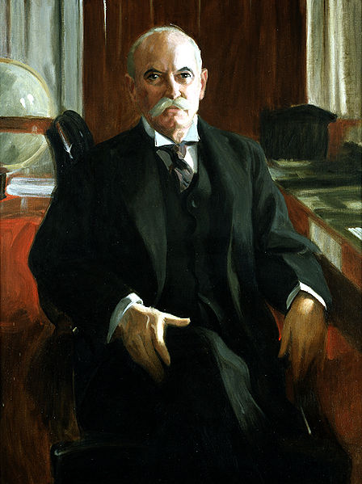
Nelson Aldrich
chair of Senate finance committee
sponsor: 16th Amend. (income tax)
sponsor: Aldrich–Vreeland Act of 1908
wrote Aldrich plan
  studied European central banks
  met with bankers on Jekyll Island
  basis of Federal Reserve Act
grandfather of VP Nelson Rockefeller

Slide 5
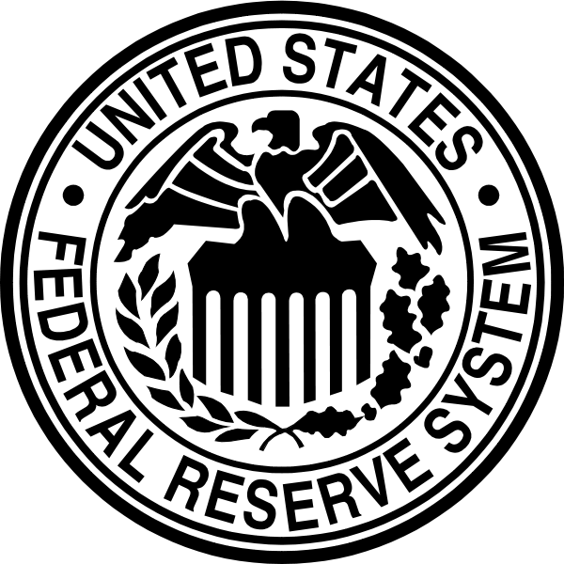
Federal Reserve
central bank –
public authority that regulates a nation’s depository institutions and controls the quantity of money
Federal Reserve (“the Fed”) –
central bank in the United States

Slide 6

Federal Reserve History
precipitated by panic of 1907
Aldrich–Vreeland Act of 1908
  National Monetary Commission
Aldrich plan floated
Federal Reserve Act of 1913
  introduced by Glass
  Woodrow Wilson signed
  William Jennings Bryan supported

Slide 7
Federal Reserve History
Aldrich plan
  big NY bank, private control
  but citizens distrust “money trust”
Glass plan
  based loosely on Aldrich plan
  smaller NY bank, private control
Federal Reserve Act of 1913
  Wilson added Board to Glass plan
  more centralized control

Slide 8
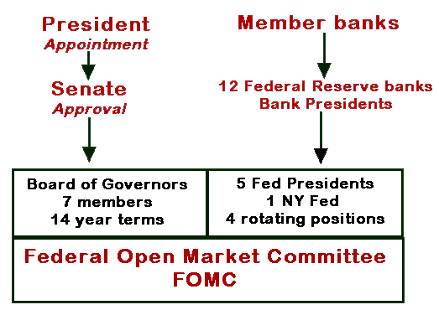
Federal Reserve Structure

Slide 9

Federal Reserve Structure
Federal Reserve Banks
  12 regional banks
Board of Governors
  7 governors
Federal Open Market Committee
  7 board governors
  1 FRB of NY president
  4 other FRB presidents (rotating)
Federal Advisory Council
  12 bankers (1 from each district)

Slide 10
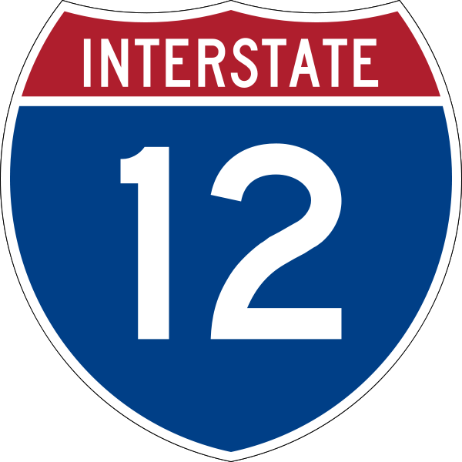
12 Federal Reserve Districts
Federal Reserve decentralized
  unlike other central banks
  Aldrich plan wanted big NY bank
  others opposed NY domination
legislation called for 8-12 districts
cities picked before districts drawn
economic districts, not state lines
final result
  12 districts
  medium size NY bank

Slide 11
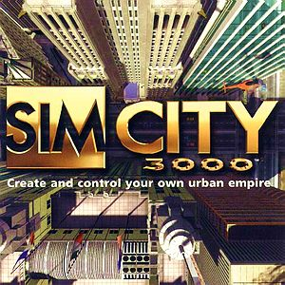
12 Federal Reserve Districts
Boston
New York
Philadelphia
Cleveland
Richmond
Atlanta
Chicago
St. Louis
Minneapolis
Denver
Dallas
San Francisco

Slide 12

12 Federal Reserve Districts
NY wanted to consume northeast
  Philadelphia, Boston, & D.C.
  but citizens distrust “money trust”
National Bank Act of 1863
  3 central reserve clearing banks:
  New York, Chicago, & St. Louis
political favors
  Richmond: VA House banking chair
  Cleveland: OH secretary of war
  St. Louis/KC: MO speaker of house

Slide 13
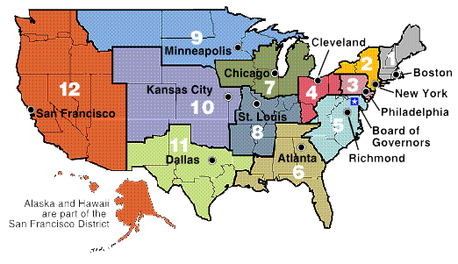
12 Federal Reserve Districts

Slide 14

Federal Reserve Bank of New York
Federal Reserve bank
district with largest commercial banks
houses open market desk
  open market operations for Fed
houses foreign exchange desk
  foreign exchange interventions
member of BIS (with Fed chair)
  Bank for International Settlements
repository for $100 billion of gold
permanent voting member of FOMC

Slide 15
Federal Reserve Banks
Federal Reserve banks (FRB) –
12 regional banks responsible for the regulation of the commercial banks within their own particular district

Slide 16
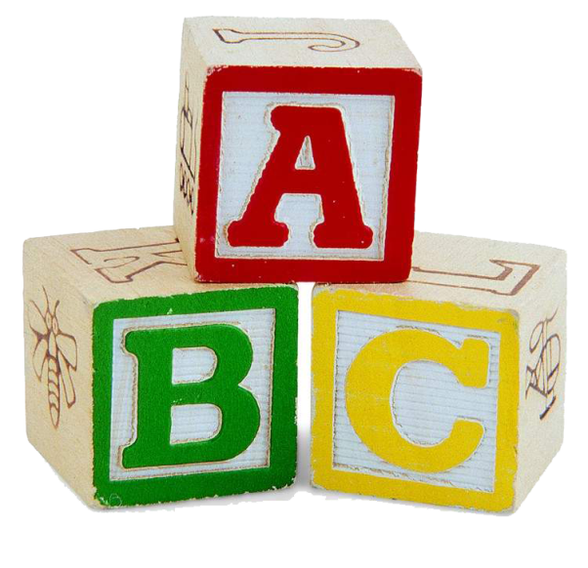
Federal Reserve Banks
3 class A directors
  professional bankers
  elected by member banks
3 class B directors
  industry, labor, agriculture leaders
  elected by member banks
3 class C directors
  represent public interest
  appointed by Board of Governors
  Bank President must be class C

Slide 17
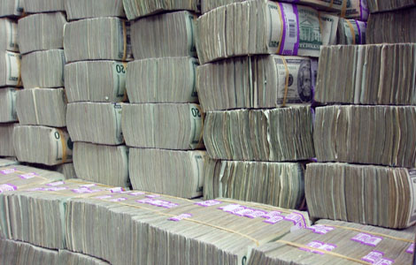
Federal Reserve Bank Functions
clear checks
issue new currency
withdraw damaged currency
discount loans to banks in districts
evaluate proposed mergers
liaisons for business community
examine bank holding companies
examine state-chartered member banks
collect data on local economy
research monetary policy

Slide 18
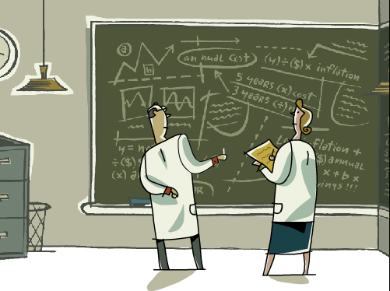
FRB Monetary Policy Involvement
Each Federal Reserve bank
directors establish discount rate
decide which banks get discount loans
directors appoint 1 banker to FAC
  Federal Advisory Council
  1 banker from each district
5/12 bank presidents vote in FOMC
  1 FRB of NY president (permanent)
  4 other FRB presidents (rotating)
  directs open market operations

Slide 19
Member Banks
nationally chartered banks must join
state chartered banks may join
all depository institutions
  must keep reserves at Fed
  subject to reserve requirements
member banks
  associate with 1 FRB (district)
  invest 6% of capital in FRB stock
  get 6% dividends on FRB earnings
  vote on 6/9 FRB directors

Slide 20
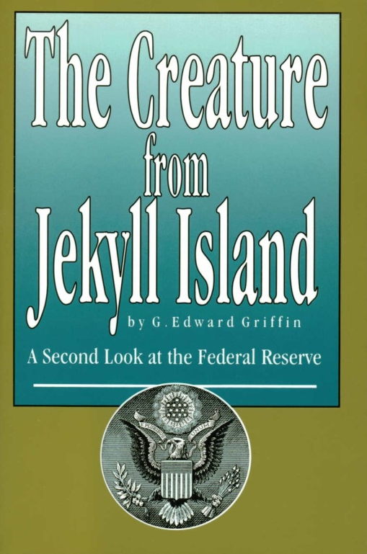
Conspiracy Theories
conspiracy theory: Fed is private
origin of theory
  FRB capitalization by banks
  FRB director voting by banks
refutation
  FRB capitalization is forced
  FRB voting is token
  FRB president must be class C
  BoG has the real power

Slide 21
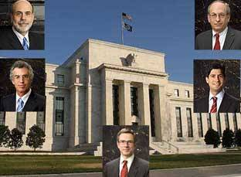
Board of Governors
Board of Governors (BoG) –
main governing body of
Federal Reserve System

Slide 22
Board of Governors
7 governors
  all from different FRB districts
  14 year non-renewable terms
  staggered expiring every 2 years
  appointed by President
  confirmed by Senate
chairman and vice-chairman
  selected from governors
  4 year renewable terms
  appointed by President

Slide 23
Board of Governors
Current governors
Ben Bernanke (2006-2020) (Chair)
Janet Yellen (2010-2024) (Vice-Chair)
Kevin Warsh (2006-2018)
Elizabeth Duke (2008-2012)
Daniel Tarullo (2009-2022)
Sarah Bloom Raskin (2010-2016)
Vacant (Diamond nominated)

Slide 24
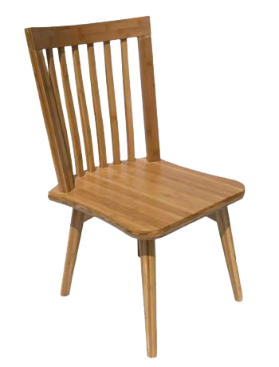
Federal Reserve Chairman
Chairmen
Charles Hamlin (1914-1916)
William Harding (1916-1922)
Daniel Crissinger (1923-1927)
Roy Young (1927-1930)
Eugene Meyer (1930-1933)
Eugene Black (1933-1934)
Marriner Eccles (1934-1948)

Slide 25
Federal Reserve Chairman
Chairmen
Thomas McCabe (1948-1951)
William Martin (1951-1970)
Arthur Burns (1970-1978)
William Miller (1978-1979)
Paul Volcker (1979-1987)
Alan Greenspan (1987-2006)
Ben Bernanke (2006-present)

Slide 26
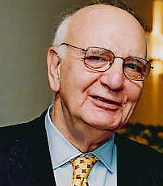
Paul Volcker
Federal Reserve chairman 1979-1987
  appointed by Carter
  reappointed once by Reagan
  “fired”: didn’t support de-regulation
  ended 1970’s stagflation
  caused 1981 recession
  targeted monetary aggregates
previously FRBNY president
Economic Recovery Advisory Board chair

Slide 27
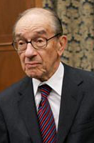
Alan Greenspan
Federal Reserve chairman 1987-2006
  appointed by Reagan
  re-appointed by Bush, Clinton, & Bush 2
  very stable economy / low inflation
  obfuscated his words
  acted first at FOMC meetings
  policy in 2000’s caused housing bubble?
chair of Council of Economic Advisers (Ford)
economic consulting firm (numbers guy)
friend of objectivist philosopher Ayn Rand

Slide 28
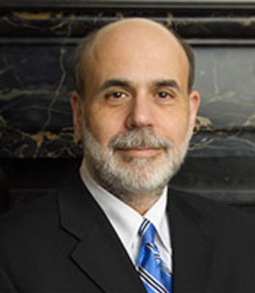
Ben Bernanke
Federal Reserve chairman 2006-present
  appointed by Bush 2
  re-appointed by Obama
  scholar of Great Depression
  big on transparency
  speaks clearly
  acts last at FOMC meetings
economics professor (Stanford, Princeton)
Federal Reserve Governor 2002-2005
chair of Council of Economic Advisers (Bush 2)

Slide 29
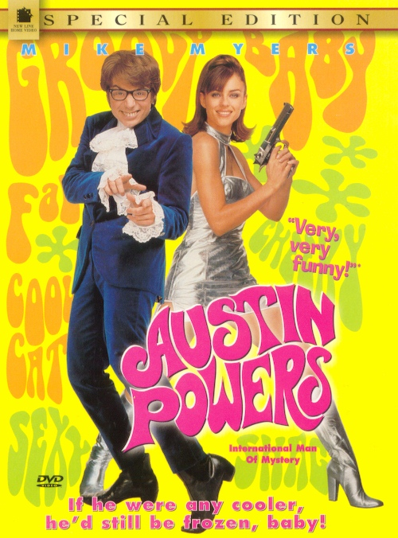
Federal Reserve Chairman Powers
controls agenda of the Board
directs board staff
Federal Reserve spokesperson
point of contact for
  President
  Congress
  foreign central banks

Slide 30
Federal Reserve History
originally much less centralized
Banking Act of 1935 changed that
before Banking Act of 1935
  FRB presidents were “governors”
  BoG was “Board of Directors”
  BoD members were “directors”
  BoD members paid much less
  most power with FRB, not BoD
now most power with BoG

Slide 31
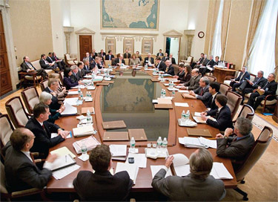
Federal Open Market Committee
Federal Open Market Committee (FOMC) –
main policy-making group in the Federal Reserve System

Slide 32
Federal Open Market Committee
Voting members of FOMC
7 governors from BoG
1 FRB of NY president (permanent)
4 other FRB presidents (rotating)
chair of BoG chairs the FOMC

Slide 33
Federal Open Market Committee
Non-voting FOMC attendees at table
7 non-voting FRB presidents
secretary of FOMC
Board of Governors staff
  director of Research and Statistics
  director of Monetary Affairs
  director of International Finance

Slide 34
Federal Open Market Committee
Other FOMC attendees in room
FRB directors of Research
senior FRB staff
senior Board of Governors staff
(Seated around side of room.
Do not speak at meetings.)

Slide 35
Federal Open Market Committee
meets every 6 weeks
BoG has a majority (7/12)
formulates monetary policy
  decides open market operations
  sets reserve requirements
  reviews discount rates

Slide 36
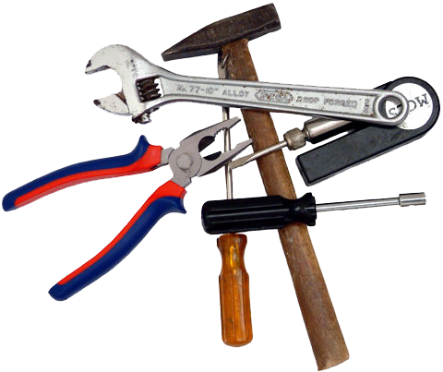
Federal Reserve Policy Tools
traditional tools
  required reserve ratios
  discount rate
  open market operations
additional (new) tools
  interest on reserves
  term auction facility
  primary dealer credit facility
  term securities lending facility

Slide 37
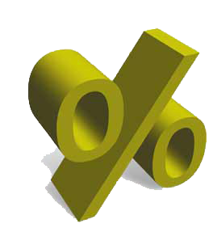
Definitions
discount rate –
interest rate to borrow funds
from Federal Reserve
federal funds rate –
interest rate to borrow
from other banks

Slide 38
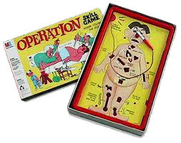
Definitions
1/10
required reserve ratio –
required percentage of liabilities
banks must keep as reserves
open market operations –
purchase or sale of securities by the Federal Reserve in the open market
(usually U.S. treasury bills and bonds)

Slide 39
Open Market Operations
policy decided by FOMC
implemented by FRB of NY
  open market desk sells or buys
  with primary dealers (18 banks)
buying bonds increases money supply
selling bonds decreases money supply

Slide 40
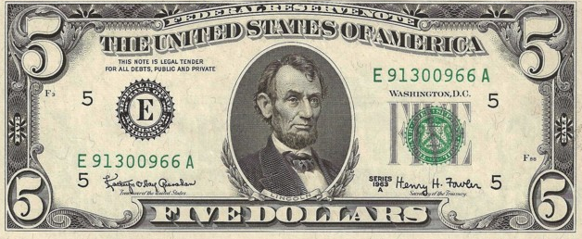
Federal Reserve Notes
reserve banks issue notes
Department of Treasury prints notes
  Bureau of Printing & Engraving
notes made of cloth, not paper
old: marked by issuing reserve bank
new: generic federal reserve notes

Slide 41

Federal Reserve Notes
Bank of Richmond note
5th district = E

Slide 42

Federal Reserve Revenue
revenue
  seigniorage
  service fees
fund all operations
rebate excess to Treasury
e.g., 2003:
  $23.8 billion revenue
  $22.0 billion rebated to Treasury
  $1.8 billion for operations

Slide 43
Federal Reserve Revenue
seigniorage –
profit that results from producing
coins (difference between
face value and metal value)
service fees –
profit that results from fees
charged for miscellaneous services performed (e.g., check clearing)

Slide 44

Monetary Policy Goals
price stability
high employment
economic growth
financial market stability
interest-rate stability
foreign exchange stability
price stability –
low and stable inflation

Slide 45
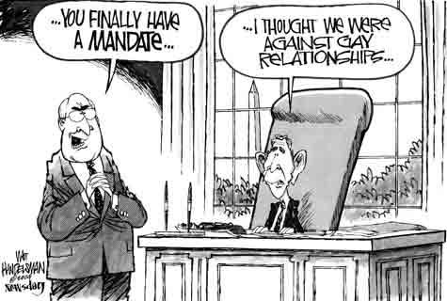
Monetary Policy Goals
dual mandate –
co-equal objectives
(price stability and
maximum employment)
hierarchical mandate –
Price stability first,
other goals only if they don’t interfere with price stability

Slide 46
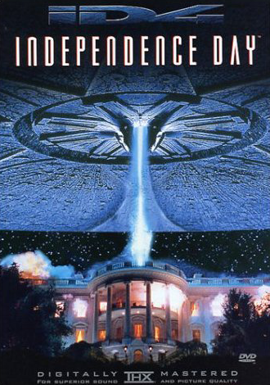
Independence
instrument independence –
ability of the central bank to
set monetary policy instruments
goal independence –
ability of the central bank to
set goals of monetary policy

Slide 47
Independence
independent
  long terms for BoG
  determines own budget
  instrument and goal independence
not independent
  Congress can amend Fed legislation
  President appoints BoG and chair
overall: very independent
independence leads to lower inflation
  less political business cycles

Slide 48
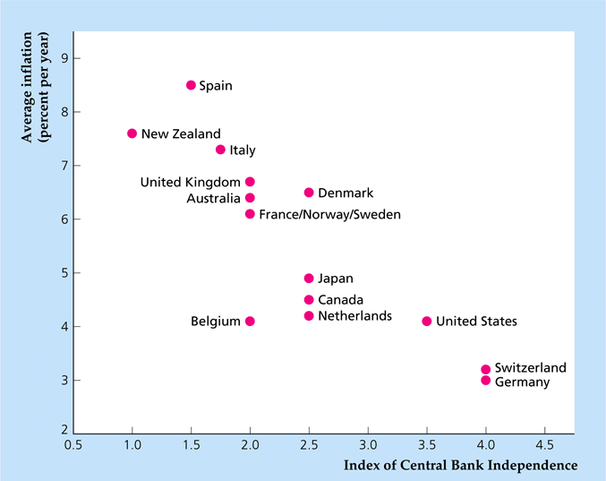
Independence

Slide 49
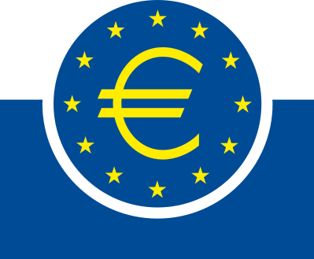
European Central Bank
patterned after Federal Reserve
  national central banks (NCBs)
  executive board (EB)
  governing council (GC)
NCBs similar to Fed banks
EB similar to Fed BoG
GC similar to FOMC

Slide 50
European Central Bank
Executive Board
  President
  Vice-president
  4 other members
  8 year non-renewable terms
Governing Council
  EB and NCB presidents
  will be rotating NCB if more join

Slide 51
European Central Bank
NCBs control own budgets
monetary operations not centralized
doesn’t regulate financial institutions
monthly meetings (Frankfurt, Germany)
12 NCB heads, 6 EB members
operates by consensus

Slide 52
European Central Bank
most independent in the world
EB members have long terms
determines own budget
less goal independent (price stability)
charter fixed by Maastricht Treaty

