Slide 1
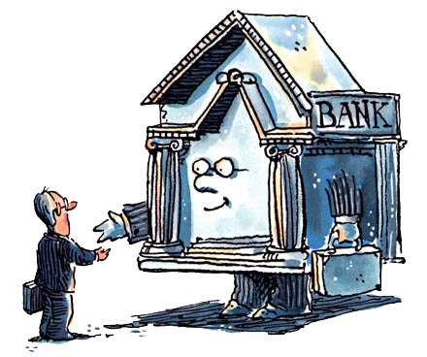
Unit 2: Banking
Evolution of Central Banks
3/8/2011

Slide 2
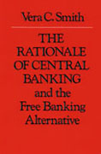
Roles of a Central Bank
banker's bank
monopoly of note issue
regulator of commercial banks
lender of last resort
monetary policy
Which are “natural” (market evolved)?

Slide 3
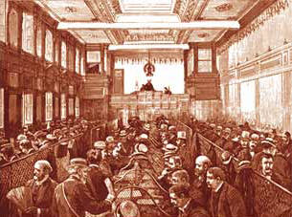
Banker’s Bank
banker’s bank –
institution whose liabilities
are held by commercial
banks as reserves

Slide 4
Banker’s Bank
clearinghouse association (CHA) –
institution where checks and banknotes drawn on member banks are cancelled against each other so that only net balances are payable
correspondent banking services –
services provided to other banks (usually when small banks have deposits at large banks)

Slide 5
Banker’s Bank
Banks that provide correspondent services are not banker’s banks unless correspondent banks hold those liabilities as reserves.
Banker’s banks usually hold the bulk of outside money reserves in the system (e.g., gold and silver).

Slide 6
Banker’s Bank
Private clearinghouse associations (CHAs) whose liabilities are transferred among banks as a medium of settlement are banker’s banks.
When they evolve naturally, they will not be commercial bank rivals, but rather jointly owned institutions specializing in clearing and settlement.

Slide 7
Banker’s Bank
If government grants legal privileges to a particular commercial bank which make that bank larger and more secure than any other, lesser banks will use it as a banker’s bank.
Bank of England legal privileges
government deposits
monopoly on note issue
only joint stock bank (pre-1826)

Slide 8
Monopoly of Note Issue
monopoly of note issue –
permission for one bank to issue banknotes and prohibition on any other bank issuing banknotes
There is no evidence that note issue is a natural monopoly. Without government monopolies there are always many banks that issue notes.

Slide 9
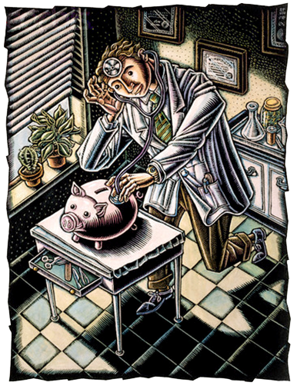
Regulator of Commercial Banks
regulator of commercial banks –
monitoring and policing of banks
Reasons for private regulation
minimize bank defaults (clearing)
public confidence in banks

Slide 10
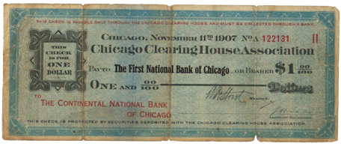
Regulator of Commercial Banks
Chicago CHA
history
1865 founded
1867 solvency statements
1873 minimum capital ($250k)
1876 examinations
remedies for shaky member banks
post bond
infuse new capital
expulsion

Slide 11
Regulator of Commercial Banks
CHAs promote public confidence
internalize “contagion externality”
audit banks rumored insolvent
publicize results
mutual-support lending
but only in U.S.
branch banking restrictions
no contagion problem elsewhere

Slide 12
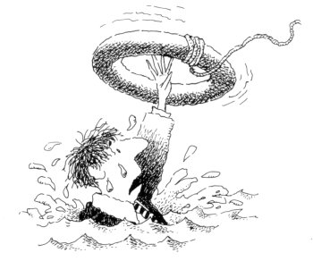
Lender of Last Resort
lender of last resort (LOLR) –
bank ready to insert high-
powered money into the system
in the event of an internal drain
high-powered money –
money that can be held by commercial banks as reserves

Slide 13
Lender of Last Resort
solvency –
assets > liabilities
liquidity –
ability to pay debts
as they become due

Slide 14
Lender of Last Resort
rescue solvent but illiquid banks
classic concept
problem of fire sale losses
problem of internal drain
prevent M from shrinking
modern concept
offset fall in M/R by injecting R

Slide 15
Lender of Last Resort
fire sale –
sale of goods at extremely discounted prices, typically
when the seller faces bankruptcy
internal drain –
public’s preference for high-powered money prompts redemption depleting banking system of reserves and forcing a sharp contraction

Slide 16
Lender of Last Resort
If there are centralized reserves (e.g., a very large banker’s bank), then only the bank holding most of the reserves can act as the lender of last resort because no other bank has reserves to lend.

Slide 17
Lender of Last Resort
Bagehot’s prescription for LOLR
lend freely to qualifying banks
save banks worth saving
announce #1 in advance
allay fearful reserve demands
bank needs good collateral
don’t support insolvent banks
lend at a penalty interest rate
reduce moral hazard
Fed has violated #3 and #4

Slide 18
Lender of Last Resort
Reasons to prefer OMO to loans
open market operations
inject via bond purchases
no lending to particular bank
avoids allocational favoritism
lets market allocate funds
avoids moral hazard
fights systemic contraction
not particular banks’ insolvency

Slide 19
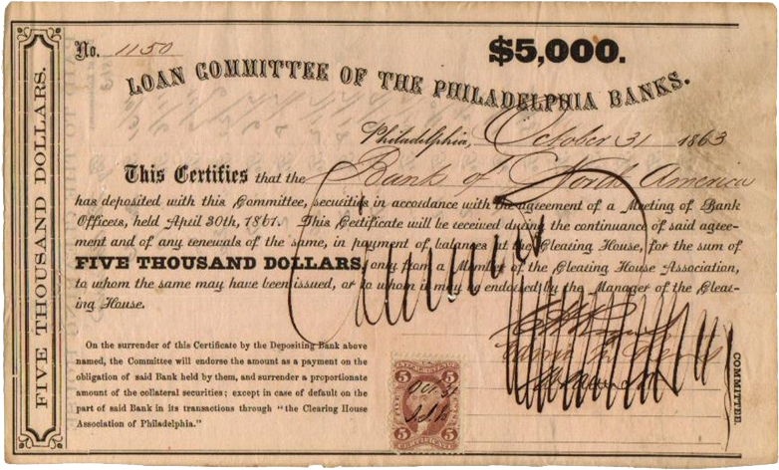
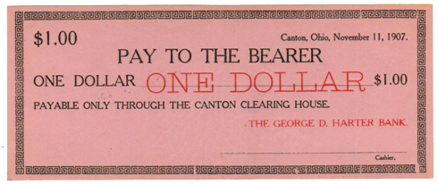
Lender of Last Resort
CHAs would act as a lender of last resort using loans.

Slide 20
Lender of Last Resort
New York CHA as LOLR
ordinarily 100% gold reserves
1857 panic
temporarily irredeemable notes
used as collateral
issued clearing certificates
1893, 1907 panics
issued small denomination notes
illegal, but not prosecuted
imitated by other CHAs

Slide 21
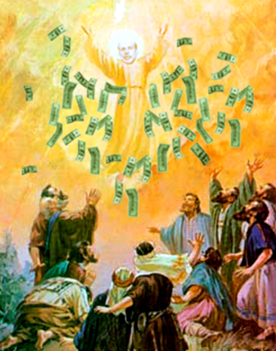
Monetary Policy
monetary policy –
pursue macroeconomic goals through control of the monetary aggregate
Monetary policy only makes sense in the context of a government.
Without central banks, the public
and banks jointly determine M through their choices of banknote holdings and reserves.

Slide 22
Origins of Central Banks
Bank of England
legal privileges
Federal Reserve System (USA)
nationalizing CHA functions
Bank of Canada
monetary policy
Bank of France, Bank of Italy
fiscal motive (seigniorage)

Slide 23
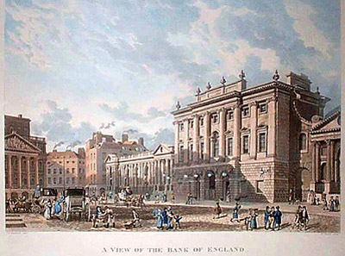
Bank of England
1694 – founded
1697 – charter made exclusive
1708 – six-partner rule, note monopoly in London
1833 – BOE notes legal reserves for other banks
1844 – Peel’s Act
no new note issue banks
froze existing note issue
$14m for BoE w/o reserve
>$14m 100% gold reserve

Slide 24
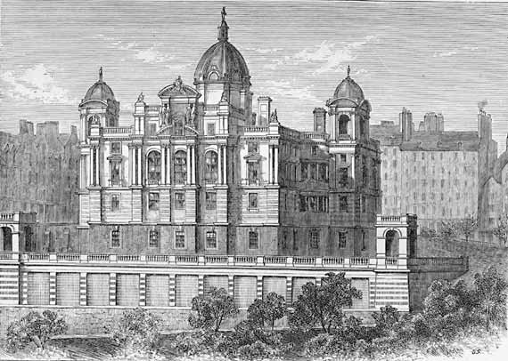
Scotland
1695 – Bank of Scotland chartered
1707 – Union of the Parliaments
1716 – BoS monopoly expired
1727 – Royal Bank of Scotland chartered
1769 – 32 banks of issue
shake-out with Ayr failure
leading role by BoS, RBS, BLC
1810 – 25 banks; CBS (large joint-stock bank) entered
1844 – 19 banks; Peel’s Act froze entry

Slide 25
Objectives of a Central Bank
seigniorage (inflation)
bureaucratic
political business cycles
macroeconomic policy

Slide 26
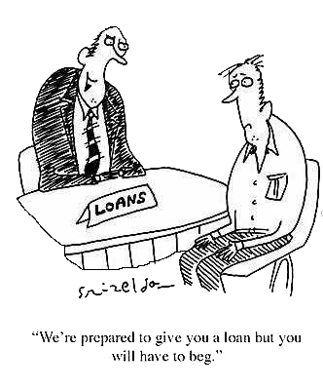
Seigniorage
seigniorage –
profit that results from producing
coins (difference between
face value and metal value)
Governments that find it hard to borrow or tax must rely more on seigniorage. Therefore, poorer countries tend to have higher rates of seigniorage – and thus higher inflation.

Slide 27
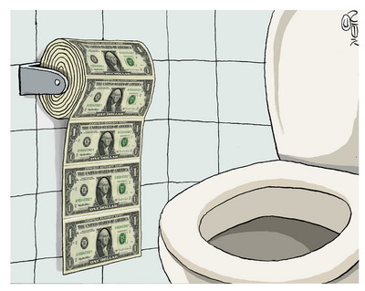
Inflation
Incentives for inflation
seigniorage (revenue)
reduction in real debt
bracket creep (tax brackets)
short term macroeconomics
reduction of interest rates
reduction of unemployment

Slide 28
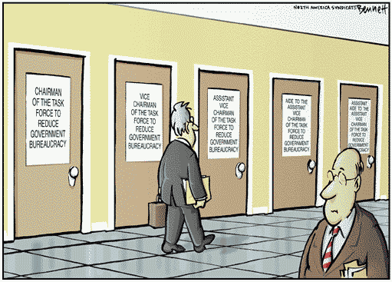
Bureaucracy
bureaucracy –
does not answer to profit-seeking shareholders, so can pursue managers’ comfort instead

Slide 29
Bureaucracy
Theories
scapegoating
budget padding
revolving door

Slide 30
Bureaucracy
Scapegoating
congress faults central bank
blame macro outcomes
in exchange
long terms in office
budgetary autonomy

Slide 31
Bureaucracy
Budget padding
higher salaries
plusher offices
larger travel budgets
vanity publications
more employees

Slide 32
Bureaucracy
Revolving door
churned portfolio
buy $183, sell $184
profit for bond dealers
unpredictable policies
high paid Fed watchers
including ex-Fed officials

Slide 33
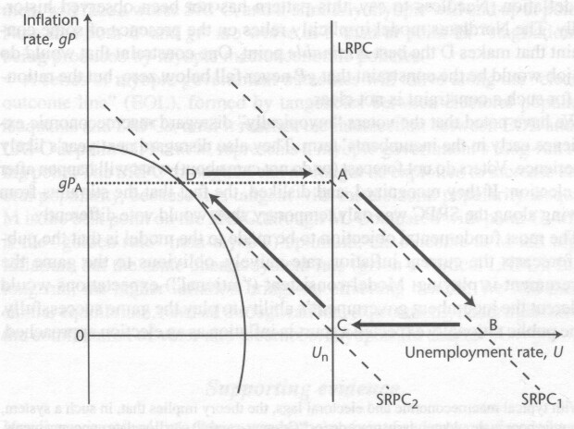
Political Business Cycles
political business cycle –
pre-election the central bank works to maximize the
incumbent president’s votes
Move along Phillips Curve to best short run attainable inflation and unemployment combination on the day of the election.

Slide 34
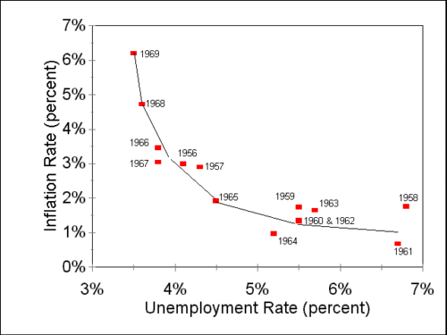
Political Business Cycles
Phillips Curve –
inverse relation between unemployment and inflation
in an economy
The short run Phillips Curve is downward sloping, but the long run Phillips Curve is vertical at the natural rate of unemployment.

Slide 35
Political Business Cycles

Slide 36
Political Business Cycles
President Nixon pressured Federal Reserve chairman Arthur Burns to pursue an expansionary monetary policy for the 1972 election (documented in the Nixon tapes and domestic policy advisor John Ehrlichman’s memoirs). This was one of the causes of 1970’s stagflation.

Slide 37
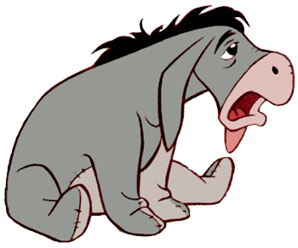
Macroeconomic Policy
dual mandate –
maximum employment
and price stability
misery index –
unemployment rate +
inflation rate
We’ll study macroeconomic policy in a later lecture.

