Slide 1
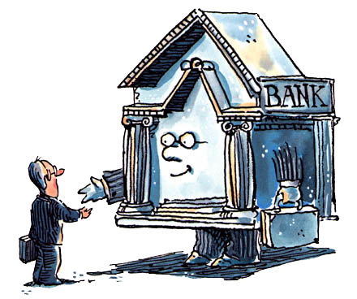
Unit 2: Banking
History of Banking in the U.S.
3/1/2011

Slide 2

Key Point
Banking has always been one
of the most regulated industries.
We will see that problems
with banking are the result
of too much regulation,
not of too little regulation.

Slide 3
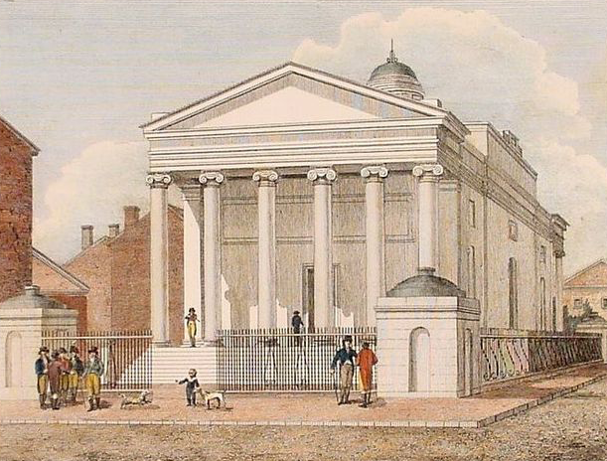
Bank of North America
1781-1785
chartered by Congress of the Confederation
Robert Morris was architect
needed congress charter (mercantilism)
first commercial bank in the U.S.
helped finance Revolutionary War
interstate branching (3 states)
never became real central bank
became First Bank of Pennsylvania
now Wachovia (Wells Fargo), Charter #1

Slide 4
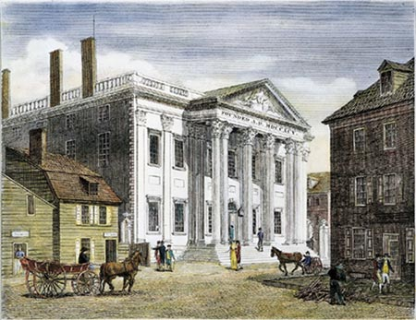
First Bank of the United States
1791-1811 (20 year charter)
Alexander Hamilton was architect
first U.S. central bank
no monopoly on issue of banknotes
interstate branching
held government deposits
public legal tender: notes okay for taxes
$10 million capital (1/5 government)
re-charter failed by 1 vote in House
became Girard Bank, now Citizens Bank

Slide 5
First Bank of US (1809)
Assets | Liabilities + Equity
land + buildings $0.5M | equity $10M
reserves $5.0M | retained earnings $0.5M
U.S. securities $2.2M | notes $4.5M
due to state banks $0.8M | deposits $8.5M
loans $15M
$23.5M | $23.5M
5/(4.5+8.5) = 5/13 = 38% reserve ratio

Slide 6
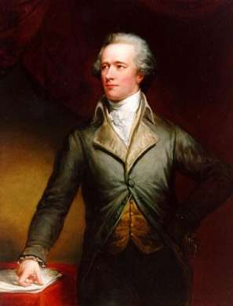
Alexander Hamilton
Secretary of the Treasury (Washington)
wrote half of Federalist Papers
formed United States Mint
got Morris to form Bank of North America
started Bank of New York
architect of 1st Bank of the United States
imposed excise tax (Whiskey Rebellion)
killed by Aaron Burr (VP) in a duel

Slide 7
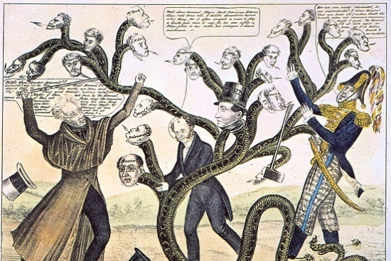
Second Bank of the United States
1816-1836 (20 year charter)
founded due to War of 1812
legality upheld in McCulloch v. Maryland
$35 million capital
mostly same as 1st bank, more capital
state bank reserves were 2nd bank notes
gold flowed out to Bank of England
redemption suspended, loans called in
bank panic in 1819 fueled opposition
Andrew Jackson vetoed re-charter

Slide 8
Second Bank of US (1832)
Assets | Liabilities + Equity
land + buildings $3M | equity $35M
reserves $7M | retained earnings $0M
U.S. securities $0M | notes $21M
due to state banks $3M | deposits $23M
loans $66M
$79M | $79M
7/(21+23) = 7/44 = 16% reserve ratio

Slide 9
Political Parties
Republicans
anti-bank
free trade
no taxes
frugal government
militia
Federalists
pro-bank
high tariffs
internal taxes
high debt
standing army
Democratic
anti-bank
anti-war
Whig
pro-bank
interventionist
Federalist
x 1812

Slide 10
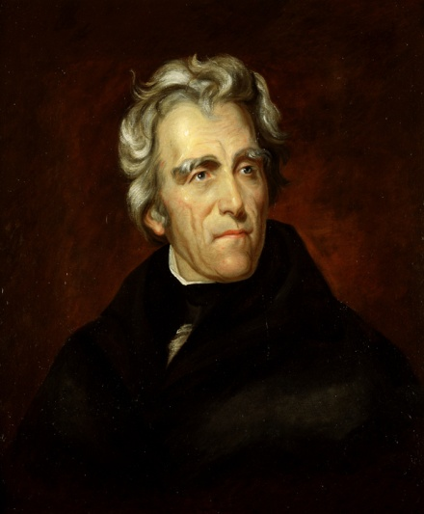
Andrew Jackson
President of U.S. (1829-1837) (Democrat)
advocated hard money
  gold or silver
  100% reserves
very anti-bank
“the bank is trying to kill me, but I will kill it”
vetoed 2nd Bank re-charter
pulled government deposits out of 2nd Bank
paid off national debt (tariffs and land sales)
held money in gold, land payments in specie

Slide 11
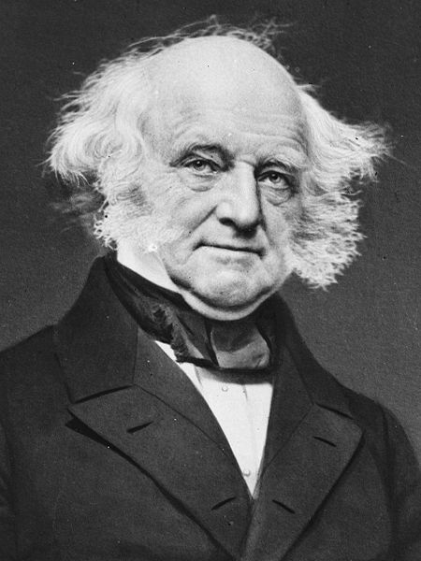
Martin Van Buren
independent treasury –
separation of bank and state
Martin Van Buren
President of U.S. (1837-1841) (Democrat)
implemented an independent treasury
hard money for government transactions
deregulated banks at the federal level

Slide 12
Early State Banks
1776-1837
regulation at state level
no general incorporation for banks
  9/31 states outlawed banking
  some states setup monopoly banks
  some still chartered banks
6 states tried deposit/note insurance (NY)

Slide 13

State Chartering
In early America, starting a corporation required a special charter from the legislature. This made the process very political. Later states adopted general incorporation statutes which allowed corporations to form by meeting specified conditions, avoiding a legislature vote for each company.

Slide 14
State Chartering
The transition from legislative chartering to general incorporation in states was part of the transition from mercantilism to laissez faire.
laissez faire –
transactions between private parties are free from state intervention, including restrictive regulations, taxes, tariffs and enforced monopolies

Slide 15
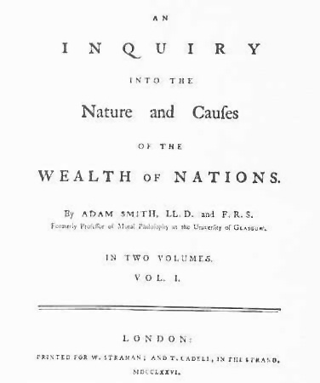
State Chartering
mercantilism –
alliance between government and certain privileged merchants
Adam Smith’s book The Wealth
of Nations was a systematic
anti-mercantilism treatise.
The American Revolution was fought mainly because Americans were afraid of the British East India Company.

Slide 16
State Chartering
For example, Alexander Hamilton founded the Bank of New York in 1784. His political rival Aaron Burr slipped an unnoticed provision into the Manhattan Company’s charter allowing banking. Thus the Democratic-Republicans got a bank to rival the Federalists’ bank. Both banks later became part of J.P. Morgan Chase.

Slide 17
“Free Banking” Era
1837-1863
not really free banking
similarities
  complete federal deregulation
  general incorporation of banks
deviations
  no interstate/intrastate branch banking
  prohibition on small bank notes
  bond collateral requirement

Slide 18

“Free Banking” Era
interstate branch banking –
the ability of a bank to have
branches in more than one state
intrastate branch banking –
the ability of a bank to have
multiple branches in the same state
unit banking –
no interstate or intrastate branching

Slide 19
“Free Banking” Era
Branching allows diversification.
Assets: Without branching banks only loan locally, so when the local economy goes bad, many loans default at once.
Liabilities: Without branching banks only get deposits locally, so when the local economy goes bad, many customers withdraw at once.

Slide 20
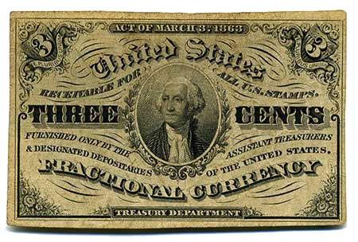
“Free Banking” Era
fractional currency –
currency in denominations less than
a dollar (e.g., 5¢, 10¢, 25¢, etc.)
When specie was in short supply (especially silver), fractional currency would be useful. Prohibitions on fractional banknotes made silver shortages (Gresham’s Law) worse.

Slide 21
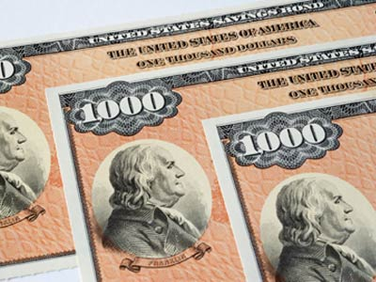
“Free Banking” Era
bond collateral requirement –
dollar for dollar banknote to
state bond ratio
Bond collateral requirements forced the riskiest form of investment on banks: in governments that spent beyond their means and would often default on debt.
Sometimes bonds of other states eligible.

Slide 22

“Free Banking” Era
wildcat banking –
fraudulent banks setup in wilderness that made it very hard to redeem notes
Wildcat banking total losses were only $1.2 million (less than 2% inflation!).
Wildcat banking developed from too much regulation, not too little.

Slide 23
“Free Banking” Era
The stability of the bank system affects the reserve rate, not the other way around.
Scotland had real free banking. Its reserve rate was around 2% (very low). This indicates it was a very stable system.
To deal with the “wildcat banking” that resulted from restrictions on branching, note brokers would issue weekly reports on values of banknotes and counterfeiting.

Slide 24
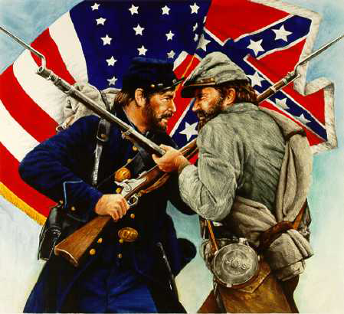
Civil War
Pre- Civil War federal government expenditures were 2% of GDP.
Pre- Civil War state government expenditures were 5% of GDP.
Post- Civil War federal government expenditures were 20% of GDP.

Slide 25
National Bank Act of 1863
also known as the National Currency Act
quickly amended in 1864
created Comptroller of the Currency
created national bank charters
Comptroller of Currency approval needed
banks could issue banknotes
federal bond collateral requirement
2% tax on state banknotes
unit banking (no branching)
dual banking system (state/federal)

Slide 26
Act of March 3, 1865
Act didn’t have a formal name
raised state banknote tax from 2% to 10%
with 2% tax, banks had kept issuing notes
10% tax shut them down
tax was designed to end state banknotes
forbidding them = unconstitutional
same method used for marijuana
restrictions repealed in 1994

Slide 27
Post- Civil War
Post- Civil War debt declined (government retired it) while demand for currency rose. Due to the bond collateral requirement, this meant the money supply shrunk and there was deflation.
There were seasonal spikes in demand for money due to harvests. Canada had free banking with no bank panics. The U.S. had no free banking and many panics.

Slide 28
Post- Civil War
inelastic currency –
inability of the system to convert
deposits into banknotes
This inelasticity meant even though customers would be perfectly happy with notes, banks had to give out silver or gold when people withdrew deposits. This depleted reserves and led to bank insolvency. Bank panics spread.

Slide 29
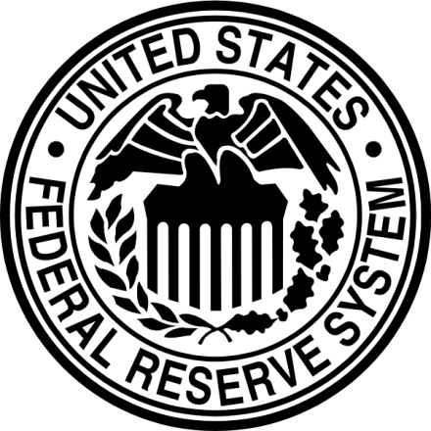
Federal Reserve Act
1913
Federal Reserve System (12 regional banks)
real central bank for U.S.
lender of last resort
nationally chartered banks must join
state chartered banks may join
imposed reserve requirement for deposits
federal reserve notes could be reserves
check clearing services offered
coincided with World War I

Slide 30


Glass-Steagall Act
1933 (also known as Banking Act of 1933)
created federal deposit insurance
  Federal Deposit Insurance Corporation
  state and national banks could join
divided commercial banks from securities
  repealed by Gramm-Leach-Bliley 1999
imposed Regulation-Q
  no interest on checkable deposits
  capped interest on other deposits

