Slide 1
Unit 1: Money
Bonds & Stock Market
2/15/2011

Slide 2
Definitions
risk structure of interest rates –
the relationship among the interest rates on various bonds with the same term to maturity
term structure of interest rates –
the relationship among the interest rates on various bonds with different terms to maturity

Slide 3
Risk Structure

Slide 4
Risk Structure
Risk structure factors*
default risk
liquidity
income tax
* relative to alternative assets

Slide 5
Risk Structure
default –
party issuing debt instrument is
unable to make interest payments or
pay off the amount owed at maturity
default-free bonds –
bonds with no default risk
risk premium –
interest rate spread between bonds with default risk and default-free bonds

Slide 6
Risk Structure
Mishkin claims that federal government bonds are default-free.
But just because a government can theoretically pay off a bond doesn’t mean it can credibly commit to do so or will follow through in practice.
Many governments have defaulted.

Slide 7
Risk Structure
Corporate bonds
risk_{c}↑ → B^{D}_{c}↓ → P_{Bc}↓ → i_{Bc}↑
(R^{e}_{c} ↓ → B^{D}_{c}↓ → P_{Bc}↓ → i_{Bc}↑)
Treasury bonds
risk_{T}↓ → B^{D}_{T}↑ → P_{BT}↑ → i_{BT}↓
(R^{e}_{T}↑ → B^{D}_{T}↑ → P_{BT}↑ → i_{BT}↓)
risk premium (i_{Bc} – i_{BT})↑
Risk is relative to alternative assets.

Slide 8
Risk Structure
Price of Bonds, P($)
P Increasing ↑
Interest Rate i (%)
i increases ↓
Price of Bonds, P($)
P Increasing ↑
Interest Rate i (%)
i increases ↓
S^{c}
S^{T}
i₂^{T}
i₂^{T}
P₂^{T}
P₁^{C}
i₁^{C}
P₁^{T}
i₁^{T}
P₂^{C}
i₂^{C}
D₂^{T}
D₂^{c}
D₁^{c}
Risk Premium
D₁^{T}
Quantity of Corporate Bonds
(a) Corporate Bond Market
Quantity of Treasury Bonds
(b) Default free (US Treasury) Bond Market

Slide 9
Risk Structure
A bond with a default risk will always have a positive risk premium, and an increase in default risk will raise the risk premium.
Credit rating agencies rate the quality of bonds in terms of probability of default.
AAA less likely to default than CCC.

Slide 10
Risk Structure
Moodys | S&P | Fitch | Definitions
Aaa | AAA | AAA | Prime Maximum Safety
Aa1 | AA+ | AA+ | High Grade Quality
Aa2 | AA | AA
Aa3 | AA- | AA-
A1 | A+ | A+ | Upper Medium Grade
A2 | A | A
A3 | A- | A-
Baa1 | BBB+ | BBB+ | Lower Medium Grade
Baa2 | BBB | BBB
Baa3 | BBB- | BBB-

Slide 11
Risk Structure
Moodys | S&P | Fitch | Definitions
Ba1 | BB+ | BB+ | Non Investment Grade
Ba2 | BB | BB | Speculative
Ba3 | BB- | BB-
B1 | B+ | B+ | Highly Speculative
B2 | B | B
B3 | B- | B-
Caa1 | CCC+ | CCC | Substantial Risk
Caa2 | CCC | - | In poor standing
Caa3 | CCC- | -
Ca | - | - | Extremely speculative
C | - | - | May be in default
- | - | DDD | Default
- | - | DD | -
- | D | D

Slide 12
Risk Structure
As we’ll see later when we discuss the sub-prime crisis, rating agencies are very unreliable.

Slide 13
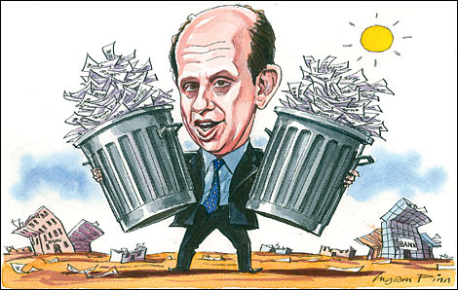
Risk Structure
Mishkin speaks derisively of “junk bonds”. In reality so-called junk bonds were high yield corporate bonds that funneled money to productive companies. They short-circuited venture capital / private equity / investment banks / hedge funds, going directly to individual investors instead.

Slide 14
Risk Structure
Junk bonds often facilitated leveraged buyouts, allowing entrepreneurs with better management techniques to buy out a firm on credit and trim the fat by firing middle management increasing firm productivity. Junk bonds were a main engine of growth in the 1980’s. Michael Milken, the “junk bond king,” was a hero, not a villain.

Slide 15
Risk Structure
Higher liquidity relative to alternative assets increases the demand for bonds.
Liquidity is lumped into the risk structure of interest rates even though the classification is a bit of a misnomer.

Slide 16
Risk Structure
Corporate bonds
liquidity_{c}↓ → B^{D}_{c}↓ → P_{Bc}↓ → i_{Bc}↑
Treasury bonds
liquidity_{T}↑ → B^{D}_{T}↑ → P_{BT}↑ → i_{BT}↓
risk premium (i_{Bc} – i_{BT})↑
Liquidity is relative to alternative assets.

Slide 17
Risk Structure
Price of Bonds, P($)
P Increasing ↑
Interest Rate i (%)
i increases ↓
Price of Bonds, P($)
P Increasing ↑
Interest Rate i (%)
i increases ↓
S^{c}
S^{T}
i₂^{T}
i₂^{T}
P₂^{T}
P₁^{C}
i₁^{C}
P₁^{T}
i₁^{T}
P₂^{C}
i₂^{C}
D₂^{T}
D₂^{c}
D₁^{c}
Risk Premium
D₁^{T}
Quantity of Corporate Bonds
(a) Corporate Bond Market
Quantity of Treasury Bonds
(b) Default free (US Treasury) Bond Market

Slide 18
Risk Structure
Municipal bonds have a lower yield than federal bonds even though they have a higher default risk. Why?
Income from municipal bonds is
not taxed by the federal government due to state sovereignty reasons
(11th amendment).

Slide 19
Risk Structure
Just as lowering risk raises expected return, making bond income tax-free similarly raises expected return.

Slide 20
Risk Structure
Municipal bonds
taxes_{M}↓ → B^{D}_{M}↑ → P_{BM}↑ → i_{BM}↓
(R^{e}_{M}↑ → B^{D}_{M}↑ → P_{BM}↑ → i_{BM}↓)
Treasury bonds
taxes_{T}↑ → B^{D}_{T}↓ → P_{BT}↓ → i_{BT}↑
(R^{e}_{T}↓ → B^{D}_{T}↓ → P_{BT}↓ → i_{BT}↑)
Taxes are relative to alternative assets.

Slide 21
Risk Structure
Risk structure factors
default risk: risk_{B}↑ → B^{D}↓ → P_{B}↓
liquidity: liquidity_{B}↓ → B^{D}↓ → P_{B}↓
income tax: tax_{B}↓ → B^{D}↑ → P_{B}↑

Slide 22
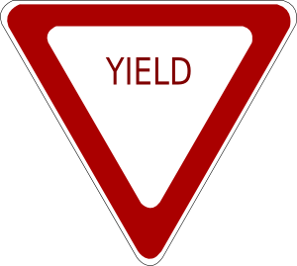
Term Structure
yield curve –
plot of the yields of bonds with differing
terms to maturity but the same risk structure (risk, liquidity, and tax considerations)
inverted yield curve –
downward sloping yield curve

Slide 23
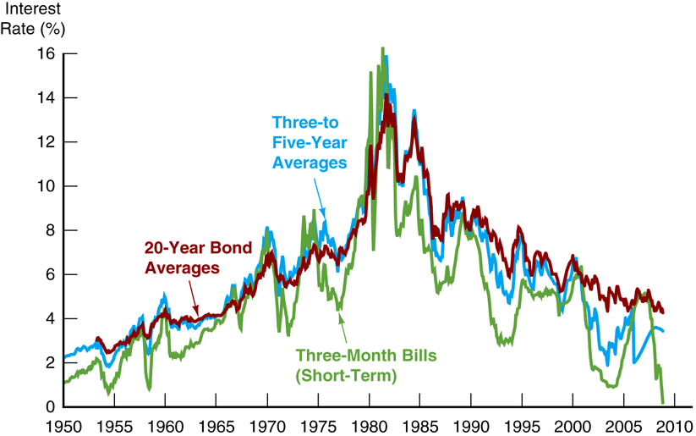
Term Structure

Slide 24
Term Structure
Term structure empirical facts
interest rates on bonds of different maturities move together over time
low short-term interest rates usually mean upward sloping yield curves; high short-term interest rates usually mean downward sloping yield curves
yield curves almost always slope upward

Slide 25
Term Structure
Term structure theories
expectations theory
segmented markets theory
liquidity premium theory /
preferred habitat theory

Slide 26
Term Structure
expectations theory –
the interest rate of a long-term bond will equal the average of short-term interest rates people expect over the life of the long-term bond
Assumption: Bonds of different
maturities are perfect substitutes.
Implication: R^{e} on bonds of
different maturities are equal.

Slide 27
Term Structure
i_{t} ≡ interest rate on one-period bond
i^{e}_{t+1} ≡ expected interest rate on one-period bond next period
i_{2t} ≡ interest rate on two-period bond

Slide 28
Term Structure
Expected return from two-period bond
(1 + i_{2t})(1 + i_{2t}) – 1 = 1 + 2i_{2t} + (i_{2t})² – 1
= 2i_{2t} + (i_{2t})² ≈ 2i_{2t}
Expected return from one-period bond
(1 + i_{t})(1 + i^{e}_{t+1}) – 1 = 1 + i_{t} + i^{e}_{t+1} + i_{t}(i^{e}_{t+1}) – 1 = i_{t} + i^{e}_{t+1} + i_{t}(i^{e}_{t+1}) ≈ i_{t} + i^{e}_{t+1}
R^{e} equal
2i_{2t} = i_{t} + i^{e}_{t+1}

Slide 29
Term Structure
Two period formula
i_{2t} = (i_{t} + i^{e}_{t+1})/2
Generalized formula
i_{nt} = (i_{t} + i^{e}_{t+1} + i^{e}_{t+2} + … + i^{e}_{t+(n–1)})/n
Example
i_{5t} = (5% + 6% + 7% + 8% + 9%)/5 = 7%

Slide 30
Term Structure
Explains Fact 1 that short and long rates move together:
Short rate rises are persistent
i_{t}↑ → i_{t+1}↑, i_{t+2}↑, etc. →
average of future rates i_{nt}↑
Therefore: i_{t}↑ → i_{nt}↑, i.e.,
short and long rates move together

Slide 31
Term Structure
Explains Fact 2 that yield curves tend to have steep slope when short rates are low and downward slope when short rates are high:

Slide 32
Term Structure
When short rates are low, they are expected to rise to normal level, and long rate = average of future short rates will be well above today’s short rate: yield curve will have steep upward slope

Slide 33
Term Structure
When short rates are high, they will be expected to fall in future, and long rate will be below current short rate: yield curve will have downward slope

Slide 34
Term Structure
Doesn’t explain Fact 3 that yield curve usually has upward slope:
Short rates as likely to fall in future as rise, so average of future short rates will not usually be higher than current short rate: therefore, yield curve will not usually slope upward

Slide 35
Term Structure
segmented markets theory –
markets for different maturity bonds are completely separate;
interest rates are determined by supply and demand for that bond only
Assumption: Bonds of different
maturities are not substitutes.
Implication: Interest rate at each
maturity determined seperately.

Slide 36
Term Structure
Explains Fact 3 that yield curve is usually upward sloping:
People typically prefer short holding periods and thus have higher demand for short-term bonds, which have higher price and lower interest rates than long bonds.

Slide 37
Term Structure
Does not explain Fact 1 or Fact 2 because assumes long and short rates determined independently.

Slide 38
Term Structure
liquidity premium theory –
the interest rate of a long-term bond will equal the average of short-term interest rates people expect over the life of the long-term bond
plus a liquidity premium

Slide 39
Term Structure
Assumption: Bonds of different
maturities are substitutes,
but not perfect substitutes.
Implication: Modifies expectations
theory with features of segmented
markets theory.

Slide 40
Term Structure
Investors prefer short rather than long bonds, so they must be paid positive liquidity (term) premium, l_{nt}, to hold long-term bonds.
l_{nt} ≡ liquidity premium for
n-period bond at time t
l_{nt} always positive, rises with maturity.

Slide 41
Term Structure
Liquidity premium formula
i_{nt} = (i_{t} + i^{e}_{t+1} + i^{e}_{t+2} + … + i^{e}_{t+(n–1)})/n + l_{nt}
Example
(5% + 6% + 7% + 8% + 9%)/5 + 1% = 8%

Slide 42
Term Structure
Liquidity Premium (Preferred Habitat)
Theory Yield Curve
Interest Rate
i_{nt}
Liquidity
Premium
l_{nt}
Expectations Theory
Yield Curve
0
5
10
15
20
25
30
Years to Maturity, n

Slide 43
Term Structure
Explains Fact 1 that short and long rates move together:
Interest rates on different maturity bonds move together over time; explained by the first term in the equation.

Slide 44
Term Structure
Explains Fact 2 that yield curves tend to slope up when short rates are low and slope down when short rates are high:
Yield curves tend to slope upward when short-term rates are low and to be inverted when short-term rates are high; explained by the liquidity premium term in the first case and by a low expected average in the second case.

Slide 45
Term Structure
Explains Fact 3 that yield curve is usually upward sloping:
Yield curves typically slope upward; explained by a larger liquidity premium as the term to maturity lengthens

Slide 46
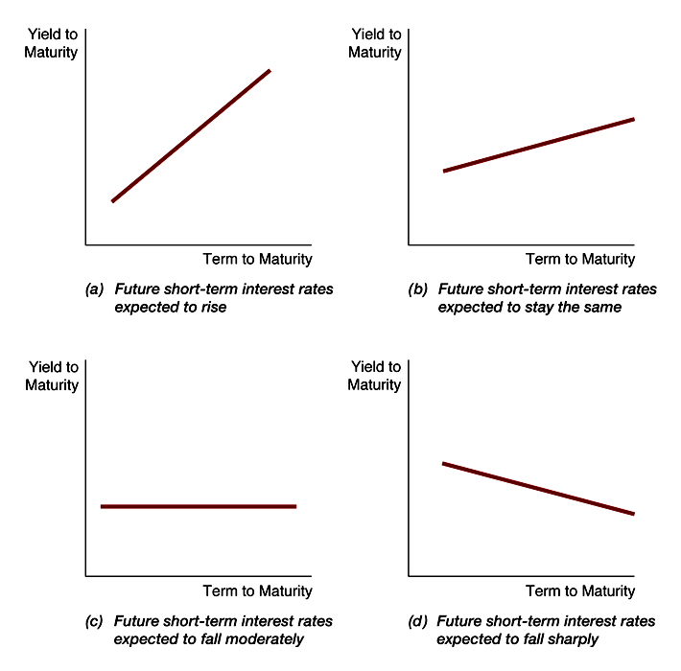
Term Structure

Slide 47
Term Structure
Term structure theories
expectations theory: explains 1 & 2, not 3
segmented markets theory: explains 3, not 1 & 2
liquidity premium theory: explains 1, 2, & 3

Slide 48
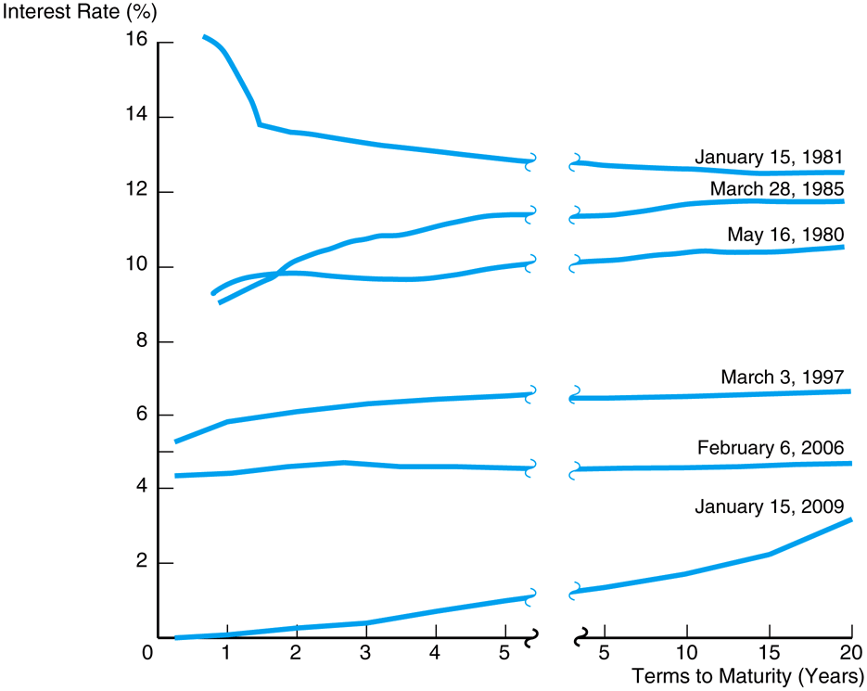
Interpreting yield curves

Slide 49
Stock Valuation
Current stock values are the present discounted value of future dividends.

Slide 50
Stock Valuation
One-Period Stock Valuation Model
p₀ ≡ current price of stock
D₁ ≡ dividend paid for year 1
k_{e} ≡ required return in equity
p₁ ≡ stock price at the end of year 1
p₀ = D₁/(1 + k_{e}) + p₁/(1 + k_{e})

Slide 51
Stock Valuation
Generalized Stock Valuation Model
with final sale:
p₀ = D₁/(1 + k_{e})¹ + D₂/(1 + k_{e})² +
… + D_{n}/(1 + k_{e})^{n} + p_{n}^{e}/(1 + k_{e})^{n}
without final sale:
p₀ = ∑D_{t}/(1 + k_{e})^{t}

Slide 52
Stock Valuation
Generalized Stock Valuation Model
model:
p₀ = D₁/(1 + k_{e})¹ + D₂/(1 + k_{e})² +
… + D_{n}/(1 + k_{e})^{n} + p_{n}^{e}/(1 + k_{e})^{n}
fundamentals:
D₁/(1 + k_{e})¹ + … + D_{n}/(1 + k_{e})^{n}
bubble:
p_{n}^{e}/(1 + k_{e})^{n}

Slide 53
Stock Valuation
Gordon Growth Model
D₀ ≡ most recent dividend paid
g ≡ expected constant growth rate
p₀ = D₀(1 + g)¹/(1 + k_{e})¹ +
D₀(1 + g)²/(1 + k_{e})² + … +
D₀(1 + g)∞/(1 + k_{e})∞
simplified:
p₀ = D₀(1 + g)/(k_{e} – g) = D₁/(k_{e} – g)

Slide 54
Setting Prices
uncertainty↑ → k_{e}↑ → p₀↓
economy growth↑ → g↑ → p₀↑
dividends↑ → D₀↑ → p₀↑

Slide 55
Setting Prices
The price is set by the buyer willing to pay the highest price.
The market price will be set by the buyer who can take best advantage of the asset.
Superior information about an asset can increase its value by reducing its perceived risk.

Slide 56
Setting Prices
Information is important for individuals to value each asset.
When new information is released about a firm, expectations and prices change.
Market participants constantly receive information and revise their expectations, so stock prices change frequently.

Slide 57
Stock Valuation

Slide 58
Expectations
adaptive expectations –
expectations are formed from past experience only
rational expectations –
expectations will be identical
to optimal forecasts
(the best guess of the future)
using all available information

Slide 59
Expectations
Adaptive expectations
Expectations are formed
from past experience only.
Changes in expectations
will occur slowly over time
as data changes.

Slide 60
Expectations
Rational expectations
Boils down to assuming agents use the same model of the economy as the researcher (“model-consistent”).
People can make mistakes, but they do not make systematic forecasting errors.
Optimal prediction, may not be accurate.
It is costly not to have optimal forecast.
Xe = X^{of} = E_{t} [ X | Ω_{t} ]

Slide 61
Efficient Market Hypothesis
efficient market hypothesis –
applies rational expectations
to financial markets;
stock prices reflect
all available information

Slide 62
Efficient Market Hypothesis
Efficient market hypothesis
weak form – stock prices reflect past stock price history
semi-strong form – stock prices reflect all publicly available information
strong form – stock prices reflect all information (public and insider)

Slide 63
Efficient Market Hypothesis
arbitrage –
market participants eliminate unexploited profit opportunities
Arbitrage is the mechanism tending toward the efficient market hypothesis.
R^{of} > R* → p_{t}↑ → R^{of}↓
R^{of} < R* → p_{t}↓ → R^{of}↑
until… R^{of} = R*

Slide 64
Efficient Market Hypothesis
The optimal forecast of a security’s return using all available information equals the security’s equilibrium return.
In an efficient market, a security’s price fully reflects all available information.
All unexploited profit opportunities will be eliminated.
Efficient market holds even if there are some uninformed, irrational participants.

Slide 65
Efficient Market Hypothesis
Favorable evidence
Investment analysts and mutual funds don’t beat the market
Stock prices reflect publicly available information: anticipated announcements don’t affect stock price
Stock prices close to random walk
Technical analysis doesn’t outperform market

Slide 66
Efficient Market Hypothesis
Unfavorable evidence
Small-firm effect: small firms have abnormally high returns
January effect: high returns in January
Market overreaction
Excessive volatility
Mean reversion
New information is not always immediately incorporated into prices

Slide 67
Efficient Market Hypothesis
Implications
Published reports of financial analysts not very valuable
Should be skeptical of hot tips
Stock prices may fall on good news
Prescription for investor
Shouldn’t try to outguess market
Buy and hold
Diversify with no-load mutual fund

