Slide 1
Unit 1: Money
Interest Rates
2/15/2011

Slide 2
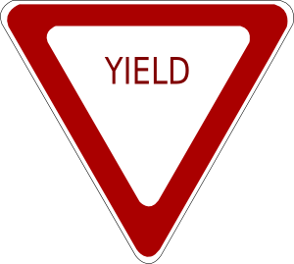
Definitions
interest rate –
the price of time
(not the price of money)
price paid for rental of funds
yield to maturity –
interest rate that equates the present value
of payments received from a credit market
instrument with its value today

Slide 3
Definitions
present discounted value (PDV) –
today’s value of future payment
cash flows –
cash payments to holder of a security
bond –
debt security with periodic payments
for a specified period of time

Slide 4
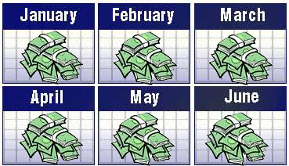
Credit Market Instruments
Types of credit market instruments
simple loan
fixed-payment loan (fully amortized loan)
discount bond (zero-coupon bond)
coupon bond

Slide 5
Simple Loan
simple loan –
lender provides funds to borrower;
at the maturity date the principal
plus additional interest is due

Slide 6
Simple Loan
PV = FV/(1 + i)^{n}
PV ≡ present value
FV ≡ future value (or CF for cash flow)
i ≡ yield to maturity (or interest rate)
n ≡ time to maturity (usually in years)
FV = PV(1 + i)^{n}

Slide 7
Fixed-Payment Loan
fixed-payment loan –
lender provides funds to borrower;
funds are repaid by making the
same payment every period with
part of the principal plus interest
for a set number of years

Slide 8
Fixed-Payment Loan
PV = FP/(1 + i)¹ + FP/(1 + i)² +
FP/(1 + i)³ + … + FP/(1 + i)^{n}
PV ≡ present value
FP ≡ future payment
i ≡ interest rate
n ≡ time to maturity (usually in years)

Slide 9
Fixed-Payment Loan
PV = FP/(1 + i)¹ + FP/(1 + i)² +
FP/(1 + i)³ + … + FP/(1 + i)^{n}
PV = [FP/(1 + i)] [1 + 1/(1 + i)¹ + 1/(1 + i)² + … + 1/(1 + i)^{n-1}]
The second term (1 + 1/(1 + i)¹ + etc.) is the present value of an ordinary annuity. It can be found in tables on the Internet and in the back of financial and accounting textbooks for values of i and n.

Slide 10
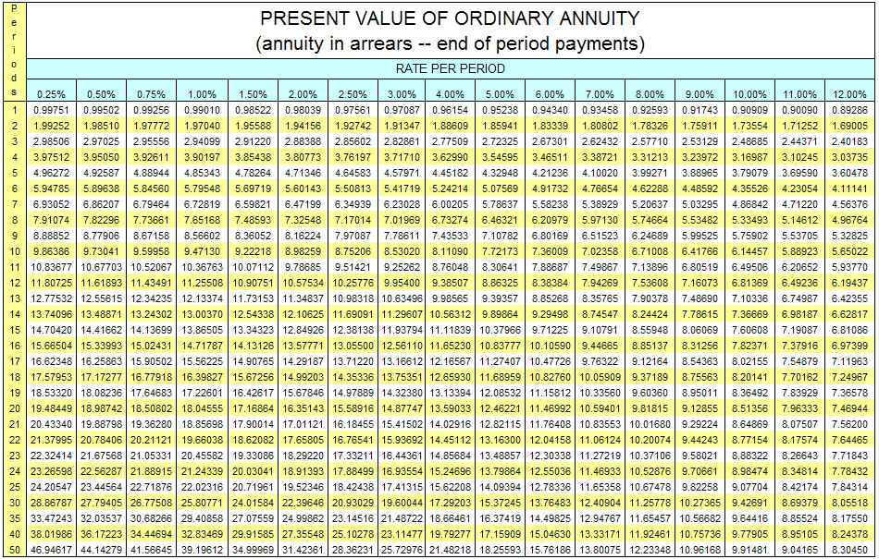
Present Value of Ordinary Annuity

Slide 11
Discount Bond
discount bond (zero-coupon bond) –
bought at a price below face value;
face value repaid on maturity date

Slide 12
Discount Bond
PV = FV/(1 + i)^{n}
PV ≡ present value
FV ≡ future value (or CF for cash flow)
i ≡ yield to maturity (or interest rate)
n ≡ time to maturity (usually in years)

Slide 13
Discount Bond
i = (F - P)/P
P ≡ current price of bond
F ≡ face value of bond
P = PV
F = FV
n = 1 (maturity in 1 year)
PV = FV/(1 + i)^{n}
P = F/(1 + i)¹
P + Pi = F
Pi = F - P
i = (F – P)/P

Slide 14
Coupon Bond
coupon bond –
pays the owner of the bond a fixed
interest payment (coupon payment)
every period until the maturity date
when face value is repaid

Slide 15
Coupon Bond
PV = FV/(1 + i)^{n} + C/(1 + i)¹ +
C/(1 + i)² + … + C/(1 + i)^{n}
PV ≡ present value
FV ≡ future value
C ≡ coupon payment
i ≡ interest rate
n ≡ time to maturity (usually in years)

Slide 16
Coupon Bond
PV = FV/(1 + i)^{n} + C/(1 + i)¹ +
C/(1 + i)² + … + C/(1 + i)^{n}
PDV of bond selling price
PDV of coupon payments
Coupon payments calculation can be simplified using ordinary annuity tables.

Slide 17
Consol
consol (perpetuity) –
a coupon bond with no maturity date and no repayment of principal

Slide 18
Consol
P_{C} = C/i_{C}
FV = 0
n = ∞
PV = C/(1 + i)¹ + C/(1 + i)² + … + C/(1 + i)∞
PV = C[1/(1 + i)¹ + 1/(1 + i)² + … + 1/(1 + i)∞]
PV = C[1/i] = C/i
P_{c} = C/i_{C}

Slide 19
Rate of Return
R = i_{C} + g
R ≡ rate of return
i_{C} ≡ current yield
g ≡ rate of capital gain
Rate of return for 1 year.

Slide 20
Bonds
Insights
rise in interest rates → fall in bond prices
i↑ → P_{B}↓
prices and returns more volatile for
long term bonds than short term bonds
even bonds with huge interest rates can
have negative returns if interest rates rise
when holding periods don’t match
maturity periods, there is interest rate risk

Slide 21
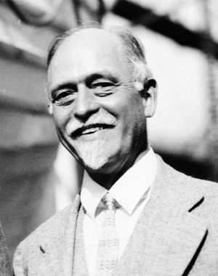
Fisher Equation
i = r + π^{e}
i ≡ nominal interest rate
r ≡ real interest rate
π^{e} ≡ expected inflation
The Fisher equation shows that lenders need to build in expected inflation to get the returns they want.

Slide 22
Fisher Equation
i = r + π^{e}
This is a simplified approximate form.
(1 + i) = (1 + r)(1 + π^{e})
1 + i = 1 + r + π^{e} + rπ^{e}
i = r + π^{e} + rπ^{e}
rπ^{e} ≈ 0
i = r + π^{e}

Slide 23
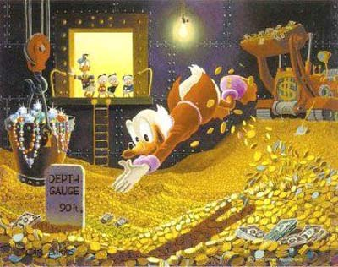
Bond Demand
Determinates of Bond Demand
wealth: W↑ → B^{D}↑
expected returns: R^{e}↑ → B^{D}↑
risk or uncertainty: risk↑ → B^{D}↓
liquidity: liquidity↑ → B^{D}↑

Slide 24
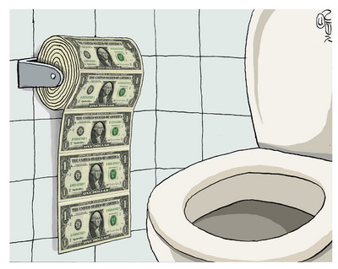
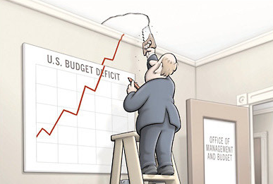
Bond Supply
Determinates of Bond Supply
profitability of investments: I profitability↑ → B^{S}↑
expected inflation: π^{e}↑ → B^{S}↑
government deficit: (G – T)↑ → B^{S}↑

Slide 25
Graphical Version
P_{B}
B^{S}
Bond market:
stock analysis
B^{D}
B

Slide 26
Graphical Version
Bond demand
W↑ → B^{D}↑ → P_{B}↑
higher wealth
shifts the B^{D} curve out
move along B^{S}
price of bonds goes up
P_{B}
B^{S}
P_{B2}
P_{B1}
B^{D}
B^{D}'
B

Slide 27
Graphical Version
Bond demand
i^{e}↓ → R^{e}↑ →
B^{D}↑ → P_{B}↑
lower expected
interest rate
raise expected returns
shifts the B^{D} curve out
move along B^{S}
price of bonds goes up
P_{B}
B^{S}
P_{B2}
P_{B1}
B^{D}
B^{D}'
B

Slide 28
Graphical Version
Bond demand
π^{e}↓ → R^{e}↑ →
B^{D}↑ → P_{B}↑
lower expected inflation
raise expected returns
shifts the B^{D} curve out
move along B^{S}
price of bonds goes up
P_{B}
B^{S}
P_{B2}
P_{B1}
B^{D}
B^{D}'
B

Slide 29
Graphical Version
Bond demand
risk↓ → B^{D}↑ → P_{B}↑
lower riskiness
raise expected returns
shifts the B^{D} curve out
move along B^{S}
price of bonds goes up
P_{B}
B^{S}
P_{B2}
P_{B1}
B^{D}
B^{D}'
B

Slide 30
Graphical Version
Bond demand
liquidity↑ →
B^{D}↑ → P_{B}↑
higher liquidity
shifts the B^{D} curve out
move along B^{S}
price of bonds goes up
P_{B}
B^{S}
P_{B2}
P_{B1}
B^{D}
B^{D}'
B

Slide 31
Graphical Version
Bond supply
I profit↑ →
B^{S}↑ → P_{B}↓
higher investment profitability
shifts the B^{S} curve out
move along B^{D}
price of bonds
goes down
P_{B}
B^{S}
B^{S}'
P_{B1}
P_{B2}
B^{D}
B

Slide 32
Graphical Version
Bond supply
π^{e}↑ →
B^{S}↑ → P_{B}↓
higher expected inflation
shifts the B^{S} curve out
move along B^{D}
price of bonds
goes down
P_{B}
B^{S}
B^{S}'
P_{B1}
P_{B2}
B^{D}
B

Slide 33
Graphical Version
Bond supply
(G – T)↑ →
B^{S}↑ → P_{B}↓
higher government deficit
shifts the B^{S} curve out
move along B^{D}
price of bonds
goes down
P_{B}
B^{S}
B^{S}'
P_{B1}
P_{B2}
B^{D}
B

Slide 34
Graphical Version
Graphical notes
Some factors influence both supply and demand
(e.g., expected inflation)
bond price and the interest rate are inversely related,
so when we see bond price go down that means
interest rate goes up

Slide 35
Graphical Version
Bond market:
flow analysis
The same factors that effect the stock bond market will effect the flow bond market.
i
L^{S}
L^{D}
L/time

Slide 36
Graphical Version
flow analysis
i_{H} to i_{L} is the bid/ask spread
at L_{a} not L_{e} due to transactions costs
i
L^{S}
i_{H}
i_{L}
L^{D}
L_{a}
L_{e}
L/time

Slide 37
Liquidity Preference Theory
transactions demand –
money demand for transactions
Vectors
population: N↑ → y↑ → M^{D}↑ → P↓
output/person: y/N↑ → y↑ → M^{D}↑ → P↓
vertical integration: merge↑ → M^{D}↓ → P↑
clearing system efficiency: eff.↑ → M^{D}↓ → P↑

Slide 38
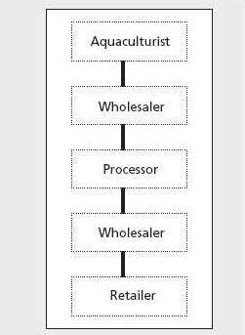
Liquidity Preference Theory
Vectors
population: e.g., black death, baby boom
output/person: e.g., Internet revolution (productivity)
vertical integration: e.g., oil company buys gas stations
clearing system efficiency: e.g., credit card use

Slide 39
Liquidity Preference Theory
portfolio demand –
money demand as a store of value
(captures precautionary and speculative)
Vectors
wealth: W↑ → M^{D}↑ → P↓
uncertainty: uncertainty↑ → M^{D}↑ → P↓
interest differential: i↑ → M^{D}↓ → P↑
anticipations about inflation: π^{e}↓ → M^{D}↑ → P↓

Slide 40
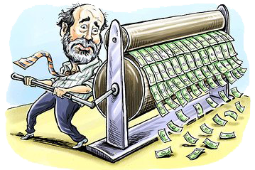
Liquidity Preference Theory
Vectors
wealth: e.g., win the lottery
uncertainty: e.g., travel to a foreign country
interest differential: i.e., interest rate soars
anticipations about inflation: e.g., print money non-stop

Slide 41
Graphical Version
i
M^{S}
M^{D}
M

Slide 42
Interest Rate
Effects on interest rate
liquidity effect: M^{S}↑ → i↓
income effect: M^{S}↑ → W↑, y↑ → M^{D}↑ → i↑
price-level effect: M^{S}↑ → P↑ → M^{D}↑ → i↑
fisher effect: M^{S}↑ → π^{e}↑ → M^{D}↑ → i↑
Keynes talked about the liquidity effect. Friedman rebutted him by noticing the other secondary effects.

Slide 43
Interest Rate
A
liquidity effect
B
income effect
price-level effect
fisher effect
liquidity effect larger
i
time
A
B

Slide 44
Interest Rate
A
liquidity effect
B
income effect
price-level effect
fisher effect
liquidity effect smaller
slow adjustment
i
time
A
B

Slide 45
Interest Rate
A
liquidity effect
fisher effect
B
income effect
price-level effect
liquidity effect smaller
fast adjustment
i
time
A
B

