Slide 1

Unit 1: Money
History of Money & Inflation
2/8/2011

Slide 2
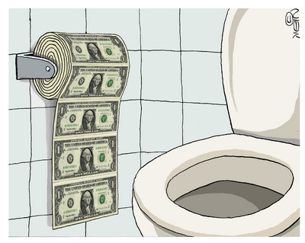
Inflation
inflation –
a rise in the price level (fall in PPM)
hyperinflation –
a rise in the price level exceeding 50% per month

Slide 3

History
Through most of history, war and inflation were closely related. Most government spending was on war before the modern welfare state.

Slide 4
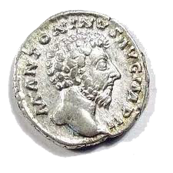
History
Denarius silver debasement in the Roman empire
54 AD 94% silver content
218 AD 43% silver content
268 AD 1% silver content
Rise in the price level results from the increase in the money stock, not from the fall in value of the coin.
In contrast, Athens drakma never debased.

Slide 5
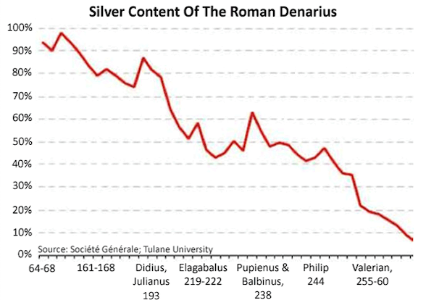
History

Slide 6
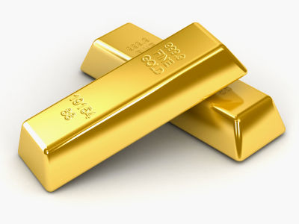
History
The classical gold standard experienced a gradual deflation of 0.5% per year on average. Countries would temporarily leave the gold standard to inflate for war, and return afterward – often at the old level.

Slide 7
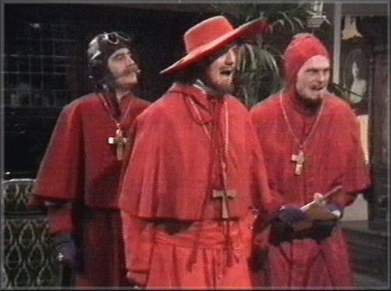
History
During the 16th century, Spain’s price level increased 200-300% due to gold and silver imports from the new world (1% per year).
185,000 kg of gold was imported in 15 years, increasing Europe’s gold supply by 20%.

Slide 8
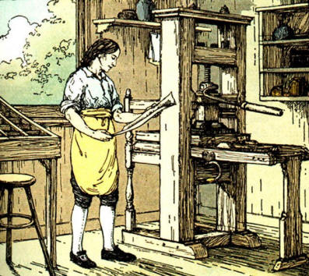
History
Colonial Americans generally used Spanish dollar coins rather than British pounds because England had a prohibition on the export of specie to the colonies. Often the unit of account was pounds, but the medium of exchange was dollars.

Slide 9
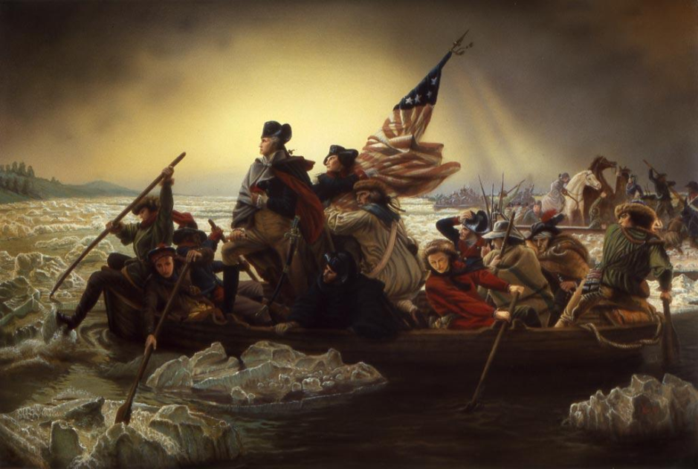
History
Revolutionary War financing
6% taxation
19% borrowing
75% seigniorage
continentals
226 million issued by Congress
200 million issued by states
counterfeit by British

Slide 10
History
continentals : pounds
1775 3 to 1
1778 5 to 1
1779 30 to 1
1780 76 to 1
1781 167 to 1
later totally worthless
“not worth a continental” – totally without value

Slide 11
History
In the west, American colonies were first to use paper money.
This was one of the first hyperinflations in history.
Continentals were totally repudiated, but debt was paid back. Congress didn’t accept own currency in March of 1781.

Slide 12
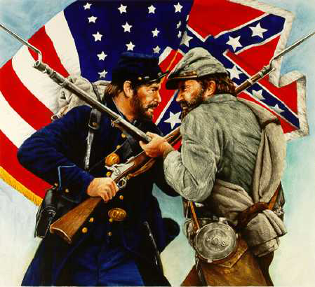
History
Civil War financing (North)
20% taxation
65% borrowing
15% seigniorage
Civil War financing (South)
7% taxation
24% borrowing
52% seigniorage
17% seizing supplies

Slide 13
History
confederate dollar in specie
1862 82.7¢
1863 29.0¢
1865 1.7¢
later totally worthless
Price level increase
North 90.5%↑
South 2076%↑

Slide 14
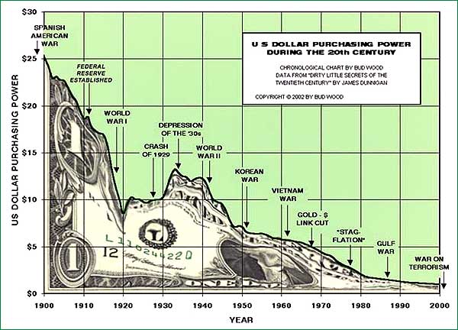
History
20th century America
The purchasing power of the dollar has declined 95.5% since 1913 when the Federal Reserve was created.

Slide 15
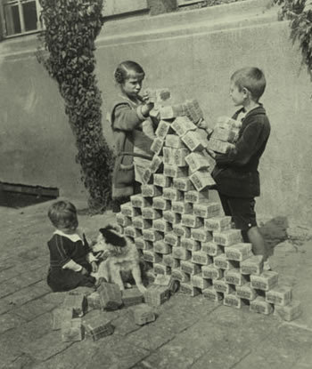
History
German hyperinflation
1921-1923, the Weimar Republic (Germany) was unable to afford its WWI reparation payments required under the Treaty of Versailles (132 billion goldmarks – far more than the total German gold).

Slide 16
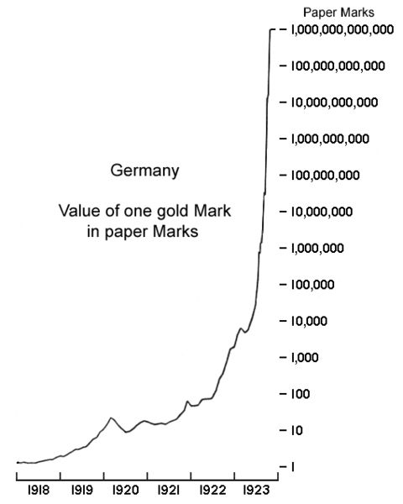
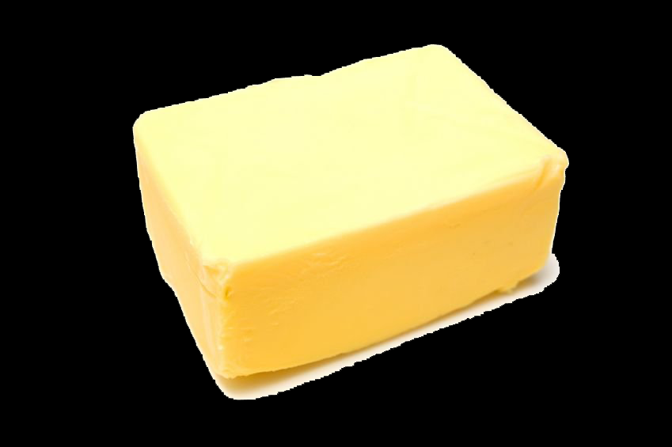
History
Price of a pound of butter
1914 1.4 marks
1918 3 marks
1922 2400 marks
1923 6 trillion marks

Slide 17
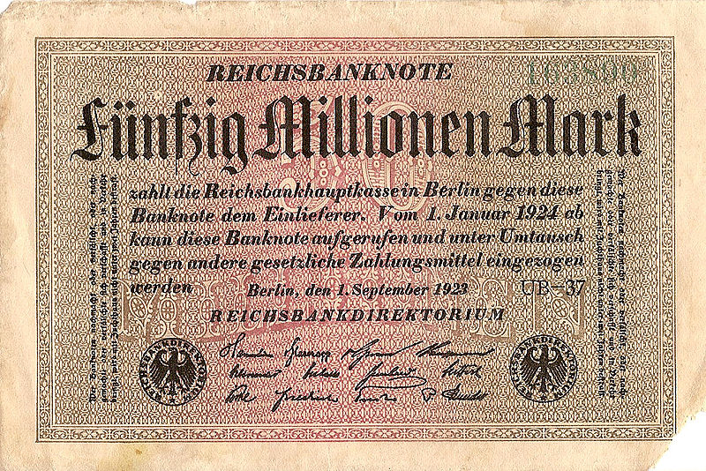
History
There were no wage and price controls this crisis.
Germans didn’t revert to barter (shows transactions costs).
Germans didn’t revert to foreign money (shows network effects).
Hyperinflation ended with a currency reform: cut 12 zeros.

Slide 18
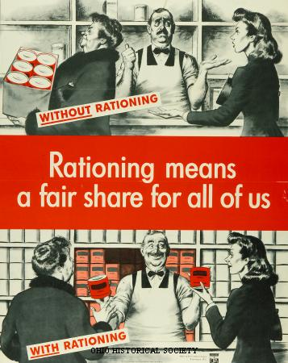
History
In post WWII Germany there was fear of inflation, so wage and price controls were imposed.
This led to rationing, black markets, and reversion to barter.
Ludwig Gerhart eliminated all wage and price controls on a Sunday, which began the German miracle (real wages doubled).

Slide 19
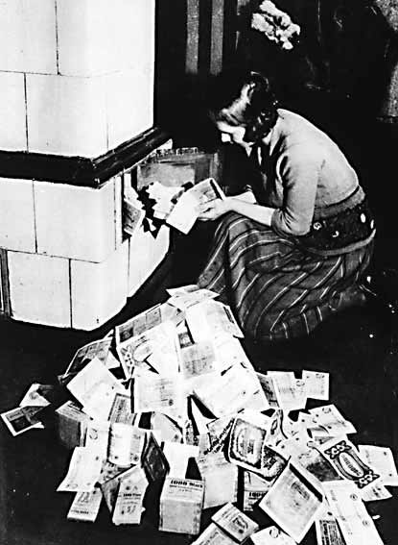
History
Reversion to barter means the monetary system completely broke down.
The lesson is clear:
It is better to have hyperinflation with no wage and price controls than wage and price controls with no hyperinflation.

Slide 20
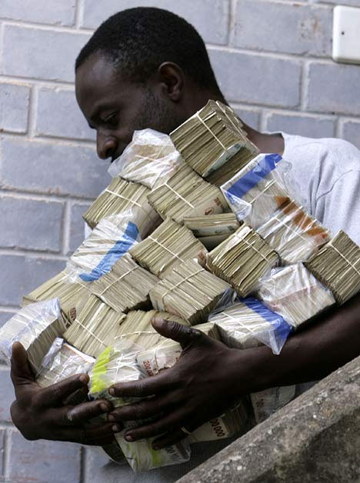
History
Zimbabwe’s inflation began shortly after it repudiated debt owed to the International Monetary Fund and confiscated all white-owned farmland.

Slide 21
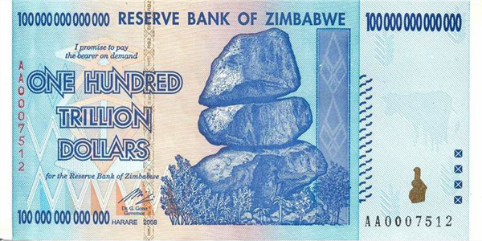
History
Zimbabwe inflation rate
2004 132.75%
2005 585.84%
2006 1,281.11%
2007 66,212.3%
2008 231,150,888.87%
2009 6.5 x 10¹⁰⁸%*
* 6.5 quindecillion novemdecillion percent (650 million googol)

Slide 22

Hyperinflations
Angola 1991-1995
Argentina 1975-1991
Austria 1921-1922
Belarus 1994-2002
Bolivia 1984-1986
Bosnia 1992-1993
Brazil 1986-1994
Bulgaria 1996
Chile 1971-1973
China 1948-1949
Danzig 1922-1923
Georgia 1993-1995
Germany 1922-1923
Greece 1942-1944
Hungary 1945-1946
Israel 1970-1971
Japan 1948-1951
Krajina 1992-1993
Madagascar 2004-2005
Mozambique 1977-1992
Nicaragua 1987-1990
Peru 1988-1990
Philippines 1942-1944
Poland 1989-1991
Romania 1998-2005
Russia 1921-1922
Russia 1992-1999
Turkey 1990-1995
Ukraine 1993-1995
United States 1861-1865
Yugoslavia 1989-1994
Zaire 1989-1996
Zimbabwe 2004-2010

Slide 23
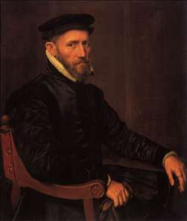
Gresham’s Law
Gresham’s Law –
an artificially overvalued money tends to drive an artificially undervalued money out of circulation
Sometimes inaccurately stated as “bad money drives out good.”
Applies when government sets exchange rates between monies.

Slide 24
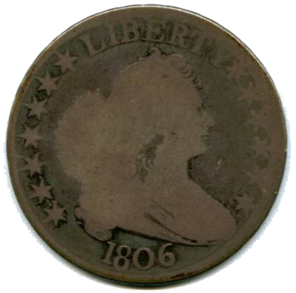
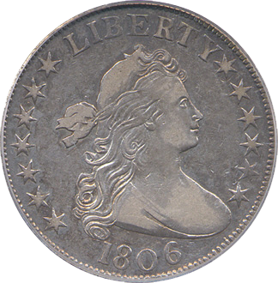
Gresham’s Law
Gresham’s Law applies to new coins and worn coins. Worn coins are likely to have lost some of their metallic weight through wear and tear, so they should have less value than new coins. But government sets them to have the same value. Thus worn coins are artificially overvalued and new coins are artificially undervalued.

Slide 25
Gresham’s Law
Merchants want to hoard the coins with full metal content and pass along coins with less metal content. So worn coins tend to stay in circulation and new coins are drawn out of circulation when commodity money is used.
The artificially overvalued money drives the artificially undervalued money out of circulation – bad money drives out good.

Slide 26
Gresham’s Law
Worn coins & new coins
New coins undervalued
Worn coins overvalued
Therefore,
Worn coins drive out new coins

Slide 27
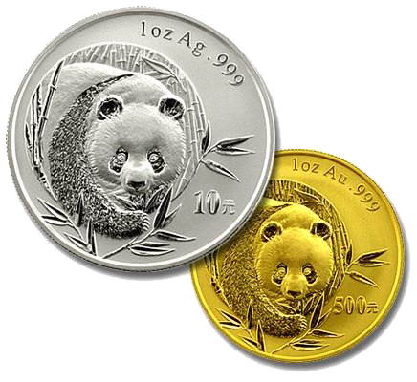
Gresham’s Law
parallel standard –
market exchange rate with two monies
bimetallic standard –
government fixed exchange rate
of gold and silver

Slide 28
Gresham’s Law
Silver to gold ratio
1792 (Hamilton)
Fixed: 15 to 1
Market: 15.5 to 1
Gold undervalued
Silver overvalued
Therefore,
Silver drives out gold

Slide 29
Gresham’s Law
Silver to gold ratio
1835
Fixed: 16 to 1
Market: 15.5 to 1
Gold overvalued
Silver undervalued
Therefore,
Gold drives out silver

Slide 30
Gresham’s Law
Silver to gold ratio
1866
Fixed: 16 to 1
Market: 30 to 1
Gold undervalued
Silver overvalued
Therefore,
Silver should drive out gold
… but silver was de-monetized

Slide 31
Gresham’s Law
Silver was good for small transactions and gold was good for large transactions. In the absence of government interference, both would circulate.
Most countries were on bimetallic standards, but went to gold standard by default through Gresham’s Law.

Slide 32
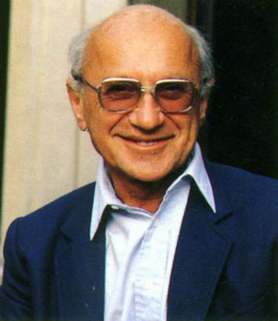
Inflation
“Inflation is always
and everywhere a monetary phenomenon.”
– Milton Friedman
Inflation used to be synonymous with monetary growth. Now it means a rise in the price level.

Slide 33
Inflation
high money growth
  can cause persistent high inflation
  there is no limit to money growth
fiscal policy alone
  cannot cause persistent high inflation
  spending limited to 100% of GDP, polit. pressures
supply-side phenomena
  cannot cause persistent high inflation
  price level rises temporarily, then reverts to old level

Slide 34
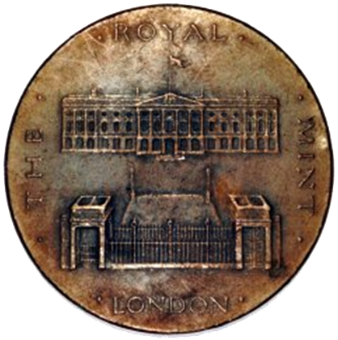
Seigniorage
seigniorage –
profit that results from producing coins
(difference between
face value and metal value)

Slide 35

Seigniorage
government revenue
taxation
borrowing
seigniorage

Slide 36
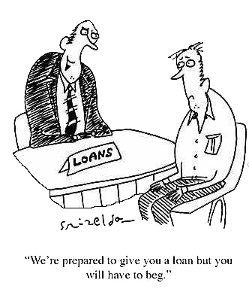
Seigniorage
Governments that find it hard to borrow or tax must rely more on seigniorage. Therefore, poorer countries tend to have higher rates of seigniorage – and thus higher inflation.

Slide 37
Seigniorage
debasement –
lowering the value of the currency
(usually commodity money)

Slide 38
Seigniorage
M = PQ + C + S
M ≡ nominal value assigned to coin
P ≡ nominal price paid per oz. of precious metal
Q ≡ number of oz. of precious metal in the coin
C ≡ cost of coining the metal (“brassage”)
S ≡ nominal seigniorage

Slide 39
Seigniorage
M = PQ + C + S
Competition
price of a coin (M) equals marginal cost of a coin (PQ + C)
M = PQ + C means S = 0
with informed coin users, Q adheres to a quality standard
(below standard coins rejected or discounted)
competition bids up P until S = 0 at the margin

Slide 40
Seigniorage
M = PQ + C + S
Government (Royal Mint)
can earn seigniorage profit permanently
only if has legally protected monopoly
allows it to maintain P or Q below competitive level
without losing business

Slide 41
Seigniorage
M = PQ + C + S
Debasement
reduces Q for given M
replace silver with cheaper “base” metal (copper, zinc, tin)
each coin is cheaper (C↑, but less than (PQ)↓)
debasement allows more coins per oz. of silver

Slide 42
Seigniorage
M = PQ + C + S
Debasement requires deceit or compusion
no seigniorage if public notices & discounts debased coins
short run: disguise debasement
  mints use same dies, new coins nearly identical
long run: use legal tender laws to compel use
  triggers Gresham’s law, can make calling in old coins
  compulsory, can increase P slightly above legal tender

Slide 43
Seigniorage
M = PQ + C + S
Seigniorage without debasement
reduce P instead of Q
draw metal to mint through compulsion
give mint monopsony privilege
(all silver mines must sell to mint)
e.g., all Spanish New World silver had to be sold
to the Royal Spanish Mint at its price

Slide 44
Seigniorage
M = PQ + C + S
Fiat seigniorage
bullion content (Q) is zero
production cost (C) is near zero (6¢/note)
M = PQ + C + S reduces to M = S
nominal seigniorage equals approximately
$100 for each $100 produced

Slide 45
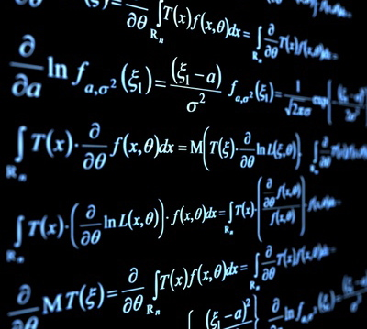
Seigniorage
M = S
easier notation:
S = ΔH
s = S/P
s = ΔH/P
S ≡ nominal seigniorage
s ≡ real seigniorage
H ≡ high powered money
(monetary base)

Slide 46
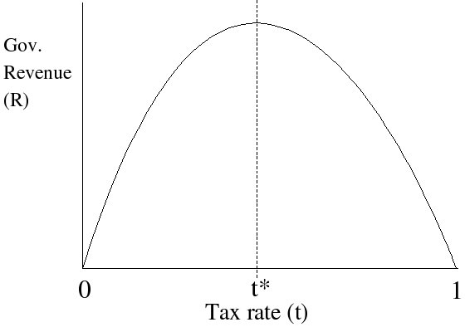
Seigniorage
Laffer curve
There exists a tax rate that will yield maximum government revenue. That rate is less than 100% because at higher tax rates the tax base shrinks: people are incentivized to work less and to evade taxes.

Slide 47
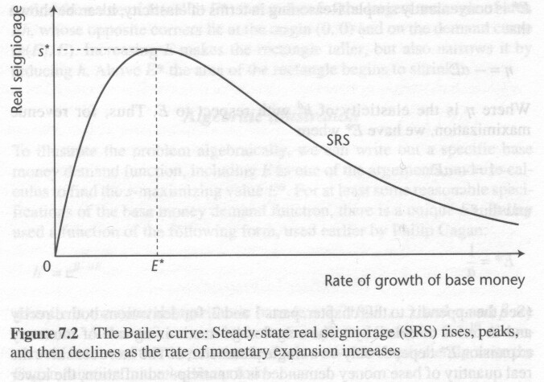
Seigniorage
Bailey curve
There exists a rate of monetary expansion that will yield maximum government seigniorage revenue. That rate is less than infinite because at higher expansion rates the demand for money falls: price level rises faster than nominal seigniorage.

Slide 48
Seigniorage
s = ΔH/P
s = (ΔH/H)(H/P)
s = Eh
E = ΔH/H
h = H/P
E ≡ growth rate of H (“tax rate”)
h ≡ real money stock (“tax base”)

Slide 49
Seigniorage
Bailey curve
s* = E*h
SRS curve maps perfect foresight
rays (lines) from the origin show expectations

Slide 50
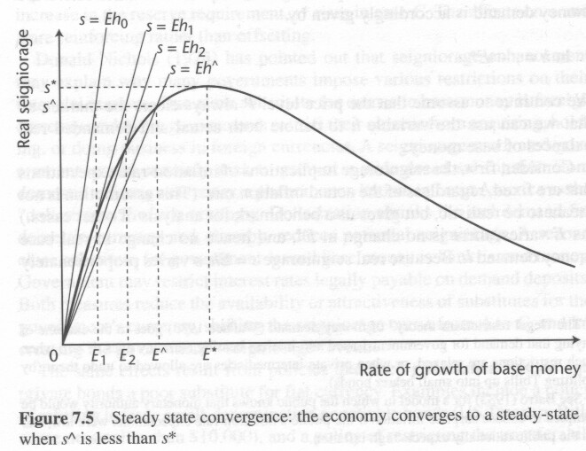
Seigniorage
Bailey curve
When target seigniorage
(s^) is less than maximum seigniorage (s*), the Bailey curve converges to a steady state solution.

Slide 51
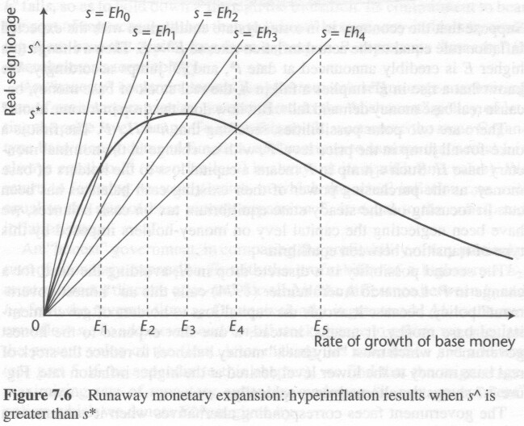
Seigniorage
Bailey curve
When target seigniorage
(s^) is greater than maximum seigniorage (s*), the Bailey curve expands indefinitely.
This is hyperinflation.

Slide 52
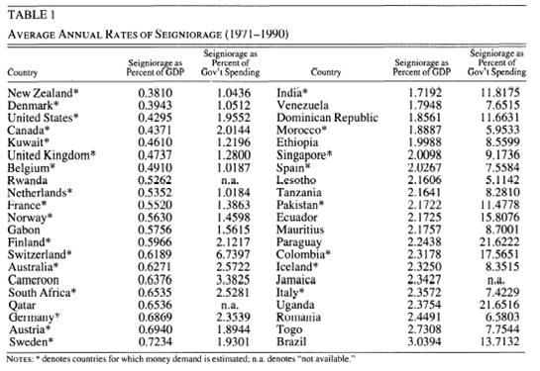
Seigniorage

Slide 53
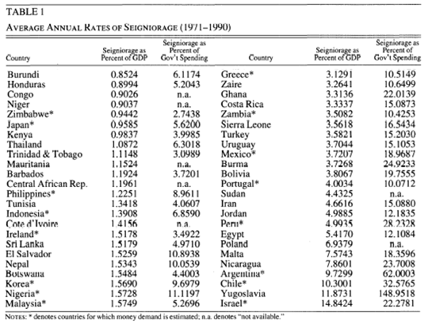
Seigniorage

