Slide 1

Unit 1: Money
Evolution of Money
2/1/2011

Slide 2
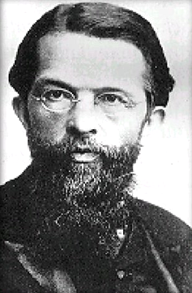
Origin of Money
Carl Menger is the father of the
Austrian school of economics.
He theorized that money came about
through evolution from barter –
aka, through the “invisible hand” (Smith)
or spontaneous order (Hayek).

Slide 3
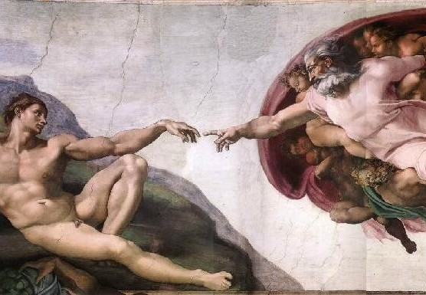
Invisible Hand
“[He] was led by an invisible hand
to promote an end which was no
part of his intention” – Adam Smith
Chicago school says:
“as if by an invisible hand”
Smith’s invisible hand was God.
Modern economists remove
God with the “as if”.

Slide 4
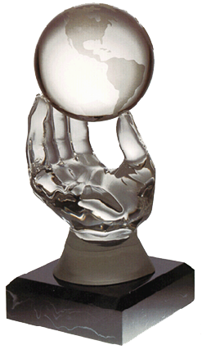
Invisible Hand
invisible hand –
self-interest drives actors to
socially beneficial behavior

Slide 5
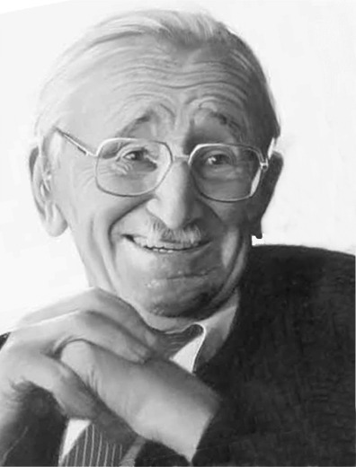
Spontaneous Order
Hayek was a modern Austrian
economist who won the Nobel prize.
“The curious task of economics
is to demonstrate to men how little
they really know about what they imagine they can design.”
– F.A. Hayek, The Fatal Conceit

Slide 6
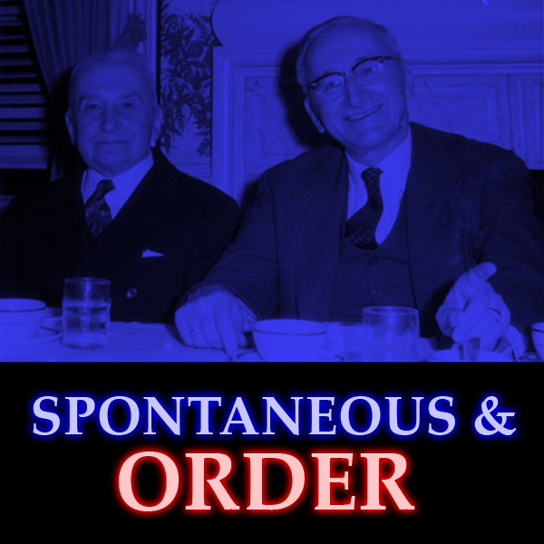
Spontaneous Order
spontaneous order –
coordination that results
from human interaction, but no conscious design

Slide 7

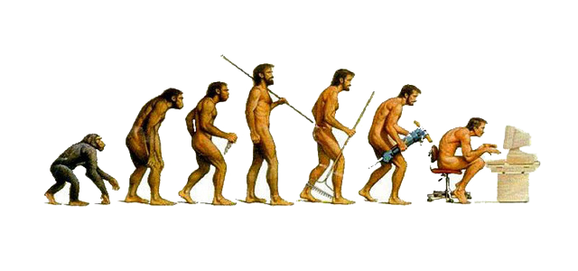
Spontaneous Order
Examples
money
language
Darwinian evolution

Slide 8


Menger’s Origin of Money
Why do people trade
useful goods and services
for silly little pieces of paper?!

Slide 9
Menger’s Origin of Money
Barter (Direct)
Medium of Exchange (Indirect)
Money (CAMOE)

Slide 10
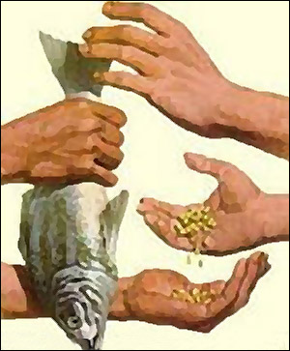
Barter
barter (direct exchange) –
trade for something that can be used directly
in consumption or production

Slide 11
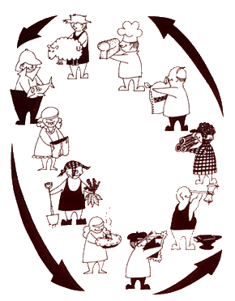
Barter
Transaction costs of barter are so huge that it is very inefficient.

Slide 12

Indirect Exchange
medium of exchange
(indirect exchange) –
something not wanted
for commodity value,
but rather for trade value

Slide 13

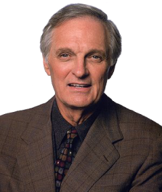



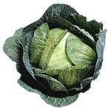
Indirect Exchange
trader
endowment
preference
trades
ends with
B > A > C B-owner refuses
to trade for A.
C > B > A C-owner refuses
to trade for B.
A > C > B A-owner refuses
to trade for C.
A
B
C

Slide 14
Indirect Exchange
trader
endowment
preference
trades
ends with
B > A > C (1) A → C
(2) C → B
C > B > A B → C
A > C > B C → A
A
B
C

Slide 15
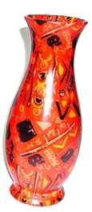
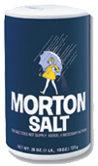
Indirect Exchange
The trades worked because a medium of exchange was used.
Here broccoli was the
medium of exchange.
But the medium of exchange could be anything.
(MOE)
(MOE)
?

Slide 16

Indirect Exchange
degree of marketability –
more highly marketable goods
are easier to sell for a “good price”
(best price with full information)
In other words, more marketable goods have lower transaction costs;
more sellers will accept them.

Slide 17


Indirect Exchange
Marketability is a
non-Walrasian concept.
In Walrasian economics
everything is always at equilibrium
(there are no transaction costs).

Slide 18
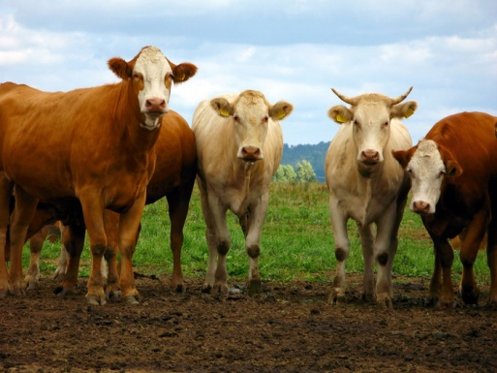
Indirect Exchange
Traders will begin to carry
an inventory of various
media of exchange.
Over time they notice some
media of exchange are more
marketable than others.
Traders pick the more marketable
medium of exchange.

Slide 19
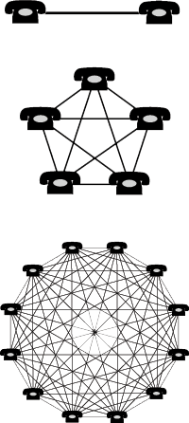
Indirect Exchange
network effect –
the value of a good increases
the more people use it
Money has a network effect.
The more people use a medium
of exchange, the more marketable
that medium of exchange is,
the more other people will adopt it.

Slide 20
Money
money –
commonly accepted
medium of exchange

Slide 21
Money
When a circulating medium of exchange becomes commonly accepted (that is, widely adopted by most traders as the preferred media of exchange), it becomes money.

Slide 22
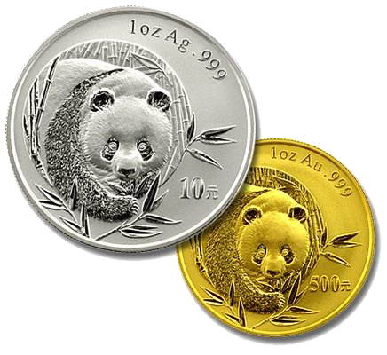
Convergence
Why did most civilizations
converge to gold or silver?

Slide 23
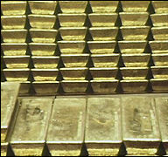
Convergence
Gold is more marketable due to several characteristics.
Characteristics
uniform
durable
divisible
portable
stable value

Slide 24
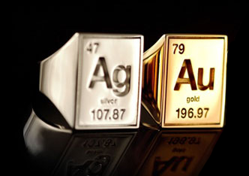
Convergence
uniform –
purity can be tested at low cost
(biting, sounding, or assaying)
Gold and silver are both pure elements on the Periodic Table.
assay – chemically test
the quality of metals

Slide 25
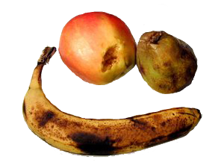
Convergence
durable –
no extra carrying cost due to spoilage
Food commodities such as
grains and olive oil could spoil.
Preventing spoilage had a cost.
Checking the quality of spoilable items during transactions had a cost
(see uniformity).

Slide 26
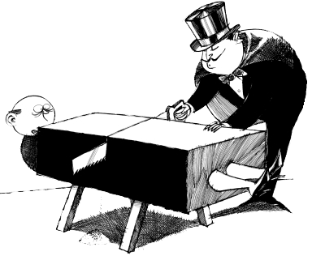
Convergence
divisible (and fusible) – payment can
be tailored to purchase size
Large pieces can be
separated into small pieces.
Small pieces can be
combined into large pieces.
(Not true of livestock.)

Slide 27

Convergence
portable –
high ratios of value to bulk
In Sweden copper plate money
weighed 44 pounds.
1 ship of gold = 15 ships of silver

Slide 28
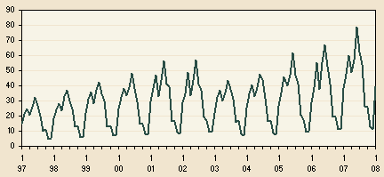

Convergence
stable value –
not subject to seasonal variations
Food commodities harvested a
certain time of year could
experience large swings in price
depending on the time of year.

Slide 29
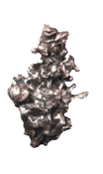
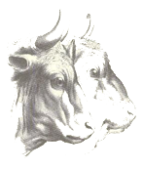
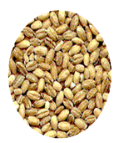
Convergence
Silver oxen barley
durable (no spoilage) ✓ ✓ ✓
portable (high value/bulk) ✓ ✓
divisible ✓ ✓
uniform (easy to grade) ✓(coined) ✓
stable value (non-seasonal) ✓

Slide 30

Convergence
When traders from two regions
with different commodity monies came into contact,
the better of the two monies
spread to the other region.

Slide 31
Mengerian
Barter (Direct)
Medium of Exchange (Indirect)
Money (CAMOE)

Slide 32
Neo-Mengerian
Money
Gold & Silver
Coin
Bank Notes

Slide 33
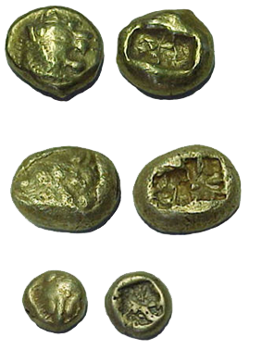
Coins
Coins first appeared in ancient Lydia (Turkey) and China.
The earliest coins were punched,
later coins were stamped,
finally coins were minted.

Slide 34
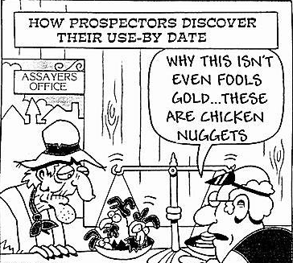
Coins
coinage –
the process of fashioning monetary metal into standardized marked discs
Merchants had to assess weight and quality when receiving payment. They would mark a piece of assessed gold to avoid the cost of re-assessing upon payout. Other traders would come to rely on the mark.

Slide 35
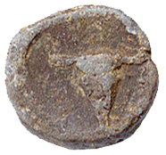
Coins
When metal commodity standard would replace another medium of exchange, often the old medium of exchange would be stamped on the coin.
Here an ox head is stamped on a coin replacing a cattle commodity standard.

Slide 36
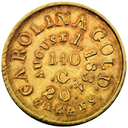
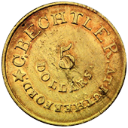
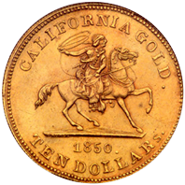
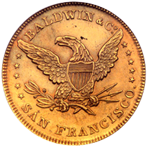
Coins
Private mints were common
around gold and silver mines.
Marketability of coins was
discontinuously greater than
marketability of unminted gold.
Marketability of money was
discontinuously greater than
that of other commodities.

Slide 37
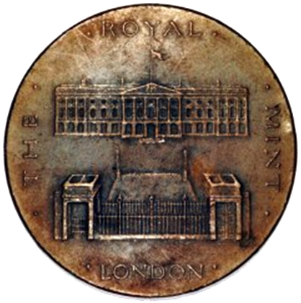
Coins
seigniorage –
profit that results from producing coins
(difference between
face value and metal value)
Governments seized a
monopoly on mints to reap
seigniorage income.

Slide 38
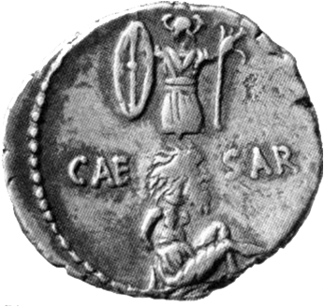
Coins
Government mint monopolies
had a number of public
interest justifications.
Justifications
seigniorage
propaganda
ending debasement

Slide 39

Bank Created Money
outside money –
full-bodied coins and other
full-bodied commodity money
(asset for holder, not a
liability for someone else)
inside money –
bank issued money
(asset for holder, a
liability for issuing bank)

Slide 40
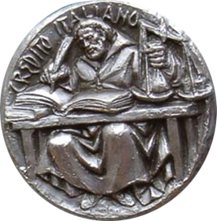
Bank Created Money
Banks began as money changers.
In medieval Italy money changers would convert foreign coin to local coin. They became deposit takers because merchants found it easier to leave money with them “on account” than to lug money everywhere.

Slide 41

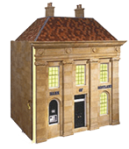


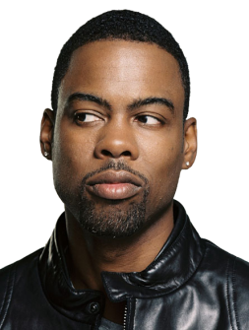
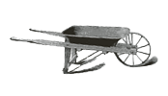
Bank Deposit Evolution
Wheel money from and to bank.

Slide 42
Bank Deposit Evolution
Do transaction at bank.

Slide 43

Bank Deposit Evolution
Use a bank check.

Slide 44


Bank Deposit Evolution
Electronic funds transfer.

Slide 45
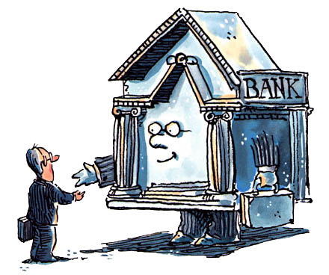
Banknotes
Banks would initially use checks payable to the bearer on demand.
But with checks you must trust
both the bank and the person
whose account will be drawn on.
Banknotes only require trust of the bank.

Slide 46
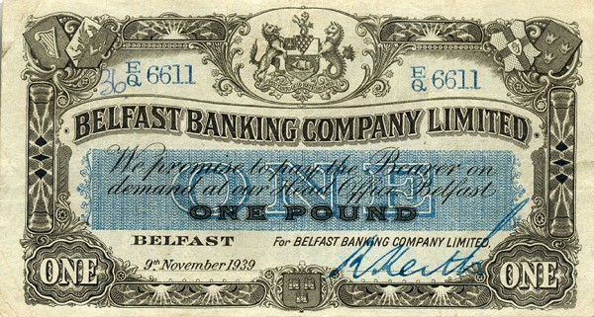
Banknotes
banknote –
bank-issued claims to
outside money not in any customer’s name, but redeemable to the bearer
Widespread use of
banknotes preceded
widespread use of checks.

Slide 47
Par Acceptance
Why did banks accept
other banks’ notes at par?
par – full value (no discount)
Par Acceptance
banks as note-changers
note deuling
mutual par acceptance pacts

Slide 48
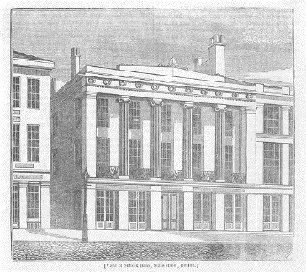
Par Acceptance
Banks are more successful note-changers than non-banks because they can issue notes – and thus hold interest bearing assets instead of non-interest bearing assets. Where transactions and redemption costs are exceeded by float profit, competition drives note-changing fees to zero.

Slide 49
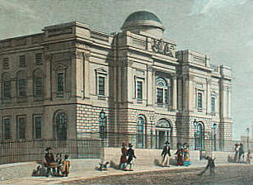
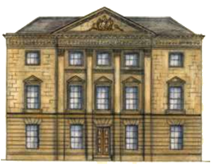
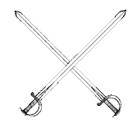
Par Acceptance
Banks would save notes and redeem a large quantity at once to embarrass the other bank. This made them both hold a lot of reserves. Cooperating with quicker redemption led to more profit.

Slide 50

Par Acceptance
Banks that accept other banks’ notes at par improve circulation of both notes. Thus wise profit seeking banks will enter into bilateral par acceptance agreements.

Slide 51


Clearing Agreements
Banks had note-porters redeem other banks’ notes.

Slide 52

Clearing Agreements
Note-porters would meet in the middle at a pub
rather than going all the way to each other’s banks.

Slide 53

Clearing Agreements
Bilateral clearing economized on time and transportation costs over unilateral redemption.
Multilateral clearing was even more efficient than bilateral.

Slide 54
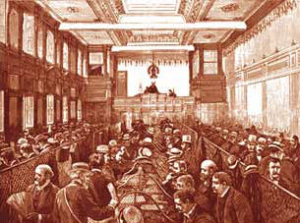
Clearing Agreements
Clearinghouse Associations (CHAs) developed to facilitate multilateral clearing.
CHAs were the institutional embodiment of par acceptance.
They developed through spontaneous order.

Slide 55
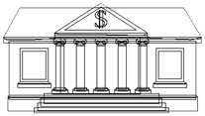
Clearing Agreements
Bilateral netting.
-5
-1
-4
+6
+3

Slide 56
Clearing Agreements
Multilateral netting.
-5
-1
-1
CH
-4
+6
+3

Slide 57
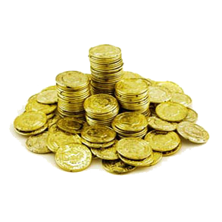

Fiat Money
commodity money –
money with a close relationship between money value and commodity value
fiat money –
money in which monetary
value far exceeds commodity value

Slide 58

Fiat Money
Is there a market path to fiat money?
If a bank stops redeeming,
it is a breach of contract.
If a bank announces it will stop
redeeming, no one will take its notes as the expiration date approaches.

Slide 59

Fiat Money
Ha Ha!
Typical path to fiat money
government gives a monopoly on
note issue to a single institution
its liabilities become widely accepted
government suspends redemption permanently

Slide 60
Fiat Money
Why doesn’t the public
reject irredeemable notes?
Public acceptance
Familiarity/Inertia
Public Receivability
Legal Tender
Forced Tender

Slide 61
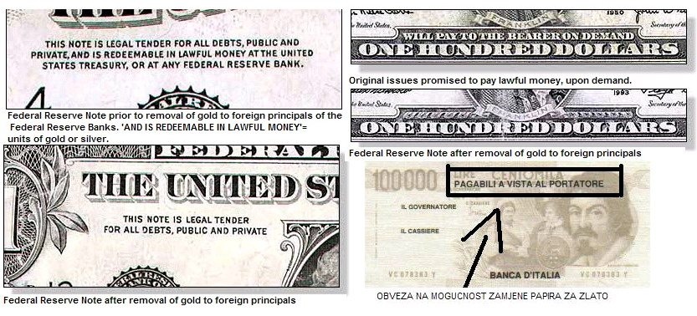
Fiat Money
Fiat money uses the same unit of account as commodity money and looks practically identical.

Slide 62
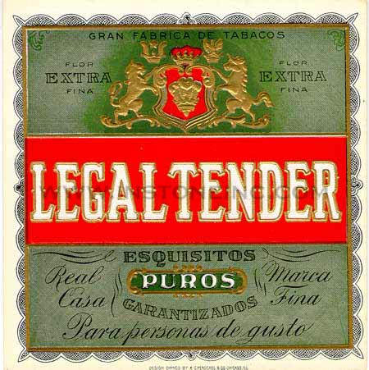
Fiat Money
public receivability –
government accepts fiat
money for tax payments
legal tender –
court forces acceptance of fiat
money for debt repayment
forced tender –
government forces use of fiat
money for spot transactions

Slide 63
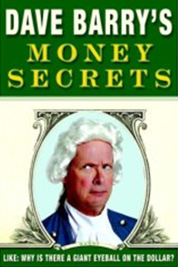
Fiat Money
“Over the years, all the governments in the world, having discovered that gold is, like, rare, decided that it would be more convenient to back their money with something that is easier to come by, namely: nothing.”
– Dave Barry

Slide 64
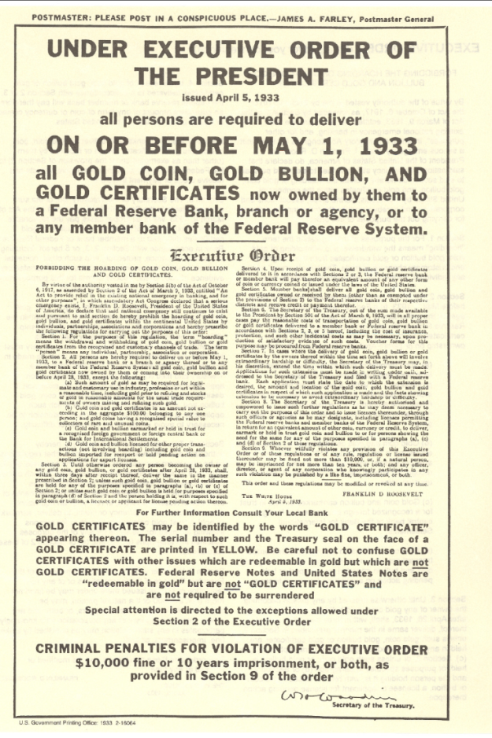
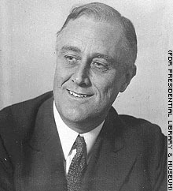

Fiat Money
The United States left the gold standard for a fiat standard domestically in 1933 when F.D.R. seized all gold by executive order.
The United States left the gold standard internationally in 1971 when Nixon ended Bretton-Woods dollar convertability.

