Slide 1
Unit 1: Money
What is Money?
2/1/2011

Slide 2
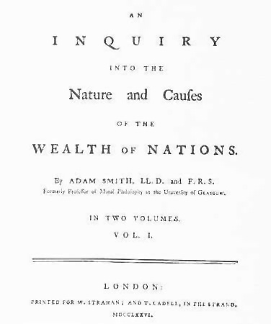
Why Trade?
Adam Smith detailed the
benefits of specialization
and division of labor in his
book The Wealth of Nations.
Each worker could become
an expert in a small area,
greatly increasing efficiency.

Slide 3
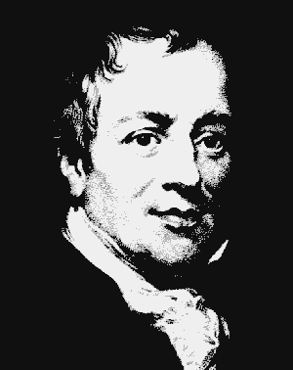
Why Trade?
Law of Association
(comparative advantage) –
Even if someone is absolutely more
productive at 2 activities, if he is
comparatively more productive at 1
activity than another relative to a
2nd person, he will be better off
specializing and trading than
producing in isolation.
David Ricardo

Slide 4
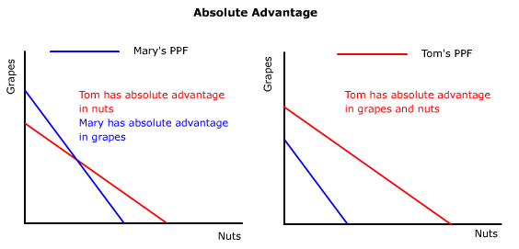
Why Trade?
Tom is better off specializing and trading
even though he has an absolute advantage.

Slide 5
production
possibilities
frontier
production
possibilities
frontier
Why Trade?
Person | Food
Andy | 100
Bob | 400
Total | 500
Person | Clothes
Andy | 100
Bob | 200
Total | 300
Specializing and trading
here gains 50 food.
consumption + production
in autarky
production
after trade
consumption
after trade
Person | Food | Clothes
Andy | 50 | 50
Bob | 200 | 100
Total | 250 | 150
Person | Food | Clothes
Andy | 0 | 100
Bob | 300 | 50
Total | 300 | 150
Person | Food | Clothes
Andy | 75 | 50
Bob | 225 | 100
Total | 300 | 150

Slide 6
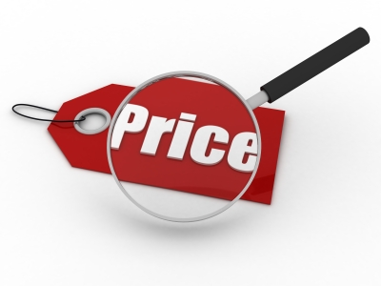
Valuing Goods
We must distinguish
between price and value:
price is objective
value is subjective

Slide 7
Valuing Goods
When people trade, the price they see is the same.
However, they do not value the items traded equally.
Instead they value the items unequally.
=
≠
There is a reverse inequality of value.

Slide 8
Valuing Goods
reverse inequality of value –
both parties to the trade value what they’re
getting more than what they’re giving up
(everyone is happy)

Slide 9
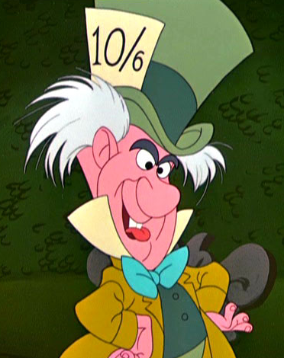
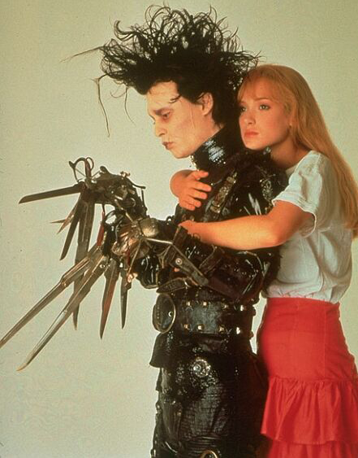
Valuing Goods
Suppose Harry wants to trade a hat to Bob for a haircut.
If the trade occurs,
Harry values
haircut > hat
Bob values
haircut < hat
Harry the
haberdasher
Bob the
barber

Slide 10
Valuing Goods
Reverse inequality of value is what makes trades mutually advantageous, which is why people trade voluntarily.
Trade is not a zero sum game with a winner and a loser.
Trade is a positive sum game. Both parties are winners.
Harry
Bob

Slide 11
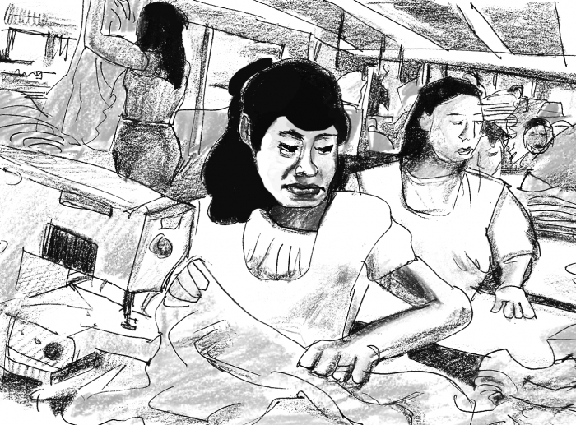
Valuing Goods
Remember the insight that people only enter into voluntary trades if they subjectively believe they are made better off.
For example, sweatshop employees work there because the alternative would be worse.

Slide 12
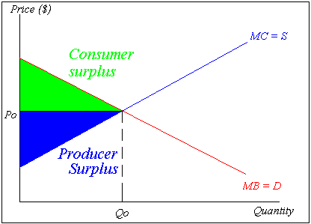
Valuing Goods
Gains from trade can be thought of graphically as consumer surplus and producer surplus.

Slide 13
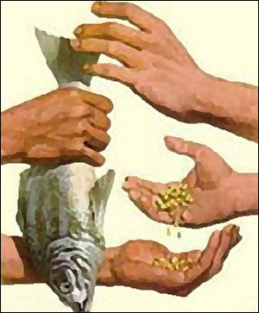
Barter
barter (direct exchange) –
trade for something that can be used directly
in consumption or production

Slide 14
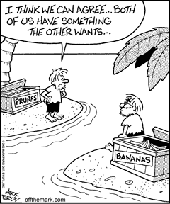
Barter
Barter can work well when you easily find a parallel trader.
In that case not using money actually saves a step.

Slide 15
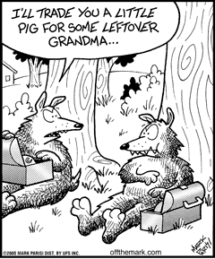
Barter
But often finding someone who has what you want and wants what you have is very difficult.
Search costs and other transaction costs can
be quite high.

Slide 16
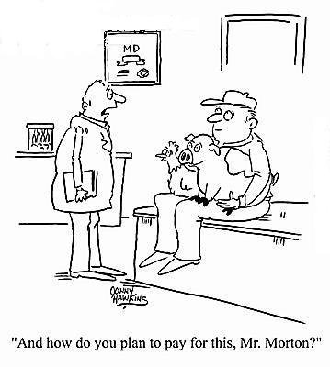
Barter
double coincidence of wants –
each person must want the good his trading partner is offerring

Slide 17
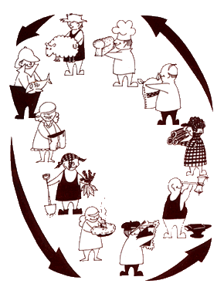
Barter
transaction costs –
opportunity costs of finding a trading partner, negotiating a deal, and monitoring the terms

Slide 18
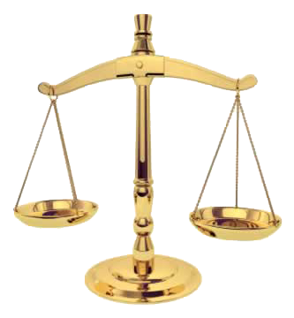
Barter
Transaction costs of barter are so huge that it is very inefficient.
Barter only exists where laws or social norms make efficient indirect trade difficult or impossible.

Slide 19
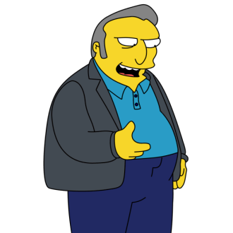
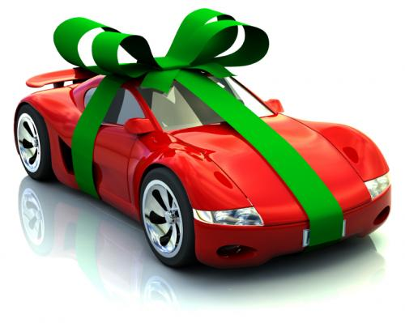
Barter
places barter survives
to evade or reduce taxes
underground economy
marriage, dating, sex
new car (trade in old)
health/dental benefits (less taxes)

Slide 20
Indirect Exchange
medium of exchange
(indirect exchange) –
something not wanted
for commodity value,
but rather for trade value

Slide 21
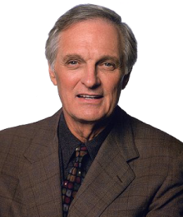
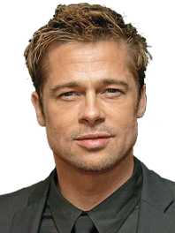
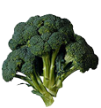
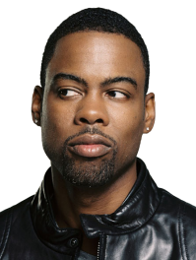
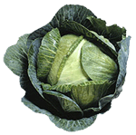
Indirect Exchange
trader
endowment
preference
trades
ends with
B > A > C B-owner refuses
to trade for A.
C > B > A C-owner refuses
to trade for B.
A > C > B A-owner refuses
to trade for C.
A
B
C

Slide 22
Indirect Exchange
trader
endowment
preference
trades
ends with
B > A > C (1) A → C
(2) C → B
C > B > A B → C
A > C > B C → A
A
B
C

Slide 23
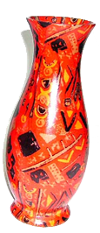
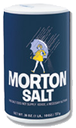
Indirect Exchange
The trades worked because a medium of exchange was used.
Here broccoli was the
medium of exchange.
But the medium of exchange could be anything.
(MOE)
(MOE)
?

Slide 24
Money
money –
commonly accepted
medium of exchange

Slide 25
Money
When a circulating medium of exchange becomes commonly accepted (that is, widely adopted by most traders as the preferred media of exchange), it becomes money.

Slide 26
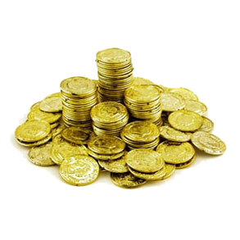
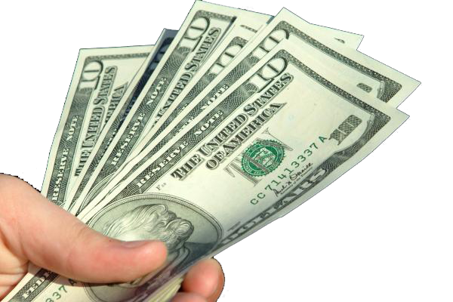
Money
commodity money –
money with a close relationship between money value and commodity value
fiat money –
money in which monetary
value far exceeds commodity value

Slide 27
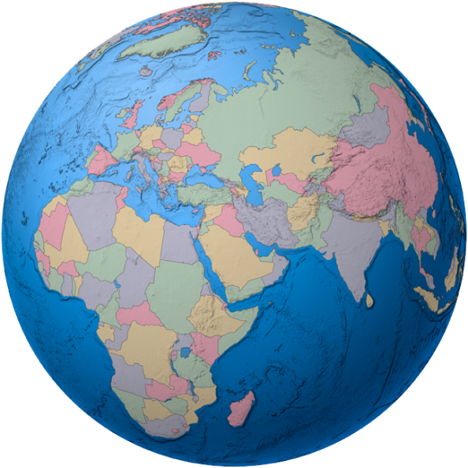
Historical Monies
Many forms of commodity money have been adopted around the world.
The commodity chosen tends to be the main production good or ornamental.

Slide 28
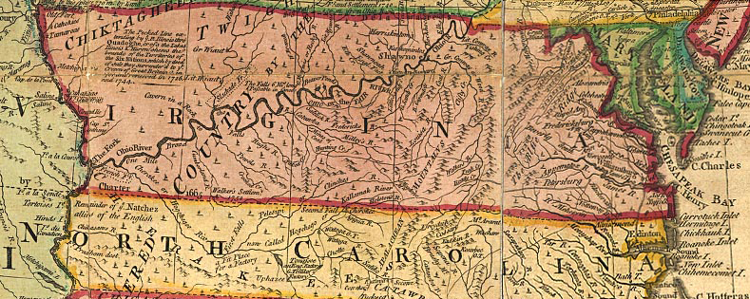
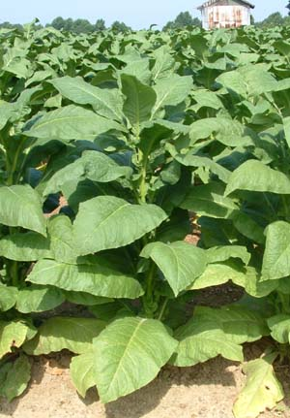
Historical Monies
Where?
What?
Colonial Virginia
tobacco

Slide 29
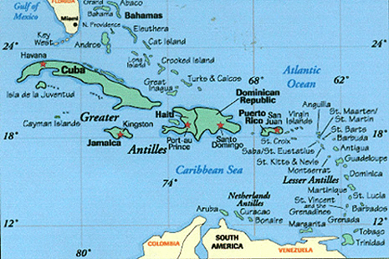
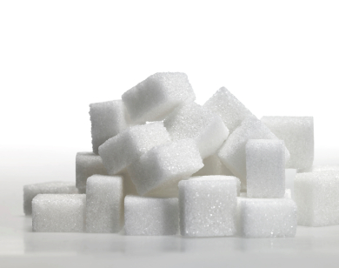
Historical Monies
Where?
What?
West Indies
sugar

Slide 30
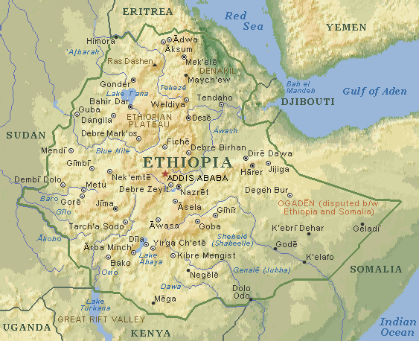
Historical Monies
Where?
What?
Abyssinia
(Ethiopia)
salt

Slide 31
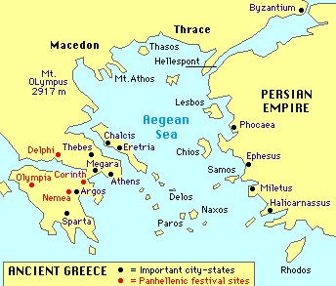
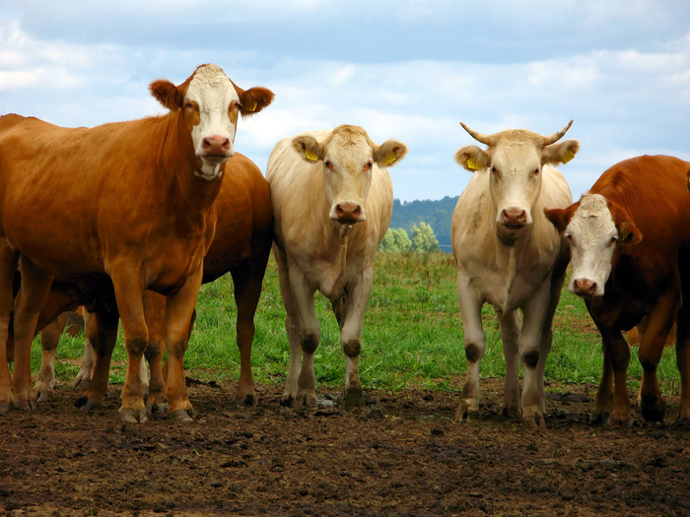
Historical Monies
Where?
What?
Ancient Greece
cattle

Slide 32
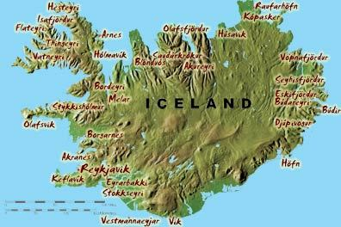
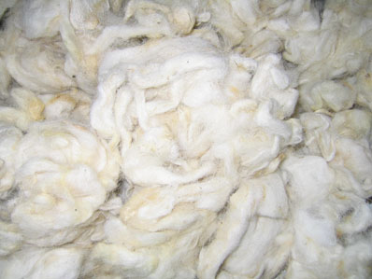
Historical Monies
Where?
What?
Midieval Iceland
wool

Slide 33
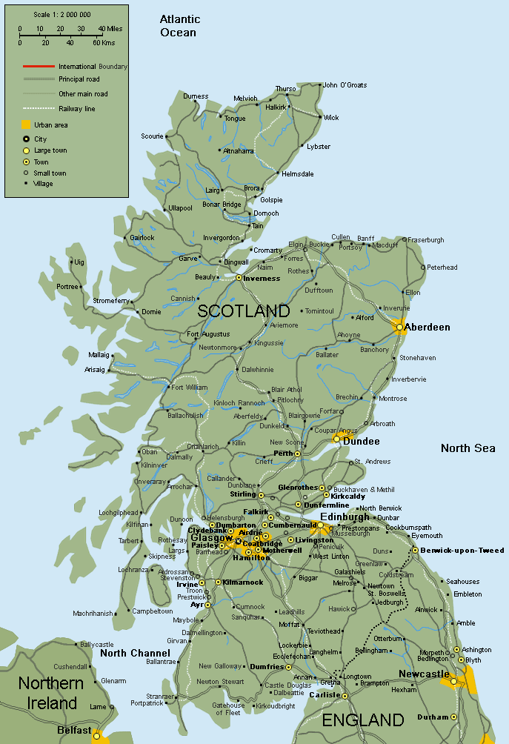
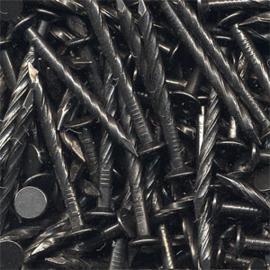
Historical Monies
Where?
What?
Scotland
nails

Slide 34
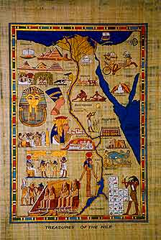
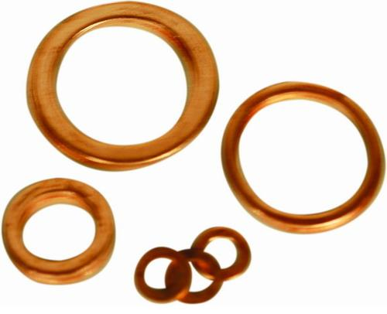
Historical Monies
Where?
What?
Ancient Egypt
copper rings

Slide 35
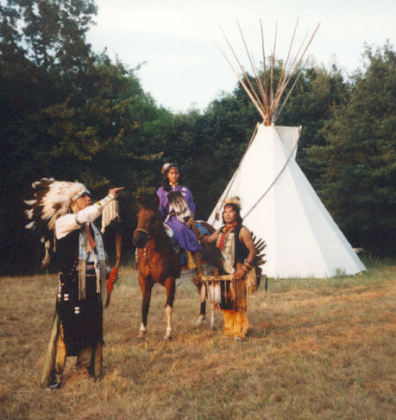
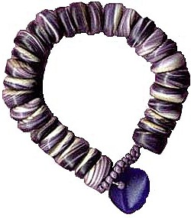
Historical Monies
Where?
What?
Native Americans
Wampum
(beads on a string)

Slide 36
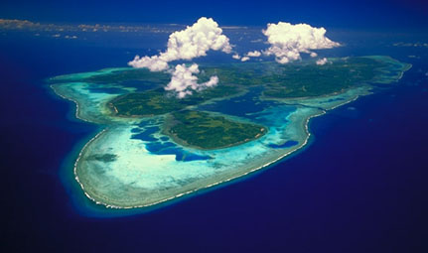
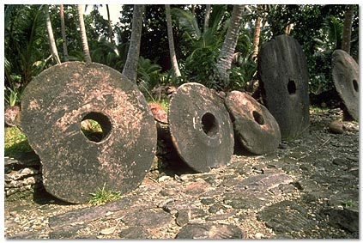
Historical Monies
Where?
What?
Island of Yap
(South Pacific)
Fei
(large stone wheels)

Slide 37
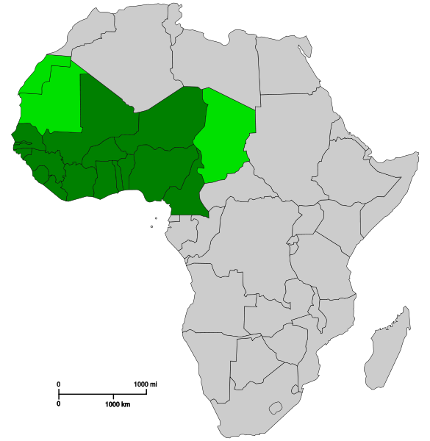
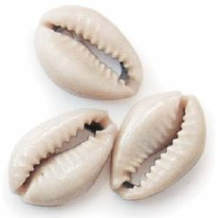
Historical Monies
Where?
What?
West Africa, China
cowrie shells

Slide 38
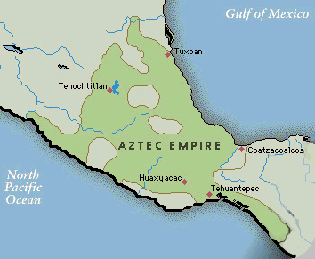
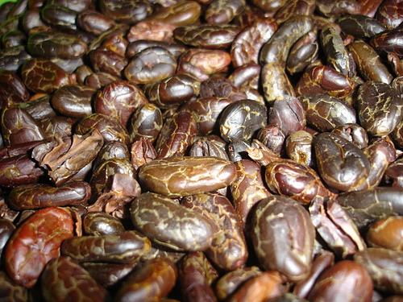
Historical Monies
Where?
What?
Aztecs
caoca beans
(chocolate)

Slide 39
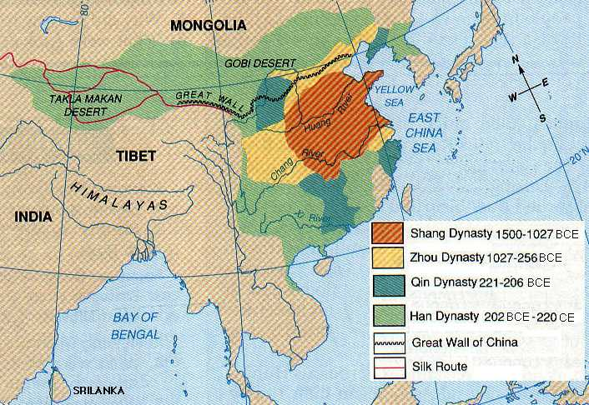
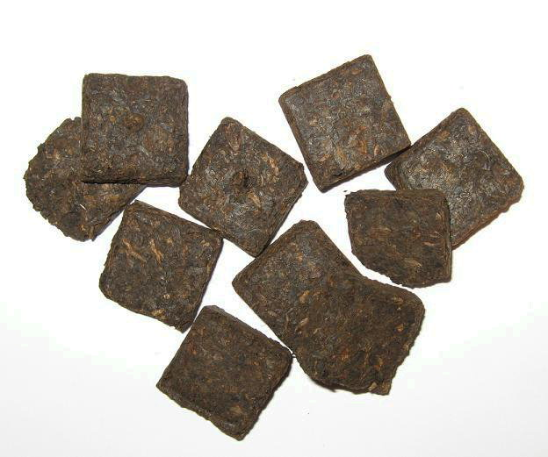
Historical Monies
Where?
What?
China, Mongolia, Siberia
tea

Slide 40
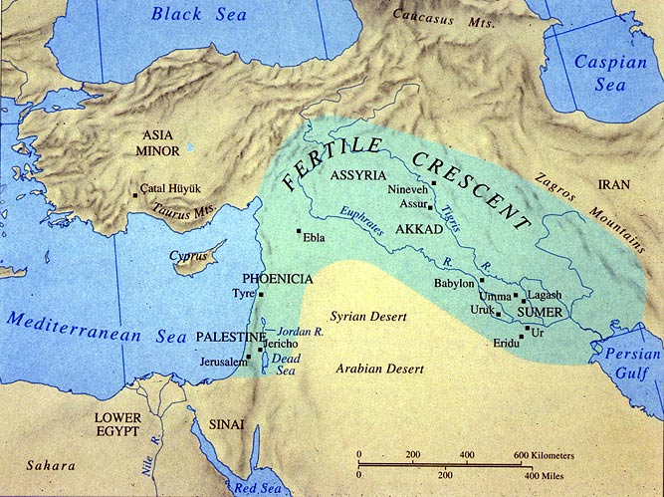
Historical Monies
Where?
What?
Mesopotamia
barley (grain)

Slide 41
Historical Monies
Where?
What?
Ancient Japan
rice

Slide 42
Historical Monies
Where?
What?
Colonial Australia
rum

Slide 43
Historical Monies
Where?
What?
prisons
cigarettes

Slide 44
Functions of Money
Main function of money
medium of exchange
Subsidiary functions of money
medium of account
store of value
standard of deferred payment

Slide 45
Functions of Money
unit of account –
common numerator of all prices
More properly:
medium of account –
good used as a pricing or accounting unit
unit of account –
specific quantity of the
good used as a pricing or accounting unit

Slide 46
Functions of Money
store of value –
separates act of buying from selling
(saving with low transaction costs)
standard of deferred payment –
money is a good way of paying back loans

Slide 47
Monetary Aggregates
Money supply
MB – monetary base (total currency)
M1 – very liquid assets
M2 – somewhat liquid assets
M3 – even less liquid assets
MZM – money with zero maturity

Slide 48
Monetary Aggregates
Money supply
MB = currency in circulation + reserves in bank vaults
+ reserves with the Fed
M1 = currency in circulation + travelers checks
+ demand deposits + other checkable deposits
M2 = M1 + time deposits (<$100k) + savings deposits
+ MMMF shares (individuals)

Slide 49
Monetary Aggregates
Money supply
M3 = M2 + time deposits (>$100k) + MMMF shares
(institutional) + short term RP agreements
+ other large liquid assets
MZM = currency in circulation + travelers checks
+ demand deposits + other checkable deposits
+ savings deposits + all MMMF shares

Slide 50
Monetary Aggregates
Notes
Only MB includes reserves.
M3>M2>M1
Fed stopped tracking M3 in 2006

Slide 51
Stock vs. Flow
wealth is a stock value
(oz. Au)
income is a flow value
(oz. Au / year)

