Slide 1
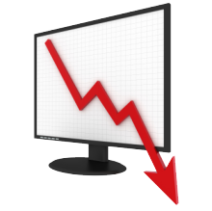
Unit 4: Macro Failures
The Subprime Crisis
12/9/2010

Slide 2
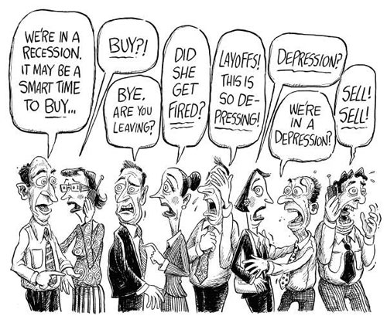
Recessions vs. Depressions
recession –
two consecutive quarters
where GDP falls
depression –
recession where unemployment hits 10%;
recession where
GDP falls 10%

Slide 3
Recessions vs. Depressions
Our current financial crisis is called the Great Recession or the Subprime Crisis.
According to the definitions, the recession began in December 2007 and ended in June 2009.

Slide 4
Recessions vs. Depressions
The unemployment rate maxed out above 10% January-March of 2010, but because that period was not within the recession (ended June 2009), this is not a depression.
Negative ΔGDP maxed out at
-7.9% in the 4th quarter of 2008.

Slide 5
Recessions vs. Depressions
Currently the unemployment rate is around 9.3%.
Unemployment is higher in places that had a lot of construction (e.g., CA, FL) and higher among high school dropouts than college graduates.

Slide 6
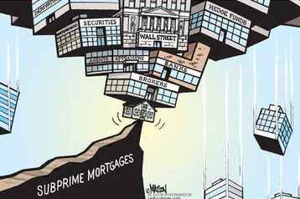
Causes of the Subprime Crisis
causes of subprime crisis
incentivized home ownership
incentivized subprime lending
wrong credit ratings
ABCT boom/bust cycle
  housing bubble
pro-cyclical bank regulation
misguided bailouts / stimulus
  creates moral hazard

Slide 7


Home Ownership
advantages
  building equity
    collateral for later loans
    disciplines savings
  tax benefits
    mortgage interest deduction
    housing tax credit
disadvantages
  not diversified
  limits labor mobility

Slide 8

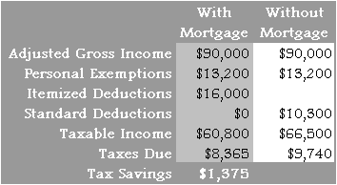
Home Ownership
The mortgage interest deduction on personal income taxes encourages people at the margin to buy houses because they get an interest free loan.

Slide 9
Home Ownership
Other types of interest aren’t deductible (e.g., car loans, credit cards, etc.).
Also stock investments are
disincentivized due to double taxation (corporate income tax + capital gains tax).

Slide 10

Home Ownership
Recently the government
has provided tax credits to encourage home buying.
We will also see that the government incentivizes banks to make home loans.

Slide 11
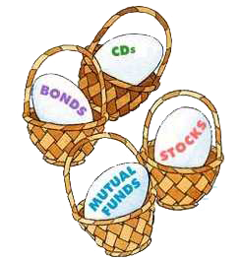
Home Ownership
Diversification of investments is important… you don’t want to put all your eggs in one basket.
But many people have the vast majority of their net worth in their house. They are very vulnerable to housing price fluctuations.

Slide 12

Home Ownership
When unemployed, it often makes sense to seek a job in a different area with a lower unemployment rate.
Renters can move easily.
Home owners have a much higher moving cost.
This limits labor mobility.

Slide 13
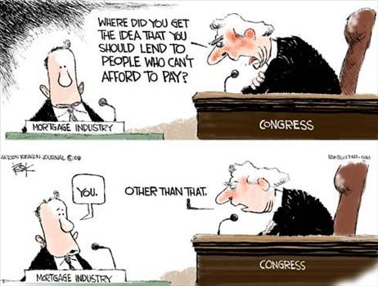
Bank Issues
government incentives
mortgage interest deduction
federal housing tax credit
Community Reinvestment Act
  prohibited redlining
  encourages subprime loans
government guarantees
  Freddie Mac, Fannie Mae
    mortgage backed securities

Slide 14
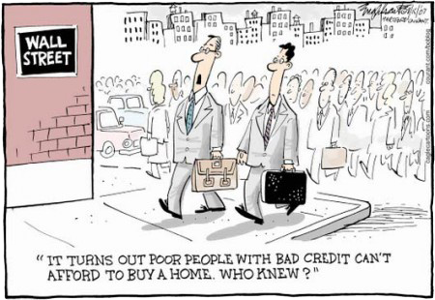
Bank Issues
The Community Reinvestment Act (CRA) prevented banks from redlining areas – they were forced to make loans to the poor.
Because the poor did not have the normal 20% down payment, banks had to innovate other loan structures getting around it.

Slide 15

Bank Issues
Banks not complying with the Community Reinvestment Act would be fined or prevented from merging.
This was at a time when restrictions on branch banking had just been lifted (1994), so mergers were highly desired.

Slide 16

Bank Issues
fixed rate mortgage –
interest rate stays the same
adjustable rate mortgage (ARM) –
interest rate fixed initially,
then adjusts to market rate later

Slide 17


Bank Issues
subprime loan –
loan to people with bad credit
(credit score below 640)
NINJA loan –
no income, no job, no assets

Slide 18
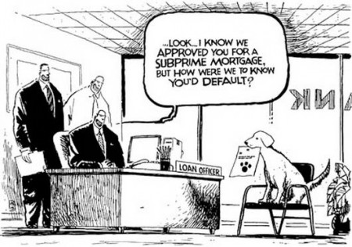
Bank Issues
Banks gave mortgages with 0% down payments to comply with the regulations against redlining.
Adjustable rate mortgages were an innovation allowing home buyers to afford mortgages that wouldn’t have been possible with the high 30 year fixed rate.

Slide 19
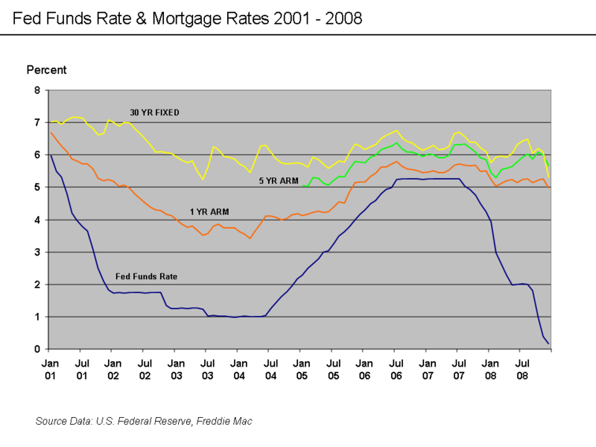
Bank Issues
Adjustable rates were significantly less than fixed rates due to the low federal funds rate. This strongly encouraged ARMs. When rates later went up after the teaser rate ended (1-5 years), rates skyrocketed.

Slide 20
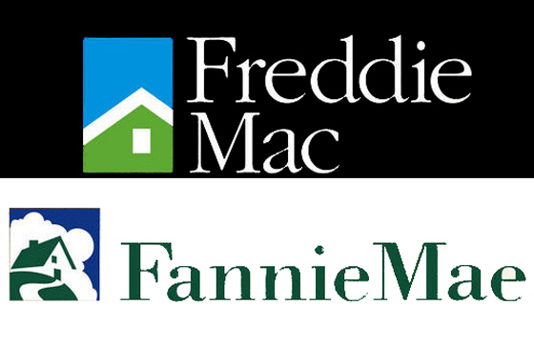
Bank Issues
The government quasi-agencies Freddie Mac and Fannie Mae would implicitly guarantee mortgages from banks (creating moral hazard) and help banks bundle them into mortgage backed securities then sell them to investors (e.g., hedge funds).

Slide 21
Bank Issues
mortgage backed securities –
break up mortgage into tiny pieces,
then bundle many mortgages together
to diversify risk and sell them off

Slide 22
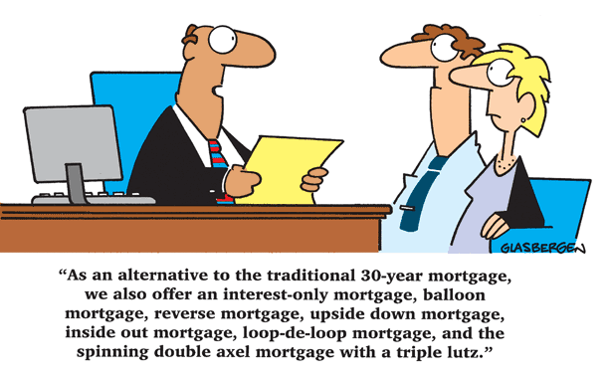
Bank Issues
Securitization of mortgages created a moral hazard problem because the lending bank wouldn’t suffer from defaults (instead the buyer of the MBS suffers).
Banks over-issued
mortgages as a result.

Slide 23

Bank Issues
FDIC deposit insurance is a moral hazard problem because losses are socialized while gains accrue to the bank shareholders. This encourages excessive risk.

Slide 24
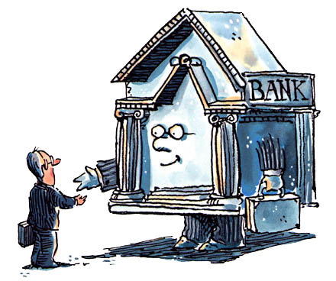
Bank Issues
moral hazard
  implicit Fredie Mac guarantee
  securitization of mortgages
  FDIC insurance
Community Reinvestment Act
  prohibited redlining
  encourages sub-prime loans
  penalties for non-compliance
    fines
    prevented from merging

Slide 25

Credit Rating Agencies
Credit rating agencies evaluated the risk of mortgage backed securities. These evaluations were grossly wrong.

Slide 26
Credit Rating Agencies
no free market in ratings
  government mandates top 3
    S&P, Moodys, Fitch
immune from lawsuits
  no penalty for wrong ratings
  first amendment
  contrast: auditors can be sued
conflicts of interest
  also provide consulting

Slide 27
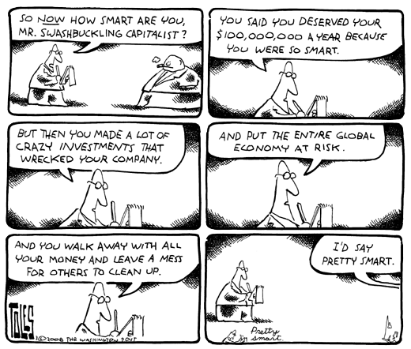
MBS buyers
Investment bankers and hedge fund managers would risk their investors’ money and get large bonuses for short term gains with no penalties for losses.
This equity moral hazard (principal/agent) problem results in excessive risk.

Slide 28
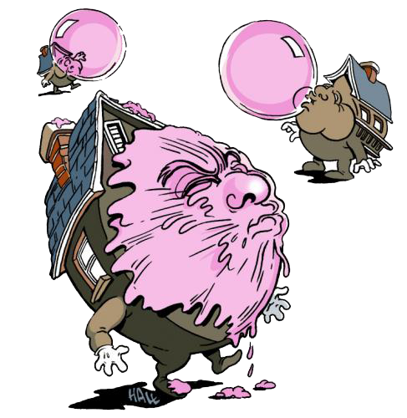
Austrian Business Cycle Theory
Austrian Business Cycle Theory
is actually a mainstream theory
for the Subprime Crisis.
Low interest rates by the Federal Reserve caused a housing bubble, which subsequently crashed. The economy suffered due to those malinvestments in housing.

Slide 29
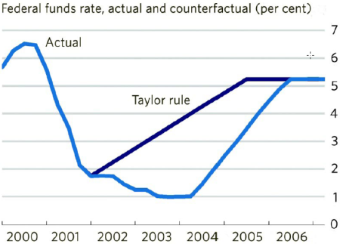
Austrian Business Cycle Theory
In the early 2000’s under Greenspan the federal funds rate was far below the Taylor Rule suggested level.
This low interest rate over-incentivized investment in areas like housing purchases and construction.

Slide 30
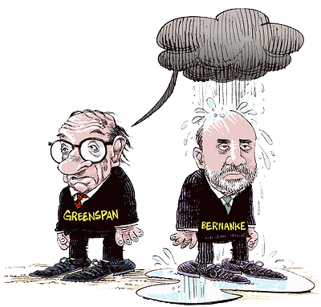
Austrian Business Cycle Theory
Greenspan lowered the federal funds rate from 6.5% in May 2000 to 1% in June 2003 through 13 rate cuts, held the FFR at 1% for a year, and then raised the FFR to 5.25% by June 2006 through 17 rate hikes.

Slide 31
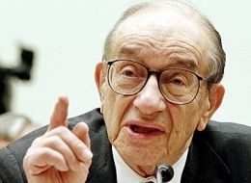
Austrian Business Cycle Theory
Greenspan put –
using monetary policy to
prevent asset price deflation
(i.e., reflate asset bubbles)

Slide 32
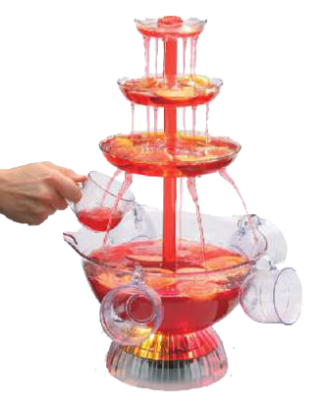
Austrian Business Cycle Theory
Fed Chair William Martin famously said it was his job to take the punch bowl away just when everyone was beginning to have fun.
By that he meant that the Fed is supposed to raise interest rates when the economy heats up to prevent inflation and asset bubbles.

Slide 33
Austrian Business Cycle Theory
Far from taking the punch bowl away when traders begin to make merry, the central bank now spikes it at the first sign of economic sobriety.
Meaning the Fed lowers interest rates when a bubble is discovered and market participants try to correct it.

Slide 34
Austrian Business Cycle Theory
When the tech bubble was bursting, instead of letting prices adjust Fed chair Greenspan lowered the federal funds rate to 2%, then 1%.
Now that the housing bubble is bursting, instead of letting prices adjust Fed chair Bernanke has lowered the federal funds rate to near zero.

Slide 35
Austrian Business Cycle Theory
Austrian business cycle
boom period
  low interest rates 2002-2006
  inflated housing bubble
bust period
  malinvestments discovered
  recession 2007-2009

Slide 36

Bursting the Bubble
bankruptcy law change
  credit cards debt harder to avoid
  pay credit card before mortgage
mortgage payments increased
  because interest rates rose
    adjustable rate mortgages
  mortgage defaults
    lower housing prices
mortgages underwater
  mortgage defaults

Slide 37
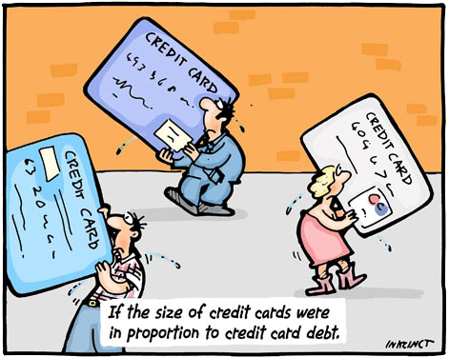
Bursting the Bubble
Congress changed bankruptcy laws making it more difficult to get out of credit card debt. So debtors short on cash began paying off credit cards rather than mortgages.

Slide 38
Bursting the Bubble
Interest rates rose, making payments on ARMs increase significantly. Many people defaulted on their mortgages, lowering home prices.

Slide 39

Bursting the Bubble
Low down payments meant many people were underwater when home prices fell: they owed more on their mortgage than the house was worth. So they just walked away, leading to more defaults and lower prices in the housing sector.

Slide 40
Bank Insolvency
banks were overleveraged
  government promoted debt
    double tax on dividends
    deduction of bond interest
mark to market accounting
  assets valued at fire sale prices
  pro-cyclical
equity requirements for banks
  must reduce leverage
    sell off assets

Slide 41

Bank Insolvency
Banks and other companies were overleveraged. This was a result of government incentives: double taxation of dividends (corporate income tax + capital gains tax) coupled with corporate deduction of interest payments.

Slide 42
Bank Insolvency
Thus debt funding is incentivized over equity funding, resulting in low equity cushions and high leverage ratios (debt to equity).

Slide 43
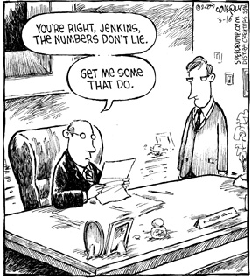
Bank Insolvency
mark to market accounting
(fair value accounting) –
valuing assets based on their current market price rather than their historical price
(i.e., rather than the price the
assets were purchased for)

Slide 44
Bank Insolvency
After Enron, corporations were required to use mark to market accounting of their assets. This meant banks holding mortgage backed securities had to value them at their fire sale prices immediately rather than waiting for a better sale price.

Slide 45

Bank Insolvency
Regulations require adequate capital by a bank to ensure it is solvent – an equity cushion.
With mark to market accounting a bank can become insolvent on paper even though it is not illiquid – the bank can still meet its obligations as they become due.

Slide 46

Bank Insolvency
This forces banks to sell off assets at fire sale losses and scramble for more capital (or for bailouts) even though the bank doesn’t have any actual liquidity problem.

Slide 47
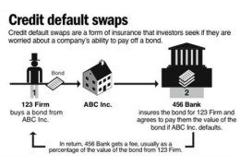
Credit Default Swaps
credit default swap (CDS) –
bet on whether a loan
will be repaid;
type of insurance that
allows hedging

Slide 48
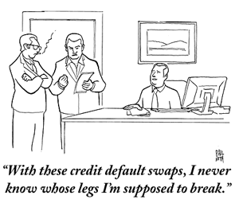
Credit Default Swaps
credit default swaps
bet on whether loan repaid
  type of insurance
  helped hedging risk
models wrong
  housing prices always up
  premiums too low
insurers defaulted on CDSs
  AIG, Lehman Brothers

Slide 49
Credit Default Swaps
Credit default swaps of MBSs allowed banks to hedge against the risk of mortgage default.
But because models assumed housing prices would always go up, systemic risk wasn’t taken into account and thus premiums were priced too low.

Slide 50
Credit Default Swaps
Additionally the insurers didn’t have enough liquid assets to pay out CDS holders when the credit condition triggered.
This meant AIG and Lehman Brothers were insolvent and all banks that had relied on their CDSs for hedging were screwed.

Slide 51
Credit Default Swaps
Another concern with CDSs was that the holder wasn’t required to have an insurable interest. So a person could bet that MBSs would default even if he held no MBS.

Slide 52
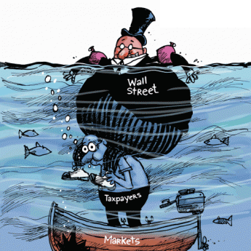
Government Response
government response
bailouts / stimulus spending
  Federal Reserve
    quantitative easing
    quantitative easing 2
  Treasury
    TARP
regulation
  Financial Stability Act

Slide 53
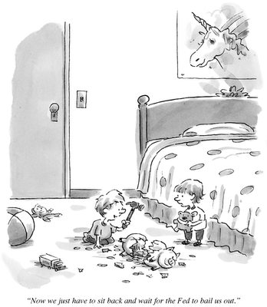
Government Response
In quantitative easing 1 (QE1) the Federal Reserve bought $1.2 trillion in mortgage backed securities to prop up banks and stimulate the economy.
This is unusual in both the amount and in the type of asset. Usually the Fed confines itself to short term treasury securities.

Slide 54
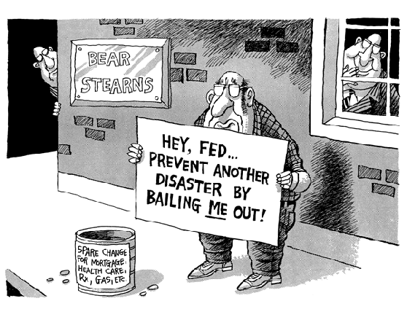
Government Response
The Federal Reserve bailed out AIG, but declined to bail out Lehman Brothers.
It implicitly bailed out Bear Sterns and Merrill Lynch by swapping treasury securities for their mortgage backed securities to encourage mergers.

Slide 55
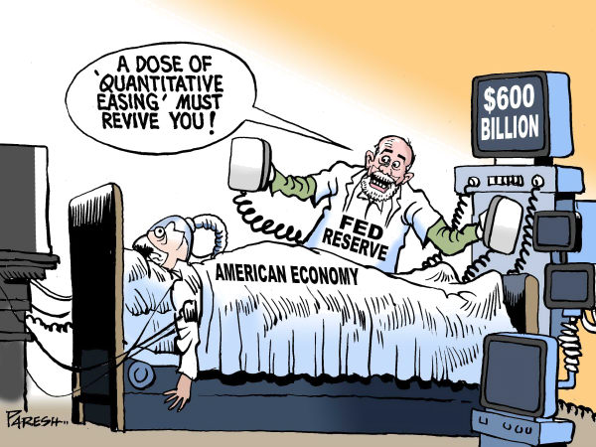
Government Response
In quantitative easing 2 (QE2) the Fed plans to buy $600 billion of long term (30 year) treasury securities. Note that the Fed usually buys short term treasury securities in its open market operations.

Slide 56
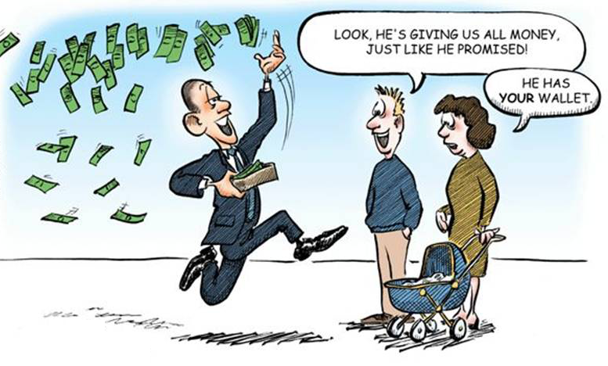
Government Response
The Troubled Asset Relief Program (TARP) was a $700 billion stimulus package bailing out banks and other companies supposedly to stimulate the economy.
Keynesians loved the idea.

Slide 57
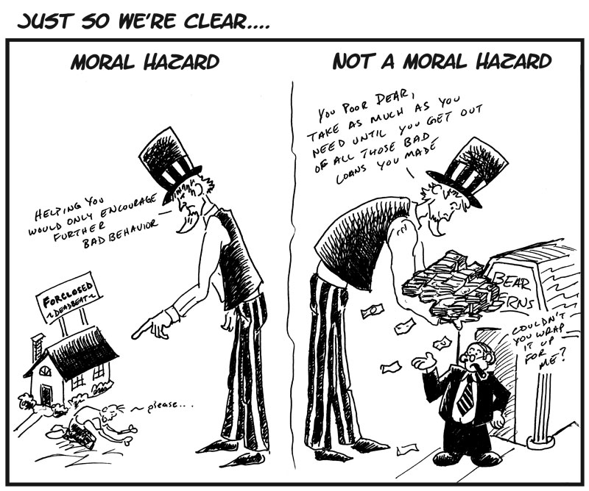
Government Response
Bailouts have created a moral hazard for banks.
The implicit guarantee that banks will be bailed out in the future encourages excessive risk taking.
this is satire…
both are moral hazard

Slide 58
Government Response
Dodd-Frank Wall Street Reform and Consumer Protection Act of 2010
consolidates regulatory agencies
eliminates thrift charter
creates Financial Stability Oversight Council
creates Bureau of Consumer Financial Protection
Volcker rule
regulates derivatives
regulates hedge funds

Slide 59
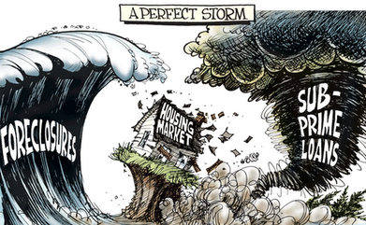
Causes of the Subprime Crisis
causes of subprime crisis
incentivized home ownership
incentivized subprime lending
wrong credit ratings
ABCT boom/bust cycle
  housing bubble
pro-cyclical bank regulation
misguided bailouts / stimulus
  creates moral hazard

