Slide 1
Unit 4: Macro Failures
International Banking Crises
12/7/2010

Slide 2
International Crises
Types of crises
exchange rate crisis
banking crisis
default crisis
Often these crises occur together (twin or triple crises).

Slide 3
International Crises
exchange rate crisis –
(aka balance of payments crisis)
big depreciation in the currency; drain of foreign reserves
forcing a devaluation
or switch to float

Slide 4
International Crises
banking crisis –
bank panics leading to
massive bank failures;
when banks and other institutions face losses, insolvency, and bankruptcy

Slide 5
International Crises
default crisis –
government default
on sovereign debt;
when governments are
unwilling or unable
to honor principal/interest payments on their debt

Slide 6
International Crises
twin crisis –
2/3 of exchange rate,
banking, and default crises
triple crisis –
3/3 of exchange rate,
banking, and default crises

Slide 7
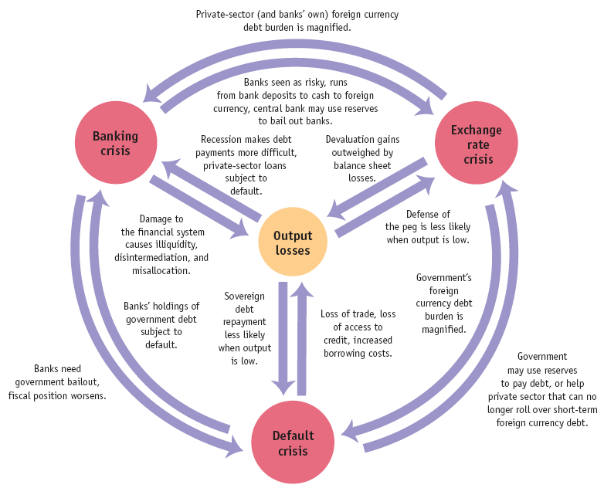
International Crises

Slide 8
International Crises
Types of crises
exchange rate crisis
banking crisis
default crisis
Often these crises occur together (twin or triple crises).

Slide 9
Risk Premiums
currency premium –
exchange rate risk premium;
higher interest rate that
must be paid to compensate
for possibility of fluctuations
in the exchange rate
(i.e., the peg is not credible)

Slide 10
Risk Premiums
So if there is a chance the foreign country will devalue its exchange rate peg, foreign investors will need to be paid a currency premium to get them to invest in spite of that risk – the premium should exactly compensate them for the probability of that event occurring.

Slide 11
Risk Premiums
country premium –
default risk premium;
higher interest rate that
must be paid to compensate
for possibility of government expropriation of private investment or default on sovereign debt

Slide 12
Risk Premiums
Some governments have been known to seize foreign investments nationalizing industries.
To compensate for that risk a country premium must be paid.
A country premium is also paid on government bonds to compensate for the risk of sovereign debt repudiation (refusing to pay it back).

Slide 13
Sovereign Default
sovereign default –
repudiation of debt;
country government
default on its bonds
partial repudiation –
declaration by government
that it won’t pay back
part of its debt

Slide 14
Sovereign Default
Question
When do governments
default on their debt?
Answer
When the benefits of
defaulting exceed the costs.

Slide 15
Sovereign Default
Costs of defaulting
financial market penalties
can’t borrow until resolved
downgrade in credit ratings
higher country risk premium
can’t borrow in own currency
broader macroeconomic costs
bank panics
financial disintermediation
lost investment, trade, output

Slide 16
Sovereign Default
Output if repays
Y – (1 + r_{L})L
Output if defaults
Y – cY
Y ≡ nominal output
L ≡ amount of loan (bonds)
r_{L} ≡ loan rate of interest
c ≡ % of output lost in default

Slide 17
Sovereign Default
if
Y – (1 + r_{L})L > Y – cY
then repay;
otherwise, default
Y ≡ nominal output
L ≡ amount of loan (bonds)
r_{L} ≡ loan rate of interest
c ≡ % of output lost in default

Slide 18
Sovereign Default
In general countries that default on their sovereign debt get hit with a
4-5% country risk premium for the next 3-10 years. They also have to denominate their future bond issues in a foreign currency (e.g., dollars) and suffer bank panics leading to massive bank failures.

Slide 19
Argentina (2001-2002)
Argentina (2001)
fixed exchange rate
1:1 peg (peso to dollar)
current account deficit
imports > exports
↓ foreign exchange reserves

Slide 20
Argentina (2001-2002)
Reactions
future devaluation feared
bank runs began
convert pesos to dollars
withdraw money
government devalues peso
1.4:1 new peg (pesos to dollars)
force converts bank accounts
dollar accounts to pesos
30% of wealth seized

Slide 21
Argentina (2001-2002)
Reactions
devaluation ramifications
more bank panics
foreign investors avoid bonds
don’t roll over debt
macroeconomic consequences
tax revenue declines
social welfare spending up
government debt unsustainable

Slide 22
Argentina (2001-2002)
Reactions
government repudiates debt
only default on foreign held debt
arbitrage opportunity
people buy foreign at discount
so default on all debt
partial repudiation
pennies on dollar for most
IMF paid in full

Slide 23
Argentina (2001-2002)
Effects
triple crisis
exchange rate
banking
default
unemployment hit 25%
inflation peaked at 10%/month
all bank accounts frozen for 1 year
massive exchange rate devaluation
from 1:1 to 4:1 (pesos to dollars)

Slide 24
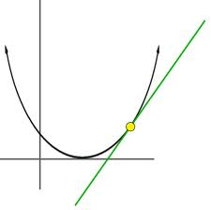
Tangents
I’m going to cover a few concepts that didn’t fit neatly into the broad lecture topics.

Slide 25
Growth
This class has focused on business cycles because they are impacted by monetary policy.
But in macroeconomics economic growth is far important than business cycles. Government policies aiming to mitigate business cycles often retard growth – a terrible tradeoff.

Slide 26
Growth
Example
begin w/ $3,000 average income
country A
6% growth rate
50 years later: $55,260 income
country B
2% growth rate
50 years later: $8,075 income
6.8x higher standard of living in A

Slide 27
Growth
Government policies of taxes, regulation, and uncertainty cause lower growth rates in the U.S.
Lack of a sound money as well as disrespect for property rights and the rule of law cause low growth rates in developing countries.

Slide 28
Deflation
As mentioned throughout this course, many economists are afraid of deflation.
It is widely believed that deflation causes recessions.
But some economists (myself included) like deflation.

Slide 29
Deflation
Deflation and recessions often go together, but that doesn’t necessarily mean deflation causes recessions. This more likely a case of reverse causation: recessions cause disintermediation, which leads to deflation.

Slide 30
Deflation
George Selgin wrote
Less Than Zero: The Case
for a Falling Price Level
in a Growing Economy.
He advocates letting prices
fall rather than trying to
keep them constant.

Slide 31
Deflation
Selgin believes prices should fall at the rate of productivity growth.
This leaves people relative price signals and also conveys that productivity is increasing.

Slide 32
Deflation
w = W/P
Letting prices fall leaves nominal wages stable while real wages rise (real wages = labor productivity).
If prices are manipulated to stay constant, nominal wages rise when real wages rise.

Slide 33
Deflation
Tradeoff
falling P, stable W; or
stable P, rising W
Either way you have an unstable macroeconomic variable. But the latter choice (stabilizing P) requires constant government intervention; whereas, the former is natural.

Slide 34
Deflation
Why do prices fall naturally?
As productivity increases, goods can be produced cheaper. That savings is passed on to consumers through lower prices.

Slide 35
Deflation
The best example of this is computers, whose prices fall
at a huge rate year to year as technology improves.
But the same is true of any item. The prices of most items drop slower than computers. And their price drop is often obscured by inflation (a rise in the price level).

Slide 36
Deflation
Policies attempting to stabilize
the price level raise prices.
Nominal wages rise slower, so profits rise until wages catch up.
This causes asset bubbles.

Slide 37
Deflation
Allowing natural deflation
(as occurred during the gold standard at 0.5% per year) means your wages would be stable and you could buy
more and more stuff for
that wage every year.

