Slide 1
Unit 4: Macro Failures
The Great Depression
12/2/2010

Slide 2
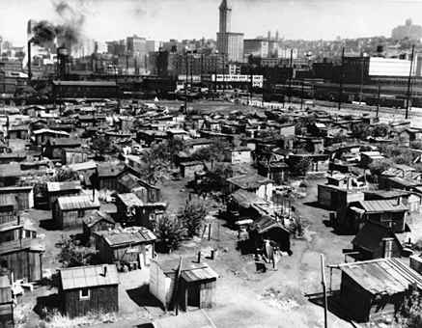
Aggregate Theories
Keynesian – J.M. Keynes
Debt Deflation – Irving Fisher
Monetarist – Milton Friedman
ABCT – F.A. Hayek & L.v. Mises
Golden Fetters – B. Eichengreen

Slide 3
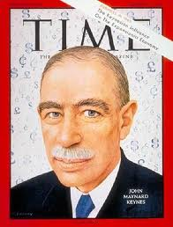
Keynesian
John Maynard Keynes viewed the Great Depression as a failure of aggregate demand due to animal spirits causing less investment. He advocated a counter cyclical public spending policy. Thus he advocated that governments engage in fiscal policy increasing government spending to offset reductions in private investment.

Slide 4
Keynesian
Keynes’ ideas were taken very seriously in both Britain and the United States. Sweden and Germany implemented them also. Keynes wrote the pamphlet “A Means to Prosperity” outlining specific policy recommendations in 1933. His main book the General Theory of Employment, Interest and Money was published in 1936.

Slide 5
Keynesian
Keynes wrote several op-eds on the depression, including “An Open Letter to President Roosevelt” in the New York Times in 1933. Felix Frankfurter, a top advisor to President Franklin D. Roosevelt, arranged a meeting between the President and Keynes in 1933.
However, it is unclear whether massive increases in government spending were caused by Keynes or just coincidental.

Slide 6
Keynesian
blamed aggregate demand failure
advocated government spending
massive public works projects
wrote pamphlets, books, and op-eds
“A Means to Prosperity” (1933)
General Theory of Employment,
Interest and Money (1936)
“An Open Letter to President
Roosevelt” (1933)

Slide 7
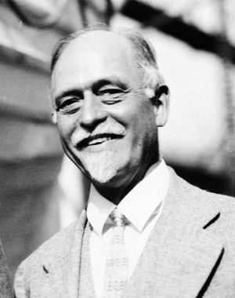
Debt-Deflation
Irving Fisher believed the Great Depression was caused by margin calls on people who borrowed money to invest in the stock market.
Margin requirements were 10%. Margin calls led to a vicious cycle: investors were forced to sell stocks to pay margins, then the stock price fell, then they needed to sell more.

Slide 8
Debt-Deflation
As loans were paid off banks did not loan the money out again. Thus the money supply contracted, causing a severe spiraling deflation.
Many borrowers defaulted on their debts, causing banks to become insolvent. Bank runs led to a bank panic, massive bank failures, and further severe spiraling deflation.

Slide 9
Debt-Deflation
10% margin means needed $1 to get a $9 loan to buy a $10 stock. The stock was collateral for the 90% loan.
If the stock went down a lot, more collateral was required. This was called a margin call. Thus part of the stock would often need to be sold.

Slide 10
Debt-Deflation
buying on margin –
purchase of an asset by paying the margin and borrowing the balance
from a bank or broker
margin call –
lender’s demand on an investor using margin to deposit additional money or securities so that the margin account is brought up to the minimum margin

Slide 11
Debt-Deflation
margin calls
margin requirements were 10%
margin calls when stocks declined
selling made stocks decline more
banks
didn’t re-lend called in loans
borrowers default, banks insolvent
bank runs, bank panics, bank failures
spirals in margin calls & bank failures
massive deflation

Slide 12
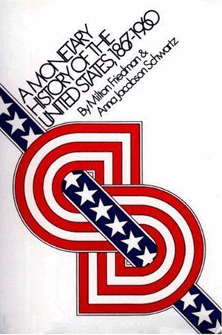
Monetarist
Milton Friedman and Anna J. Schwartz wrote a detailed monetary history of the United States with a new theory about the Great Depression.
They believed the depression was caused by contractionary monetary policy by the Federal Reserve.

Slide 13
Monetarist
M1 declined by 25% 1929-1933.
M2 declined by 35% 1929-1933.
The Fed was looking at interest rates rather than monetary aggregates. It only considered M1 the money supply (i.e., didn’t know savings and other M2 elements were part of money supply) and didn’t calculate that very well.

Slide 14
Monetarist
Early the Depression the Fed didn’t want to expand the money supply, fearful of re-creating the stock bubble.
So in 1928 the Fed began contracting.
Late in the Depression the Fed believed it had a loose policy, but did not take into account bank failures which made the money supply still contractionary.

Slide 15
Monetarist
In addition the president of the NY Fed bank (Benjamin Strong) died in 1928. He was most in tune with international financial conditions and a powerful figure among bankers. The power vacuum left in his absence was not filled by anyone particularly competent.

Slide 16
Monetarist
Doubling reserve requirements led to a double dip recession in 1936.
In general Federal Reserve policy was the opposite of what should have been done in hindsight according to economists Friedman and Schwartz.

Slide 17
Monetarist
money supply
M1 declined by 25% 1929-1933
M2 declined by 35% 1929-1933
Federal Reserve
looked at interest rates, not M1
tight policy 1928 (stock market)
believed loose later, really tight
due to bank failures
doubled reserve requirements 1936
led to double dip recession

Slide 18
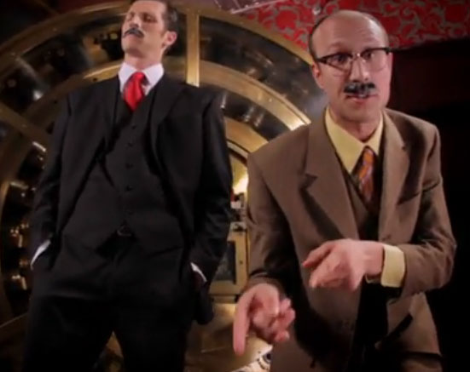
Austrian Business Cycle Theory
Ludwig von Mises and F.A. Hayek believed the Great Depression was a simple application of the Austrian Business Cycle Theory.
The 1920’s were the boom phase, with the Fed setting interest rates artificially low. The Great Depression was the inevitable bust from malinvestments.

Slide 19
Austrian Business Cycle Theory
boom
artificially low interest rates
1920’s expansion
stock bubble
bust
1929 stock market crash
malinvestments revealed
Great Depression

Slide 20
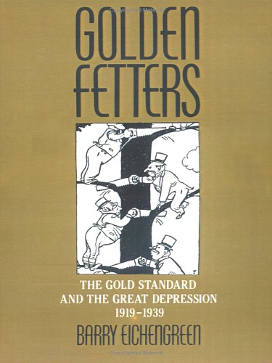
Golden Fetters
Barry Eichengreen theorized that the Great Depression was caused by the international gold standard.
He wrote the book Golden Fetters.
In the interwar period (between WWI & WWII) countries operated on the gold exchange standard. Both gold and foreign currencies could be used as backing for printing money.

Slide 21
Golden Fetters
Countries agreed to provide 50% backing of gold or foreign reserves for each dollar printed. But 30% of foreign reserves had to be gold. So the minimum backing was 15% gold (all foreign reserves, with 30% gold).
(0.5)(0.3) = 0.15

Slide 22
Golden Fetters
Only countries accruing gold could grow their money supplies. These were the countries with trade surpluses (exports > imports):
just the United States and France.
The U.S. had a tight monetary policy due to the 1920’s stock bubble. France was afraid of hyperinflation.
Therefore, LM contracted worldwide.

Slide 23
Golden Fetters
gold exchange standard
restrictions on printing money
15% minimum gold backing
must import gold to print money
only trade surplus countries
United States – contracted
France – feared hyperinflation
LM contracted worldwide
deflation
output declined

Slide 24
Other Theories
tariffs
wage & price floors
income tax
make-work projects
consumer loans
gold standard
regime uncertainty

Slide 25
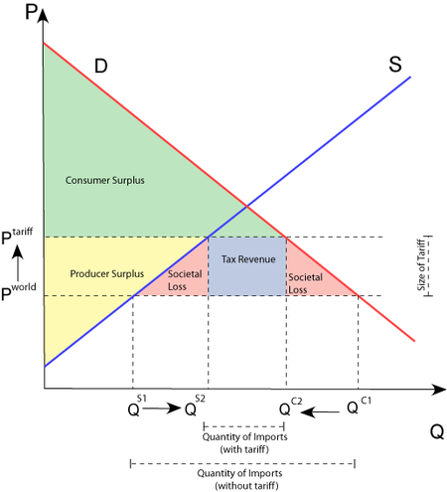
Tariffs
tariff –
tax imposed on a product when it is imported into a country
Tariffs are very bad.
Tariffs hurt consumers and help domestic producers.
But producers are helped far less than consumers are hurt;
there is a deadweight loss.

Slide 26
Tariffs
It is easier to organize producers than consumers (concentrated benefits vs. distributed losses).
So producers are often successful in convincing stupid politicians to impose tariffs (e.g., on steel).

Slide 27
Tariffs
Other countries invariably respond with tariffs on other items as revenge.
retaliatory tariff –
tariff imposed by a foreign country to punish the government for its high tariffs

Slide 28
Tariffs
Imagine you are in a rowboat with someone you don’t like.
You shoot a hole on your side of the boat. To get you back, he shoots a hole on his side of the boat.
That’s how tariffs work: you hurt yourself more and everyone sinks.

Slide 29
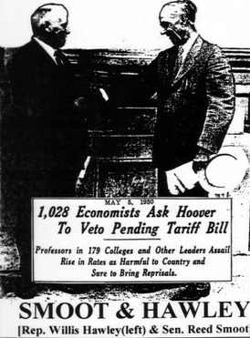
Smoot-Hawley Tariff
The Smoot-Hawley Tariff Act of 1930 dramatically raised tariffs. It was signed into law by President Herbert Hoover.
Many economists believe that the discussion in Congress about Smoot-Hawley caused the stock market crash of 1929 as stocks dropped in anticipation.

Slide 30
Smoot-Hawley Tariff
passed in 1930
signed by President Herbert Hoover
1,028 economists asked for veto
23 countries threatened retaliation
Smoot and Hawley not re-elected
raised tariffs on 20,000 goods
tariff rate varied (depends on good)
imports declined 66% 1929-1933
exports declined 61% 1929-1933
caused 1929 stock market crash

Slide 31
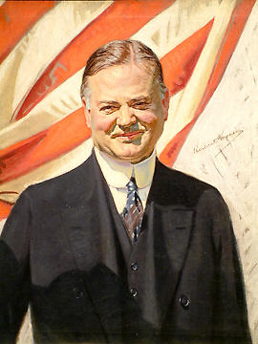
Wage & Price Floors
President Herbert Hoover was a big believer in wage & price floors.
In World War I, President Wilson appointed Hoover head of the U.S. Food Administration. While there he rationed food for the nation, setting prices and encouraging people to eat potatoes rather than meat.

Slide 32
Wage & Price Floors
Under President Harding, Hoover was appointed Secretary of Commerce. In that capacity he started regulating business like never before. He would regularly meet with business leaders and threaten them if they didn’t do business the way he wanted them to.

Slide 33
Wage & Price Floors
President Coolidge had a very hands off presidency. In contrast, President Hoover immediately began running things like a wartime economy.
jawboning –
attempt to persuade others to act in a certain way by using the influence or pressure of a high office
(implicit threat if don’t comply)

Slide 34
Wage & Price Floors
Hoover would jawbone business leaders to keep wages & prices high.
He would meet with business leaders to negotiate cartels among them. Additionally he would plead with business leaders to not lower wages.

Slide 35
Wage & Price Floors
Note that the reason Keynesianism is said to be needed is because of wage inflexibility (or price rigidity in monetarism and new Keynesianism).
But government (Hoover) was the one causing the wage and price rigidities with jawboning!

Slide 36
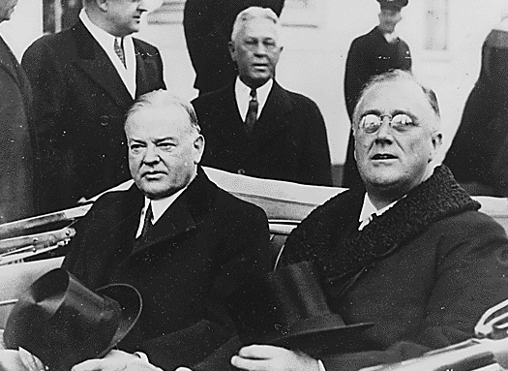
Wage & Price Floors
Later Franklin D. Roosevelt exacerbated the problem through the creation of government programs explicitly designed to keep prices and wages high.

Slide 37
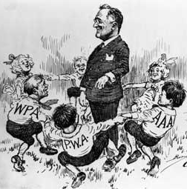
Wage & Price Floors
The National Industrial Recovery Act (NIRA) of 1933 gave the FDR administration the power to regulate work hours, pay rates, and prices.
This meant maximum
hours, a minimum wage,
and price floors.

Slide 38
Wage & Price Floors
The Agricultural Adjustment Act (AAA) of 1933 gave the FDR administration the power to pay farmers not to grow crops. These farm subsidies (which are still in place today) raise food prices hurting consumers.

Slide 39
Wage & Price Floors
Herbert Hoover
head of U.S. Food Administration
rationed food for nation (WWI)
Secretary of Commerce
massive business regulation
President
jawboned business leaders
kept wages & prices high

Slide 40
Wage & Price Floors
Franklin D. Roosevelt
National Industrial Recovery Act
work hours: max hours
wages & salaries: min wage
prices: price floors
Agricultural Adjustment Act
farm subsidies
raise food prices

Slide 41
Income Tax
The first income tax was imposed during the Civil War. Soon after the war it was repealed. Next an income tax was imposed for WWI. The 16th amendment authorized taxes by person (rather than apportioned by state).

Slide 42
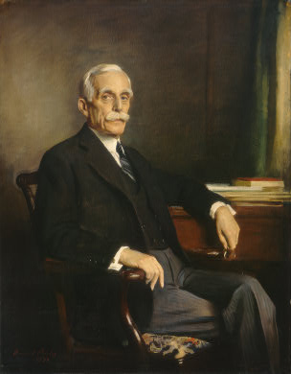
Income Tax
In the early 1920’s Andrew Mellon was the 3rd wealthiest person in the United States. He agreed to serve as Secretary of the Treasury under President Harding and continued to serve in that capacity with President Coolidge and President Hoover.

Slide 43
Income Tax
Mellon was the first presidential advisor to aggressively advocate for lower taxes. He believed lower taxes would result in higher revenue. This is apparent due to the Laffer Curve, but that concept was unknown then.

Slide 44
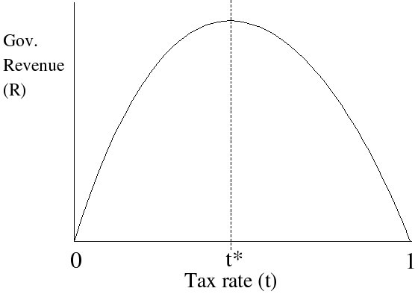
Income Tax
Laffer curve
There exists a tax rate that will yield maximum government revenue. That rate is less than 100% because at higher tax rates the tax base shrinks: people are incentivized to work less and to evade taxes.

Slide 45
Income Tax
Cutting income tax rates both increased compliance and increased incentives to work.
High tax rates incentivized leisure rather than work at the margin and resulted in top wage earners evading taxes.

Slide 46
Income Tax
income tax rates fell
top rate: 77% to 25%
bottom rate: 4% to 0.5%
estate tax rate fell
revenues increased
businesses greatly expanded
owners kept more profits

Slide 47
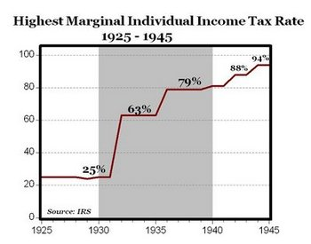
Income Tax
Franklin D. Roosevelt did the opposite. He raised the top tax rate from 25% to 80% by 1935. They kept going up during WWII.
Higher tax rates incentivize sitting on money rather than forming businesses and hiring.

Slide 48
Income Tax
In 1942 he imposed Executive Order 9250, setting income tax rates above $25,000 at 100%.
100%!
Congress later rescinded this, despite FDR arguing to the House Ways and Means committee that a 100% tax was necessary.

Slide 49
Income Tax
Andrew Mellon
Secretary of Treasury 1921-1932
Harding, Coolidge, Hoover
cut income tax 77% to 25%
economy boomed in 1920’s
Franklin D. Roosevelt
raised income tax
25% to: 63%, 79%, 88%, 94%
100% tax by executive order
Great Depression

Slide 50
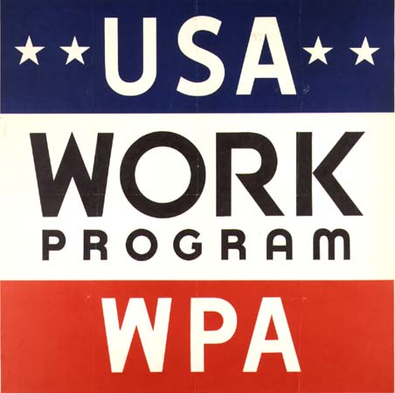
Make-Work Projects
Franklin D. Roosevelt passed two primary initiatives designed to directly employ people: the Civilian Conservation Corps and the Works Progress Administration.

Slide 51
Make-Work Projects
The Civilian Conservation Corps planted trees, constructed parks, and built roads all over the nation.
The Works Progress Administration built parks, roads, bridges, dams, schools, and public buildings. It also funded arts, drama, media, and literacy projects.

Slide 52
Make-Work Projects
But critics said projects were often neither needed nor wanted.
This is the classic broken window fallacy, with money thrown away on useless things with advocates pointing at the benefits ignoring the opportunity cost of the taxes.

Slide 53
Make-Work Projects
Workers had no incentive to be productive: the faster they worked, the faster their projects would end. Workers often couldn’t be demoted or fired. They would be paid even if the project was delayed or improperly constructed.

Slide 54
Make-Work Projects
Civilian Conservation Corps
trees, parks, roads
Works Progress Administration
bridges, dams, schools
arts, drama, media, literacy
projects often unnecessary
Broken Window Fallacy
no incentive for productivity

Slide 55
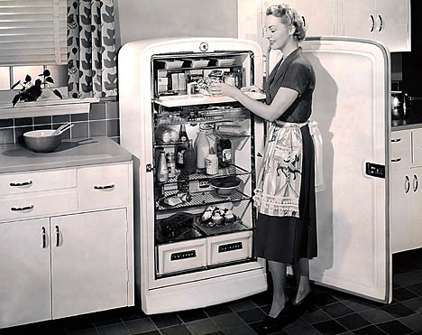
Consumer Loans
As the Great Depression set in, banks tried to call in as many loans as possible. So people who had loans for consumer durables (like refrigerators) found banks repossessing if they missed just one payment. This meant consumer spending dropped a lot: they couldn’t borrow to buy.

Slide 56
Gold Standard
As mentioned internationally countries could only print money if backed by 50% of gold or foreign reserves. But 30% of foreign reserves must be in gold, so the floor was really 15% gold.
The Federal Reserve Act was even stricter, requiring 40% gold backing for Federal Reserve notes.

Slide 57
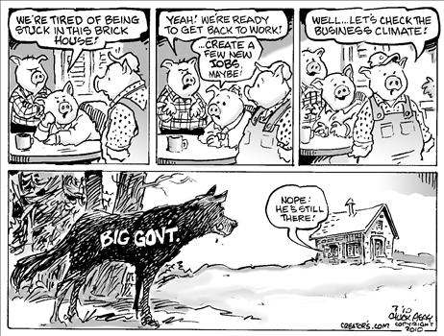
Regime Uncertainty
When government regulations change frequently, tax rates fluctuate a lot, and business conditions are unstable, often entrepreneurs refrain from starting new businesses or expanding old businesses until they can better predict potential profits and losses.

Slide 58
Miscellaneous
consumer loans
banks called in loans quicker
only 1 missed payment
consumer spending declined
gold standard (note backing)
internationally: 15% gold
Federal Reserve: 40% gold
regime uncertainty
taxes, regulation, etc. vary
don’t invest

Slide 59
Money Supply
PPM
(1/P)
M^{d}₁₉₂₉
M^{s}₁₉₂₉
In the 1920’s boom money supply expanded by 40%, but the price level was stable because money demand also increased.
M^{d}₁₉₂₁
PPM₁
M^{s}₁₉₂₁
M

Slide 60
Money Supply
PPM
(1/P)
M^{s}₁₉₂₉
In the bust of the early 1930’s the price level fell
(PPM increased).
What caused this?
M^{d}₁₉₂₉
PPM₂
PPM₁
M

Slide 61
Money Supply
PPM
(1/P)
M^{d}₁₉₃₃
M^{s}₁₉₂₉
Keynesians say money demand rose, shifting M^{d}
to the right.
M^{s} stayed constant.
M^{d}₁₉₂₉
PPM₂
PPM₁
M

Slide 62
Money Supply
PPM
(1/P)
M^{s}₁₉₂₉
Monetarists say money supply fell, shifting M^{s}
to the left.
M^{d} stayed constant.
M^{d}₁₉₂₉
PPM₂
PPM₁
M^{s}₁₉₃₃
M

Slide 63
Money Supply
PPM
(1/P)
M^{d}₁₉₃₃
M^{s}₁₉₂₉
Here are both shown at once, though only one happened.
M^{d}₁₉₂₉
PPM₂
PPM₁
M^{s}₁₉₃₃
M

Slide 64
Money Supply
PPM
(1/P)
M^{s}₁₉₂₉
The data shows us the monetarists were right: money supply was the primary factor shifting.
M^{d}₁₉₂₉
PPM₂
PPM₁
M^{s}₁₉₃₃
M

Slide 65
Money Supply
M2
1921: $32 billion
1929: $46 billion
1933: $30 billion
1921-1928: +4.6%/year
1928-1929: 0%/year
1929-1930: -3%/year

Slide 66
Money Supply
M2
1921: $32 billion
1929: $46 billion
1933: $30 billion
1921-1928: +4.6%/year
1928-1929: 0%/year
1929-1930: -3%/year

Slide 67
Unemployment
Civilian unemployment rates
1923: 3.2%
1924: 5.5%
1925: 4.0%
1926: 1.9%
1927: 4.1%
1928: 4.4%
1929: 3.2%
1930: 8.9%
1931: 15.9%
1932: 23.6%
1933: 24.9%
1934: 21.7%
1935: 20.1%
1936: 17.0%
1937: 14.3%
1938: 19.0%
1939: 17.2%
1940: 14.6%
1941: 9.9%
1942: 4.7%
1943: 1.9%

Slide 68
Unemployment
Milton Friedman pointed out that when you see unemployment high for a decade, it is not a rise in cyclical unemployment, but rather a rise in the natural rate of unemployment.

Slide 69
End of the Depression
Conventional wisdom is that the Great Depression ended with World War II. This doesn’t really make sense though. Of course it is possible to lower unemployment by conscripting people into low wage, high risk jobs (the army). But the real end is after WWII when unemployment lowered for voluntary work.

Slide 70
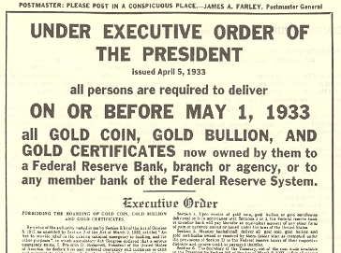
FDR Left Gold Standard
The U.S. left the gold standard domestically in 1933.

Slide 71
Statistics
1929-1933
unemployment rose 3% to 25%
money supply deflated
M1 fell 25%
M2 fell 35%
9,000 banks failed
international trade
imports declined 66%
exports declined 61%
real wage increased

Slide 72
Comparisons
The Great Depression was
the first recession with interventionism. Before Hoover and FDR, all other presidents didn’t intervene.

Slide 73
Comparisons
ΔM2
Δ#banks
Δp
Δy
1839-1843
-34%
-23%
-42%
+16%
full employment
with flexible prices
1929-1933
-35%
-42%
-27%
-30%
massive unemployment
price rigidities

Slide 74
Comparisons
ΔM2
Δ#banks
U.S. 1929-1933
-35%
-42%
unit banking
Fed monopoly
Canada 1929-1933
-15%
no bank failures
nationwide branch
free banking

Slide 75
Severity vs. Duration
Factors leading to the severity of the Great Depression are different than factors leading to its extended duration.

Slide 76
Severity vs. Duration
P
LRAS
SRAS
In an AS/AD analysis, severity factors effect AD and duration factors effect SRAS.
AD
y_{n}
y

Slide 77
Severity vs. Duration
AD (severity)
bank panics
1/3 fall in M2
SRAS (duration)
government cartels
wages & prices rigid
LRAS
tariffs
international trade

