Slide 1
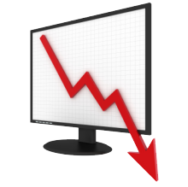
Unit 4: Macro Failures
Asymmetric Information
11/23/2010

Slide 2
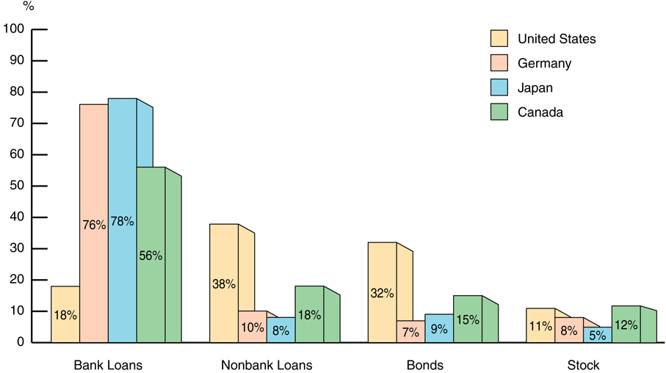
Financial Structure

Slide 3
Financial Structure
business financing
  stocks not the primary source
  debt & equity securities not the primary source
  indirect financing > direct financing (many times >)
  financial intermediaries the primary source
financial system among most regulated sectors
only large corporations have easy access to securities
most debt contracts involve collateral
debt contracts complicated & regulate behavior

Slide 4
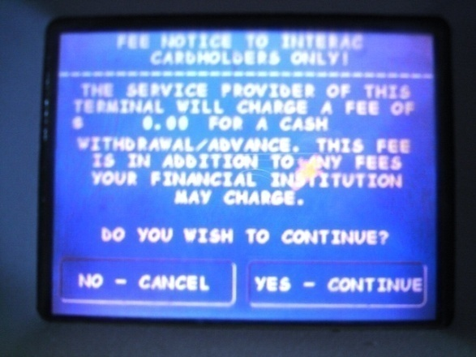
Transaction Costs
transaction costs –
time & money spent trying to exchange financial assets, goods, or services
Broker commissions are
transaction costs of trading stocks.
ATM fees are transaction costs of withdrawing money from banks.

Slide 5
Transaction Costs
Transaction costs lead to less transactions being profitable, which leads to less transactions being made.
Recall that all voluntary transactions take place because traders value what they get more than what they give.
Thus all transactions increase welfare. Because transaction costs decrease transactions, they decrease welfare.

Slide 6
Transaction Costs
In the context of the stock market, transaction costs means less investment and less diversification (more portfolio risk).
Transaction costs can be reduced through financial intermediaries.

Slide 7
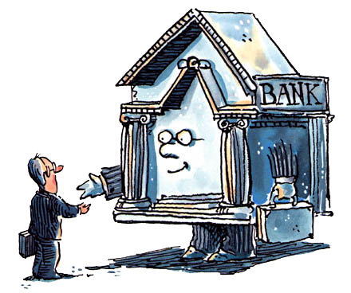
Financial Intermediaries
financial intermediaries –
institutions that borrow funds from
savers and make loans to others
(e.g., banks, insurance companies,
mutual funds, pension funds)
Lowers transaction costs
take advantage of economies of scale
develop expertise to lower costs

Slide 8

Asymmetric Information
asymmetric information –
unequal knowledge each party to a transaction has about the other party
Types
adverse selection (before transaction)
moral hazzard (after transaction)
vs.

Slide 9

Adverse Selection
adverse selection –
ex-ante (before transaction)
asymmetric information;
the most undesirable people
(from the other party’s point of view)
are the ones most likely to want
to engage in the financial transaction

Slide 10
Adverse Selection
Used car market
The seller has more information than
the buyer about the car’s quality.
If buyers assume the car has the average condition and thus pay an average price,
then that’s a bad deal for everyone with above average cars, so they don’t sell.
Only those with below average cars (lemons) sell. This leads to far less sales.
Seller warranties solve this problem.

Slide 11
Adverse Selection
Financial markets have similar problems.
Avoiding adverse selection
private investors research companies
government requires audits & disclosures
financial intermediaries use expertise
collateral & net worth mitigate default

Slide 12

Moral Hazard
moral hazard –
ex-post (after transaction)
asymmetric information;
the risk that one party to a transaction will engage undesirable behavior
(from the other party’s point of view)

Slide 13
Moral Hazard
Moral hazard in equity contracts
Managers have an incentive for fancy offices or embezzling money rather than making a profit.
principal-agent problem –
managers act in their interest rather than in the interest of the owners
due to a different set of incentives

Slide 14
Moral Hazard
Avoiding moral hazard in equity contracts
investors audit firms
government: audits & penalties for fraud
venture capital firms in management
use debt contracts instead

Slide 15
Moral Hazard
Moral hazard in debt contracts Borrowers have incentives to
take on projects that are riskier
than the lenders would like.
For example, if I have fire insurance
I may roast marshmallows over a bonfire in the middle of my living room.

Slide 16
Moral Hazard
Avoiding moral hazard in debt contracts
collateral & net worth align incentives
monitoring and restrictive covenants
  discourage undesirable behavior
  encourage desirable behavior
  keep collateral valuable
financial intermediaries use expertise

Slide 17
Financial Structure
business financing
  stocks not the primary source
  debt & equity securities not the primary source
  indirect financing > direct financing (many times >)
  financial intermediaries the primary source
financial system among most regulated sectors
only large corporations have easy access to securities
most debt contracts involve collateral
debt contracts complicated & regulate behavior

Slide 18
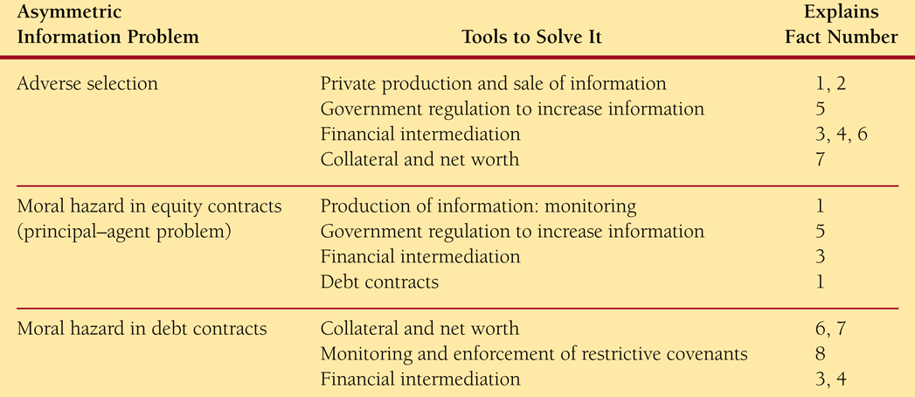
Financial Structure

Slide 19

Conflict of Interest
conflict of interest –
type of moral hazard problem
caused by economies of scope;
organization is involved in multiple objectives and has conflicts between those objectives (one corrupts the other)
economies of scope –
ability to use one resource to provide many different products and services

Slide 20
Conflict of Interest
Conflict of interest examples
investment banks: underwriting & research
  research optimistic for IPO issuers
accounting firms: auditing & consulting
  opinions skewed for future consulting
  opinions audit systems of consultants
credit rating agencies: rating & consulting
  ratings skewed for future consulting
  ratings on structure of consultants

