Slide 1
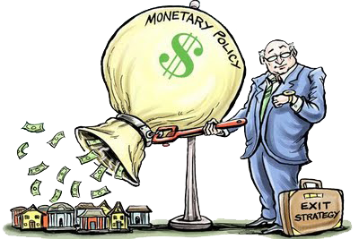
Unit 3: Monetary Policy
Other Macro Models
11/16/2010

Slide 2
AS/AD Analysis
AS/AD analysis rules
At long run equilibrium, LRAS, SRAS, & AD intersect.
Shifts in LRAS bring SRAS with it.
Shifts in AD bring SRAS with it.
Shifts in SRAS bring AD with it.

Slide 3
AS/AD Analysis
P
LRAS
SRAS
At long run equilibrium, LRAS, SRAS, & AD intersect.
AD
y_{n}
y

Slide 4
AS/AD Analysis
P
LRAS₂
LRAS₁
SRAS₁
2
Shifts in LRAS bring SRAS with it.
SRAS₃
AD
1
y_{n}
y

Slide 5
AS/AD Analysis
P
LRAS
SRAS₁
2
Shifts in AD bring SRAS with it.
AD₂
SRAS₃
AD₁
1
y_{n}
y

Slide 6
AS/AD Analysis
P
LRAS
SRAS₁
1
Shifts in SRAS bring AD with it.
AD₃
SRAS₂
AD₁
2
y_{n}
y

Slide 7
Expectations Theories
expectations – economic actor prediction of future macroeconomic conditions (especially inflation)
static expectations – (classical) play no role in decisions
erratic expectations – (Keynesian) animal spirits; all over the map; exogenous in an unpredictable way
adaptive expectations – (monetarist) use historical data
rational expectations – (new classical) use all information; no systematic error

Slide 8
Definitions
procyclical –
economic quantity positively correlated
with state of the economy;
up during booms, down during busts
countercyclical –
economic quantity negatively correlated
with state of the economy;
down during booms, up during busts

Slide 9
Stylized Facts
real output (y) – procyclical
unemployment (U) – countercyclical
price level (P) – procyclical
money supply (M^{s}) – procyclical
real wage (W/P) – procyclical
nominal interest rate (i) – procyclical
real interest rate (r) – acyclical*
labor productivity – procyclical
* no correlation + or –

Slide 10
Stylized Facts
Most models get some stylized fact wrong. For example, the Keynesian and monetarist models incorrectly predict countercyclical real wages. Real business cycle predicts the price level countercyclical and real wages that are too procyclical.

Slide 11
Macroeconomic Models
classical
orthodox Keynesian
monetarist
new classical
real business cycle
new Keynesian
Austrian business cycle

Slide 12
Classical Model
no long run / short
run distinction
prices perfectly
flexible
Say’s Law
static expectations
hands off policy
P
AS
AD
y

Slide 13
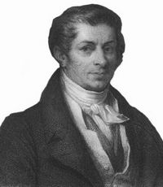
Classical Model
Say’s Law –
total supply of goods and services will equal total demand derived from consumption; a general glut (economy-wide over-supply) is impossible

Slide 14
Classical Model
Keynesians phrased Say’s Law as “supply creates its own demand.”
This is a tautology for barter; less straightforward for money.
Classicals and neoclassicals believed Say’s Law implies the economy must always be at full employment.

Slide 15
Orthodox Keynesian Model
no LR / SR distinction
prices rigid down
W money illusion
sticky prices justified
IS/LM model
Philip’s Curve tradeoff
U vs π
predicts W/P counter
erratic expectations
use fiscal policy
P
AS
AD
y

Slide 16
Orthodox Keynesian Model
money illusion –
nominal vs. real confusion (wages or prices);
workers confuse a rise in nominal wages for a rise in real wages;
producers confuse a rise in the price level for a change in relative prices

Slide 17
Monetarist Synthesis Model
LR / SR distinction
SR Philip’s tradeoff
LR natural rate U
W money illusion
adaptive expectations
crowding out
predicts W/P counter
use monetary policy
rules, no discretion
P
LRAS
SRAS
AD
y_{n}
y

Slide 18
Monetarist Synthesis Model
crowding out –
fiscal policy is ineffective because a rise in government spending induces an opposing decline in private investment and net exports, with the net effect being unchanged output
G↑ → I↓, NX↓ →‾y

Slide 19
New Classical Model (EBCT)
LR / SR distinction
P money illusion
equilibrium always
no involuntary U
rational expectations
hands off policy
P
LRAS
SRAS
AD
y_{n}
y

Slide 20
New Classical Model (EBCT)
Also known as equilibrium business cycle theory (EBCT). Under new classical theory the economy is always at equilibrium: all unemployment is voluntary. Leisure and consumption (financed by work) are subsitutes; workers choose to work more or less depending on wage conditions.

Slide 21
Real Business Cycle Model
supply side shocks
cause cycles
no SR
money neutrality
equilibrium always
no involuntary U
predicts P counter
predicts W/P too pro
rational expectations
hands off policy
P
LRAS
AD
y_{n}
y

Slide 22
Real Business Cycle Model
Under real business cycle theory supply side shocks cause what appear to be business cycles. These shocks consist of shocks to consumer taste, technology, productivity, government regulation, etc.

Slide 23
New Keynesian Model
LR / SR distinction
P&W money illusion
real & nominal rigidity
micro-foundations
menu costs
efficiency wage
productivity counter
rational expectations
fiscal/monetary policy
P
LRAS
SRAS
AD
y_{n}
y

Slide 24
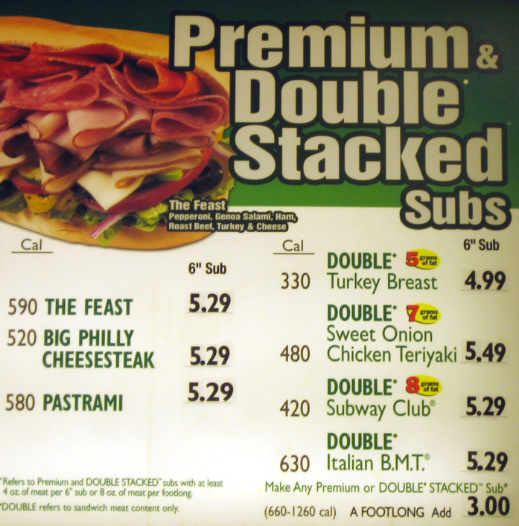
New Keynesian Model
menu costs –
because reprinting menus costs money, there are rigidities preventing price flexibility due to inflation or deflation
When prices change frequently, electronic menus are used.
For example, gas stations.

Slide 25
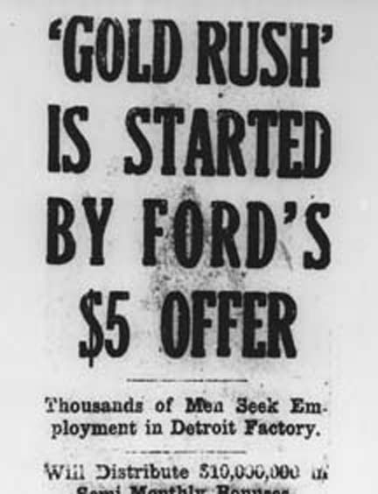
New Keynesian Model
efficiency wage –
managers pay workers more than the market clearing wage to increase their productivity
The most famous example of this is Henry Ford paying $5/day when the prevailing wage was $2.50/day. His productivity significantly increased.

Slide 26
New Keynesian Model
avoiding shirking
threat of firing greater
minimizing turnover
less quitting, less training
adverse selection
better applicants
sociological
higher morale
nutritional
eat better

Slide 27
Austrian Business Cycle Theory
bubble theory
malinvestments
LR / SR distinction
P money illusion
interest rate too low
natural vs. loan
adaptive expectations
hands off policy
P
LRAS
SRAS
AD
y_{n}
y

Slide 28
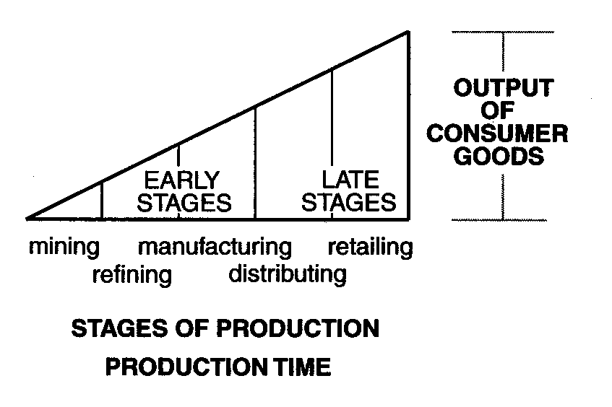
Austrian Business Cycle Theory
structure of production –
produced goods can be lower order (little capital, short production time) or higher order (more capital, long production time)
Producers try to orient the structure of production to match consumers’ savings preferences (prefered higher/lower order mix).

Slide 29
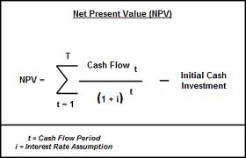
Austrian Business Cycle Theory
present discounted value (PDV) –
today’s value of future payment
The present discounted value of an investment is higher with lower interest rates. So when interest rates are low, investments become more attractive. When interest rates rise, investments already made become less profitable (or unprofitable).

Slide 30
Austrian Business Cycle Theory
Austrian business cycle theory is a bubble theory of business cycles. Government expansion of the money supply leads to lower interest rates. Companies re-orient their structure of production toward more roundabount production (more investment) as a result.

Slide 31
Austrian Business Cycle Theory
That re-orientation is due to a belief that consumer preferences for higher/lower order mix have changed and to the present discounted value of investments rising, both of which are triggered by companies misinterpreting lower interest rates.

Slide 32
Austrian Business Cycle Theory
When interest rates later rise back from their temporary bank (loan) rate to the natural rate, real consumer preferences have re-asserted themselves and the present discounted value of investments drops. Past investments have thus been revealed to be malinvestments.

Slide 33
Austrian Business Cycle Theory
Companies then have to abandon some of these bad investments, shrinking output.
So Austrian business cycle theory predicts a boom phase (or bubble) caused by artificially low interest rates and a bust phase caused by interest rates correcting themselves.

Slide 34
Macroeconomic Models
Model | Expectations | Policy
classical | static | hands off
orthodox Keynesian | erratic | fiscal
monetarist | adaptive | monetary
new classical | rational | hands off
real business cycle | rational | hands off
new Keynesian | rational | fiscal, monetary
Austrian business cycle | adaptive | hands off

