Slide 1
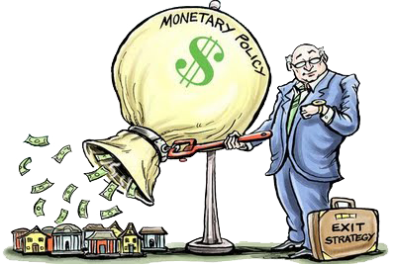
Unit 3: Monetary Policy
Keynesian Models (ISLM)
11/11/2010

Slide 2
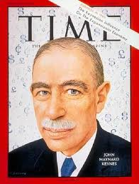
John Maynard Keynes
father of modern macroeconomics
student of Alfred Marshall
wrote The General Theory of
Employment, Interest, and Money
helped setup Bretton Woods
a director of the Bank of England
made a Baron
parliament (House of Lords)

Slide 3
John Maynard Keynes
favored fiscal policy over monetary
opposed classical economists
theories
“in the long run, we’re all dead”
animal spirits
liquidity preference
paradox of thrift
liquidity trap

Slide 4
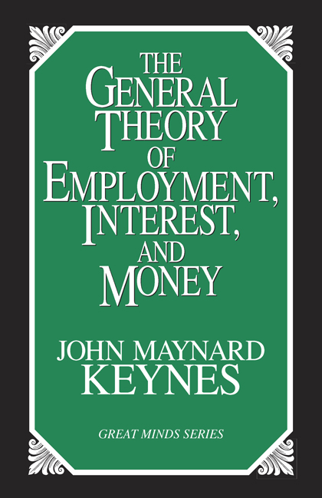
The General Theory
The General Theory was actually quite ambiguous. There are four popular interpretations.
Hydraulic Keynesianism gained the most prominence because economists like models.

Slide 5
The General Theory
Interpretations
hydraulic – ISLM model
(John Hicks, Paul Samuelson)
fundamentalist – post-Keynesian
secular stagnation – Depression
not a business cycle
dynamic disequilibrium –
Marshellian Keynesianism
(Axel Leijonhufvud)

Slide 6
Classical Theory
P
AS
In classical theory the price level was perfectly flexible, which means aggregate supply was vertical.
AD
y

Slide 7
Othodox Keynesianism
P
In orthodox Keynesianism the price level was rigid downward, which means aggregate supply was horizontal.
AS
AD
y

Slide 8
Keynes vs. Classicals
Classical economists believed the price level would adjust whenever aggregate demand shifted, so government interventions could have no effect on aggregate output.
Keynes believed classical economics held in the long run, but in the short run the price level wouldn’t adjust.

Slide 9
Keynesian Cross
Y^{ad}
Y = Y^{ad}
The Keynesian cross equates aggregate demand (aggregate expenditure) with aggregate output (aggregate income).
C + I + G + NX
45°
Y

Slide 10
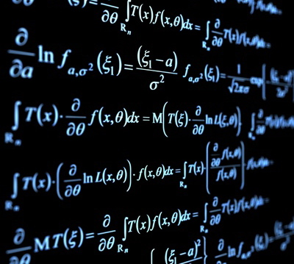
Consumption
C = c₀ + cY_{D}
Y_{D} = Y – T
C = c₀ + c(Y – T)
C ≡ consumption
T ≡ taxes
Y ≡ nominal income
Y_{D} ≡ disposable income
c₀ ≡ autonomous consumption
c ≡ marginal propensity to consume

Slide 11
Aggregate Demand
Y = C + I + G + NX
Y = c₀ + cY – cT + I + G + NX
Y – cY = c₀ – cT + I + G + NX
(1 – c)Y = c₀ – cT + I + G + NX
Y = [1/(1–c)](c₀ – cT + I + G + NX)
I ≡ investment
G ≡ government spending
NX ≡ net exports

Slide 12
Aggregate Demand
Increases in consumption, investment, government spending, net exports, and autonomous consumption are positively related to an increase in output.
An increase in taxes is negatively related to an increase in output.

Slide 13
Investment
Note that economists use the word “investment” different from ordinary people. Investment is the purchase of new physical assets (e.g., new machines or new houses). Used assets don’t count, nor do common stocks or bonds.

Slide 14
Animal Spirits
animal spirits –
emotional waves of optimism and pessimism that influence investment spending, causing wild fluctuations
Keynes believed changes in spending were dominated by investment spending, unstable due to “animal spirits.”

Slide 15
Keynesian Multipliers
Y = C + I + G + NX
Y = [1/(1–c)](c₀ – cT + I + G + NX)
Multipliers
ΔY/ΔI = 1/(1–c)
ΔY/ΔG = 1/(1–c)
ΔY/ΔNX = 1/(1–c)
ΔY/Δc₀ = 1/(1–c)
ΔY/ΔT = -c/(1–c)

Slide 16
Keynesian Multipliers
The tax multiplier is less than the other multipliers. It is multiplied by the marginal propensity to consume (c), which is less than 1.
This leads Keynesians to believe that increases in government spending are more effective than tax cuts.

Slide 17
Critique of Keynesianism
Comparing spending to tax multipliers doesn’t take into account the growth incentives of low taxes.
Aggregation obscures that some spending is less useful than other spending.
(e.g., Frederic Bastiat’s
broken window fallacy)

Slide 18
Broken Window Fallacy
Some economists suggested that government spending increases output because of a multiplier: if government builds a bridge, the bridge workers buy bread, then bakers buy shoes, etc.

Slide 19
Broken Window Fallacy
Bastiat pointed out by that logic you should break a window
(or break every window in France), because then the homeowner would pay repairmen to fix the window, the repairmen buy bread, then bakers buy shoes, etc.

Slide 20
Broken Window Fallacy
But if the money had not been spent repairing the window, it would have been spent on something else with a similar multiplier. The broken window is “what is seen,” whereas the alternative purchase is “what is unseen” (the opportunity cost).

Slide 21
Broken Window Fallacy
So breaking windows doesn’t really help the economy. Nor does wasting money on useless public projects such as digging ditches – the lost multiplier is collected taxes that could have been spent by consumers.

Slide 22
Broken Window Fallacy
broken window fallacy –
fallacy of taking into account easy to see positive effects of a policy, but not taking into account negative hidden effects of a policy

Slide 23
IS/LM Model
The IS/LM model is hydraulic Keynesianism, a general equilibrium framework for Keynesian ideas popularized by
John Hicks and
Paul Samuelson.
i
LM
IS
y

Slide 24
IS/LM Model
i
The IS curve represents combinations of interest rates and output with the goods market in equilibrium (aggregate demand = aggregate output).
IS
y

Slide 25
IS/LM Model
i
The LM curve represents combinations of interest rates and output with the money market in equilibrium (money supply = money demand).
LM
y

Slide 26
IS/LM Model
Note that the IS curve slopes down and the LM curve slopes up.
Factors that shift IS:
C, I, G, T, & NX
Factors that shift LM:
M^{S}, M^{D}
i
LM
IS
y

Slide 27
IS/LM Model
C↑ → IS shifts right
→ i↑, y↑
I↑ → IS shifts right
→ i↑, y↑
G↑ → IS shifts right
→ i↑, y↑
T↓ → IS shifts right
→ i↑, y↑
NX↑ → IS shifts right
→ i↑, y↑
i
LM
i₂
i₁
IS₂
IS₁
y₁
y₂
y

Slide 28
IS/LM Model
i
LM₁
LM₂
M^{S}↑ → LM shifts right
→ i↓, y↑
M^{D}↓ → LM shifts right
→ i↓, y↑
i₁
i₂
IS
y₁
y₂
y

Slide 29
IS/LM Model
Shifts
C↑ → IS shifts right → i↑, y↑
I↑ → IS shifts right → i↑, y↑
G↑ → IS shifts right → i↑, y↑
T↑ → IS shifts left→ i↓, y↓
NX↑ → IS shifts right → i↑, y↑
M^{S}↑ → LM shifts right → i↓, y↑
M^{D}↑ → LM shifts left → i↑, y↓

Slide 30
IS/LM Model
i
LM curve vertical
fiscal policy fails
monetary policy works
This is also known as complete crowding out.
G↑ → I↓, NX↓ →‾y
LM
IS
y

Slide 31
IS/LM Model
LM curve horizontal
fiscal policy works
monetary policy fails
This is also known as a liquidity trap. Keynes believed in this, thus he promoted fiscal rather than monetary policy.
i
LM
IS
y

Slide 32
Liquidity Trap
liquidity trap –
demand for money is infinitely elastic (LM curve horizontal), causing monetary policy to be completely ineffective
Neoclassical economists refute this through the Pigou Effect: real money balances influence consumption and the IS curve.

Slide 33
Critique of Keynesianism
Keynes recommended that governments run deficits (fiscal stimulus) during recessions and surpluses (fiscal dampener) during booms.
Politicians heard economists say “sometimes run deficits” and forgot the “sometimes” part.

Slide 34
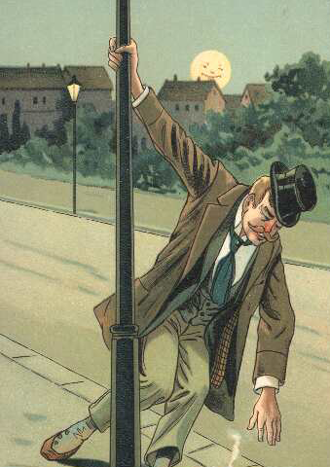
Critique of Keynesianism
Politicians use economists like drunks use lampposts: more for support than illumination.

Slide 35
Critique of Keynesianism
It’s also important to remember the limitations of models. Models simplify, but often economists prefer a simple model to a correct one.
If you lose your keys, you can look where you lost them or look where the light is.

Slide 36
IS/LM Model: Long Run
In the long run the IS and LM curves should intersect at the natural rate of unemployment.
If right of y_{n}:
P↑ → (M/P)↓ →
LM shift left (until
IS & LM intersect at y_{n})
i
LM
IS
y_{n}
y

Slide 37
Mundell-Fleming
i
The Mundell-Fleming model extends IS/LM to an open economy (an economy with international trade) by adding a balance of payments line (BoP=0).
LM
BoP
IS
y

Slide 38
Mundell-Fleming
When there is perfect capital mobility, the BoP line is horizontal.
above BoP line:
captial inflow
below BoP line:
capital outflow
i
i>i*
BoP
i<i*
y

Slide 39
Mundell-Fleming
When there is no capital mobility, the BoP line is vertical.
left of BoP line:
current account surplus
right of BoP line:
current account deficit
i
BoP
CA surplus
CA deficit
y

Slide 40
Mundell-Fleming
When there is some capital mobility, the BoP line is upward sloping.
above BoP line:
captial inflow
below BoP line:
capital outflow
i
i>i*
BoP
i<i*
y

Slide 41
Mundell-Fleming
IS ≡ goods market in equilibrium
LM ≡ money market in equilibrium
BoP ≡ balance of payments in equilibrium
Equations
Y = C(Y-T, i-π_{e}) + I(i-π_{e},Y₋₁) + G + X(ρ,Y,Y*)
M/P = L(i,Y)
BoP = X(ρ,Y,Y*) + σ(i-i*) + k
KA↑ ≡ capital inflow
KA↓ ≡ capital outflow

Slide 42
Mundell-Fleming
FP ≡ fiscal policy
MP ≡ monetary policy
0 ≡ ineffective
+ ≡ effective
perfect capital mobility
no capital mobility
 | float | fixed
FP | 0 | +
MP | + | 0
 | float | fixed
FP | + | 0
MP | + | 0

Slide 43
Mundell-Fleming
Figuring it out
float
IS + BoP curves move
fixed
LM curve moves
perfect/some capital mobility
mechanism: interest rates
no capital mobility
mechanism: goods trade

Slide 44
Mundell-Fleming
floating,
perfect capital mobility
fiscal policy
ineffective
G↑ → IS shifts right
→ i>i* → KA↑
→ e↓ → NX↓ →
IS shifts left
i
LM
BoP
IS₂
IS₁
1
2
y

Slide 45
Mundell-Fleming
floating,
perfect capital mobility
monetary policy
effective
M^{S}↑ → LM shifts right
→ i<i* → KA↓
→ e↑ → NX↑ →
IS shifts right
i
LM₁
1
LM₂
BoP
IS₃
IS₁
2
y

Slide 46
Mundell-Fleming
fixed,
perfect capital mobility
fiscal policy
effective
G↑ → IS shifts right
→ i>i* → KA↑ → e↓ → LM shifts right
→ e↑
i
LM₁
2
LM₃
BoP
IS₂
IS₁
1
y

Slide 47
Mundell-Fleming
fixed,
perfect capital mobility
monetary policy
ineffective
M^{S}↑ → LM shifts right
→ i<i* → KA↓ → e↑ → LM shifts left
→ e↓
i
LM₁
2
1
LM₂
BoP
IS
y

Slide 48
Mundell-Fleming
floating,
no capital mobility
fiscal policy
effective
G↑ → IS shifts right
→ CA deficit → e↑
→ IS & BoP shift right
i
IS₃
2
IS₂
LM
2
1
BoP₁
BoP₃
IS₁
y

Slide 49
Mundell-Fleming
LM₁
floating,
no capital mobility
monetary policy
effective
M^{S}↑ → IS shifts right
→ CA deficit → e↑
→ IS & BoP shift right
i
LM₂
1
IS₃
2
2
BoP₁
BoP₃
IS₁
y

Slide 50
Mundell-Fleming
LM₃
LM₁
fixed,
no capital mobility
fiscal policy
ineffective
G↑ → IS shifts right
→ CA deficit → e↑
→ LM shifts left → e↓
i
2
IS₂
1
BoP
IS₁
y

Slide 51
Mundell-Fleming
LM₁
fixed,
no capital mobility
monetary policy
ineffective
M^{S}↑ → LM shifts right
→ CA deficit → e↑
→ LM shifts left → e↓
i
LM₂
1
2
BoP
IS
y

Slide 52
Mundell-Fleming
If two countries trade a lot, one country’s policies can effect the other country.
With secondary IS curve movements, there is an opposite effect on the other country.

Slide 53
Mundell-Fleming
Fiscal policy helps
the other country.
Floating + PCM:
shift IS right causes a secondary effect of shift IS back left:
G↑ here → NX↓ here →
NX↑ abroad → shift IS right abroad → y↑ abroad

Slide 54
Mundell-Fleming
Monetary policy hurts
the other country.
Floating + PCM:
shift LM right causes a secondary effect of shift IS right:
NX↑ here → NX↓ abroad →
shift IS left abroad → y↓ abroad

Slide 55
Mundell-Fleming
This is why the U.S. government strongly encourages other countries to use a fiscal stimulus and strongly discourages other countries from using a monetary stimulus.

