Slide 1
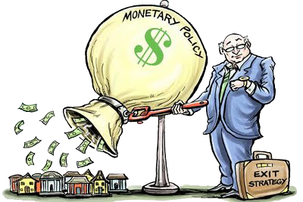
Unit 3: Monetary Policy
Foreign Exchange
11/4/2010

Slide 2
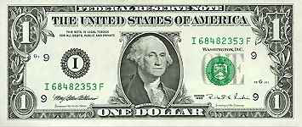

Exchange Rate
exchange rate –
price of one currency
in terms of another
For example:
dollars/euro ($/€) or
euros/dollar €/$)
It is important to specify
which is the denominator!

Slide 3
Exchange Rate
Note: Throughout the chapter Mishkin refers to exchange rate as euro/dollar. That is the opposite of the way most Americans and most economists think of the exchange rate.
Our convention:
e ≡ exchange rate (in $/€)

Slide 4

Exchange Rate
spot transaction –
immediate (2 day)
exchange of bank deposits
spot exchange rate –
exchange rate for
spot transactions;
exchange rate for immediate
(2 day) exchange of bank deposits

Slide 5

Exchange Rate
forward transaction –
exchange of bank deposits
at some future date
forward exchange rate –
exchange rate for
forward transactions;
exchange rate for exchange of bank deposits at some future date

Slide 6
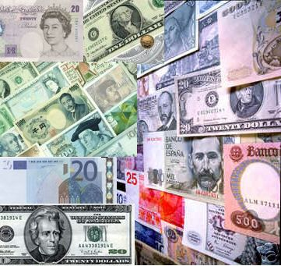
Exchange Rate
foreign exchange market –
the financial market where exchange rates are determined

Slide 7
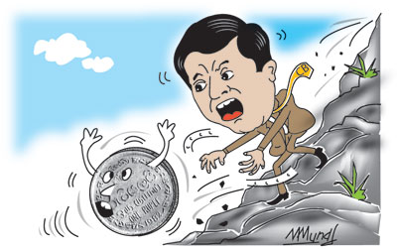
Exchange Rate
appreciation –
when a currency increases in
value relative to another currency
depreciation –
when a currency decreases in value relative to another currency

Slide 8
Exchange Rate
appreciation
  country’s goods abroad become more expensive
  foreign goods in the country become cheaper
  (€/$)↑ means dollar appreciates
  ($/€)↓ means dollar appreciates
  e↓ means dollar appreciates (e ≡ $/€)

Slide 9
Exchange Rate
depreciation
  country’s goods abroad become cheaper
  foreign goods in the country become more expensive
  (€/$)↓ means dollar depreciates
  ($/€)↑ means dollar depreciates
  e↑ means dollar depreciates (e ≡ $/€)

Slide 10
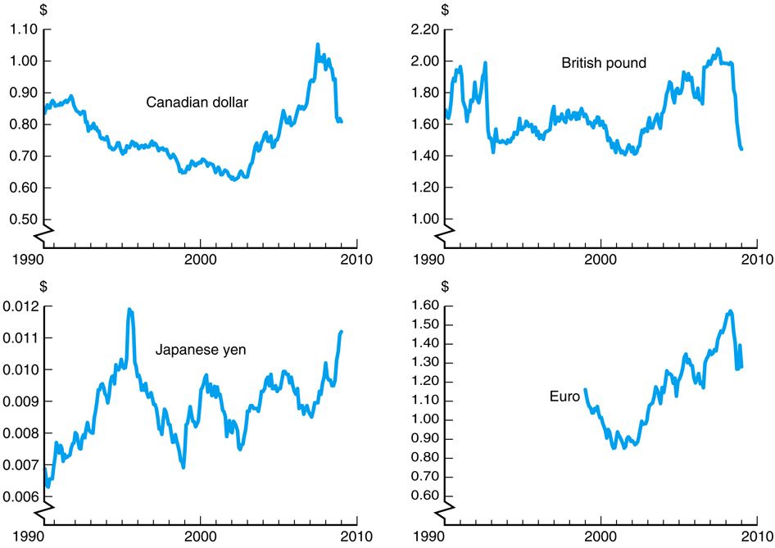
Exchange Rate

Slide 11


Purchasing Power Parity
law of one price (LOOP) –
the price of a good should be
the same throughout the world
(assuming transportation costs and trade barriers are low)
e.g., if steel costs $100/ton in America and €50/ton in Europe,
then the exchange rate should be
e = 2 $/€
There can be
only one!

Slide 12
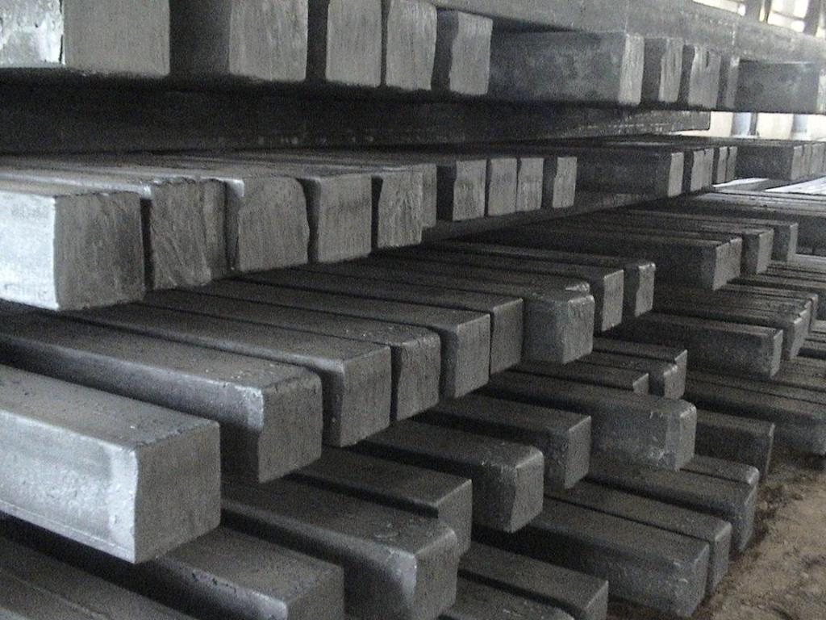
Purchasing Power Parity
arbitrage –
taking advantage of a price difference between two markets
Arbitrage causes the law of one price (LOOP). If prices are different, an entrepreneur can buy steel in the cheaper country and sell it in the more expensive country for a profit.

Slide 13
Purchasing Power Parity
theory of purchasing
power parity (PPP) –
exchange rates between any
two currencies will adjust to
reflect changes in the price
levels of the two countries
e.g., if the euro price level rises 10%, the dollar will appreciate 10%.
$
€

Slide 14
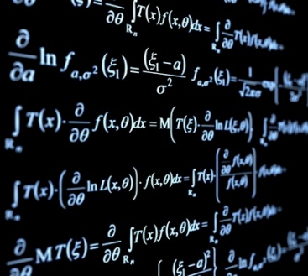
Purchasing Power Parity
PPP in math form
eP*/P = 1
e = P/P*
e ≡ exchange rate (in $/€)
P ≡ domestic price level (in $)
P* ≡ foreign price level (in €)
$
€

Slide 15
Purchasing Power Parity
PPP assumptions
all goods are identical
trade barriers are low
transportation costs are low
all goods traded across borders
all services traded across borders
These assumptions do not hold in the real world. PPP works in the long run, but not the short run.
$
€

Slide 16
Purchasing Power Parity

Slide 17

Long Run Exchange Rate
Long run determinates of e
relative price levels
trade barriers
imports vs. exports
productivity

Slide 18
Long Run Exchange Rate
Factor | Exchange Rate | Domestic Currency
domestic price level (P) ↑ | e↑ | depreciates
trade barriers ↑ | e↓ | appreciates
imports ↑ | e↑ | depreciates
exports ↑ | e↓ | appreciates
productivity ↑ | e↑ | depreciates

Slide 19

Interest Rate Parity
interest rate parity –
the rate of return should be the same throughout the world
(assuming capital mobility)
This is an arbitrage theory.
If there are capital controls imposed, interest rate parity
does not hold in the short run.
There can be
only one!

Slide 20

Interest Rate Parity
IRP in math form
RoR = (1 + i)
RoR* = [E(e_{t+1})/e_{t}](1 + i*)
RoR = RoR*
RoR ≡ domestic rate of return
RoR* ≡ foreign rate of return
i ≡ domestic interest rate
i* ≡ foreign interest rate
E(e_{t+1}) ≡ forward exchange rate
e_{t} ≡ spot exchange rate

Slide 21
Interest Rate Parity
RoR = (1 + i)
RoR* = [E(e_{t+1})/e_{t}](1 + i*)
RoR = RoR*
If you invest money domestically (at interest rate i), you should get the same return as investing money abroad (at interest rate i*) converting it initially at the spot rate and back at the forward rate.

Slide 22
Interest Rate Parity
RoR = (1 + i)
RoR* = [E(e_{t+1})/e_{t}](1 + i*)
RoR = RoR*
e
RoR
e₁
RoR*
i₁
i %Δ

Slide 23
Interest Rate Parity
domestic interest rate rises → i↑ → shifts RoR right → e↓ → domestic currency appreciates
e
RoR₁
RoR₂
e₁
e₂
RoR*
i₁
i₂
i %Δ

Slide 24
Interest Rate Parity
foreign interest rate falls → i*↓ → shifts RoR* left → e↓ → domestic currency appreciates
e
RoR
e₁
RoR*₂
e₂
RoR*₁
i₁
i %Δ

Slide 25
Interest Rate Parity
forward (expected) exchange rate falls → E(e_{t+1})↓ → shifts RoR* left → e↓ → domestic currency appreciates
e
RoR
e₁
RoR*₂
e₂
RoR*₁
i₁
i %Δ

Slide 26
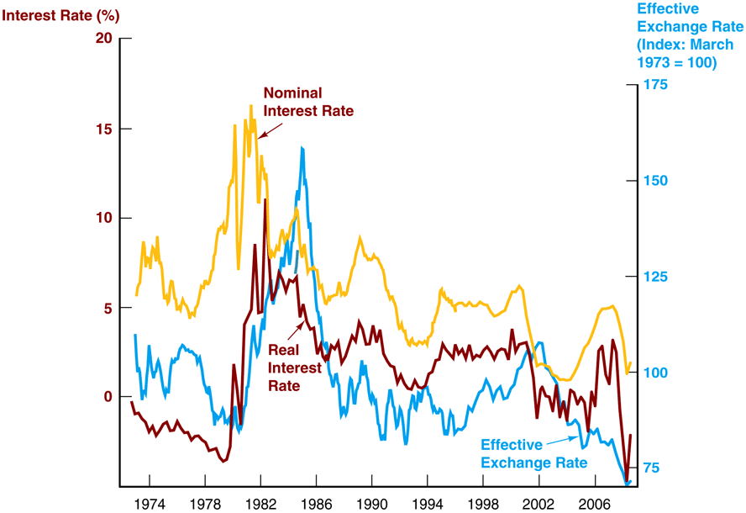
Interest Rate Parity

Slide 27
Short Run Exchange Rate
Factor | Exchange Rate | Domestic Currency
domestic interest (i) ↑ | e↓ | appreciates
foreign interest rate (i*) ↑ | e↑ | depreciates
forward exchange rate ↑ | e↑ | depreciates

Slide 28
Short Run Exchange Rate
Because the forward exchange rate (expected future exchange rate) impacts interest rate parity, all of the factors that effect the long run exchange rate enter into those expectations and can effect the short run exchange rate.

Slide 29
Short Run Exchange Rate
Factor | Exchange Rate | Domestic Currency
expected domestic price level (P) ↑ | e↑ | depreciates
expected trade barriers ↑ | e↓ | appreciates
expected imports ↑ | e↑ | depreciates
expected exports ↑ | e↓ | appreciates
expected productivity ↑ | e↑ | depreciates

