Slide 1
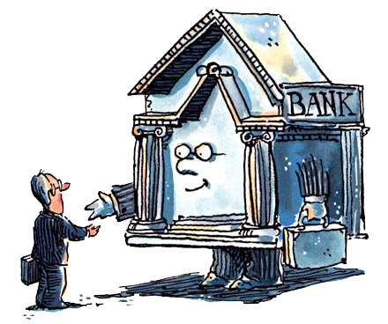
Unit 2: Banking
History & Theory of Free Banking
10/5/2010

Slide 2
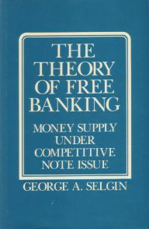
Definition
free banking –
a regime in which private banks can competitively issue paper currency notes and transferable deposits without significant legal restrictions
(rather than a central bank having a monopoly on the issue of notes)

Slide 3
Characteristics
competitive redeemable banknotes
mutual par acceptance of notes
check clearing through CHAs
short term credit markets for reserves
no legal tender laws
no reserve requirements

Slide 4
Scholars
Larry White (GMU professor)
George Selgin (former GMU professor)
Kevin Dowd
F.A. Hayek (Nobel prize winner)
Vera Smith

Slide 5
Simplified Bank Balance Sheet
Assets | Liabilities + Equity
R ≡ reserves | N ≡ banknotes
L ≡ loans + securities | D ≡ deposits
 | K ≡ capital
assume capital is given (K constant)
risk/return tradeoff between reserves and loans
non-interest bearing vs. interest bearing liabilities

Slide 6
Constraint
R + L = N + D + K
R ≡ reserves
L ≡ loans + securities
N ≡ notes in circulation
D ≡ deposits
K ≡ equity capital

Slide 7
Interest
 | Assets | Liabilities
Non-interest bearing | R ≡ reserves | N ≡ notes
Interest bearing | L ≡ loans | D ≡ deposits
assets
risk/return tradeoff between reserves and loans
loans have higher interest and higher default risk
liabilities
notes have lower operating cost (lower interest)
deposits have lower liquidity cost

Slide 8
Profit Function
π = i_{L}L – i_{D}D – C - Q
π ≡ expected bank profit
i_{L} ≡ interest rate on loans
i_{D} ≡ interest rate on deposits
C ≡ operating cost
Q ≡ liquidity cost

Slide 9
Cost Function
C = f(R,L,N,D)
MOC ≡ marginal operating cost
C_{R} ≡ MOC of holding larger reserves (C_{R} > 0)
C_{L} ≡ MOC of holding larger loan portfolio (C_{L} > 0)
C_{N} ≡ MOC of having larger note circulation (C_{N} > 0)
C_{D} ≡ MOC of having larger total deposits (C_{D} > 0)

Slide 10
Cost Function
C = f(R,L,N,D)
C_{R} > 0 means that ↑R → ↑C
C_{L} > 0 means that ↑L → ↑C
C_{N} > 0 means that ↑N → ↑C
C_{D} > 0 means that ↑D → ↑C

Slide 11
Simplified Liquidity Function
Q = f(R,N,D)
MLC ≡ marginal liquidity cost
Q_{R} ≡ MLC of holding larger reserves (Q_{R} < 0)
Q_{N} ≡ MLC of having larger note circulation (Q_{N} > 0)
Q_{D} ≡ MLC of having larger total deposits (Q_{D} > 0)

Slide 12
Simplified Liquidity Function
Q = f(R,N,D)
Q_{R} < 0 means that ↑R → ↓Q
Q_{N} > 0 means that ↑N → ↑Q
Q_{D} > 0 means that ↑D → ↑Q

Slide 13
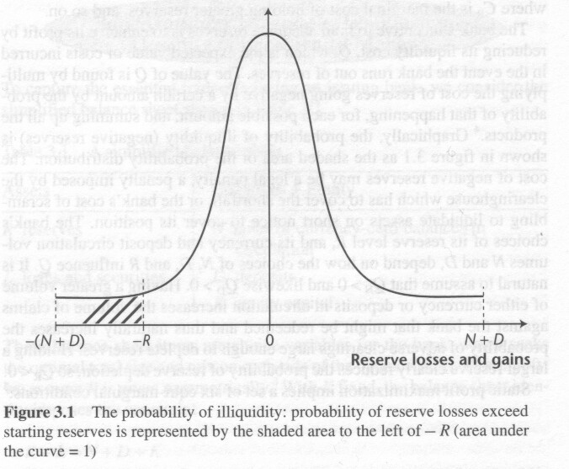
Actual Liquidity Function
Q = p(X ‑ R) φ(X| N, D) dX

Slide 14
Equi-marginal Conditions
i_{L} – C_{L} = -Q_{R} – C_{R}
i_{L} – C_{L} = C_{N} + Q_{N}
i_{L} – C_{L} = i_{D} + C_{D} + Q_{D}
-Q_{R} – C_{R} = C_{N} + Q_{N}
-Q_{R} – C_{R} = i_{D} + C_{D} + Q_{D}
C_{N} + Q_{N} = i_{D} + C_{D} + Q_{D}
i_{L} – C_{L} ≡ marginal net benefit from making loans
-Q_{R} – C_{R} ≡ marginal net benefit from holding reserves
C_{N} + Q_{N} ≡ marginal cost of financing via note issue
i_{D} + C_{D} + Q_{D} ≡ marginal cost of financing via deposits

Slide 15
Equi-marginal Conditions
Note that the 6 equi-marginal conditions are every possible combination of the 4 cost/benefit functions.
i_{L} – C_{L} ≡ marginal net benefit from making loans
-Q_{R} – C_{R} ≡ marginal net benefit from holding reserves
C_{N} + Q_{N} ≡ marginal cost of financing via note issue
i_{D} + C_{D} + Q_{D} ≡ marginal cost of financing via deposits

Slide 16
Equi-marginal Conditions
So all you need to know for the test is that every combination of these things is equal. If given an equation, look at the subscripts.
MB for loans (L subscripts)
MB for reserves (R subscripts)
MC for notes (N subscripts)
MC for deposits (D subscripts)

Slide 17
Equi-marginal Conditions
MB of loans = MB of reserves: i_{L} – C_{L} = -Q_{R} – C_{R}
MB of loans = MC of notes: i_{L} – C_{L} = C_{N} + Q_{N}
MB of loans = MC of deposits: i_{L} – C_{L} = i_{D} + C_{D} + Q_{D}
MB of reserves = MC of notes: -Q_{R} – C_{R} = C_{N} + Q_{N}
MB of reserves = MC of deposits: -Q_{R} – C_{R} = i_{D} + C_{D} + Q_{D}
MC of notes = MC of deposits: C_{N} + Q_{N} = i_{D} + C_{D} + Q_{D}

Slide 18
Equi-marginal Conditions
1. i_{L} – C_{L} = -Q_{R} – C_{R}
i_{L} – C_{L} ≡ marginal net benefit from making loans
-Q_{R} – C_{R} ≡ marginal net benefit from holding reserves
at equilibrium: MB for loans = MB for reserves
(interest for loans isn’t worth liquidity problems)
note: Q_{R} is negative

Slide 19
Equi-marginal Conditions
2. i_{L} – C_{L} = C_{N} + Q_{N}
i_{L} – C_{L} ≡ marginal net benefit from making loans
C_{N} + Q_{N} ≡ marginal cost of financing via note issue
at equilibrium: MB for loans = MC for notes
(interest for loans isn’t worth cost of more notes)

Slide 20
Equi-marginal Conditions
3. i_{L} – C_{L} = i_{D} + C_{D} + Q_{D}
i_{L} – C_{L} ≡ marginal net revenue from making loans
i_{D} + C_{D} + Q_{D} ≡ marginal cost of financing via deposits
at equilibrium: MB for loans = MC for deposits
(interest for loans isn’t worth cost of more deposits)
note: Q_{R} is negative

Slide 21
Equi-marginal Conditions
4. -Q_{R} – C_{R} = C_{N} + Q_{N}
-Q_{R} – C_{R} ≡ marginal net benefit from holding reserves
C_{N} + Q_{N} ≡ marginal cost of financing via note issue
at equilibrium: MB for reserves = MC for notes
(liquidity of reserves isn’t worth cost of more notes)
note: Q_{R} is negative

Slide 22
Equi-marginal Conditions
5. -Q_{R} – C_{R} = i_{D} + C_{D} + Q_{D}
-Q_{R} – C_{R} ≡ marginal net benefit from holding reserves
i_{D} + C_{D} + Q_{D} ≡ marginal cost of financing via deposits
at equilibrium: MB for reserves = MC for deposits
(liquidity of reserves isn’t worth cost of more deposits)
note: Q_{R} is negative

Slide 23
Equi-marginal Conditions
6. C_{N} + Q_{N} = i_{D} + C_{D} + Q_{D}
C_{N} + Q_{N} ≡ marginal cost of financing via note issue
i_{D} + C_{D} + Q_{D} ≡ marginal cost of financing via deposits
at equilibrium: MC for notes = MC for deposits
(cost for more notes same as cost for more deposits)

Slide 24
Interest on Reserves
Since many central banks now pay interest on reserves, these equations are complicated a bit. There are three ways to resolve the issue.
Central banks and free banking are incompatible, so interest on reserves from central banks is irrelevant.
Reserves that collect interest should be grouped with loans because they become interest bearing assets.
Put an interest term in the reserves equation:
i_{R} – Q_{R} – C_{R} ≡ MB for reserves

Slide 25
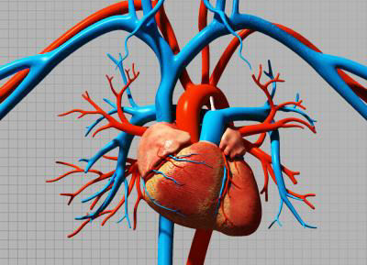
Expanding N
It is cheap to print up notes and lend them in circulation.
But the bank can only expand loan portfolio if the
currency stays in circulation.
Clients must hold its currency, not redeem or deposit
Faces rising MC of cultivating such a clientele
unlimited expansion doesn’t mean unlimited profits

Slide 26
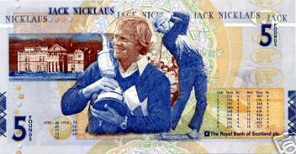
Expanding N
Increasing demand for N (non-price competition)
attract more depositors
make redemption easier
open more branch offices
hire more tellers
stay open more hours
advertise
anti‑counterfeiting measures
make the currency more attractive

Slide 27
Over-issue
over-issue –
quantity of a bank’s currency in circulation
exceeds the quantity demanded
given optimal non-price competition expenditures
cause of overissue:
N^{S} – bank expands note issue
N^{D} – consumer demand for notes falls

Slide 28
Over-issue
i
N^{S}
N^{D}
N^{D}’
N

Slide 29
Bank Over-issue
Individual with excess note balances
direct redemption
reserve loss → N reduction for over-issuing bank
deposit the excess into another bank
generates adverse clearings at the clearinghouse
reserve loss → N reduction for over-issuing bank
spending
transfers excess to someone else; same 3 options

Slide 30
Bank Over-issue
What corrects a bank’s over-issue?
reserve losses as notes return for redemption
reissuing returned notes would lead to more reserve
losses, so the bank accepts reduced circulation
reserves below bank’s desired level prompts it to sell
securities (or not roll over loans) to increase its reserves
actual N converges on desired N^{D}

Slide 31
Country Over-issue
external drain –
specie flows out of a country

Slide 32
Country Over-issue
What corrects a country-wide over-issue?
system-wide reserve losses (external drain)
direct effect: extra spending on imports
excess supply of money leads to more spending
imports paid for by exporting specie
specie comes from overissuing banks’ reserves
indirect effect via price-specie-flow mechanism
domestic P > world P
exports depressed and imports stimulated
balance of payments deficit settled with reserves

Slide 33
World Over-issue
What corrects a world-wide over-issue?
interbank adverse clearings won’t operate
external drain won’t operate
unique equilibrium system-wide volume of N
increases every bank’s desired reserves:
greater N means greater threat to existing reserves
widens the reserve-loss probability distribution
enlarges the area of the left tail
banks must contract liabilities to reduce illiquidity risk

Slide 34
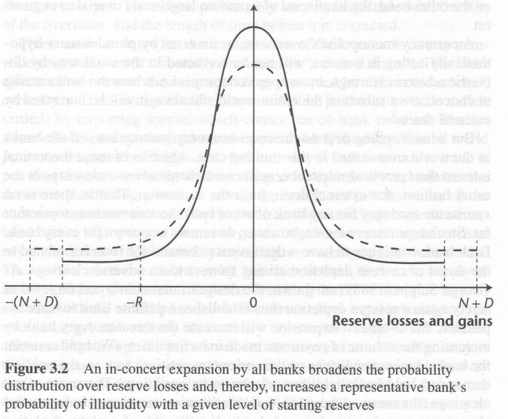
World Over-issue

Slide 35
Bank Under-issue
What corrects a bank’s under-issue?
customers spend notes less (they hold it instead)
fewer notes enter the clearing system
bank enjoys positive clearings vs. other banks
reserves become greater than desired
profit motive prompts lending out of undesired reserve
bank can profitably expand N

Slide 36
Country Under-issue
What corrects a country-wide under-issue?
banks have net positive clearings with the world
public curtails spending on imports relative to exports
reserves flow in from abroad to settle BoP
domestic banking system gains additional reserves
profit motive prompts lending out of undesired reserve
banks can profitably expand N

Slide 37
World Under-issue
What corrects a world-wide under-issue?
reduced spending per unit of currency
reduces chance of reserve depletion for any R
reduces banks’ liquidity costs
profit motive prompts lending out of undesired reserve
banks can profitably expand N

Slide 38
Equilibrium System N
System N uniquely determined by
marginal cost functions banks face for expanding N^{D}
volume of system reserves R
stochastic process generating adverse clearings
safety each bank desires against reserve depletion

Slide 39
Over/Under-issue
What corrects over/under-issue?
individual banks
direct redemption (reserve loss)
adverse clearings (reserve loss)
country-wide in-concert banks
external drain (reserve loss)
direct effect: extra spending on imports
indirect effect: price-specie-flow mechanism
world-wide in-concert banks
probability distribution broadens (reserve loss risk)

Slide 40
Money Supply
individual banks
N^{D}↑ → N↑
N^{D}↓ → N↓
country-wide in-concert banks
N^{D}↑ → N↑
N^{D}↓ → N↓
world-wide in-concert banks
N^{D}↑ → N↑
N^{D}↓ → N↓

Slide 41
Money Supply
fall in velocity → reduced turnover of bank-issued money → reduced probability of adverse clearings → banks can keep more liabilities in circulation
rise in (N + D) restores equilibrium by pushing back up the bank’s marginal benefit of holding reserves
V↓ → M↑
V↑ → M↓
free banking helps stabilize MV (=Py)

Slide 42
United States
“decentralization without freedom”
1863-1913 national banking era
restricted entry
no branch banking
bond collateral requirement
restrictions on small denominations
suspensions: 1873, 1893, 1907
milder bank panics: 1884, 1890
inelastic currency

Slide 43
Canada
real free banking
41 banks 1884, 10 banks 1930 (mergers)
freely granted charters
branch banking allowed
no bond collateral requirement
dominion notes of $5 and less
no bank panics
elastic currency

