Slide 1
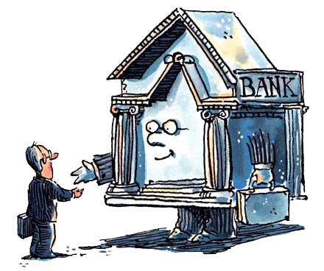
Unit 2: Banking
Bank Balance Sheet
9/28/2010

Slide 2
Bank Balance Sheet
assets –
uses of funds; financial claim or piece of property that is a store of value
liabilities –
sources of funds; IOUs or debts

Slide 3
Bank Balance Sheet
Assets | Liabilities + Equity
reserves | deposits
securities | borrowings
loans | banknotes
other | capital

Slide 4
Deposits
deposits –
money put in a bank for safekeeping or to earn interest with the intention of withdrawing it later
Deposits form the bulk of bank
liabilities in modern times.

Slide 5
Deposits
Types of deposits
checkable deposits
demand deposits
NOW accounts
MMDAs
non-transaction deposits
savings accounts
time deposits
small denomination (<$100k)
large denomination (>$100k)

Slide 6
Deposits
checkable deposits –
accounts that allow the owner to write a check to third parties
demand deposits –
non-interest bearing checking accounts (included in M1)

Slide 7
Deposits
Negotiable Order of Withdraw accounts (NOW) –
interest bearing checking accounts
(included in M1)
Money Market Deposit Accounts (MMDA) –
similar to money market mutual funds
(not included in M1; included in M2;
not subject to reserve requirements)

Slide 8
Deposits
non-transaction deposits –
owners cannot write a check drawn on these, but interest rates are usually higher than on checkable deposits
savings accounts –
money can be added or withdrawn at any time (included in M2; actually regulations limit withdraws to four per month so that they aren’t treated like checking accounts)

Slide 9
Deposits
time deposits –
fixed maturity length with substantial penalties for early withdraw
small denomination time deposits –
less than $100,000 (included in M2)
large denomination time deposits (CDs) –
more than $100,000 (included in M3)

Slide 10
Deposits
Types of deposits
checkable deposits
demand deposits (M1)
NOW accounts (M1)
MMDAs (M2)
non-transaction deposits
savings accounts (M2)
time deposits
small denomination (<$100k) (M2)
large denomination (>$100k) (M3)

Slide 11
Borrowing
Borrowing is conducted to cover temporary (often overnight) reserve shortfalls.
Types of borrowing
Federal Reserve (discount loans)
other banks (at the federal funds rate)
corporations (repurchase agreements)

Slide 12
Borrowing
discount loans –
borrowing from the Federal Reserve
federal funds rate –
interest rate to borrow from other banks
repurchase agreement –
note sold to corporations with the
obligation to buy it back the next day
(included in M3)

Slide 13
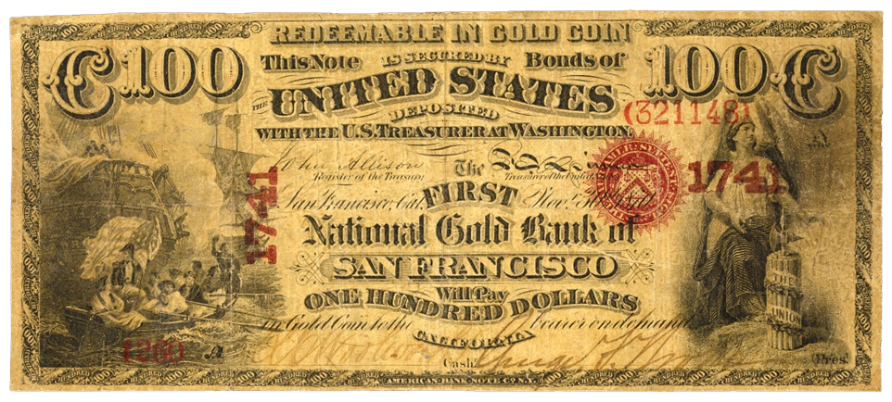
Banknotes
When banks issue banknotes that are redeemable on demand, the banknotes are a liability for the bank.

Slide 14
Banknotes
outside money –
full-bodied coins and other full-bodied commodity money (asset for holder, not a liability for someone else)
inside money –
bank issued money
(asset for holder, a liability for issuing bank)

Slide 15
Bank Capital
Bank capital is the equity that bank shareholders invest in the bank. It is the difference between total assets and total liabilities. Capital is raised by either selling more equity stock or from retained earnings (yearly bank profit).

Slide 16
Reserves
reserves –
money physically held by the bank in the medium of redemption (e.g., gold, FRNs)
This includes vault cash (currency held at the bank) and money deposited at the central bank (e.g., the Federal Reserve).

Slide 17
Reserves
100%
100% reserves –
a system in which banks hold
all of their deposits as reserves
fractional-reserve banking –
a system in which banks hold a
fraction of their deposits as reserves
1/4

Slide 18
Money Warehouse
Assets Liabilities
coins in vault $200 held for Alice $10
held for Bob $10
held for others $180
May well be chosen for storage.
Is there a more economical alternative for payments?

Slide 19
Fractional-reserve Bank
Assets Liabilities
coins in vault $40 held for Alice $10
loans, bills $160 held for Bob $10
held for others $180
Advantages to the bank? Can earn interest.
Advantages to the customers? Bank can pay interest.

Slide 20
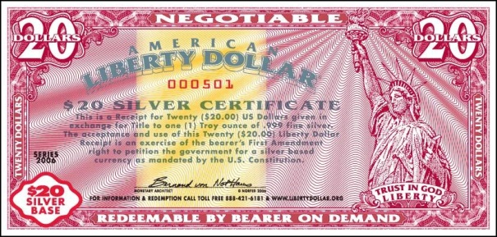
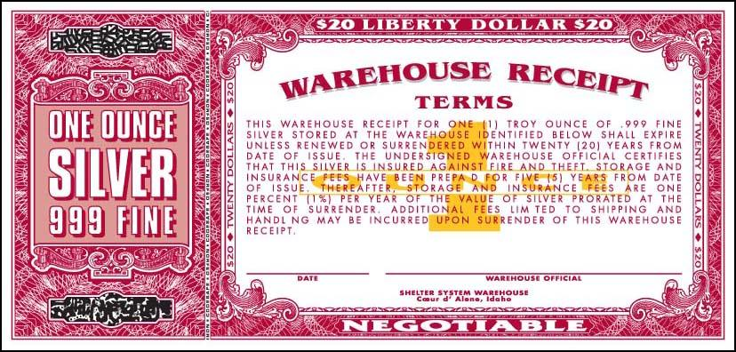
Money Warehouse Receipts

Slide 21
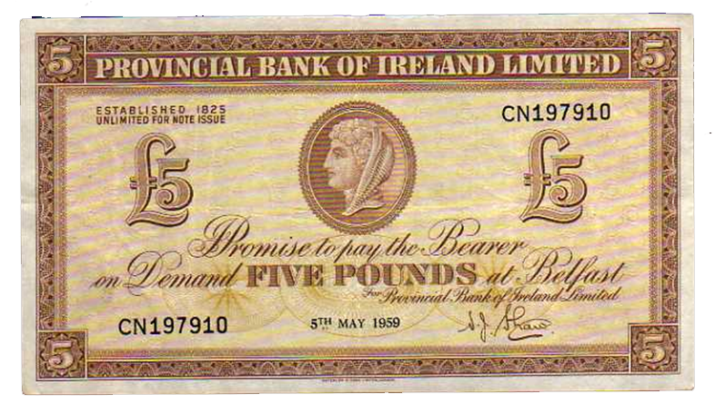
Fractional-reserve Banknotes

Slide 22
Fractional-reserve Banking
Benefits
bankers earn interest on assets
customers may earn interest on deposits
(and not have to pay storage fee)
Costs
possible bank runs (liquidity)
possible defaults on loans (solvency)
1/4

Slide 23
Fractional-reserve Banking
1/4
Fractional reserve banking operates on the premise that only a small fraction of outstanding depositors (or banknote holders) will want to withdraw their money (or redeem their banknotes) at any given time.

Slide 24
Fractional-reserve Banking
Examples of fractional reserves
airline tickets
parking spaces at GMU
telephone system
cafeteria food/meal plans

Slide 25
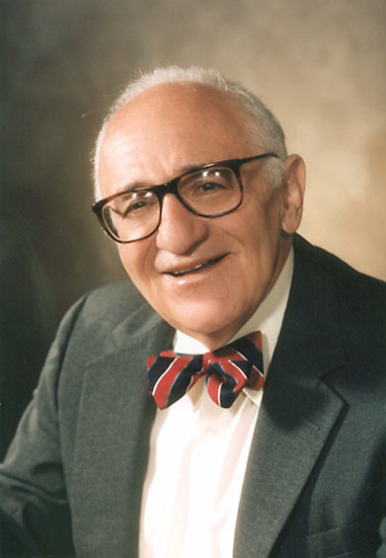
Fractional-reserve Banking
Some economists favor 100% reserves.
Murray Rothbard favored 100% reserves because he believed fractional-reserve banking was fraud.
Milton Friedman favored 100% reserves because it would have made monetary policy more effective.

Slide 26
Fractional-reserve Banking
Is fractional-reserve banking fraud?
Rothbard thinks it is fraud because people don’t realize their money is being lent out and the bank does not have enough reserves to cover obligations if everyone withdraws
(or redeems) at once.
Bank

Slide 27
Fractional-reserve Banking
On the contrary, depositors do realize banks lend out money.
If banks did not lend out money, they wouldn’t be able to pay interest to depositors. Instead, depositors would have to pay banks a storage fee to hold the money.
Bank

Slide 28
Fractional-reserve Banking
Some other economists (like Jesus Huerta de Soto) believe they can prove logically that fractional-reserve banking is fraud.
See if you can spot the flaw in the analogous logic and the actual logic.
Bank

Slide 29
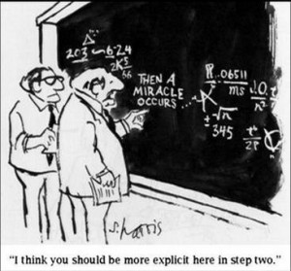
Fractional-reserve Banking
A dog has four legs.

Slide 30
Fractional-reserve Banking
A dog has four legs.
A cat has four legs.

Slide 31
Fractional-reserve Banking
A dog has four legs.
A cat has four legs.
A goat is neither
a dog nor a cat.

Slide 32
Fractional-reserve Banking
A dog has four legs.
A cat has four legs.
A goat is neither
a dog nor a cat.
4. Therefore, a goat does not have four legs.

Slide 33
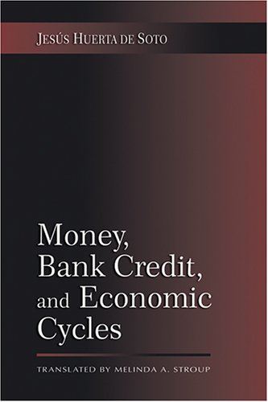
Fractional-reserve Banking
A money warehouse contract is legitimate.

Slide 34
Fractional-reserve Banking
A money warehouse contract is legitimate.
A time deposit contract is legitimate.

Slide 35
Fractional-reserve Banking
A money warehouse contract is legitimate.
A time deposit contract is legitimate.
A demand deposit contract is neither a money warehouse contract nor a time deposit.

Slide 36
Fractional-reserve Banking
A money warehouse contract is legitimate.
A time deposit contract is legitimate.
A demand deposit contract is neither a money warehouse contract nor a time deposit.
4. Therefore, a demand
deposit contract is not legitimate.

Slide 37
Reserves
reserve requirement –
regulation that for every dollar of checkable deposits, a certain fraction (e.g., 10 cents) must be kept as reserves
required reserves –
reserves held due to the reserve requirement
excess reserves –
additional reserves beyond required reserves

Slide 38
Reserves
reserve ratio –
percentage of liabilities kept as reserves
required reserve ratio –
central bank required percentage
of liabilities kept as reserves
reserve ratio ≡ reserves/liabilities
Switzerland, Canada, and Australia
have no reserve requirements.

Slide 39
Reserves
The Federal Reserve recently began paying interest on reserves banks hold at the Fed. The interest rate paid is 0.25%, which is above the current Fed funds rate. It only got the power to do so in October of 2009, though Europe has been paying interest on reserves for many years. Friedman suggested this back in 1960.

Slide 40
Deposits at Other Banks
Many small banks hold deposits at large banks. These deposits are assets for the small banks.

Slide 41
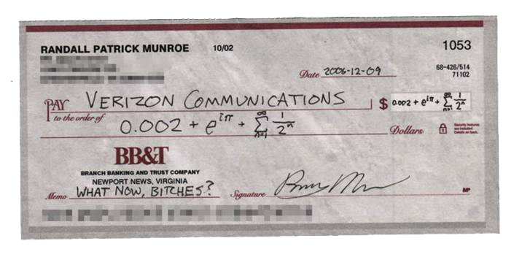
Checks in Process of Collection
Checks written on an account of another bank and deposited in this bank are considered an asset of this bank because it is a claim that will be paid within a few days.

Slide 42
Securities
Banks hold securities because they earn more interest than reserves, yet are more liquid than loans. Government regulations prohibit banks from holding equity securities (corporate stocks), so they mostly hold government bonds.

Slide 43
Loans
Banks primarily make their profits from loans. Because they cannot get cash until the loan matures, loans are much less liquid than other assets. Also loans default with a higher probability than other assets. Therefore, banks receive high
interest rates on loans.

Slide 44
Loans
Types of loans
business (commercial and industrial)
real estate (mortgages)
consumer (cars, college, etc.)
interbank (at the federal funds rate)

Slide 45
Loans
Banks borrow short and lend long.
This means bank the primary bank assets (loans) have a long maturity, but the primary bank liabilities (savings accounts) have a short maturity.

Slide 46
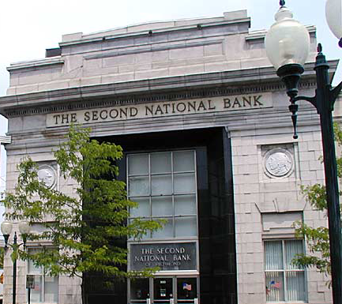
Other Assets
Banks have some assets that don’t fit neatly in the other categories. Other assets is a catch-all. The main component of other assets is buildings. Banks traditionally have big, fancy buildings as a signal that they won’t run off with your money.

Slide 47
Bank Balance Sheet
Assets | Liabilities + Equity
reserves | deposits
securities | borrowings
loans | banknotes
other | capital

Slide 48
Federal Reserve Balance Sheet
Assets | Liabilities + Equity
securities | FRNs
gold | coins
loans | bank reserves
FX reserves
(really Federal Reserve + Treasury)

Slide 49
Federal Reserve Balance Sheet
To see all currency in circulation, the Federal Reserve balance sheet must be combined with the Treasury balance sheet because while the Fed issues all paper notes, the Treasury issues all coins (token coins for change).

Slide 50
Federal Reserve Balance Sheet
Federal Reserve Notes (FRNs) are a liability for the Federal Reserve even though in a fiat regime they don’t have to redeem on demand.
The securities on the Fed balance sheet used to include practically only U.S. bonds, but recently it has exploded with other assets like mortgage backed securities.

Slide 51
Federal Reserve Balance Sheet
Loans on the Fed balance sheet are discount loans to banks.
FX reserves are foreign exchange reserves: currency of other countries held to facilitate foreign exchange with other central banks.

Slide 52
Bank Balance Sheet
Assets | Liabilities + Equity
reserves | deposits
securities | borrowings
loans | banknotes
other | capital

Slide 53
Simplified Bank Balance Sheet
Assets | Liabilities + Equity
R ≡ reserves | N ≡ banknotes
L ≡ loans + securities | D ≡ deposits
 | K ≡ capital
Balance sheet constraint:
R + L = N + D + K

Slide 54
Basic Banking
T-account –
a simplified balance sheet that lists only the changes that occur in balance sheet items starting from some initial balance sheet position

Slide 55
Basic Banking
Opening a checking account.
Assets | Liabilities
reserves +$100 | deposits +$100

Slide 56
Basic Banking
Depositing a check.
Assets | Liabilities
checks in process +$100 | deposits +$100
Assets | Liabilities
reserves +$100 | deposits +$100

Slide 57
Basic Banking
Making a loan.
Assets | Liabilities
required reserves +$10 | deposits +$100
excess reserves +$90
Assets | Liabilities
required reserves +$10 | deposits +$100
loans +$90

Slide 58
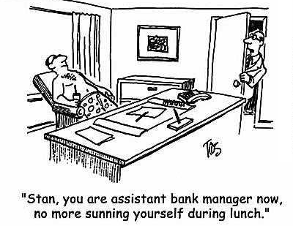
Bank Management
General principles
liquidity management
asset management
liability management
capital adequacy management

Slide 59
Bank Management
liquidity management –
acquisition of sufficiently liquid assets to meet the bank’s obligations to depositors

Slide 60
Bank Management
Banks need to have enough reserves and other liquid assets to meet the day to day demands of depositors withdrawing money. They also need to be able to replenish their reserves to meet reserve requirements when depositors withdraw a lot.

Slide 61
Bank Management
asset management –
banks aspire to minimize risk and maximize returns by seeking low default rate, diversified assets with high yield rates

Slide 62
Bank Management
liability management –
banks aspire to acquire funds at a low cost, so they seek to minimize interest paid to depositors

Slide 63
Bank Management
Liability management wasn’t a concern until the 1970’s. Regulation Q prohibited paying interest on checking accounts and capped interest on savings accounts, so banks couldn’t compete with one another.

Slide 64
Bank Management
This was the era of 3-6-3 banking:
pay 3% interest for deposits,
charge 6% interest for loans,
be on the golf course by 3 pm.
With the high inflation of the 1970’s banks used non-price competition (e.g., give away toasters for starting an account) and eventually got regulation Q repealed in 1980.

Slide 65
Bank Management
capital adequacy management –
banks decide the amount
of capital they need to
maintain, and acquire it

Slide 66
Bank Management
More capital lowers the probability of bank failure (solvency crisis) by increasing the equity cushion.
More capital lowers the
return on investment (ROI) of owners (profits/equity).
Also regulations require a
minimum amount of capital.

Slide 67
Bank Management
Capital considerations
capital↑ → (bank failure)↓
capital↑ → (owner ROI)↓
capital required by regulation

