Slide 1

Unit 1: Money
Quantity Theory of Money
9/9/2010

Slide 2

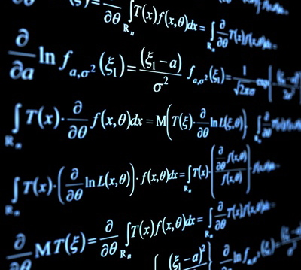
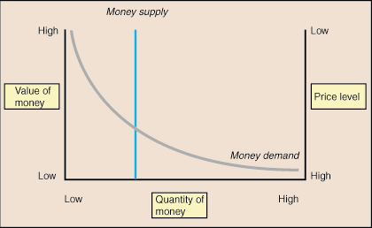
Learning Methods
Three economic languages
verbal (words)
algebraic (math)
graphical (diagrams)

Slide 3
Equation of Exchange
The equation of exchange is the fundamental mathematical idea of monetary theory.
M^{S}V = Py

Slide 4
Definitions
P
purchasing power of money (PPM) –
the basket of goods and services that a
single dollar can buy (“price” of money)
price level (P) –
weighted average of prices in the economy
PPM ≡ 1/P

Slide 5

Definitions
Price level is stated in terms of price indexes.
Price indexes are inherently imprecise because you have to pick goods to include in the index and weight them.
There is no price index that includes everything.
Government price indexes
consumer price index (CPI)
producer price index (PPI)
GDP deflator

Slide 6
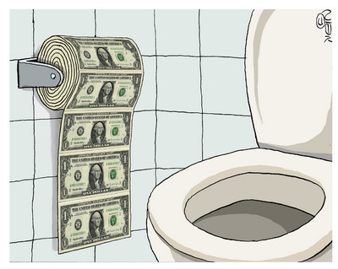
Definitions
inflation –
a rise in the price level (fall in PPM)
deflation –
a fall in the price level (rise in PPM)

Slide 7

Definitions
relative prices –
implicit barter ratios between goods
Price levels move independently of relative prices.
If the relative price of one thing goes up, logically the relative price of another thing must go down.

Slide 8


Definitions
real variables – “constant” dollars
nominal variables – “current” dollars
Capital letter variables are nominal. Lowercase letter variables are real.
nominal/P = real
Y/P = y

Slide 9
Definitions
Y
aggregate output –
total production of final
goods and services in the economy
aggregrate income –
Total income of factors of production
(land, labor, capital) in the economy
For our purposes:
Y ≡ aggregate output = aggregate income

Slide 10
Definitions
y
Y ≡ nominal output
y ≡ real output
Y/P = y
Py = Y
In the equation of exchange,
we use a lowercase y (real output)
rather than capital Y (nominal output).
This is more precise than Mishkin’s notation.

Slide 11
Definitions
M^{S}
M^{S} ≡ money supply
The money supply can be
in terms of any of the
monetary aggregates:
M1, M2, M3, MB, MZM.
Again, we will use more precise notation than Mishkin, which just uses M instead of M^{S}.

Slide 12
Definitions
M^{S}/P ≡ real money stock
real money balance –
quantity of money in real terms
Real money balance is an important concept in the Keynesian money demand theory and in later studies of seigniorage.
M^{S}/P

Slide 13
Definitions
V
velocity of money (V) –
average number of times a unit of money turns over in a given period
Velocity is defined as total spending divided by the quantity of money:
V ≡ Py/M^{S}
So the equation of exchange is an identity:
M^{S}V = Py

Slide 14
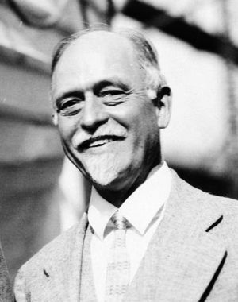
Equation of Exchange
The American neoclassical economist Irving Fisher first conceived of the equation of exchange and the quantity theory of money in his book
The Purchasing Power of Money published in 1911.

Slide 15
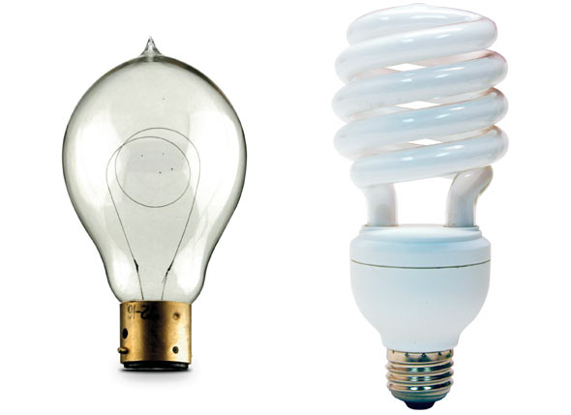
Equation of Exchange
Fisher originally conceived the equation of exchange with all transactions instead of all final transactions.
Fisher version
M^{S}V_{T} = Pt
Modern version:
M^{S}V = Py

Slide 16
Equation of Exchange
M^{S}V = Py
Important notes
an identity, not a theory (V ≡ Py/M^{S})
right side is nominal output (Y = Py)
M^{S} can be any monetary aggregate
(changing the aggregate changes V)

Slide 17


Quantity Theory of Money
The quantity theory of money conceived by Irving Fisher makes two important assumptions.
Assumptions
velocity is constant
wages and prices are completely flexible
V

Slide 18
Quantity Theory of Money
If velocity is constant‾V then ΔM^{S} → ΔPy
(doubling M^{S} will double Py).
‾VM^{S} = Py
If P is completely flexible and y is sticky,
assume‾y: ΔM^{S} → ΔP
(doubling M^{S} will double P).
‾VM^{S} = ‾yP

Slide 19
Quantity Theory of Money
k
Applying the quantity theory of money,
the equation of exchange can be
reformulated into the Cambridge equation
to make the intuition clearer.
k ≡ 1/V (a constant)
M^{S}V = Py
M^{S} = (1/V)Py
M^{S} = kPy

Slide 20
Graphical Version
We write M^{S} instead of the M Mishkin uses.
M^{S}V = Py
This is to save us a step.
We should use money demand not money supply:
M^{D}V = Py
But we equilibrate demand with supply:
M^{S} = M^{D}
Therefore:
M^{S}V = Py

Slide 21
Graphical Version
The graphical version uses the money demand equation and the money supply equation to find equilibrium.
Money demand:
M^{D} = Py/V
Money supply:
M^{S} = C
(C is a constant)

Slide 22
Graphical Version
M^{S}
M^{D} = Py/V
M^{S} = C
PPM
(1/P)
M^{D}
M

Slide 23
Graphical Version
M^{S}↑ → PPM↓ →P↑
increasing the
money supply
shifts the M^{S} curve out
move along M^{D}
PPM goes down
P = 1/PPM
P goes up
PPM
(1/P)
M^{S}
M^{S}'
PPM₁
PPM₂
M^{D}
M

Slide 24
Graphical Version
PPM
(1/P)
M^{S}
M^{S}'
M^{S}↑ → PPM↓ →P↑
matches the math:
M^{S}V = Py
‾V(M^{S}↑) = ‾y(P↑)
PPM₁
PPM₂
M^{D}
M

Slide 25
Graphical Version
M^{D} = Py/V
V↓ → M^{D}↑
→ PPM↑ → P↓
increasing velocity
shifts the M^{D} curve out
move along M^{S}
PPM goes up
P = 1/PPM
P goes down
PPM
(1/P)
M^{S}
PPM₂
PPM₁
M^{D}
M^{D}'
M

Slide 26
Graphical Version
M^{D} = Py/V
V↓ → M^{D}↑
→ PPM↑ → P↓
matches the math:
M^{S}V = Py
‾M^{S}(V↓) =‾y(P↓)
PPM
(1/P)
M^{S}
PPM₂
PPM₁
M^{D}
M^{D}'
M

Slide 27
Graphical Version
M^{D} = Py/V
y↑ → M^{D}↑
→ PPM↑ → P↓
increasing real output
shifts the M^{D} curve out
move along M^{S}
PPM goes up
P = 1/PPM
P goes down
PPM
(1/P)
M^{S}
PPM₂
PPM₁
M^{D}
M^{D}'
M

Slide 28
Graphical Version
M^{D} = Py/V
y↑ → M^{D}↑
→ PPM↑ → P↓
matches the math:
M^{S}V = Py
‾M^{S}‾V = (y↑)(P↓)
PPM
(1/P)
M^{S}
PPM₂
PPM₁
M^{D}
M^{D}'
M

Slide 29
Graphical Version
PPM
(1/P)
M^{S}
Important insight
If something doesn’t effect M^{S} or M^{D}, then it can’t effect the price level.
M^{D}V = Py
M^{S} = C
M^{D}
M

Slide 30
Graphical Version
PPM
(1/P)
M^{S}
The real money stock is the area of the rectangle.
M^{S}/P = (M^{S})(1/P)
= (M^{S})(PPM)
M^{D}
M^{S}/P
real money stock
M

Slide 31
Liquidity Preference Theory
V
But empirical evidence shows that velocity is not a constant.
Velocity declines during severe economy contractions.
Even in the short run velocity fluctuates too much to be viewed as constant.
This paved the way for a new theory.

Slide 32
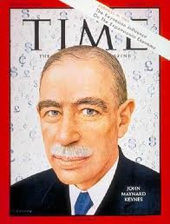
Liquidity Preference Theory
John Maynard Keynes,
the father of macroeconomics, wrote The General Theory of Employment, Interest, and Money in 1936.
His theory of demand for money, which he called the liquidity preference theory, explored the question “Why do individuals hold money?

Slide 33


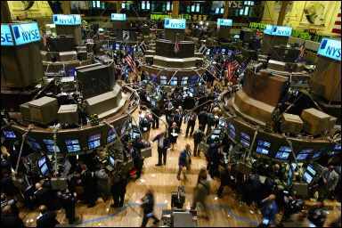
Liquidity Preference Theory
Keynes’ reasons individuals hold money
transactions motive
precautionary motive
speculative motive

Slide 34
Liquidity Preference Theory
transactions motive –
money is a medium of exchange
that can be used to carry out
everyday transactions
Keynes believed transactions
were proportional to income.
Thus the transactions component
of M^{D} depends entirely on y.

Slide 35
Liquidity Preference Theory
precautionary motive –
people hold money as a cushion against an unexpected purchase need
Keynes thought precautionary balances were based on future transactions, and thus were proportional to income.
Thus the precautionary component
of M^{D} depends entirely on y.

Slide 36
Liquidity Preference Theory
speculative motive –
people hold money as an
alternative store of wealth to bonds
Keynes thought people would switch from bonds to money when they believed bond values would fall.
Thus the precautionary component
of M^{D} depends on the interest rate.

Slide 37
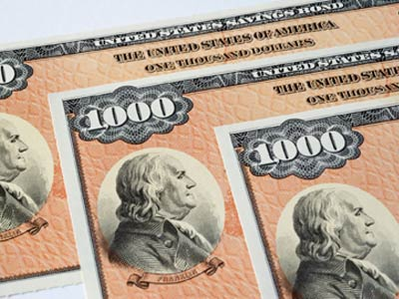
Liquidity Preference Theory
Keynes thought interest rates should be in a narrow band. When interest rates are higher than the band, people expect them to fall. When lower than the band, people expect them to rise.
If interest rates rise, then the price of a bond falls. So if you expect interest rates to rise, you expect a capital loss from holding bonds.

Slide 38
Liquidity Preference Theory
Keynes’ reasons individuals hold money
transactions motive (positively related to y)
precautionary motive (positively related to y)
speculative motive (negatively related to i)
M^{D}/P = f(i,y)
f_{i} = –
f_{y} = +
P/M^{D} = 1/f(i,y)
Py/M^{D} = y/f(i,y)
V = y/f(i,y)

Slide 39
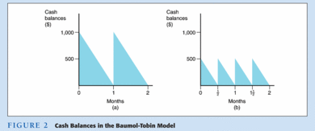
Liquidity Preference Theory
average cash balance halves
velocity doubles
gained interest from bonds
William Baumol and James Tobin showed transactions and precautionary money demand are also sensitive to the interest rate because people will vary how frequently they visit the bank based on interest rates.

Slide 40
Liquidity Preference Theory
transactions demand –
money demand for transactions
Vectors
population: N↑ → y↑ → M^{D}↑ → P↓
output/person: y/N↑ → y↑ → M^{D}↑ → P↓
vertical integration: merge↑ → M^{D}↓ → P↑
clearing system efficiency: eff.↑ → M^{D}↓ → P↑

Slide 41


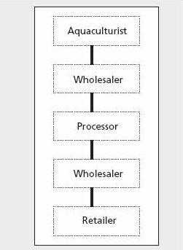

Liquidity Preference Theory
Vectors
population: e.g., black death, baby boom
output/person: e.g., Internet revolution (productivity)
vertical integration: e.g., oil company buys gas stations
clearing system efficiency: e.g., credit card use

Slide 42
Liquidity Preference Theory
portfolio demand –
money demand as a store of value
(captures precautionary and speculative)
Vectors
wealth: W↑ → M^{D}↑ → P↓
uncertainty: uncertainty↑ → M^{D}↑ → P↓
interest differential: i↑ → M^{D}↓ → P↑
anticipations about inflation: π^{e}↓ → M^{D}↑ → P↓

Slide 43



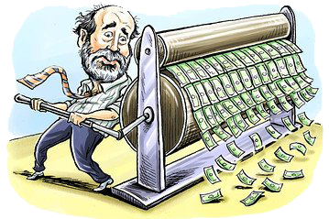
Liquidity Preference Theory
Vectors
wealth: e.g., win the lottery
uncertainty: e.g., travel to a foreign country
interest differential: i.e., interest rate soars
anticipations about inflation: e.g., print money non-stop

Slide 44
Graphical Version
M^{S}
M^{D} = Py/V
M^{S} = C
i
M^{D}
M

Slide 45
Graphical Version
i
M^{S}
M^{S}'
M^{S}↑ → i↓
increasing the
money supply
shifts the M^{S} curve out
move along M^{D}
i goes down
i₁
i₂
M^{D}
M

Slide 46
Graphical Version
M^{D} = Py/V
i
M^{S}
y↑ → M^{D}↑ → i↑
increasing real output
shifts the M^{D} curve out
move along M^{S}
i goes up
i₂
i₁
M^{D}
M^{D}'
M

Slide 47
Graphical Version
M^{D} = Py/V
i
M^{S}
P↑ → M^{D}↑ → i↑
increasing price level
shifts the M^{D} curve out
move along M^{S}
i goes up
i₂
i₁
M^{D}
M^{D}'
M

Slide 48
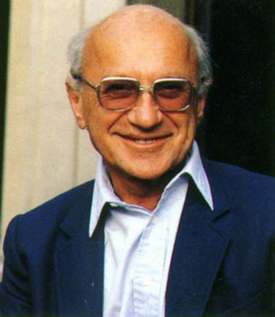
Modern Quantity Theory
Milton Friedman is a Nobel prize winning economist from the Chicago school who led the free market fight against Keynesianism in the 60’s, 70’s, and 80’s. He developed a modern quantity theory of money based on his permanent income hypothesis and an expanded asset demand theory.

Slide 49
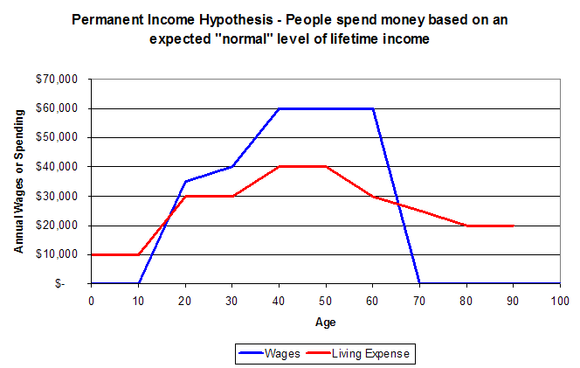
Modern Quantity Theory
The permanent income hypothesis is that people spend money based on perceived average life income.
The life-cycle hypothesis is one variant: young and old spend more than they earn, middle age earn more than they spend.

Slide 50
Modern Quantity Theory
M^{D}/P = f(y_{P}, r_{b} – r_{m}, r_{e} – r_{m}, π^{e} – r_{m})
M^{D}/P = demand for real money balances
y_{P} = present discounted value of all future earnings
r_{m} = expected return on money
r_{b} = expected return on bonds
r_{e} = expected return on equity (stocks)
π^{e} = expected inflation rate
M^{D} positively correlated to y_{P}
M^{D} negatively correlated to other terms

Slide 51
Modern Quantity Theory
M^{D}/P = f(y_{P}, r_{b} – r_{m}, r_{e} – r_{m}, π^{e} – r_{m})
Under Friedman’s theory, changes
in interest rates have little effect
on the demand for money.
Therefore, his money demand
equation can be approximated by:
M^{D}/P = f(y_{P})

Slide 52
Modern Quantity Theory
V
M^{D}/P = f(y_{P})
P/M^{D} = 1/f(y_{P})
Py/M^{D} = y/f(y_{P})
V = y/f(y_{P})
Friedman’s velocity isn’t constant, but it is much more stable than Keynes’ velocity because the relationship between y_{P} and y is very predictable.

Slide 53
Empirical Evidence
V
Empirical evidence shows that
velocity is not constant.
Velocity is sensitive to interest rates,
but is not ultra-sensitive to interest rates when interest rates are non-zero
(i.e., there is no liquidity trap).

