Slide 1

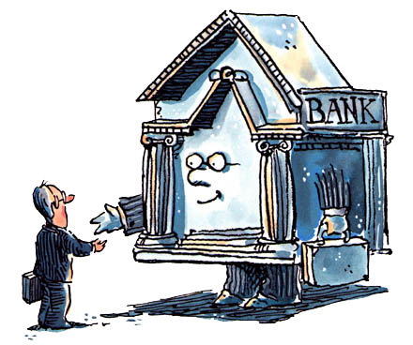
Money and Banking
Econ 310-004
Tuesdays & Thursdays
12:00-1:15 pm
Krug Hall, Room 19

Slide 2
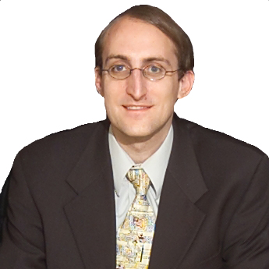
Professor
Chuck Moulton
Contact Info
chuck@moulton.org
877-MOULTON
Office Hours
Tue. & Thu., 10-11 am
Ent. Hall, Work. 342
http://www.chuckmoulton.org/gmu/econ310/

Slide 3
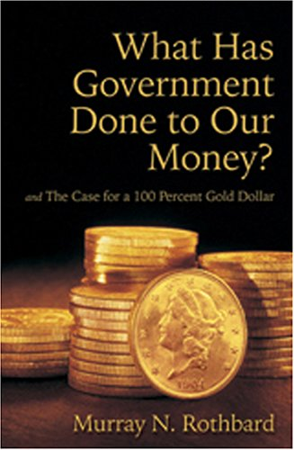
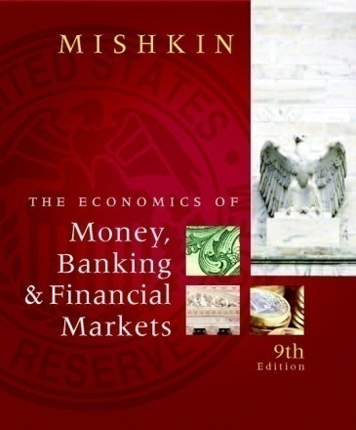
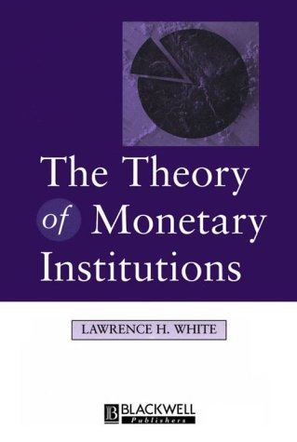
Textbooks
The Economics of
Money, Banking, and
Financial Markets
by Frederic S. Mishkin
What Has Government
Done to Our Money?
by Murray N. Rothbard
The Theory of
Monetary Institutions
by Lawrence H. White
required
required
recommended

Slide 4


Grades
20% quizzes
40% midterms
40% final exam
quizzes (5 question) on the readings, 5 lowest dropped
3 non-comprehensive midterms on the lectures, lowest dropped
comprehensive final exam (12/16/2010, 10:30 am – 1:15 pm)
no make-up quizzes or tests, no curves
might be extra credit for field trips or speakers

Slide 5
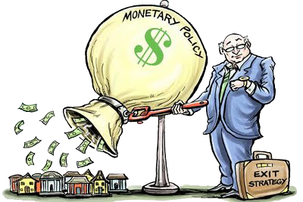
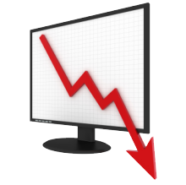
Course Overview
Unit 1: Money
Unit 2: Banking
Unit 3: Monetary Policy
Unit 4: Macro Failures
Money
Banking
Monetary Policy
Macro Failures

Slide 6

Sample Quiz
We’re going to take a sample quiz on the
syllabus to familiarize with the process.

Slide 7
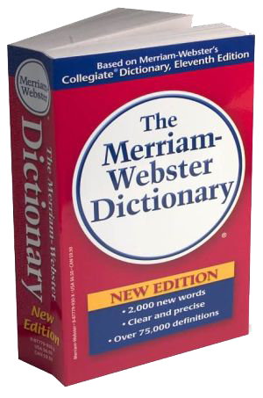


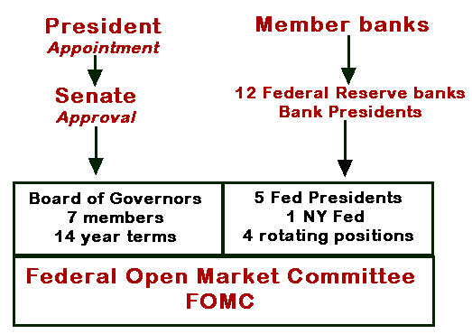
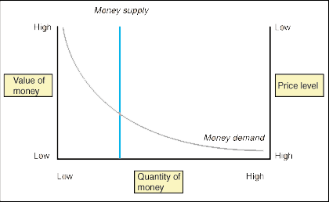
Course Method
Definitions
History
Structure
Math/Models
Application

Slide 8


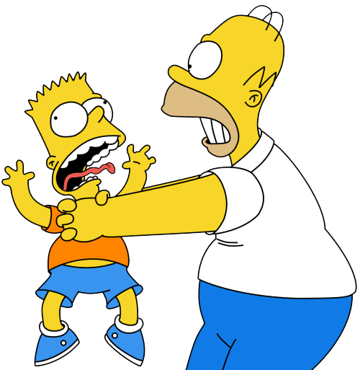
Teaching Philosophy
I aim to align student incentives with course goals,
so that quiz grades correlate with book knowledge
and midterms/final correlate with lecture knowledge .

Slide 9
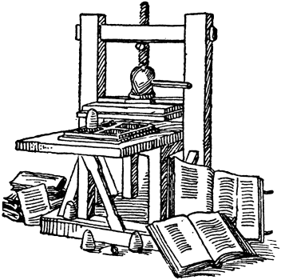
Teaching Philosophy
In my opinion notes became obsolete with
the invention of the printing press in 1440.

Slide 10
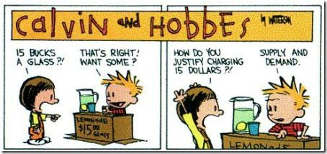
Teaching Philosophy
Learning should be fun.
If it isn’t fun, you aren’t doing it right.

Slide 11


Bias Disclosure
Libertarian
(politically)
anarcho-capitalist
(philosophically)

Slide 12
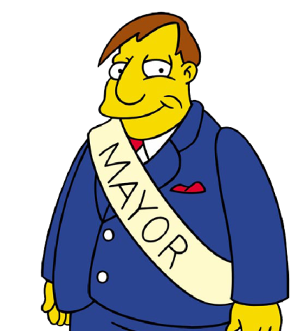

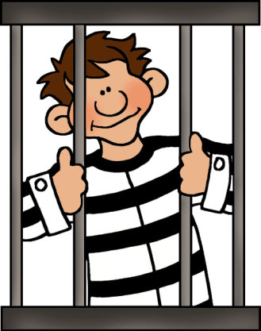
Government
government –
  a legitimized monopoly on coercion

Slide 13
Definitions
Mishkin chapters 1 and 2
have a lot of definitions.
Read those chapters!

Slide 14

Why study Money and Banking?
provides answers to personal financial questions
explains how the economy works
develops knowledge base for high income jobs
fun, interesting stuff

Slide 15
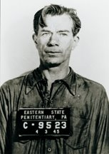
Quotes
When asked why he robbed banks,
the infamous Willie Sutton quipped,
“Because that’s where the money is.”
That’s the same reason we’ll
be studying Money and Banking.

Slide 16
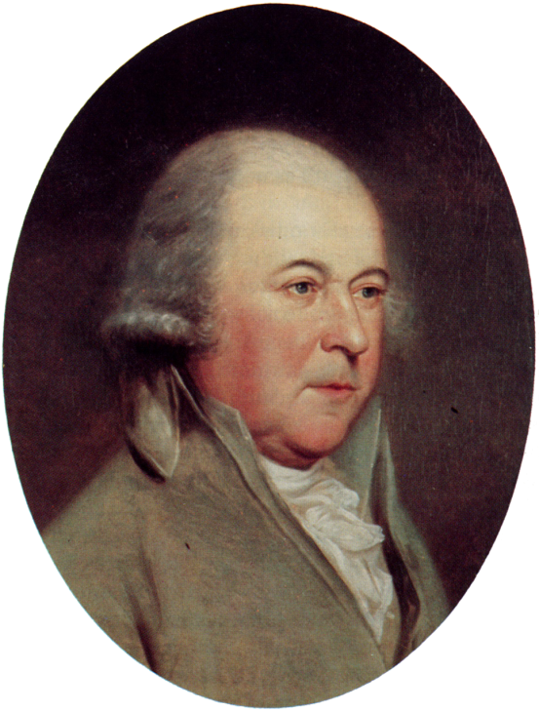
Quotes
“All the perplexities, confusion and distresses in America arise not from defects in the constitution or confederation, nor from want of honor or virtue, as much from downright ignorance of the nature of coin, credit, and circulation.” – John Adams

Slide 17
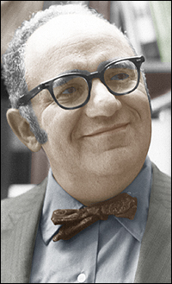
Quotes
“It is no crime to be ignorant of economics, which is, after all, a specialized discipline and one that most people consider to be a dismal science. But it is totally irresponsible to have a loud and vociferous opinion on economic subjects while remaining in this state of ignorance.” – Murray Rothbard

